Slide 1
The golden age of American magazines
1890-today

Slide 2
Makhasin=a storehouse
Magazines have been part of printed media since the 1700s.
From an Arabic word meaning storehouse. In French, magazin means store.
Magazines used to be a “storehouse” for a variety of things.

Slide 3
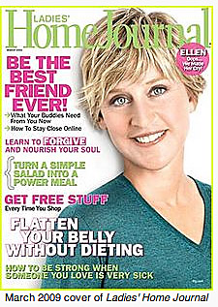
Magazines as genre
What defines a magazine?
Timeless quality, less news-oriented.
Smaller format than newspapers.
Better paper quality.
More sophisticated design.
No articles on cover.
Niche audience.

Slide 4

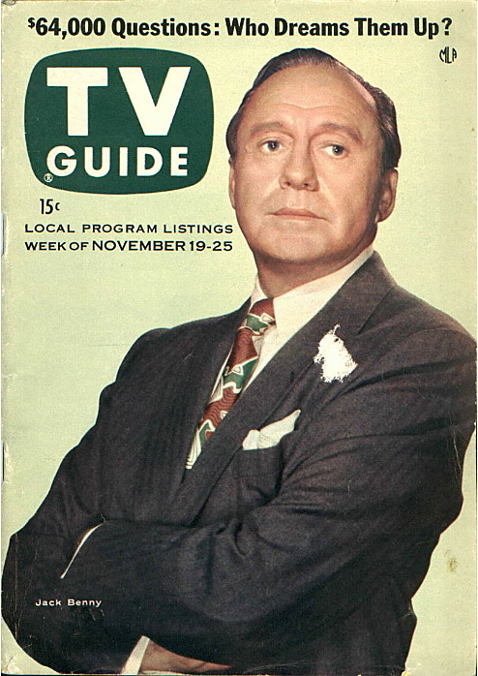
Demise of general interest
General-interest magazines used to be common.
Today most are specialty magazines.
Large-format has become smaller; small has become larger.

Slide 5
Beginning of the 20th century
1900: beginning of the golden age of magazines.
National in scope; no true national newspapers at this time.
Magazines pulled together a heterogeneous nation.

Slide 6
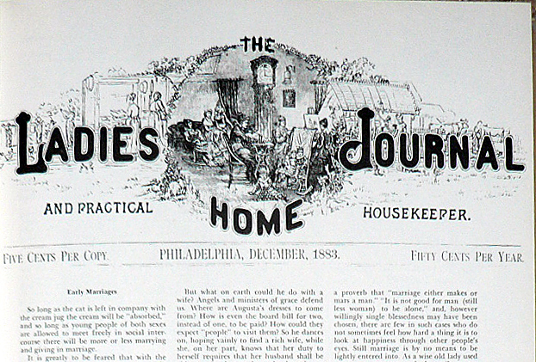
Low cost
By 1900 magazines were able to reduce their price to almost nothing.
Ladies’ Home Journal was 5 cents.
It was the first American magazine to reach 1 million circulation.

Slide 7
Magazines for cheap
Advertising increased as manufacturers wanted national audiences.
Paper got cheaper.
Printing costs went down: rotary press.
Halftone photoengraving lowered illustration costs.

Slide 8
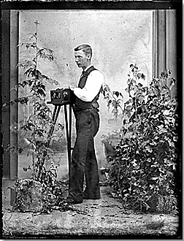
Photography:
19th century revolution
Before 1888: bulky view camera.
Glass plate negatives.
Portable darkroom.

Slide 9
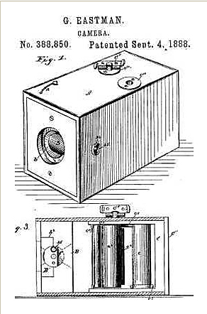
1st revolution: roll film
David Houston of Hunter, N.D., sold patent to George Eastman.
Eastman named his new company Kodak.
Even amateurs could now produce snaps.
Professionals could produce candid, action-oriented photos.

Slide 10
The halftone
At about the same time a new invention revolutionized printing: the halftone.
Before the halftone, all photos and other art was printed using wood or metal engravings.
The process meant artists had to copy photos.
Photos could not be directly transferred to print.

Slide 11
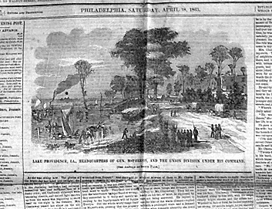
Engravings
When readers during the civil war saw photos, this is the kind of “photo” they saw: an engraving.

Slide 12
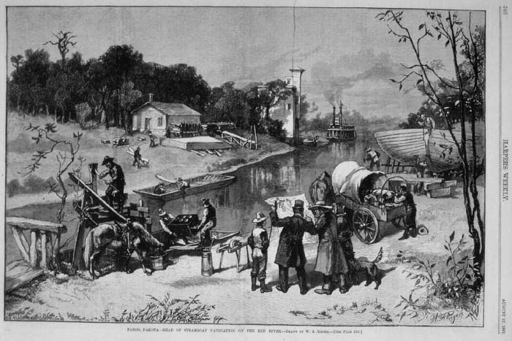
Engravings
Harper’s Weekly featured engravings. Here’s one of Fargo, 1881.

Slide 13
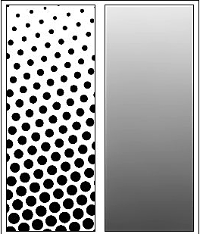
The halftone method
Shades of gray or tones of color are converted into dots.
The closer the dots, the darker the shade or color appears.
This greatly reduced the cost of printing illustrations. Magazines became profusely illustrated.

Slide 14
New content
Emphasis shifted from literature and fiction to examining social problems.
Greater practical information.
Less poetry.

Slide 15
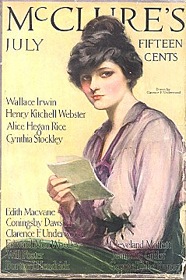
Muckraking
Theodore Roosevelt’s term for crusading journalism.
Magazines worked to uncover crime and abuses.
S.S. McClure became most famous with his McClure’s Magazine.

Slide 16
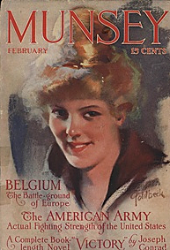
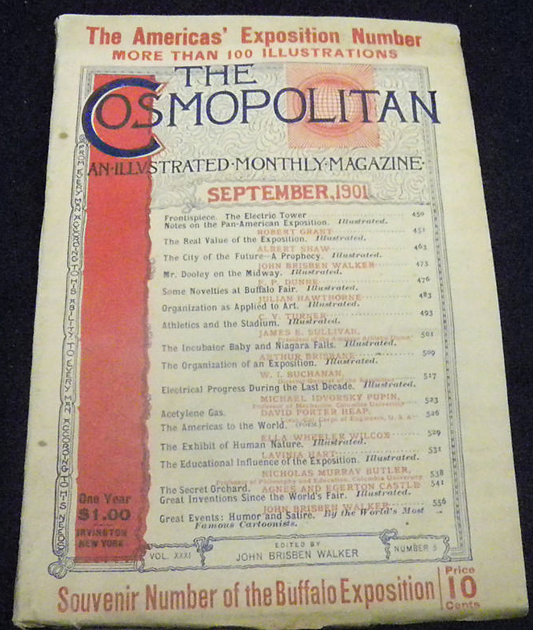
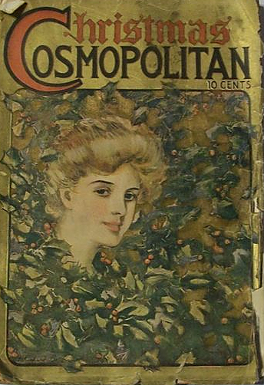
Other prominent muckrakers
Munsey’s and Cosmopolitan.
Cosmo today has radically changed its formula. But already by 1906 we can see a shift in its design.

Slide 17
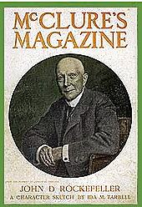
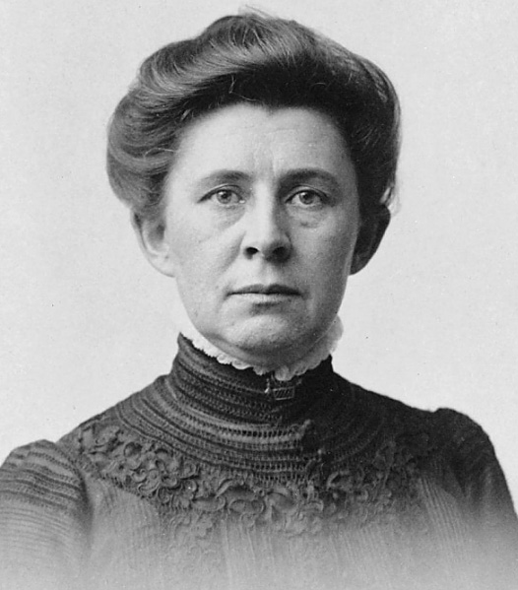
Famous muckrakers
Ida Tarbell became famous for her investigation of John D. Rockefeller and the Standard Oil Co.
The Standard Oil trust was broken up after a federal investigation based on Tarbell’s allegations.

Slide 18
Decline of muckraking
Between 1902-1912, almost all of American society was examined by muckrakers—including the press itself.
By World War I, however, this kind of investigative work in magazines was dwindling.

Slide 19
Why muckraking declined
Public lost interest in examining society’s problems.
Progressive spirit diminished.
Big business bought out and closed some magazines.
Many abuses uncovered my muckrakers were corrected.

Slide 20
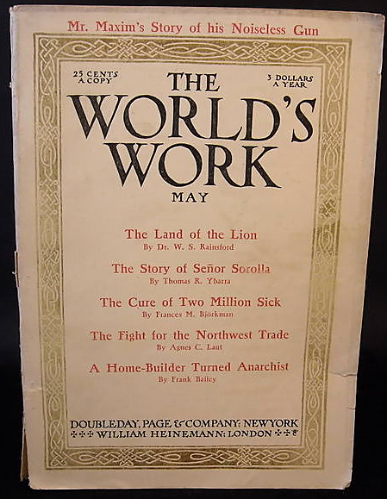
New idea: news magazine
Reporting events in a more literary style began with World’s Work.

Slide 21
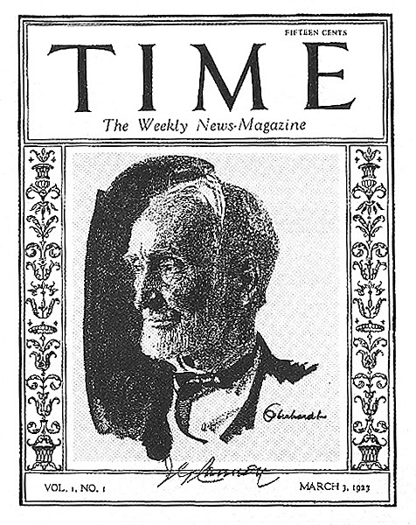
Time magazine
Henry Luce established Time in 1923. It became the iconic newsmagazine.
Luce’s empire grew to include Life, Fortune, Sports Illustrated, People and Money.

Slide 22
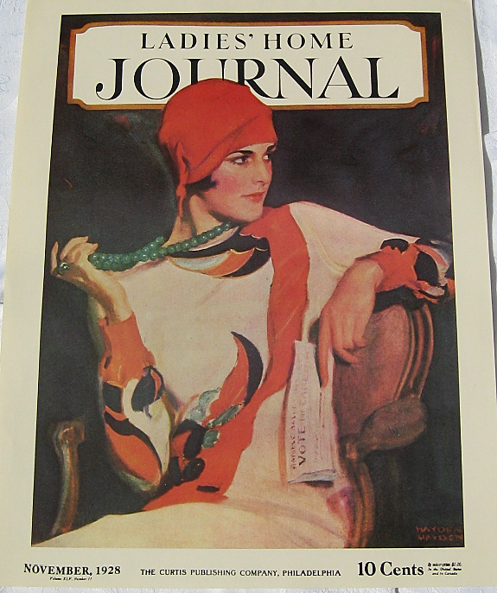
Ladies’ Home Journal
Ladies’ Home Journal under famous editor Edward Bok became the first American magazine to sell over 1 million.
By 1912 it approached 2 million circulation.

Slide 23
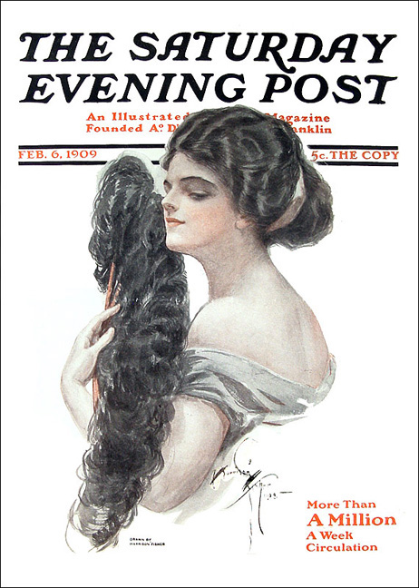
Saturday Evening Post
Could LHJ publisher Cyrus H.K. Curtis find similar success with a general-interest magazine for men?
He tried with the Saturday Evening Post.
Advertising of the new automobile industry helped make it successful.

Slide 24
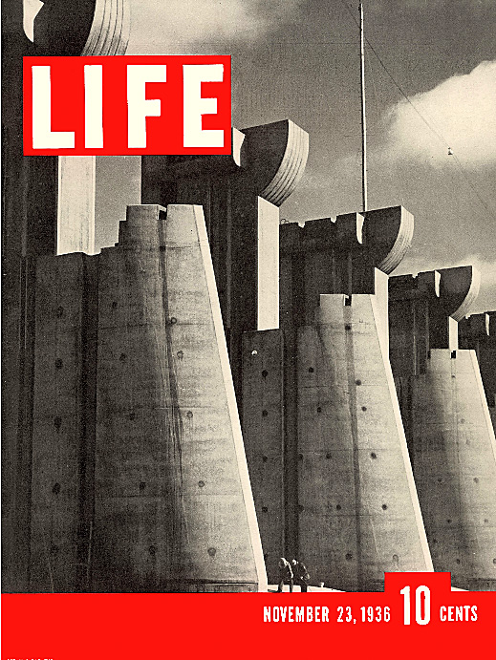
Life
Life was the greatest of all general-interest photo magazines.
Established by Henry Luce in 1936, it competed directly with Saturday Evening Post.

Slide 25
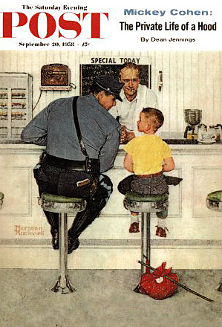
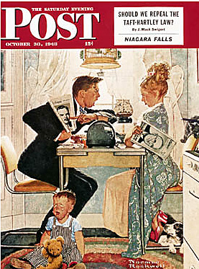
Life vs. Saturday Evening Post
After World War II Life grew to 7.7 million.
Saturday Evening Post reached nearly 7 million.
It was famous for its Norman Rockwell paintings depicting traditional American values.

Slide 26
Lowest common denominator
These Americans reached millions by providing lowest common denominator of mass tastes.
But they couldn’t reach as many as television.
After the mid-1950s, circulations held. But advertising revenue waned.

Slide 27
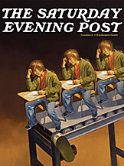
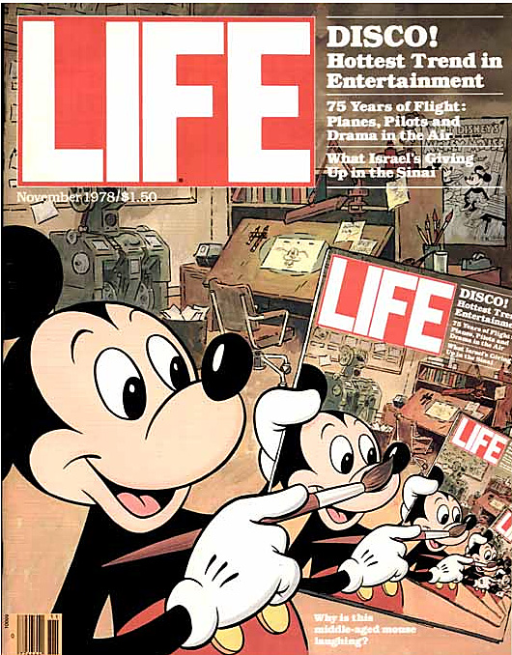
Demise of golden-age mags
Printing costs, too, were increasing, as advertisers moved to television.
In 1969 Saturday Evening Post folded.
In 1972 Life folded.
Both have returned in different disguises, but are not the same as the old mass-circulation weeklies.

Slide 28
Growth of niche magazines
Special-interest magazines had always existed.
General-interest magazines, however, had greatest power until television.
Other relatively general-interest mags like Time and TV Guide tried to establish a niche by regional and targeted marketing.
By the 1980s magazine publishing was expanding in niche areas.

Slide 29
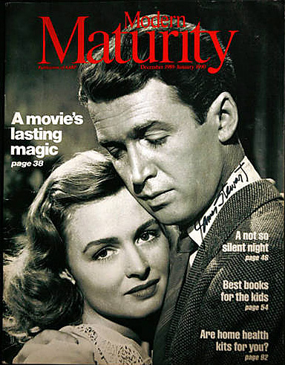
Magazines today
In 1995 the highest-circulation magazine in America was Modern Maturity, issued by the American Association of Retired Persons (AARP).
Circulation: nearly 20 million.
TV Guide still sold 17 million a week.

Slide 30
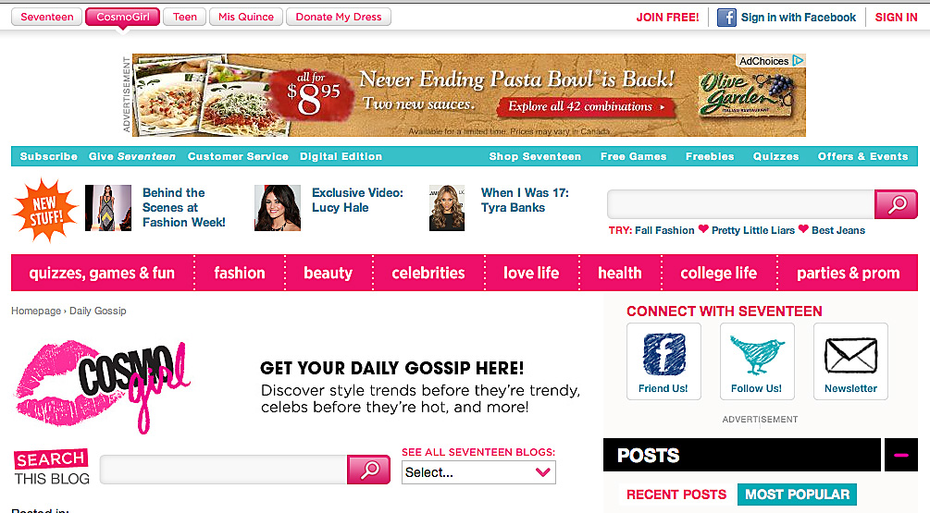
Top-selling magazines today
IN 2005 the AARP’s magazine, now renamed to AARP The Magazine, had reached 22 million.
Better Homes and Gardens came in second, 8 million.
All magazines now maintain an online presence.
Some magazines are totally online: Cosmo Girl did not survive a print edition, but survives on the net.

