Slide 1
Interview skills
5 steps to better interviews

Slide 2
Interview skills
Most of us have no formal interview skills.

Slide 3
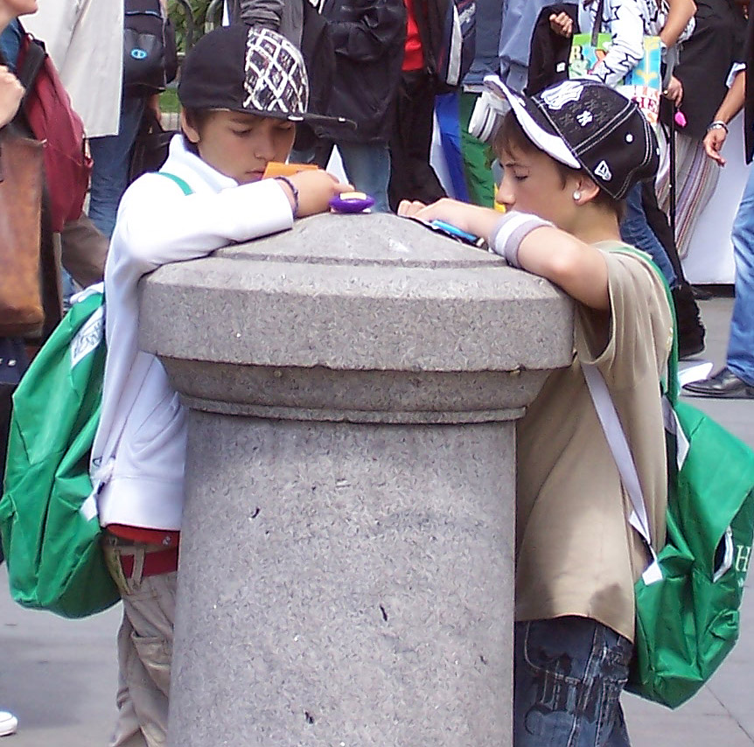
Interview skills
People tend to revert to talking about themselves, and don’t usually listen to other people’s answers.

Slide 4
Interview skills
Professional journalists are different. They tend to be curious about others, and less interested in talking about themselves.

Slide 5
Interview skills
This seems to indicate that interview skills don’t come naturally.
They also don’t come from most of our formal education.

Slide 6
Interview skills
People in the mass media, including public relations, gather information by talking to people.
The media is about people doing things.

Slide 7
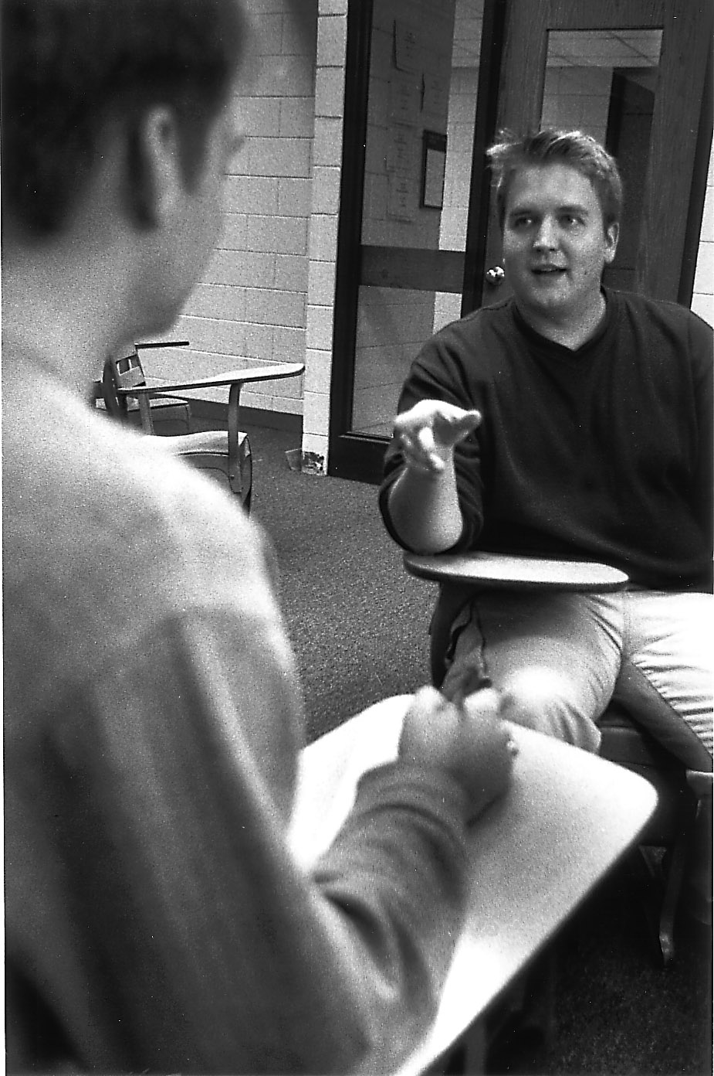
Interview skills
Media practitioners need basic interview skills.

Slide 8
Interview skills step one
Do background research.
It is really embarrassing when an interviewer asks something like, “So, Dr. Nern, what did you receive your Nobel Prize for?”

Slide 9
Interview skills: step one
Reporters start by looking at printed material: on line, in files, publications.

Slide 10
Interview skills: step two
Decide whom to interview.
Consider: Who has first-hand information? Who is the authority?
Public relations people are not usually the best interview choices.

Slide 11
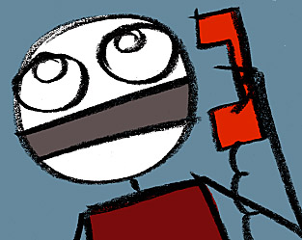
Interview skills: step two
How can you interview someone?
1. In person.
2. By phone.
3. By email.

Slide 12
Interview skills: step two
Email.
Advantages:
Fast.
Sources like it.
You can cut and paste responses without misquoting.

Slide 13
Interview skills: step two
Email disadvantages:
Harder to find a good quote.
Can’t hear and see source.
Less opportunity for follow-up questions.
Can’t establish a relationship.

Slide 14
Interview skills: step two
Telephone.
Advantages:
Faster than in person.
Actual person is talking.

Slide 15
Interview skills: step two
Telephone disadvantages:
Can’t see the person.
Hard to take notes.
Sources may not like it.

Slide 16
Interview skills: step two
Interview in person. The preferred method.
Advantages:
Establish a relationship.
See expressions.
Ask follow-up questions more easily.

Slide 17
Interview skills: step two
In person disadvantages:
Time-consuming.

Slide 18
Interview skills: step three
Do not give specific questions in advance. You may suggest general topics you’ll cover.
Do not agree to let source see final story before publication.

Slide 19
Interview skills: step three
Tips:
Don’t interview over a meal.
Dress appropriately.
Go to the person’s office.

Slide 20

Interview skills: step four
Setting up the interview.
Contact by email, call PR or secretary.
Have questions ready, just in case.

Slide 21
Interview skills: step four
Have a prepared list of questions written down.
Looks more prepared.
Helps in case you forget.
Covers all topics.
Focuses the interview.

Slide 22
Interview skills: step four
Recording the interview.
Audio recording.
Advantages:
Easy.
Get the exact quotes, no mistakes.

Slide 23
Interview skills: step four
Audio recording disadvantages:
Source may object.
Technology may fail.
Transcribing is time-consuming.

Slide 24
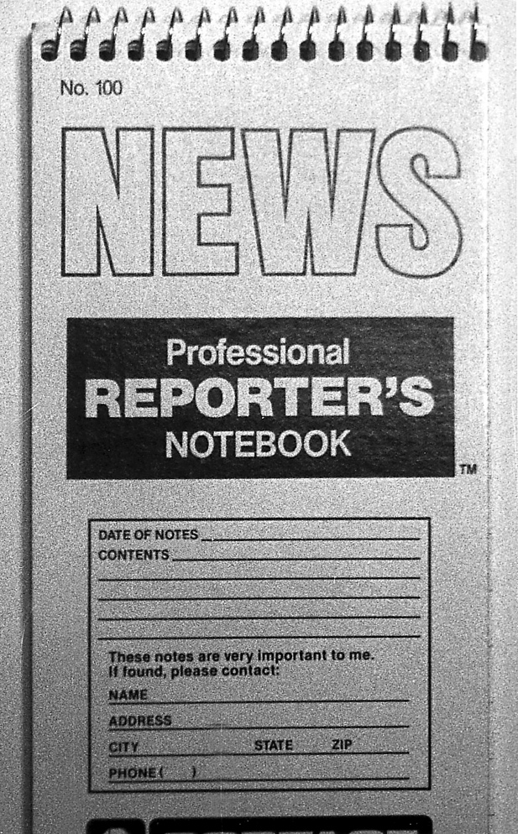
Interview skills: step four
Taking notes.
Advantages:
All professional reporters take notes; look more professional.
Easier to transcribe.
No-fail technology.

Slide 25
Interview skills: step four
Taking notes, disadvantages:
Hard to learn; need to develop a shorthand.

Slide 26
Interview skills: step four
Laptops.
Most professionals do not take interview notes using a laptop.
Puts a barrier between you and interviewer.

Slide 27
Interview skills: step five
Ask good questions.
Try the GOSS formula:
Goals
Obstacles
Solution
Start

Slide 28
Interview skills: step five
Ask quantitative questions.
Ask something a bit more personal.
Ask if there’s anything the source wants to say.

Slide 29
Interview skills: step five
Sensitive questions.
You need to ask tough questions as a stand-in for your readers.
Ask at the end, in case the source leaves.

Slide 30
Interview skills: step five
“Off the record.”
Stop a source who wants to say something off the record. The information is generally useless. You are writing for publication.
Explain to the source what this means.

Slide 31
Interview skills: step six
Review your interview.
Go over your notes right away.
Consider topic ideas, strong quotes. Make notations.
Consider transcribing to computer before you forget.

Slide 32
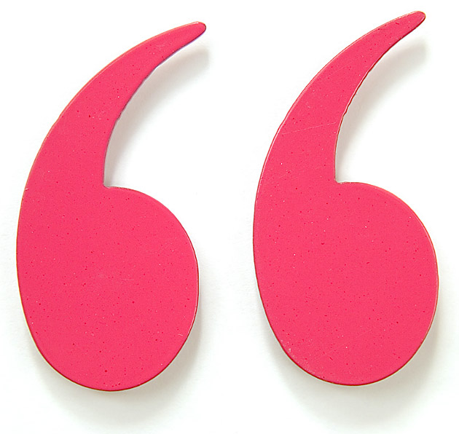
Interview skills: step five
Using quotes.
Most mass media stories include quotes for freshness and credibility.
Use to emphasize a point.

Slide 33
Interview skills: step five
A quote mark around words means they are written exactly as the source said them.
You can clean up grammar or remove obscenities.

Slide 34
Interview skills: step five
If you want to change some words, you must make a partial quote or paraphrase.

Slide 35
Interview skills: step five
Often a paraphrase works when the writer can provide information in a more clear or succinct way.

Slide 36
Interview skills: step five
Tips for quotes.
Never make up a quote. If you are not sure, take the quote marks off.
Source’s name must be complete, with specific title. Ask source to spell name.

Slide 37
Interview skills: step five
Attributions.
Choose past or present (said or says), and be consistent throughout.
You can occasionally vary with “added,” or “pointed out,” etc.
Avoid the clumsy words “stated” or “commented.”

Slide 38
Interview skills: step five
Punctuation: All punctuation marks go inside quotes in U.S. media style, except colons and semicolons.
Example:
“We must reach energy self-sufficiency,” said Nern.

Slide 39
Interview skills
A class exercise.
Ask the instructor three open-ended questions. Take notes on his/her response. Write a two-graf story using direct quotes.

