Slide 1
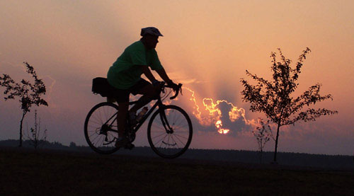
10 Principles of Photojournalism
Ross’s Jump Start Guide

Slide 2
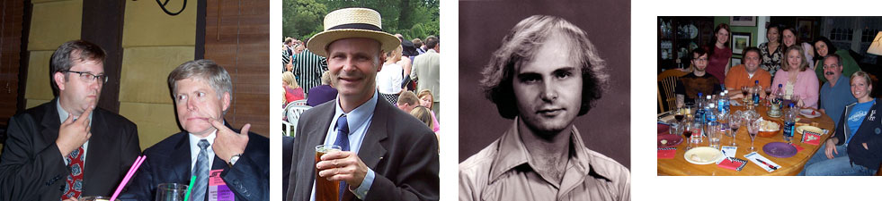
The photographic universe
We rely on photography for a variety of needs:
For our own albums, to remember people and events important to us, or to remember ourselves and others as we once were, but are no longer.

Slide 3
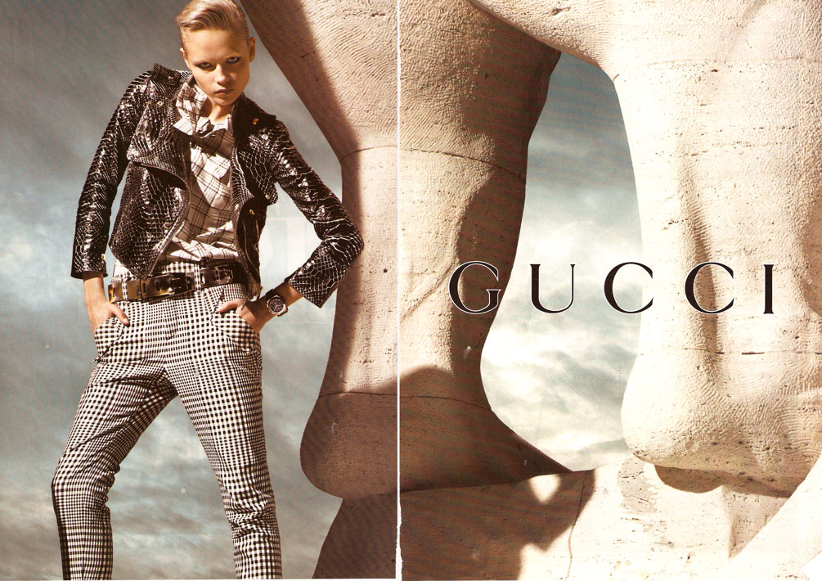
Photographic universe
Portrait photographers make formal photos.
Technical and architectural photographers use photos as instructive tools.
Advertisers make photos to sell products.

Slide 4
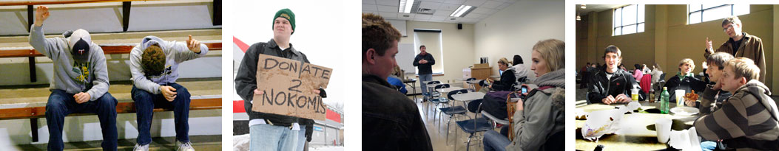
Photographic universe
Photojournalists, on the other hand, make photographs:
To report news based on accepted journalistic standards;
To communicate to a mass media audience;
To tell a non-fiction story.

Slide 5
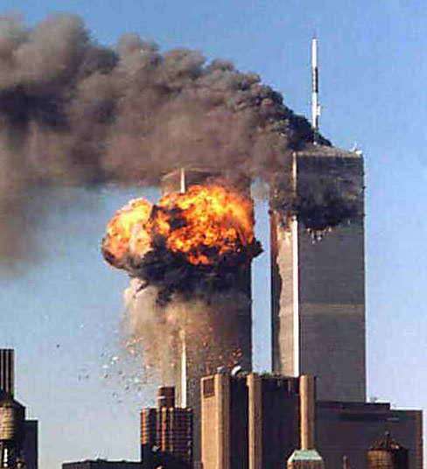
Photojournalism
The idea of photojournalism is a fairly recent concept.
The word was coined in the 1940s by journalism historian Frank Luther Mott.
It reflected the growing power of the news image in our society.

Slide 6
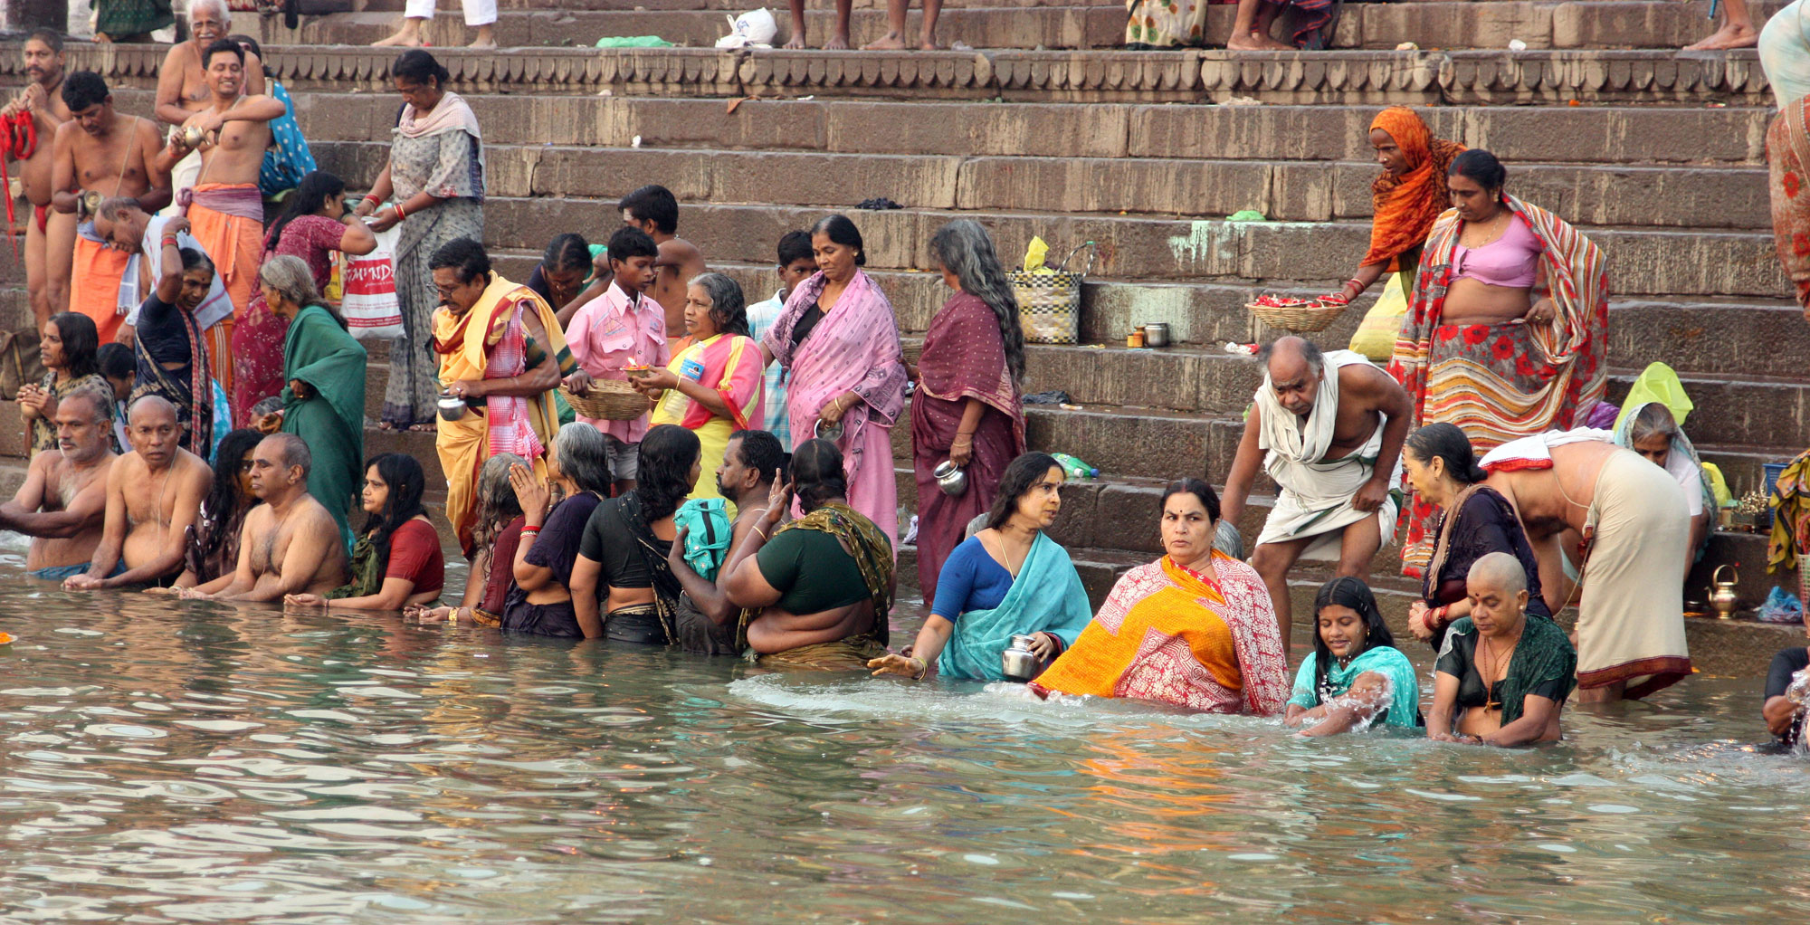
The language of photojournalism
Photojournalism is a language unlike words.
It has no past, it has no future, but it transcends cultures, speaking directly to our emotions.
It is a “slice of life.”

Slide 7
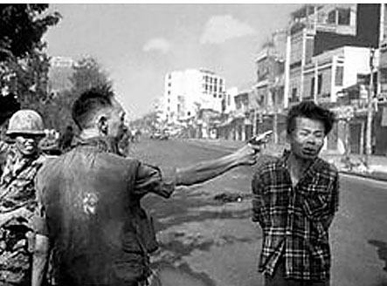
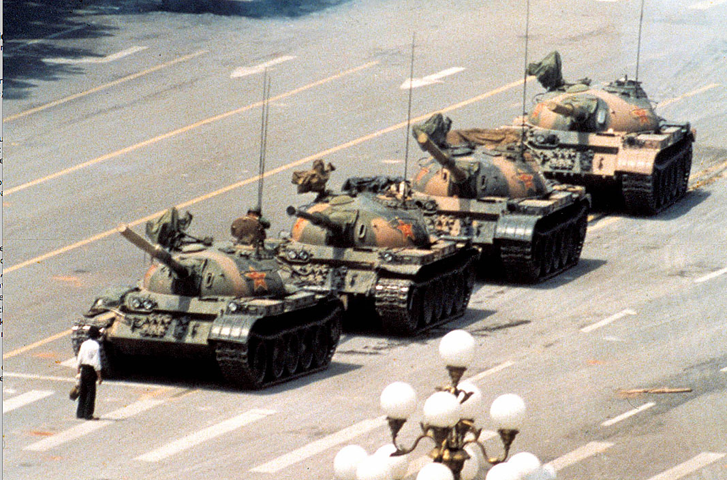
The importance of cutlines
Photojournalism-style photos always include cutlines to help give the world context.
Nevertheless, it may not be the words, but a visual image tied to an important event, that we remember.

Slide 8
Photojournalism’s power
The power of the visual image has become more important, not less, as we migrate much of our news to the internet. But many principles of strong photojournalism have stayed the same.
These principles can be adapted to many kinds of journalism, from video to magazine.

Slide 9
Ross’s Principles: One
1. Get in close.
You are publishing for a jaded audience, easily distracted.
Look for a clean, contrasting background.
Try for the “poster effect.”

Slide 10
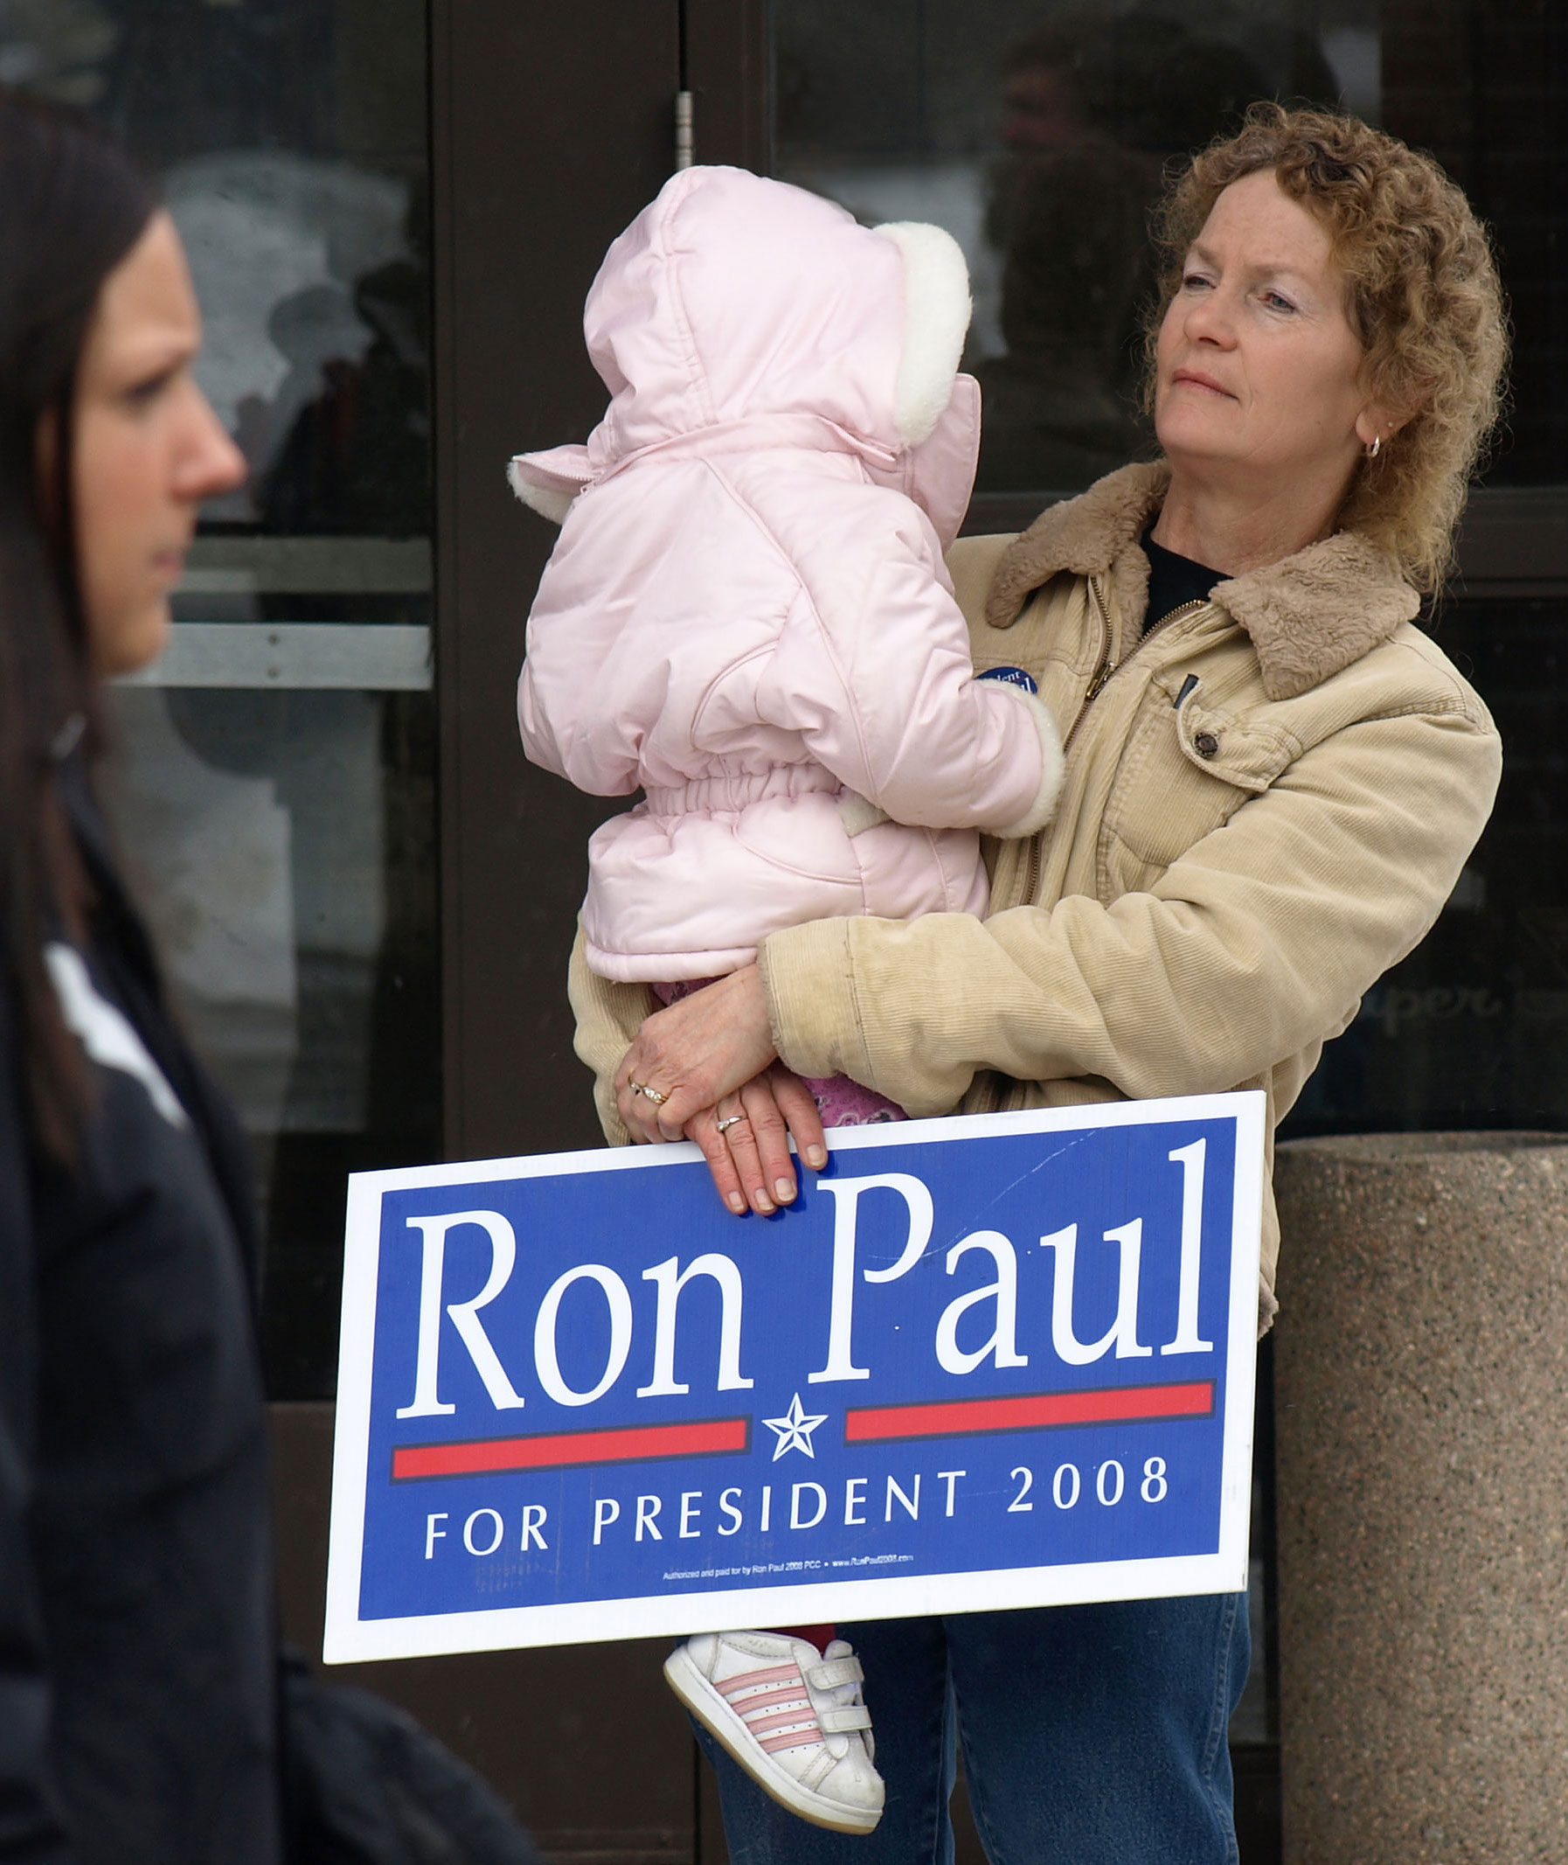
Principle One
The poster effect.

Slide 11
Ross’s principles: Two
2. Find unusual angles.
If you’re standing or sitting like everyone else, you’re probably going to take some boring photos.
Climb, crouch, lie down. Get off your butt!

Slide 12
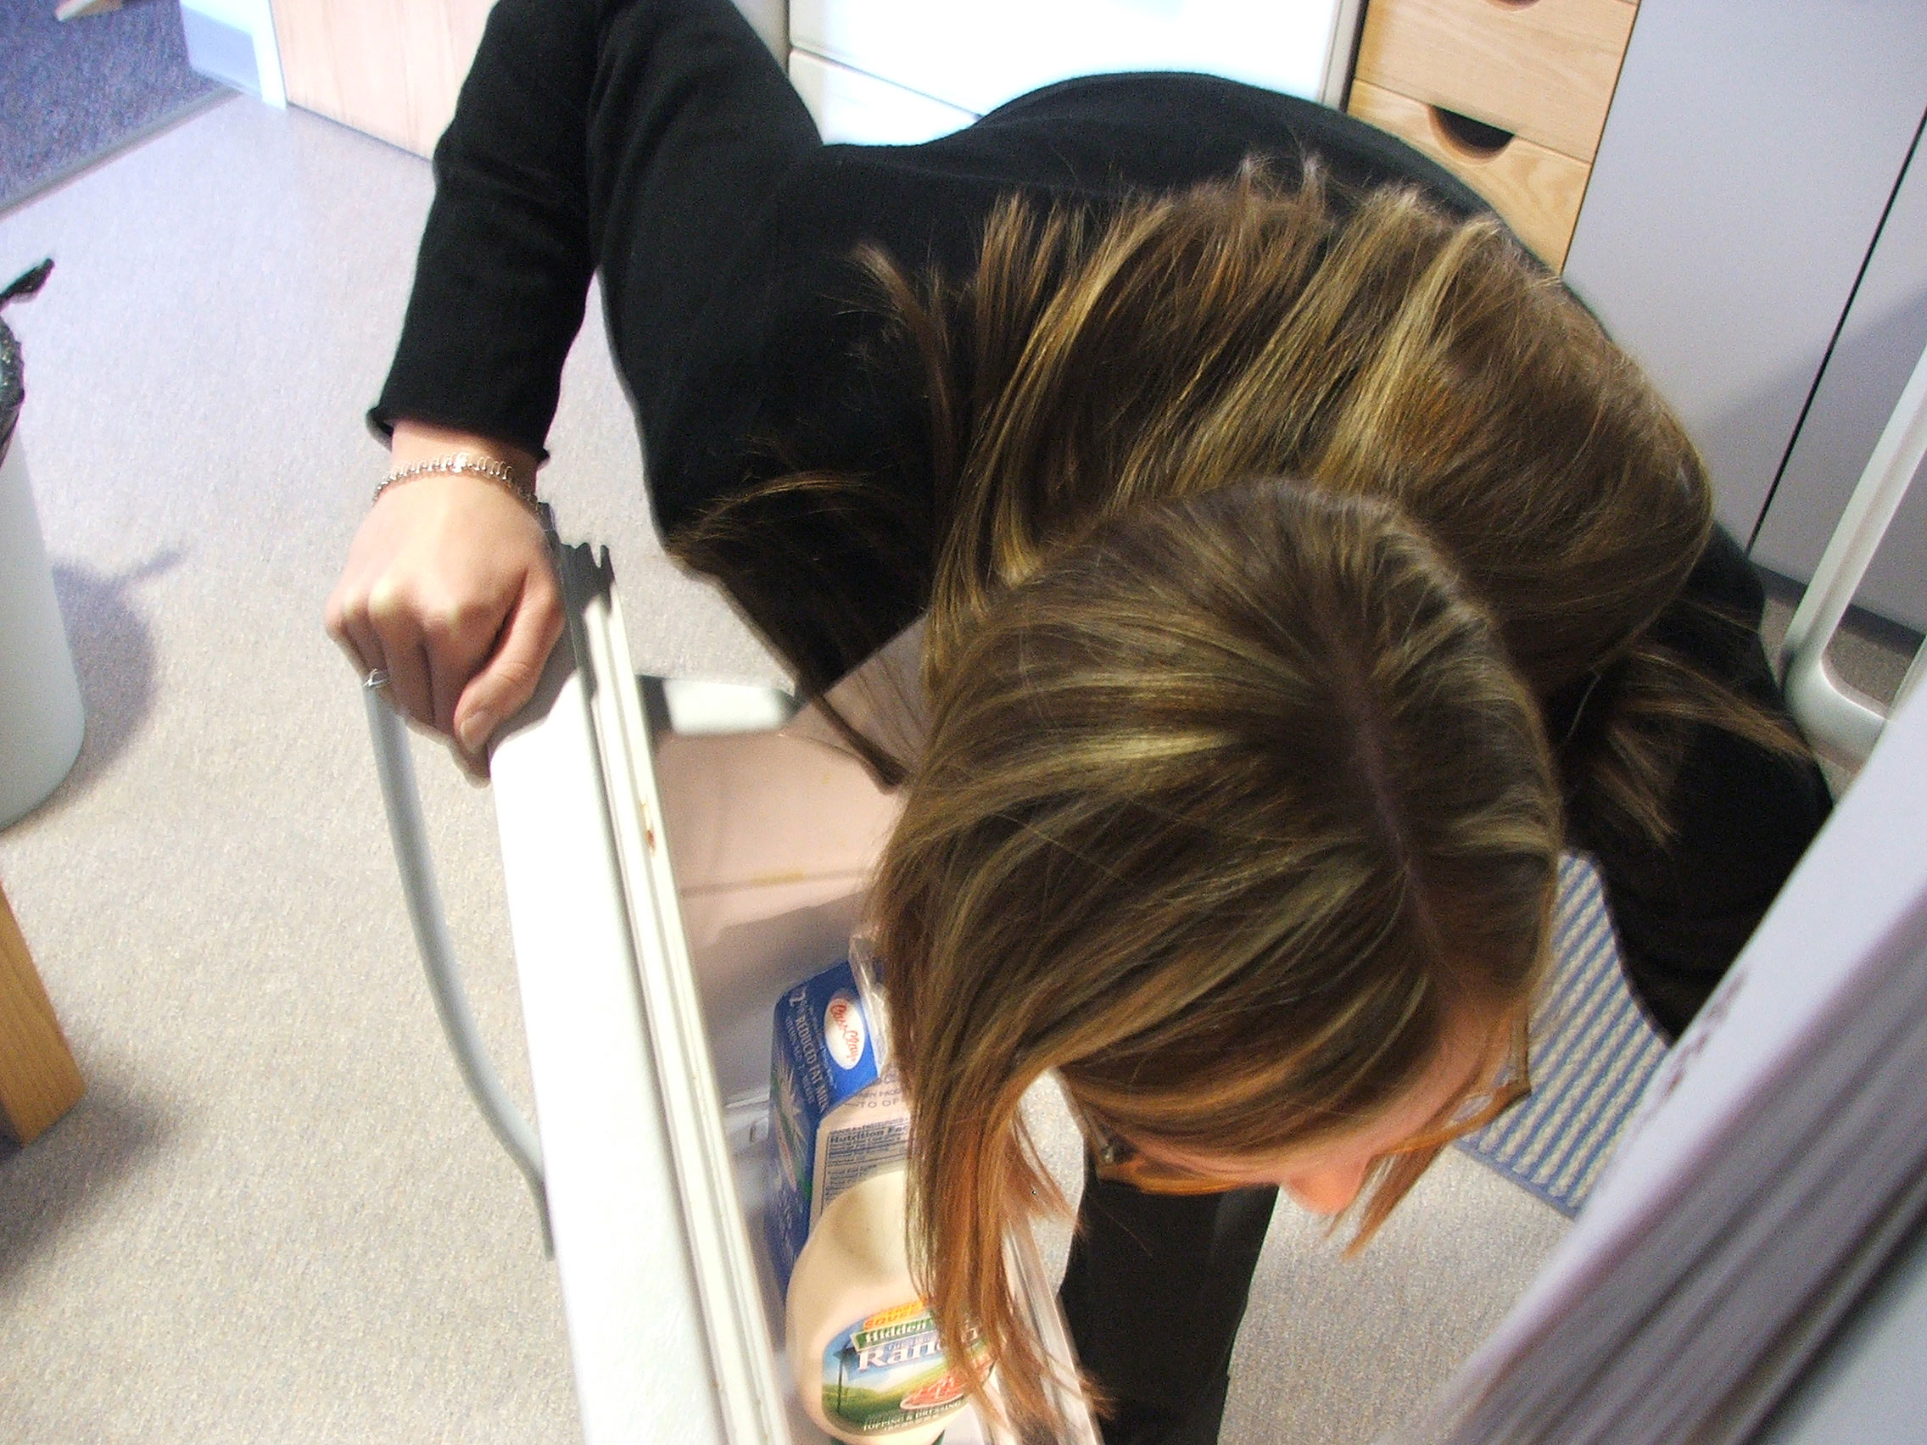
Principle Two
Unusual angles.

Slide 13
Ross’s principles: Three
3. Get idents.
People must be identified, unless a large group or far away.
This sounds hard, but most people are happy to give names if you explain why you want it.

Slide 14
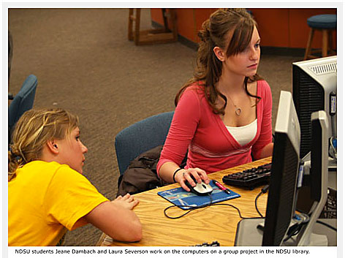
Principle Three
Get idents.

Slide 15
Ross’s principles: Four
4. Burn pixels. It’s free!
Take a lot of pictures. Move high, move low, keep on clicking.
Shoot 30 to 40 at a minimum.

Slide 16
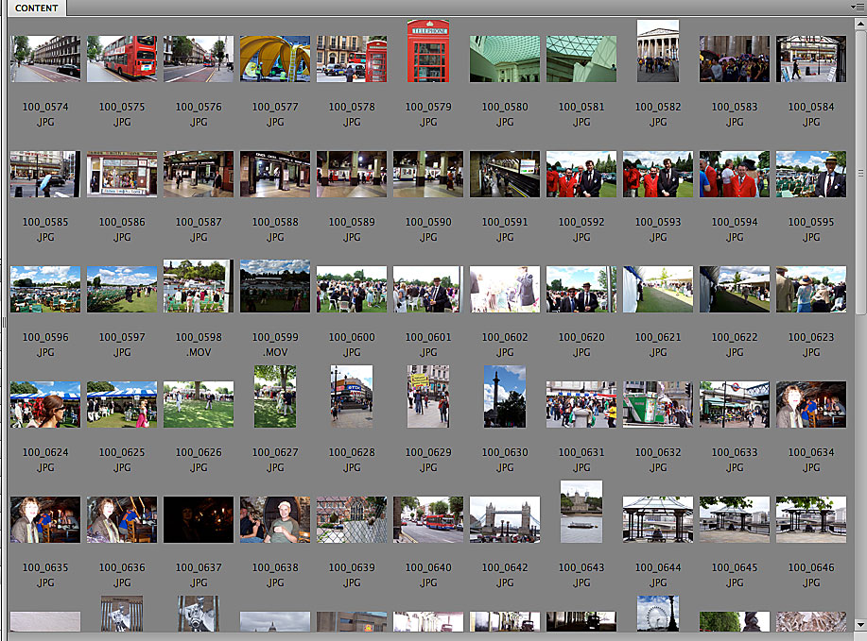
Principle Four
Take lots of pictures.

Slide 17
Ross’s principles: Five
5. Go beyond the cliché.
How many photos have you seen of people talking on the phone? Working on a computer? Shaking hands?
Don’t shoot people in boring surroundings. Have them doing something.

Slide 18
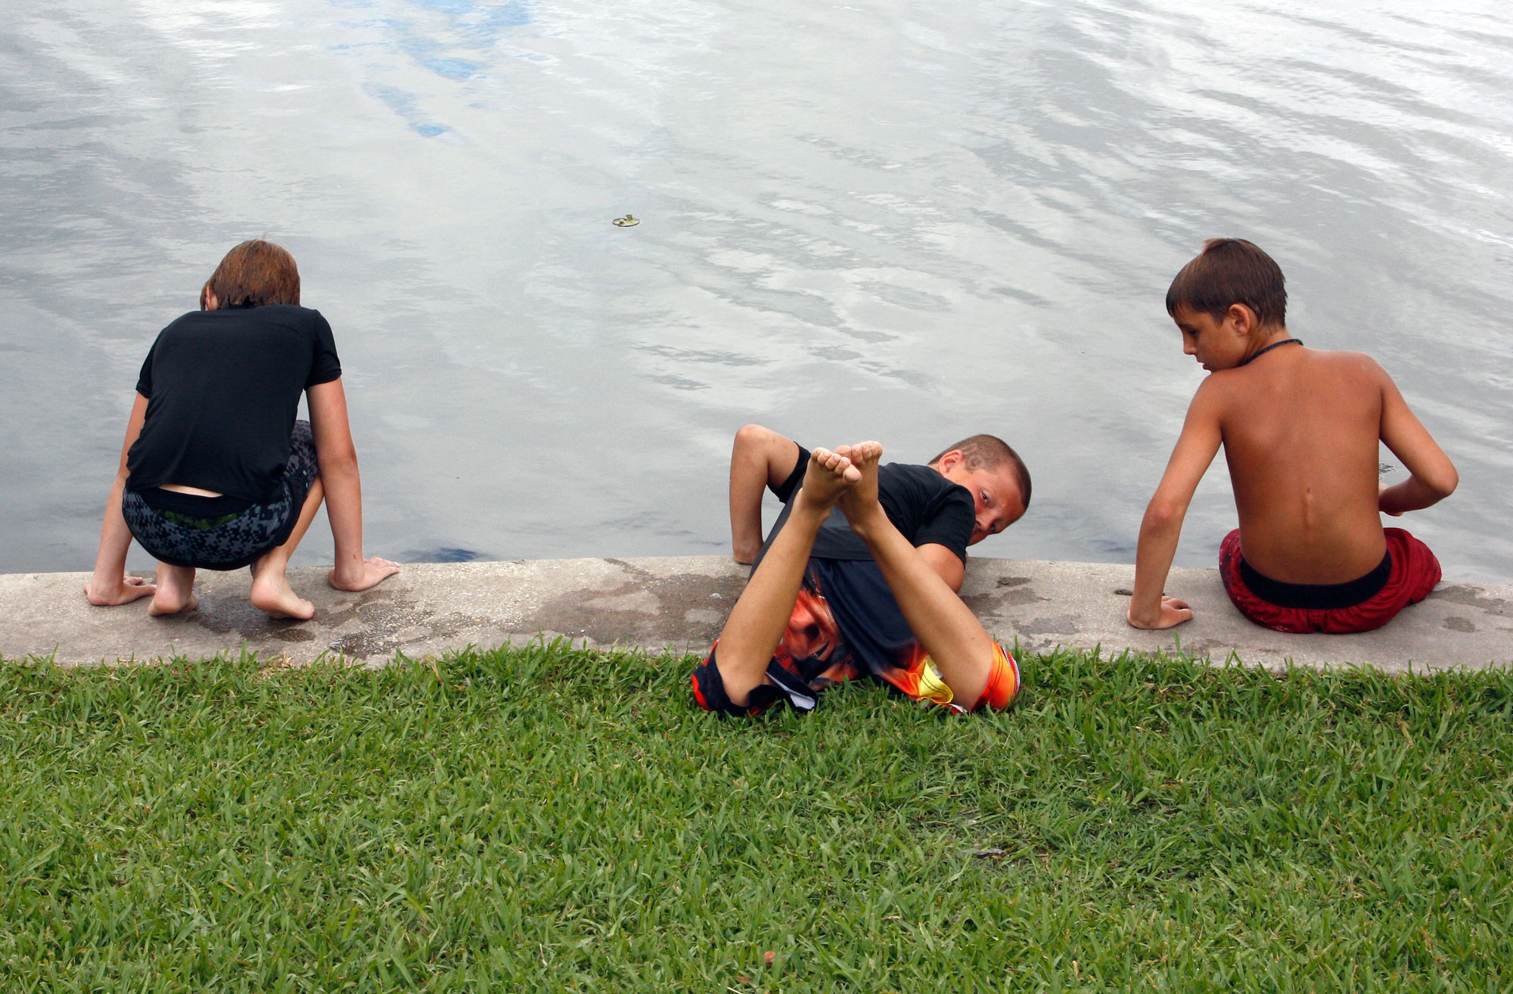
Principle Five
Go beyond the cliché.

Slide 19
Ross’s principles: Six
6. Avoid obvious posing.
If you must pose, try to make the scene appear natural.
Photojournalism is about people doing things, not just posing.

Slide 20
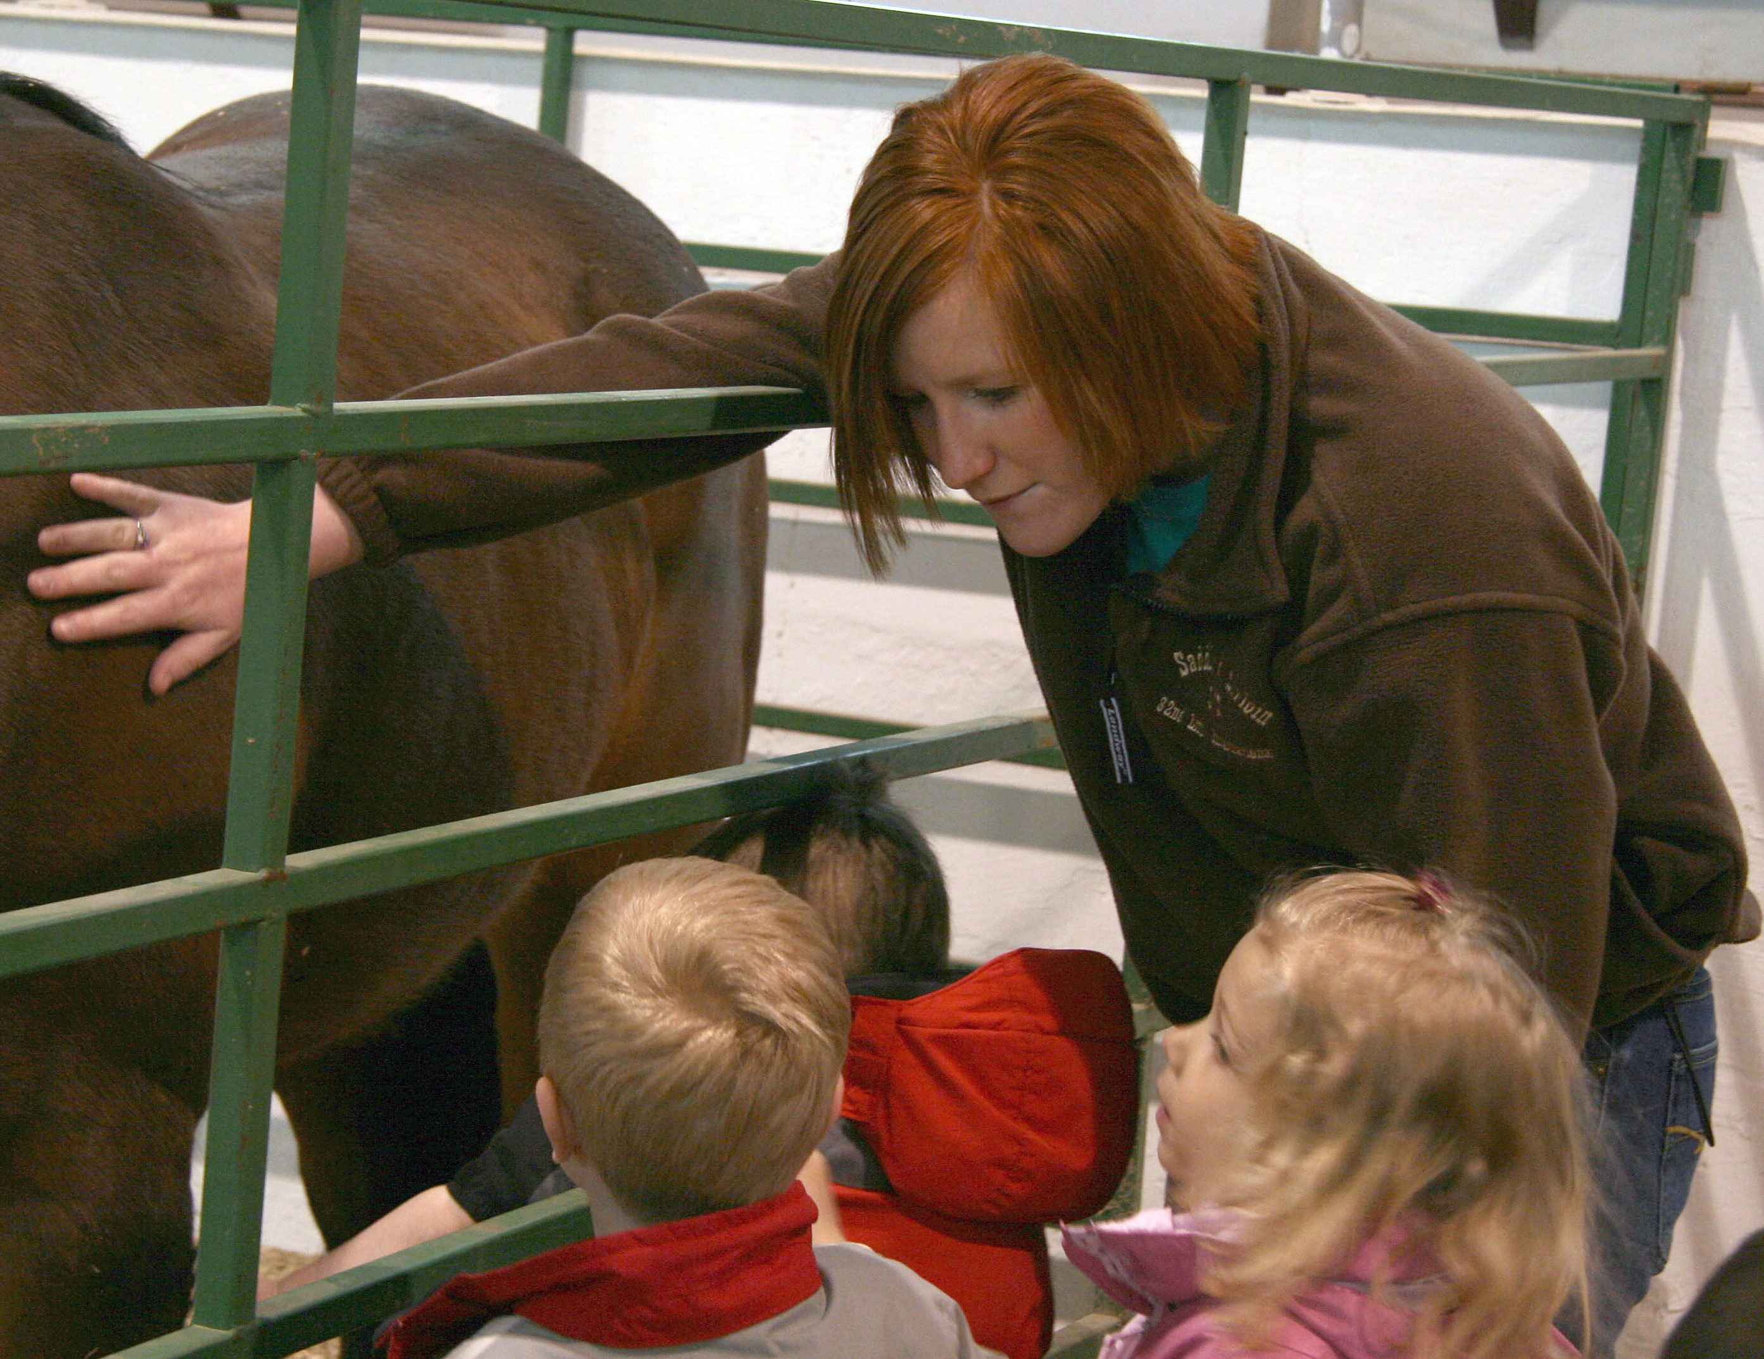
Principle Six
Avoid posing.

Slide 21
Ross’s principles: Seven
7. Add light, but don’t make it obvious.
Available light is ideal, but sometimes the quality is poor.
Try to make light look natural.
Do not use flash on camera.
Try window light, a forgiving, easy and attractive source.

Slide 22
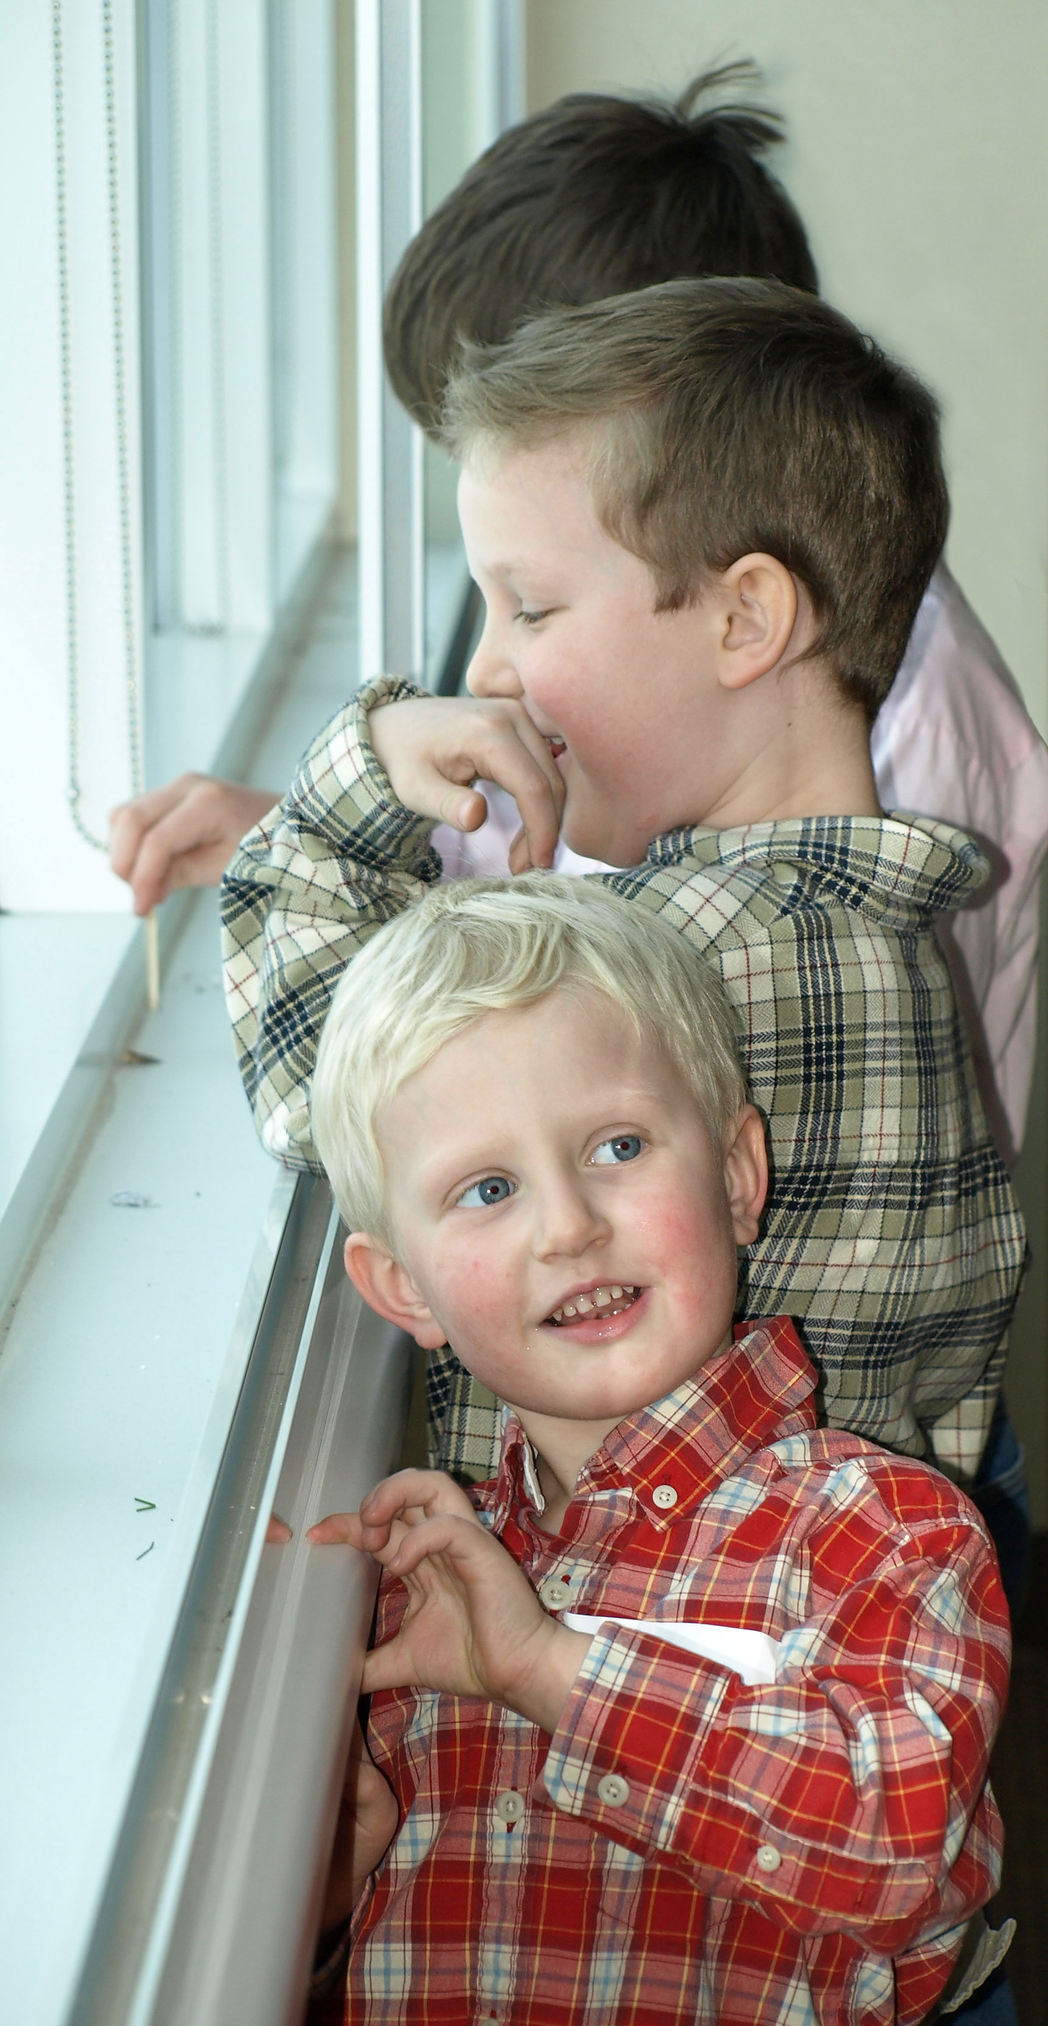
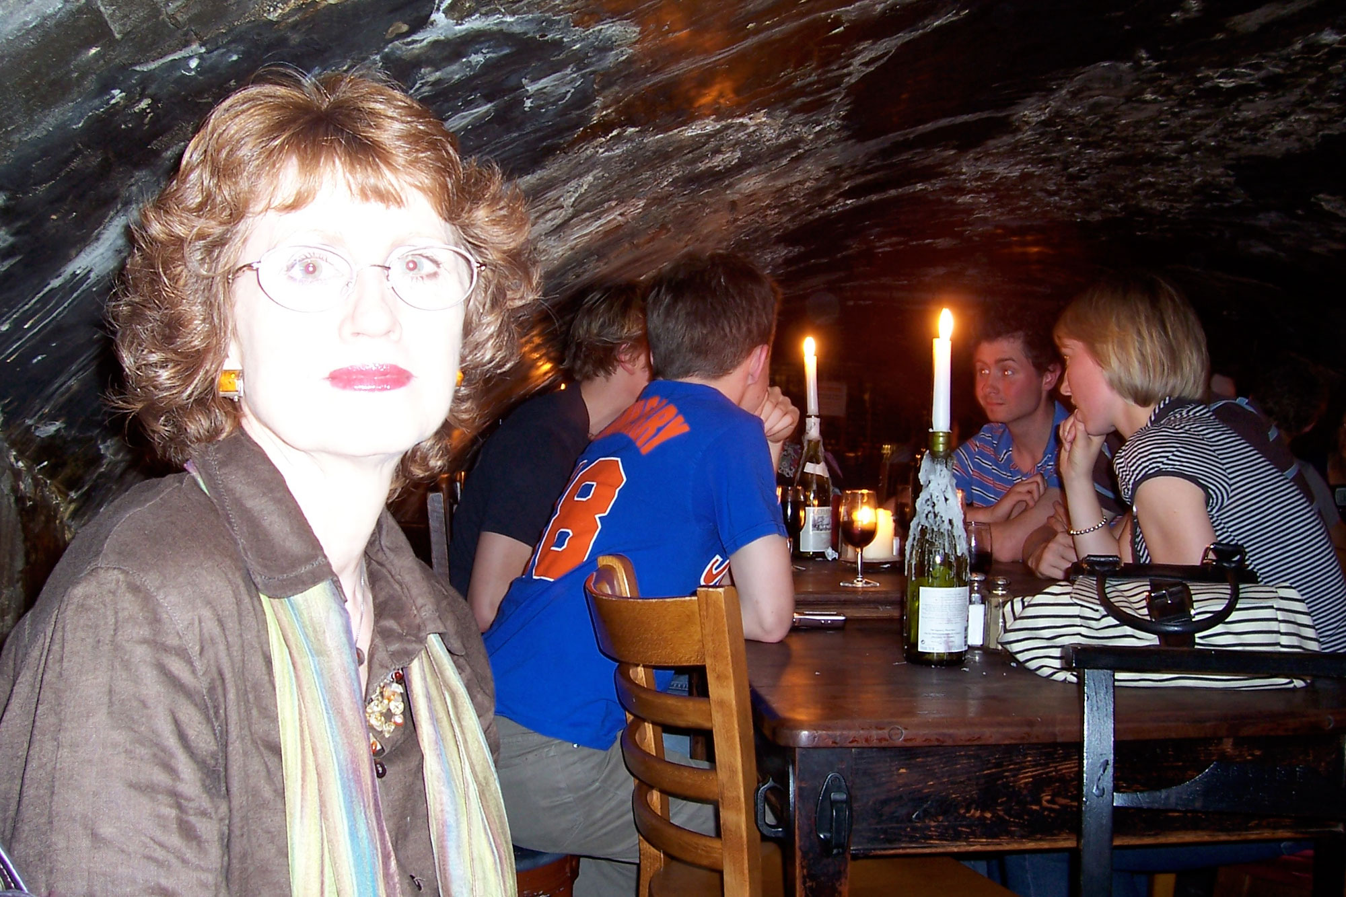
Principle Seven
Try window light.
Avoid flash on camera.

Slide 23
Ross’s principles: Eight
8. Focus faithfully, stay steady.
Blurry photos are unusable. Photoshop can’t fix true blur.
Autofocus and stabilized lenses should help. But they don’t always, as light may be low.
Slow shutter speeds record camera shake: hold your camera steady, lean against something, or use a tripod.

Slide 24
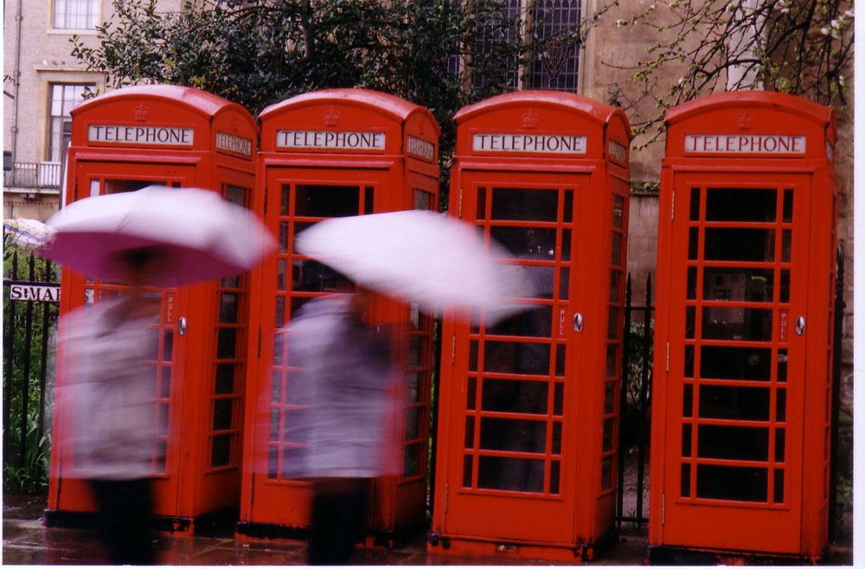
Principle Eight
Blur can sometimes be interesting. But something in the photo needs to be sharp.

Slide 25
Ross’s principles: Nine
9. Discard poorly exposed photos.
Photos that are too light or dark look even worse in print.
Don’t be fooled by the computer monitor: photos generally look better as projected color.
Photoshop can’t fix what wasn’t there to begin with: detail.

Slide 26
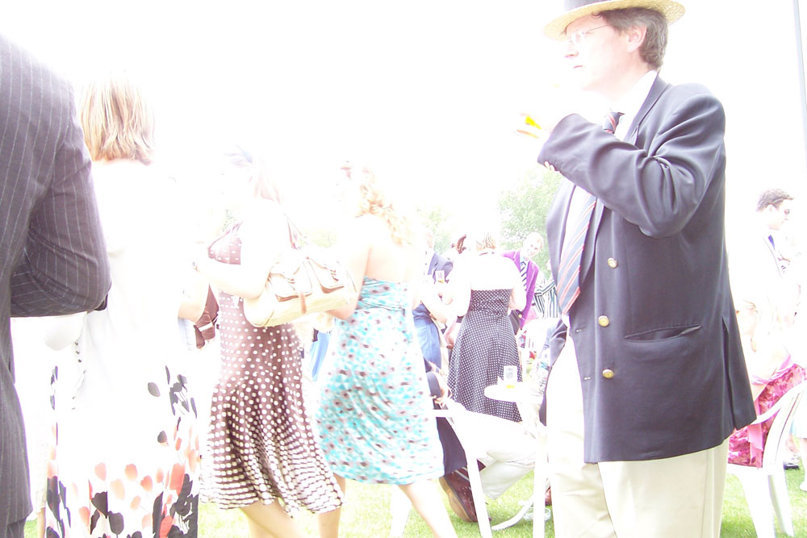
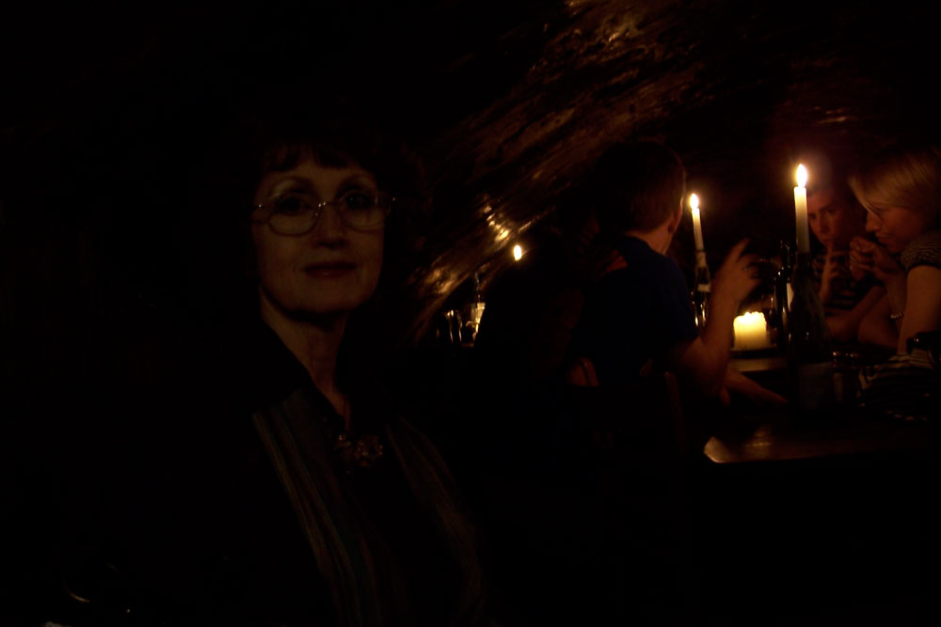
Principle Nine
Photoshop won’t work miracles on these.

Slide 27
Ross’s principles: 10
10. Have courage.
You need to be assertive as a photojournalist.
Sometimes you need to walk in front of people.
You need to ask people’s names.
A courteous but persistent demeanor is nothing to be ashamed of.

Slide 28
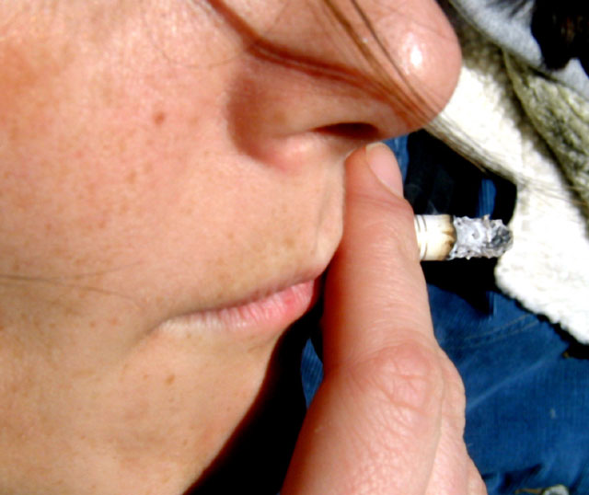
Principle 10
Have courage.

