Slide 1
Why study history?
Introduction to history of the media

Slide 2
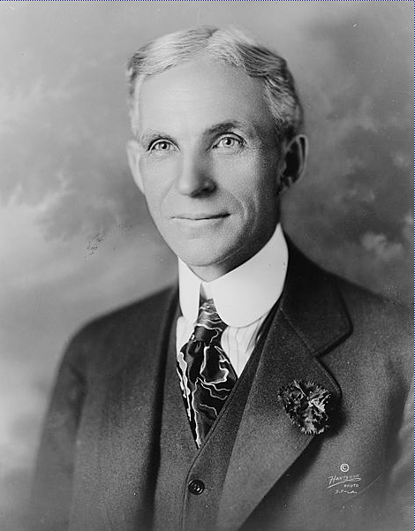
Why study history?
“History is Bunk.”—Henry Ford
Actually, he said “history is more or less bunk.”
But…Henry Ford is history.

Slide 3
Why study history?
The American idea was a break from the past.
On the other hand, Americans are interested in history:
Movies and TV.
Black Powder Groups.
Medieval groups.
Battle re-enactments.
Genealogy.

Slide 4
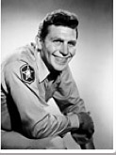
Why study history?
Historians may present boring history.
But history is a story.
As Andy Griffith explained. (http://www.youtube.com/watch?v=5QGe9kfqddQ)

Slide 5
History as a tool
Political groups are particularly interested in history.
History is produced as evidence of how we should be have today.
For example, American conservatives interpret the “Founding Fathers” as supporting their claims to small government and a religious base.
American liberals (and most professional historians) dispute this interpretation.

Slide 6
Why study history?
In this sense, history is not so different from a story you’d tell a friend:
About people;
Who did something;
And the consequences.

Slide 7
A story
What if you tell a friend this?
“Boy, you’ll never believe what happend in speech class today. The professor was talking about communicating different family values, when one of the students stood up and accused him of blasphemy.
“He kicked the professor in the butt! The class cheered, but someone called campus police anyway.
“Now there’s an all-campus meeting called on, I guess, greater classroom security.”

Slide 8
A story and history?
A story you tell your friend has a real positive aspect for historical study: you are a primary source.
Primary means the person telling the story was right there, or very close to the event in time or place.

Slide 9
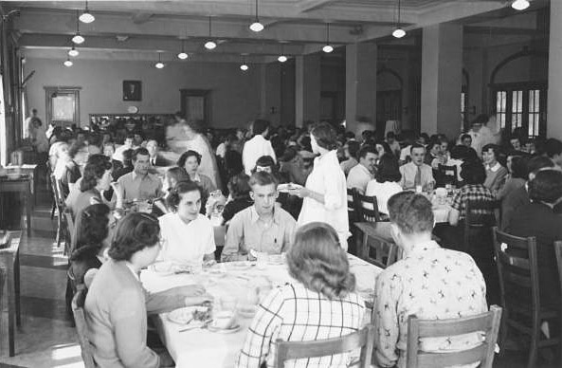
Primary sources
Let’s say you wanted to study the history of the university during the time your great grandfather was a student. What primary sources would you use?

Slide 10
Primary sources
Interview your grandfather.
Look at minutes of campus meetings.
Check course catalogs.
Look at newspapers, university and commercial.
Find diaries, personal letters.
Check out photo archives.

Slide 11
Primary sources
What else might help you to understand the time your grandfather lived in?
Magazine articles and books about the time and the university.
Interview with a history professor.
Wikipedia.
These are called secondary sources.

Slide 12
Significance
These can give you facts. But facts aren’t enough.
Why did events happen as they did? Why are they significant?
History needs interpretation.
If we go back to our classroom story, how might we add interpretation?

Slide 13
Significance
You could explain why the event happened.
But how do you know that?
You need evidence.

Slide 14
Significance
Good history, then, needs three aspects:
Evidence. Credible and persuasive.
Interpretation. Reasonable conclusions based on evidence.
Narrative. Telling a good story.

Slide 15
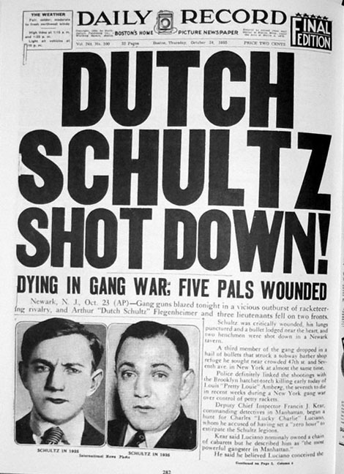
News as history
Journalists are said to write “the rough draft of history.”
News stories provide evidence, interpretation and narrative.
But why might this current-event style history have drawbacks?

Slide 16
Why study history?
It helps us understand who we are, and what we do.
To understand our personal lives, we may see a therapist.
To understand the society in which we live, we may consult a historian.

Slide 17
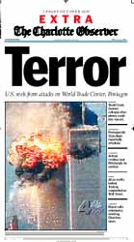
Why study history?
Why did this happen?

Slide 18
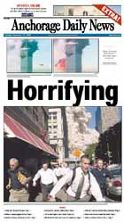

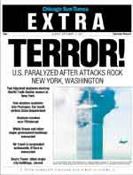
Why study history?
You cannot answer that question without studying history.

Slide 19
Why study history?
How can history help us understand 9/11?
United States invasion of Iraq in 1991.
United States support of Israel.
United States support of Saudi Arabia.
World War II and World War I.
Balfour Declaration.
Even the Crusades, a thousand years ago.
History of all this is part of understanding 9/11.

Slide 20
Why study history?
But that’s not the only reason to study history.
We study the past for its own sake, dramas of another place, another time.
History gives use an opportunity to compare your nature, your assumptions your perspective with others from the past.

Slide 21
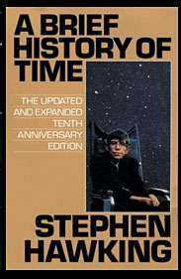
Why study history?
History is a time machine, the closest we can get, apparently.
Stephen Hawking said time travel must not be possible, because otherwise we’d be plagued with annoying tourists from the future.

Slide 22
Why study history?
And history really does help us to think critically.
Make a conclusion based on evidence.
Evaluate without models or formula.
Avoid present-mindedness.
Consider the power of the past in our lives today.
[http://www.youtube.com/watch?v=gNnfQfsnnRc]

Slide 23
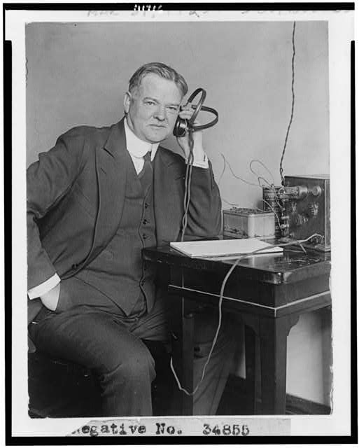
What is media history?
A study of humanity’s struggle to communicate.
The media by which we have communicated.
The barriers we have faced in efforts to communicate.

Slide 24
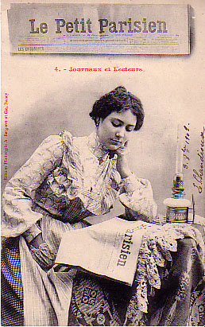
Why study history?
So why study history? [http://www.youtube.com/watch?v=44U7T8R8Qzc]

Slide 25
What do you know?
What do we know about journalism history? A wee quiz.

