Slide 1
Free press and WAR
How free should it be?

Slide 2
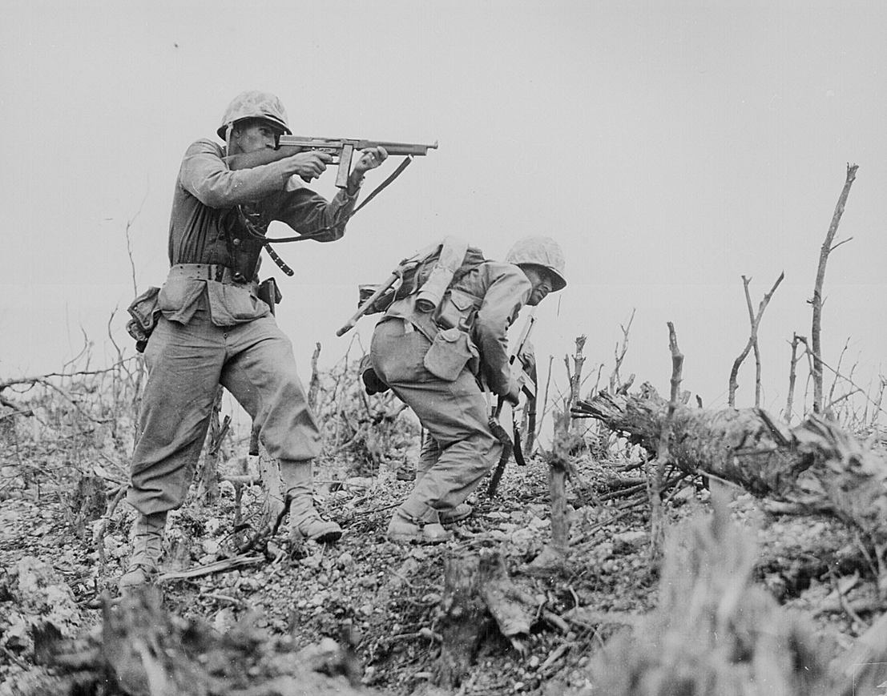
Free press and war
Democracy is defined by a free press.
But war is not a normal state of democracy.
How free should it be during wartime?

Slide 3
Democracy during war
During war, people are getting killed.
The entire country may be threatened.
The idea of telling everybody what’s really going on can get controversial.

Slide 4
War and the press
But the press are particularly interested in covering war.
Wars are perhaps the most significant events for a nation.
A source of heroism, pain, life and death, fear and triumph.

Slide 5
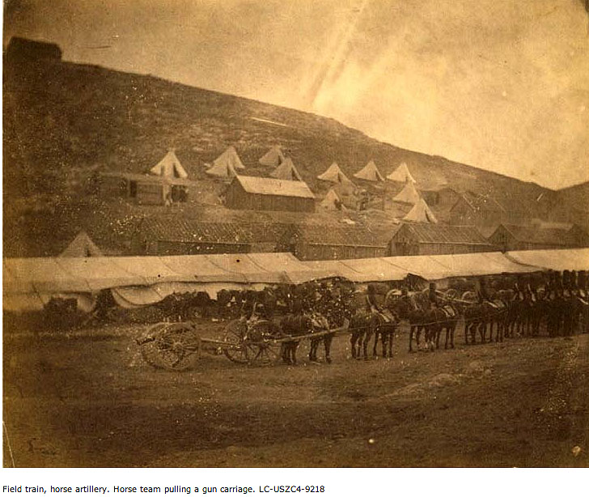
War and the press
So the press has been accompanying the troops since the beginning of mass media more than 150 years ago. (Fenton, Crimean War, 1855)

Slide 6
Right to access?
Journalists argue they have a right to battlefield access.
In a democracy, people need to know what the military is doing in their name.
We have a collective responsibility.

Slide 7
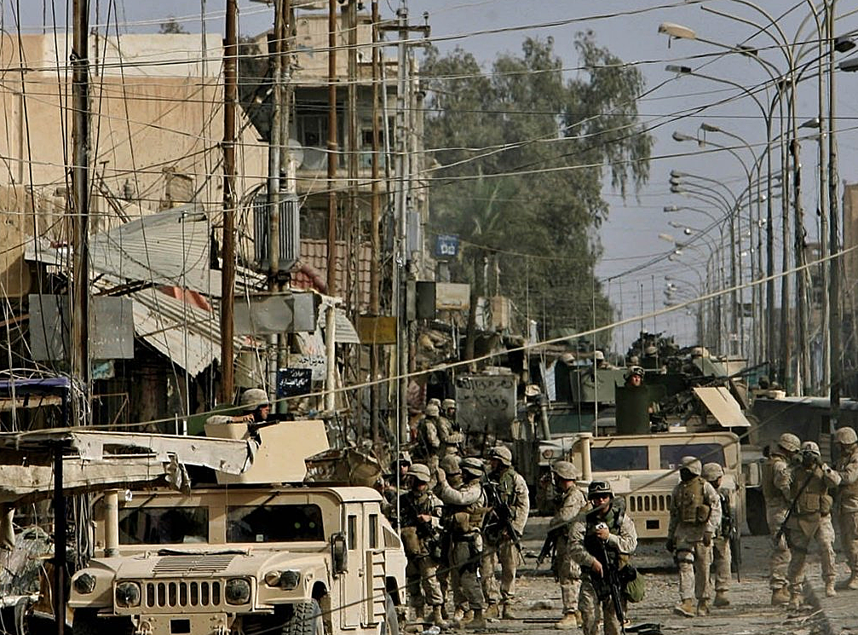
Recent wars
So what about the recent wars of the United States, in Iraq and Afghanistan?
Let’s examine using the archeological model.

Slide 8
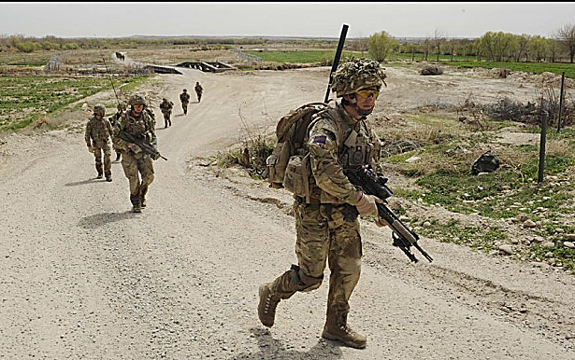
Afghanistan
Why were U.S. troops in Afghanistan?
Directly related to terrorist attacks of 9/11.
What has the role of the press been in this war?

Slide 9
Afghanistan
In Afghanistan, reporters have been free to report as they wished.
They could go along with the troops.
Live is they live, a process called “embedding.”

Slide 10
Afghanistan censorship
There has been little formal field censorship. This also was the system in Iraq recently.
Is this a good system for the country?

Slide 11
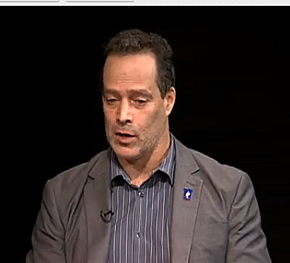
Vivid descriptions
Journalist Sebastian Junger described pretty vividly the difficulties soldiers faced in Afghanistan.
His book War told of the army’s mistakes, sometimes, and lives wasted by poor judgment. http://www.youtube.com/watch?v=IPoxepAvtN0

Slide 12
Controversy
Some political leaders and others believe such descriptions are not wise during wartime.
They argue that this reporting damages morale at home.
They argue reporters really don’t understand difficulties of an army in the field.

Slide 13
Shielding readers
Detractors argue people should be shielded from brutal descriptions of what might be their own children dying in terrible ways.
They argue there is no good reason to show this, and such incident mislead people regarding the nature of war.

Slide 14
Danger to strategy
Furthermore, detractors argue that a reporter in the field may give away something of strategic value to the enemy.
Therefore their work must be monitored and controlled.

Slide 15
Reporter antipathy
Traditionally, the military has gone along with the idea of censorship. Military leaders usually do not like the press.
Reporters point out every commander’s mistake. And they have historically given away strategic secrets, sometimes without even realizing it.

Slide 16
The general’s goal
According to the traditional joke of media history, the general’s goal is to befuddle the enemy and bamboozle the public.
It’s easier to prosecute a war if nobody back home knows what you’re doing.

Slide 17
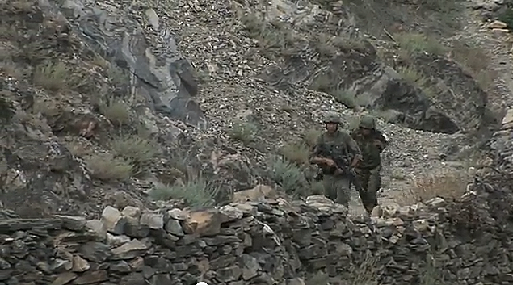
Restrepo
Sebastian Junger, along with Tim Hetherington, who later died in Libya, made a documentary about the war. Would the generals have liked it? http://www.youtube.com/watch?v=-DjqR6OucBc

Slide 18
How handled?
How has this basic philosophical difference between press and army been handled in the past?
In strikingly different ways from war to war.

Slide 19
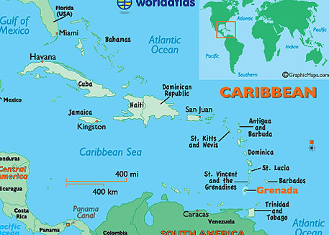
First Gulf War, Iraq, 1991
The military took a dramatically different viewpoint in 1991.
Their plan was based on two previous brief wars, Granada, 1983, and Panama, 1989.
IN 1983 the Reagan administration wanted all war news to be good news.

Slide 20
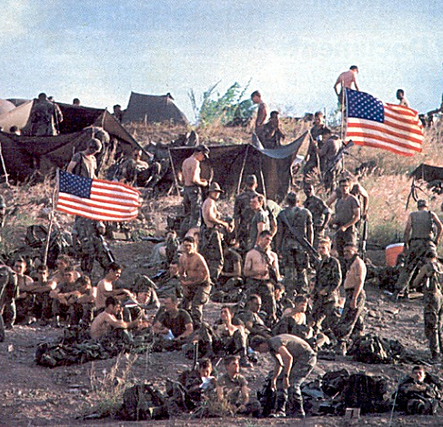
Grenada
No one in government wanted to show something negative or offensive to people back home.
Therefore, reporters were not allowed to cover this war, at all.

Slide 21
Grenada
Those reporters who charted boats to try to sneak into the Caribbean island were turned back by military gunboats.
What was happening in Grenada? Americans knew only what the government told them.

Slide 22
After Grenada
The war was brief. The press loudly complained about censorship.
The government decided to rethink. It proposed allowing small groups to go to the field and gather information.
This is called the pool system.

Slide 23
Pool system
The pool system asks a small group to gather information and report to the rest of the journalists.
The result is pooled into one story.
The reporters would always be escorted by military personnel.

Slide 24
Pool disadvantages
What might be disadvantages of the pool system?

Slide 25
Disadvantages of pool
One, you have no diversity of perspective among journalists.
Two, reporters see only what they are shown.
Three, close supervision does not allow reporters to interview soldiers at random.
Fourth, the system works against media competition to break news first.

Slide 26
Pool system in Panama
The pool system was supposed to be used only for the first hours of battle.
But in 1989 Panama invasion, the Secretary of Defense, Dick Cheney, decided not to send the assembled pool to the site.
Reporters who tried to sneak in were again blocked.
We still don’t really know what happened. No reporters were there to tell us.

Slide 27
1991 Gulf War
The first Iraqi war was fought to remove Saddam Hussein from his occupation of Kuwait.
The pool system was still operating.
Journalists faced a second problem: Saudi Arabia, staging country, was conservative and anti-press. They refused to allow journalists.

Slide 28
Gulf War
Major news media tried negotiating with U.S. military leaders Colin Powell, Norman Schwarzkopf and Dick Cheney.
The agreement was this: in a third phase, the pool system would be eliminated.
But this did not happen.

Slide 29
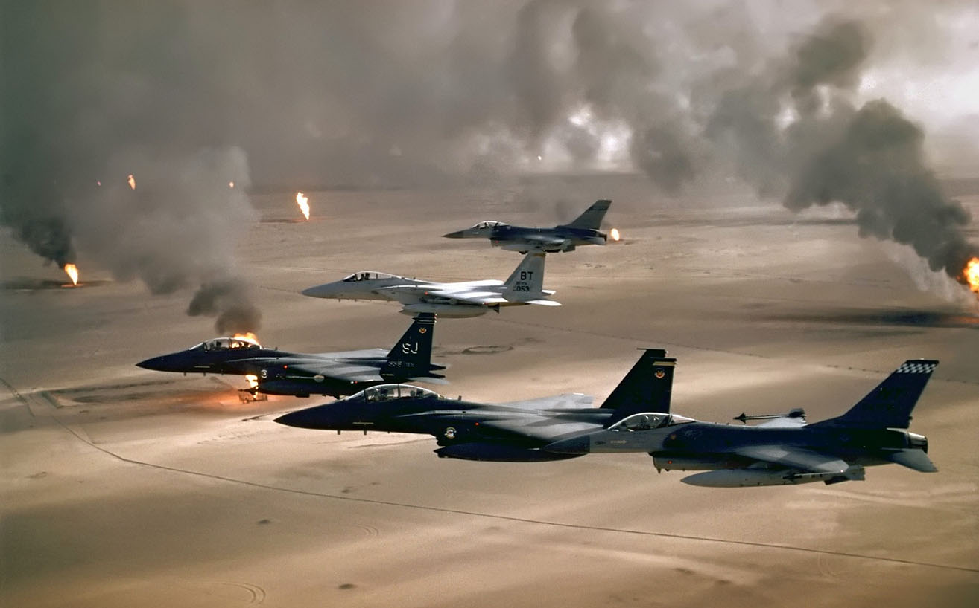
No access
When Desert Storm was launched, the pool system allowed 160 reporters across a front line of 500,000 troops. And they couldn’t talk to people at random.

Slide 30
Reporters sneak in
Some reporters tried to sneak onto the battlefields. They were caught, stripped of press credentials, and blocked from going out.
One CBS crew trying to sneak out got lost in the desert and was captured by the Iraqis.

Slide 31
Security review
Press dispatches were subject to a “security review,” that is, censorship by military authorities.
Journalists were being allowed to see and hear exactly what the military wanted them to.

Slide 32
Authoritative
Was the military an authoritative source? Some said it was.
Meanwhile, desperate reporters were trying to find something to cover. They even interviewed each other.

Slide 33
Peter Arnett
But Peter Arnett of CNN was different.
Arnett happened to be in Baghdad, the enemy capital.
He was therefore not part of the pool, and could not be controlled.

Slide 34
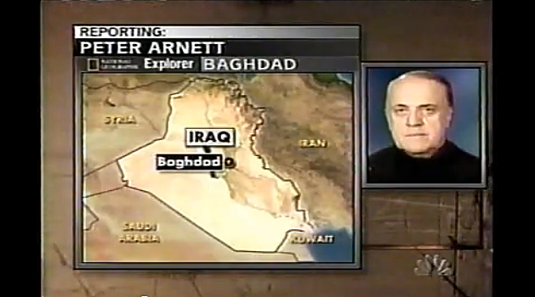
Peter Arnett
His reports were criticized by many for his “Iraqi propaganda.” http://www.youtube.com/watch?v=yIE2QSVJIdo

Slide 35
Real-time reports
Arnett offered reports in real time, as the event was happening. This was unusual at this time, and many found them fascinating.
On the other hand, the reports were not edited—this was not common at the time.
Today, real time, unedited reports on the Web are common, many from “citizen journalists.”

Slide 36
False perception?
Did allied military control give the world a false perception of this war?
Apparently yes. Many stories were told much later, and reports during the war were found to be inaccurate.

Slide 37
What was not reported
For example, the then-famous “smart bombs” of the war constituted only 11%.
70% of the bombs dropped during that war missed their target.
“Friendly fire” caused most of the 260 American deaths during this war.
American bulldozers buried alive possibly 100,000 Iraqi troops.

Slide 38
Why?
Why were Schwarzkopf and Powell so strongly opposed to media coverage of this war, and why did civilian leaders agree?
Looking into history, we see one fact: all had participated in the Vietnam War.

Slide 39
Vietnam War
To answer the questions related to Gulf War coverage we have to go back 25 years, to the Vietnam War era.
This war was much larger, much longer, much more costly and much deadlier: about 58,000 American soldiers were killed, and at least two million civilians.

Slide 40
The “conflict”
The Vietnam War was never declared by Congress, so it’s properly called a “conflict.”
It was based on the ideology of Communist containment: Communism must be kept from spreading like a plague to other countries.
In foreign policy this was called the Domino Theory.

Slide 41
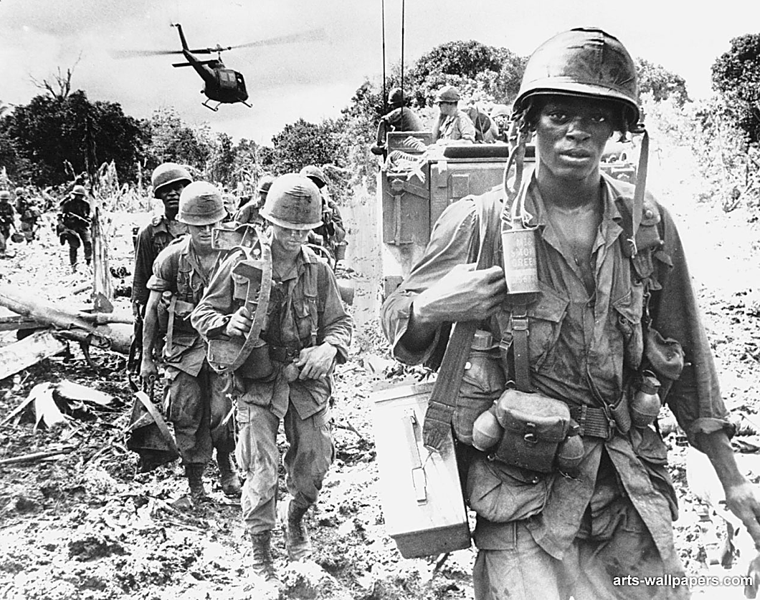
Vietnam symbolism
So Vietnam became a symbol of evil Communism vs. freedom-loving Democracy. Or so many Americans believed.
The press was welcomed as part of a patriotic, anti-Communist team.

Slide 42
Vietnam policies
The press was given great flexibility in covering this war.
Reporters could get press credentials simply by offering evidence of sponsorship by two media organizations.
The AP usually offered sponsorship. Your local newspaper also offered it. Voilà, you were there.

Slide 43
Vietnam coverage
Reporters roamed Vietnam with no restriction beyond their own logistical limitations.
They covered battles in great detail.
Sometimes they were adversarial, and critical of the United States.
Sometimes they uncovered corruption and United States complicity in atrocities.

Slide 44
Vietnam coverage
The Vietnam War ended badly for the United States. It lost; Communists won.
Commanders sought blame by pointing at the media: negative coverage, particularly by television news, demoralized Americans.
Without support from the home front, the war could not be continued.

Slide 45
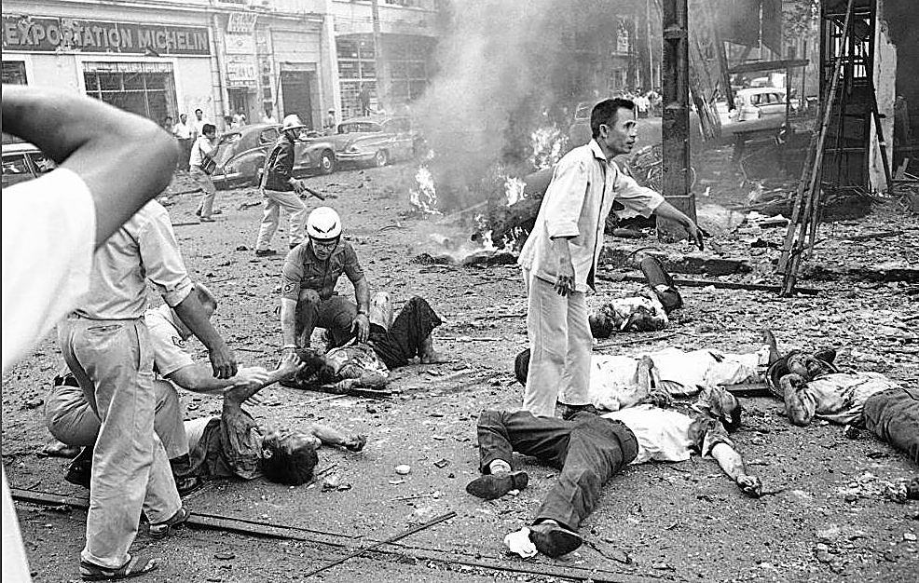
Uncensored images
Americans were particularly shocked to see hideous images of war on their living room televisions. Civilians had never seen such shocking images of war before.

Slide 46
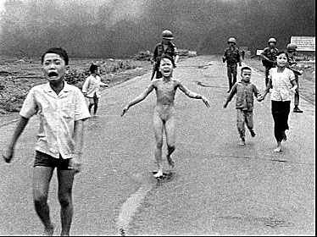
War’s reality
Most famous are the images and still photos of a misguided napalm attack by south Vietnamese forces (Still Photo by Nick Ut). http://www.youtube.com/watch?v=Ev2dEqrN4i0

Slide 47
Correspondents’ danger
War is dangerous for journalists as well as soldiers. Untrained correspondents sometimes had no idea what they were doing.
63 journalists died in Vietnam.
Today’s wars, again giving journalists the opportunity to roam with the troops, are as dangerous: more were killed (80) in Iraq by 2006 than in two decades in Vietnam. Many were assistants to U.S. correspondents.

Slide 48
The military and PR
Instead of censorship, the military in Vietnam tried public relations.
The government launched a highly professional and polished publicity campaign to build support for the war at home.

Slide 49
Early coverage
As well, the government tried to help out journalists in hope of getting more positive coverage. Military provided hospitality.
This worked for a while; correspondents and editors generally responded to pressure in favor of “patriotic” (that is, positive) coverage.

Slide 50
South Vietnam’s response
The South Vietnam government, essentially a dictatorship, did the opposite, trying to expel reporters. Washington pushed for acceptance, however.
After 1964, however, U.S. involved grew.
Between 1964 and 1975, more than 9 million U.S. troops fought in Vietnam.

Slide 51
Government PR
Many reporters and editors sided with the U.S. government regarding the war, particularly in the early years.
A few did not, particularly those from other countries. And with 700 reporters roaming Vietnam at will, the whole story did get out.

Slide 52
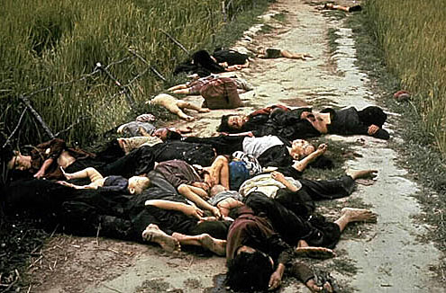
Seymour Hersh
In 1969 Seymour Hersh broke the My Lai story: more than 300 Vietnamese women and children massacred by American troops under leadership of Lieutenant William Calley.

Slide 53
My Lai
Americans were shocked that American troops could perpetrate such atrocities. Television coverage also included troops setting fire to villages and badly treating civilians.

Slide 54
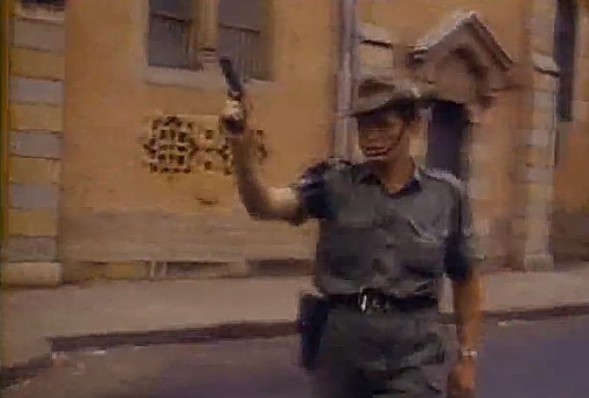
The Tet Offensive
War critics argue all wars are brutal and ugly. But Vietnam marked the first time non-combatants actually witnessed it. https://www.youtube.com/watch?v=S3mfXnFtwQc&list=PLDAGAiRAQASxQB2r_nnjpISWyvmzaOTWi

Slide 55
End of Vietnam War
Journalists began to lose interest in the war after American troop strength waned.
By 1974 only 35 reporters remained.
Editors perceived Americans were also losing interest in the war.
But the air war was still escalating in Laos and Cambodia though an American bombing campaign.

Slide 56
The end
After the United States pulled out of Vietnam, the Viet Cong (North Vietnamese) overran the country.
Many correspondents later said they had second thoughts about how the war was covered, and what Americans saw.
Some thought coverage sometimes really was not fair.
Certainly the military agreed.

Slide 57
A reflection
Others who covered the war had no second thoughts about the mistake the country was making. http://www.youtube.com/watch?v=ZnGX1WuYzFo
Did United States journalism help to lose the war in Vietnam?
Historical research says no.
But the judgment of politicians and military did not agree. And they were not about to give the media the same benefits.

