Slide 1
The Press in America
Beginnings

Slide 2
The Press: Beginnings
Development of the press in the Colonies came late.
The Pilgrims sailed in 1620; the first newspaper appeared in 1704—a century later than in Europe.
Boston, or the “Massachusetts Bay Colony,” was, however, the center of early culture in the Colonies.

Slide 3
The Press: Beginnings
Boston colonists were more concerned with education.
Harvard established in 1636.
In 1638, first press set up, to print religious texts for schools.
Newspaper publishing lagged, however.

Slide 4
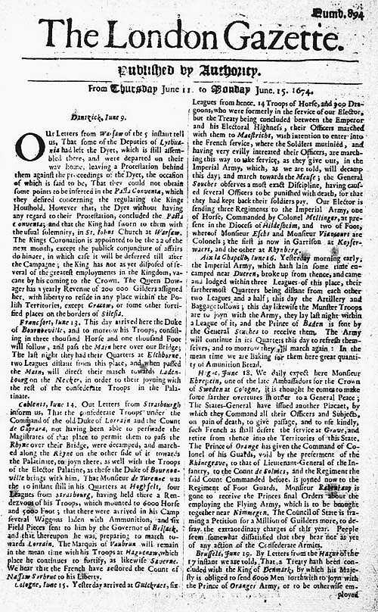
The Press: Beginnings
One reason: America was a vast wilderness. There was no news.
Colonists cared mostly about news back home, in England, and English newspapers.

Slide 5
The Press: Beginnings
As the colonies grew, commerce became more important, especially fishing and shipping.
Merchants needed a way to communicate, and find out what was happening in business.
A newspaper might fulfill that need, especially for advertising.
This explains why many early newspaper had “advertising” in their titles.

Slide 6
The Press: Beginnings
In the South, always more agrarian, less commercial, journalism lagged.
Benjamin Harris arrived in the largest city in the Colonies, Boston, in 1686. He opened a coffeehouse and bookshop, proving that the Barnes & Noble idea goes back a long ways.

Slide 7
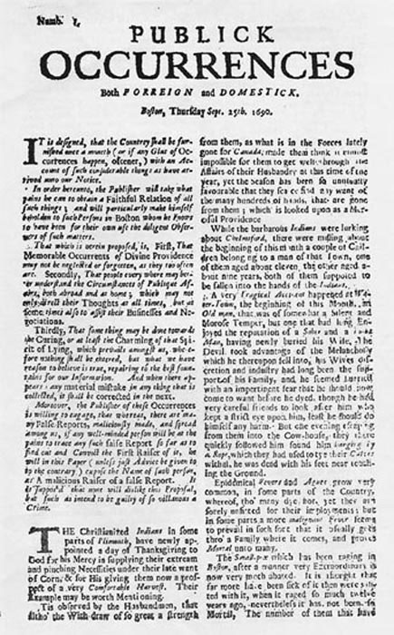
The Press: Beginnings
Harris noticed his clients were among the local elites. He thought a newspaper might attract their interest.
On Sept. 25, 1690, Harris published the first edition of Publick Occurrences, Both Forreign and Domestick.
This was the first American newspaper, fondly recalled for its long title and quirky spelling.

Slide 8
The Press: Beginnings
Like most newspapers of the time, it was 6 inches by 10 ¼ inches.
It was printed on three sides, with the fourth side blank so readers could add their own news before passing it on.
Newspapers were expensive, so often passed around at coffeehouses.

Slide 9
The Press: Beginnings
Was Harris’s newspaper really a newspaper, though? It was banned after the first issue.
Harris immediately got into trouble with authorities.
His article about the Colonial army and Indian raids could be construed as criticism of authorities.

Slide 10
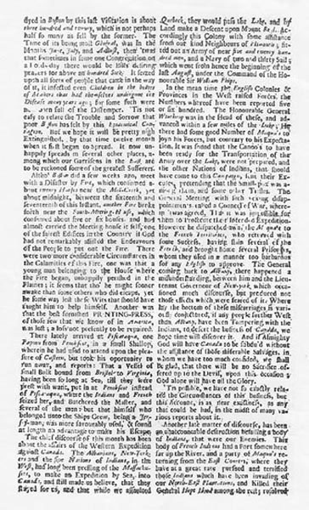
The Press: Beginnings
He also tried to spice up the paper by reporting that the French king had “taken immoral liberties” with the prince’s wife.
This was a bit too lurid for Puritan tastes.

Slide 11
The Press: Beginnings
Harris was forced out of business.
He finally returned to England, where he lived in obscurity peddling dubious medications.
Probably a century later his newspaper publishing approach would have been a lot more successful: a man before his time?

Slide 12
The Press: Beginnings
The next newspaper didn’t arrive until 14 years later, in 1704.
This was the first newspaper that lasted. It was published by a postmaster.
Early journalism in Europe and the Americas was connected to the mail service.
This was logical: mail was the only real way to disseminate information at this time.

Slide 13
The Press: Beginnings
In the Colonies, a postal system was set up in 1692. Before that, the Colonies were isolated from each other.
In 1700, John Campbell became Boston postmaster.
The Boston News-Letter, 1704, took no risks.
Material was borrowed from London press, much of it.
Campbell cleared all copy with colonial governor.

Slide 14
The Press: Beginnings
Typical dispatches:
Boston, April 18. Arrived Capt. Sill from Jamaica, about 4 weeks passage, say, they continue there very sickly.
Mr. Nathanial Oliver, a principal Merchant of this place, dyed April 15 & was decently inter’d.

Slide 15
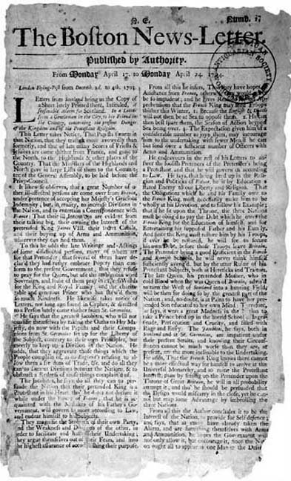
The Press: Beginnings
Campbell’s paper lasted until 1719 without competition.
That year Campbell lost his political appointment as postmaster, and his replacement started his own newspaper.

Slide 16
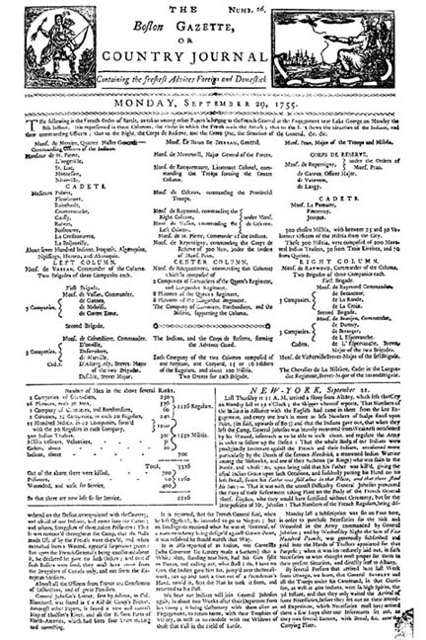
The Press: Beginnings
The new Boston Gazette was just as staid as the Boston News-Letter. But it was cheaper.
It was careful not to offend officials, as it was “published by authority,” as noted on the nameplate.
The government also gave newspaper subsidies and jobs.

Slide 17
The Press: Beginnings
“Published by authority” actually added credibility to newspapers at a time when it was hard for the editor to verify reliability of news printed.
But in 1721, a new newspaper broke the “safe” approach of not offending: the New England Courant.

Slide 18
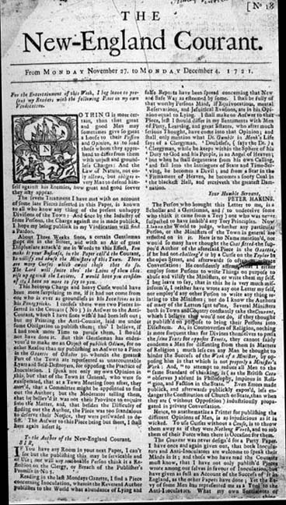
The Press: Beginnings
The New England Courant was published by Franklin—not Ben, but his older brother James.

Slide 19
The Press: Beginnings
James Franklin had published a semi-official postmaster’s paper. But when they took their business elsewhere, he decided to continue on his own.
The Courant lasted only five years—but in a spirit of rebellion.
It chose to pursue the then-radical idea of supplying readers what they wanted, not what authorities wanted them to read.

Slide 20
The Press: Beginnings
James Franklin pioneered the idea of the journalism crusade.
He hoped to provoke debate and change by providing more dramatic news.
His literary standard was high at a time when the Colonies didn’t see much decent literature.

Slide 21
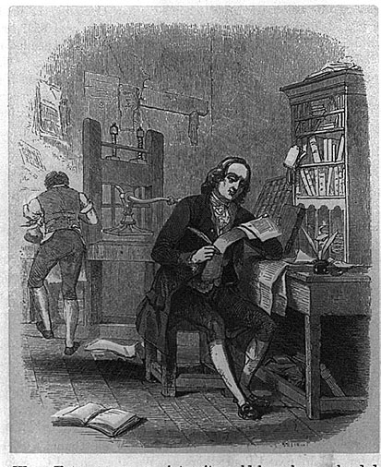
The Press: Beginnings
It was James who taught journalism to his later-famous brother, Benjamin.
Ben Franklin apprenticed with is brother as a young man.
As an apprentice of age 16, Ben wrote a number of essays for his brother’s newspaper. His pen name: “Silence Dogood.”
His essays matched the quality of British work at the time.

Slide 22
The Press: Beginnings
James Franklin refused to publish “by authority,” as previous editors had done.
He did not want authorities to check over his material before publication.
But he also faced pressure from church authorities in the strongly Puritan area of Boston.

Slide 23
The Press: Beginnings
In an incident that seems peculiar today, James Franklin attacked church leader Cotton Mather over an experimental smallpox vaccination.
Mather actually approved the vaccination, leading to James Franklin’s attack.
It would have been a lot happier for historians if Franklin had taken the right side. But never mind.

Slide 24
The Press: Beginnings
Cotton and his father, Increase Mather, defended themselves against James Franklin’s criticism.
But as public opinion was beginning to run against authoritarian techniques, sympathy went to Franklin.
But his next attack, this time against secular authorities, landed James in jail.

Slide 25
The Press: Beginnings
Franklin had suggested in 1722 that authorities did a poor job protecting the colonies against pirates.
The short jail time did nothing to damp his enthusiasm in attacks on authorities, however.

Slide 26
The Press: Beginnings
The court issued a decree prohibiting James Franklin from publishing.
James responded by making his brother Ben the publisher.
Ben’s stature increased, and so he decided to strike out on his own in Philadelphia.
James’s newspaper lost popularity, finally closed.

Slide 27
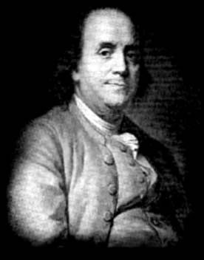
The Press: Beginnings
Philadelphia was second largest city in Colonies.
Ben Franklin arrived penniless. But he soon made a name for himself.

Slide 28
The Press: Beginnings
Franklin took over the Pennsylvania Gazette in 1729.
He was clever enough to print boldly, but just short of giving offense to authorities.
He observed in a phrase now famous:
“If all printers were determined not to print anything till they were sure it would offend nobody, there would be very little printed.”

Slide 29
The Press: Beginnings
Franklin overcame competition from the American Weekly Mercury.
By age 24 he was the owner of the Colonies’ best newspaper: best articles, biggest ad volume, largest circulation.

Slide 30
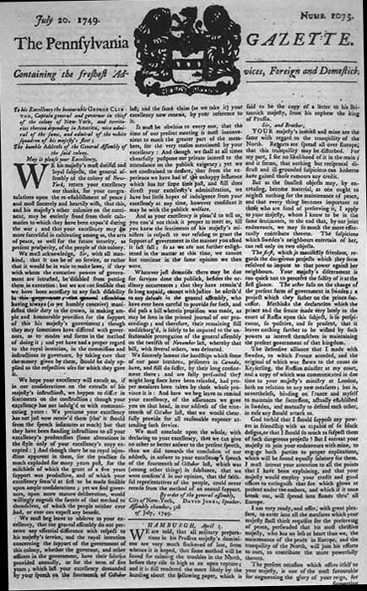
The Press: Beginnings
Ben Franklin made Colonial journalism respectable.
He was a writer and a printer, but also an engraver, an inventor, a scientist, a politician, a diplomat, an educator.
He also became the world’s most famous person, and quite a witty bon vivant. http://www.history.com/videos/meet-benjamin-franklin?cmpid=MRSS_Hulu_HIS#meet-benjamin-franklin

Slide 31
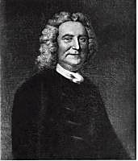
The Press: Beginnings
But Ben Franklin dealt with press laws as they existed then in the Colonies: there was no free press.
The John Peter Zenger case of 1734-35 was to test the power of these laws.

Slide 32
The Press: Beginnings
The Zenger case really wasn’t legally so significant. But in a Colonial spirit of growing revolutionary discontent, it was emotionally influential.
The historical background is complex, requiring knowledge of New York politics at the time.

Slide 33
The Press: Beginnings
Zenger was apprentice to a government-sponsored printer, William Bradford.
A group of wealthy merchants and landowners were demanding greater control over the colony’s affairs.
Zenger, a young recent immigrant from Germany, was asked to help out.

Slide 34
The Press: Beginnings
Zenger was encouraged to establish a new newspaper. His first issue of the New York Weekly Journal appeared Nov. 5, 1733.
Zenger’s powerful backers wrote anonymous pieces that immediately offended authorities, as they were called incompetent.
A year later Zenger was arrested on a charge of seditious libel.

Slide 35
The Press: Beginnings
Zenger’s trial began in 1735. His attorney, Alexander Hamilton, decided to take the case using a new defense.
Hamilton did not deny that Zenger had published the offending material.
Instead, he said it was not seditious.
He claimed the prosecution had to prove libel.

Slide 36
The Press: Beginnings
Hamilton agreed that the published statements were true.
He appealed to a jury to use their own consciences, and not rely on the judge.
He argued the case of liberty and free speech.
Zenger was declared innocent.

Slide 37
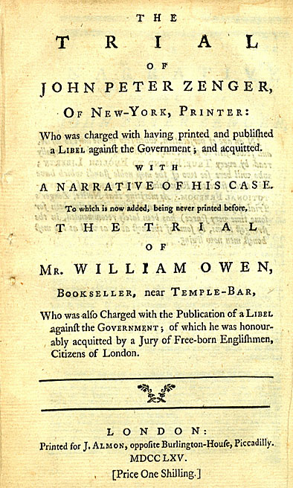
The Press: Beginnings
Though this trial had little legal effect, it inspired Colonial opposition to authority.
Truth as a defense did not reappear, however, until 50 years later.

Slide 38
The Press: Beginnings
In the 1730s, however, the judge had considerable precedent to say that truth was not a defense.
The court had established that truth made the seditious libel worse: “The greater the truth, the greater the libel.”
This was because criticism of authority could upset the community and disturb public peace and safety.
To keep the peace, seditious libel had to be stopped.

Slide 39
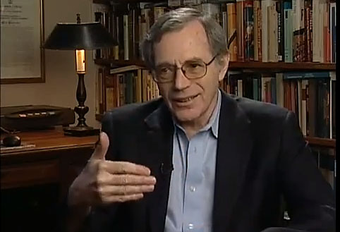
The Press: Beginnings
The Zenger trial established a contrary idea: that people have the right to criticize political leaders.
This was an idea later to inspire American rebels.
Here’s a short talk by historian Eric Foner. http://www.youtube.com/watch?v=LpXgyc8yDyA

