Slide 1
The Penny Press
Beginnings of mass media

Slide 2
Elite vs. masses
Mass media in the United States tended to separate into streams by the late 1800s.
On the one side, you had the sober press for a more elite audience, such as the New York Times.
On the other side, you had the press for the masses, such as the sensationalist New York World.
Sometimes this is called “high brow vs. low brow.”

Slide 3
Criticism
“Low brow,” sensationalist media were highly criticized then, as they are today.
But this material designed to attract high circulations was an invention of the Penny Press era of the 1830s.
Some journalists, however, say this more sensational material dates from even before.

Slide 4
Criticism
Some editors argued sensationalism was a way to draw new people into more serious news publications.
I’m not so sure about that. It’s hard to believe the National Enquirer today plays a role in encouraging interest in a Public Broadcasting news analysis….
Jazz journalism of the 1920s clearly was aimed toward profit, and not a more noble motive.

Slide 5
The neglected public
But before the 1830s “the masses” clearly were forming a neglected public among news purveyors.
The elite and political “party press” of the day aimed toward a small circulation of high-brow readers.
But technology and cultural change in the United States encouraged publishers to look beyond this audience.

Slide 6
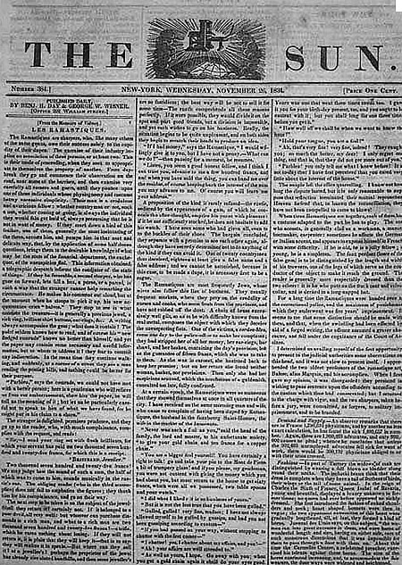
First Penny Press
On Sept. 3, 1833, a new era began for American journalism (and not much later for journalism in much of western Europe).
The New York Sun was launched by Benjamin H. Day.
Its motto: “It shines for ALL.”

Slide 7
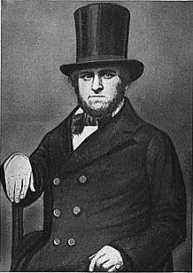
Benjamin Day
Day was a job printer, but not a very prosperous one.
He hoped to encourage business by starting the New York Sun.
Day proposed to sell the paper by the issue, instead of asking people to pay for costly subscriptions up front as was customary.
He charged one penny a copy.

Slide 8
New York Sun
In six months its circulation reached 8,000, nearly twice that of its closest rival.
Its pages were filled with crime news and trivial or sensational material, but it was very readable.
Stories included features about lost love, shocking accidents, foiled jailbreaks, etc.

Slide 9
Penny Press style
One particularly famous human interest feature described a “young gentlemen” who ran off with “a woman from the wrong side of the tracks,” involving treachery and incest, narrated in the flowery phrases of the era:
“And while our hero was unsuspiciously reposing on the soft bosom of his bride, a brother’s hand, impelled by a brother’s hate, was uplifted with fratricidal fierceness for destruction.”

Slide 10
Penny Press style
The writing style doesn’t match contemporary approaches. It was long, narrative, novel-like.
In fact, a lot of it may have actually been fiction. In the case above, names are never used, and as for time element, it was merely “recent.”
There’s nothing to indicate it couldn’t have been made up. “Tall stories” were a common feature of journalism in this era.
Press historian Paulette Kilmer has noted that in this era a story that began “It comes to us well documented…” really meant “Once upon a time….”

Slide 11
Advertising
Benjamin Day attracted plenty of advertising for his new paper—the entire back page, and a few more on the front page.
Papers like the Sun would lower standards to about any level to attract readers.
A sensational story which tripled circulation in 1835 was written by Richard Adams Locke, a descendent of John Locke.

Slide 12
Tall stories
Not quite up to the level of intellectual probity shown by his ancestor John, Richard Adams Locke’s story purported to describe life on the moon!
In a whole series of articles.
It was entertaining, even if the credibility of the Sun obviously suffered.
This approach has come down to us in some supermarket tabloids such as the World and News.

Slide 13
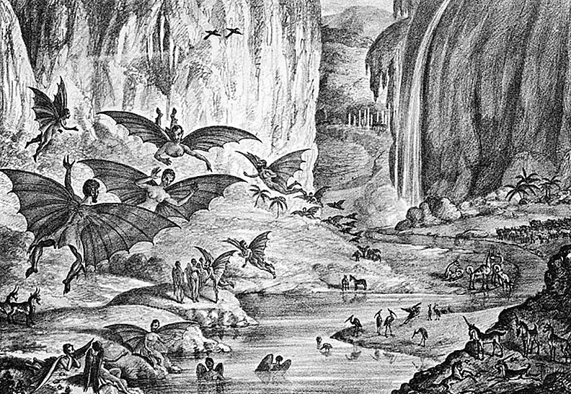
The moon hoax 1835
The engravings would be considered perhaps too lurid by today’s more conservative standards regarding nudity.

Slide 14
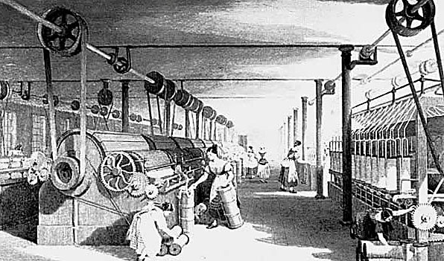
Rise of the common man
The approach of the Penny Press was successful apparently because it reflected the spirit of the age.
The Industrial Revolution saw the growth of more factory workers.
A class of laborers was beginning to be recognized as a separate profession.

Slide 15
Spirit of the age
Literacy was growing among common folk.
Presses could print more copies.
Paper was cheaper.
Transportation was easier.
Advertising was growing.

Slide 16
A new class of readers
The growing new class of newspaper readers was not so interested in arcane political opinions and discussions common in the Party Press.
They wanted “news, not views.”—Edwin Emery, journalism historian.
Penny Press news may have had a sensationalist slant. But it differed from opinion, the long polemical articles common in the press of the time.

Slide 17
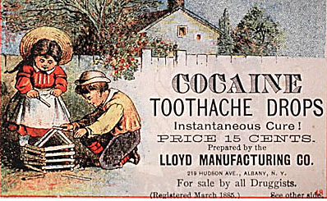
Advertisers
Early advertisers saw the relationship between advertising and circulation.
Penny Press circulations were larger, and cut across the political spectrum.
Party press circulations were small and spread more narrowly.
This ad dates from 1885.

Slide 18
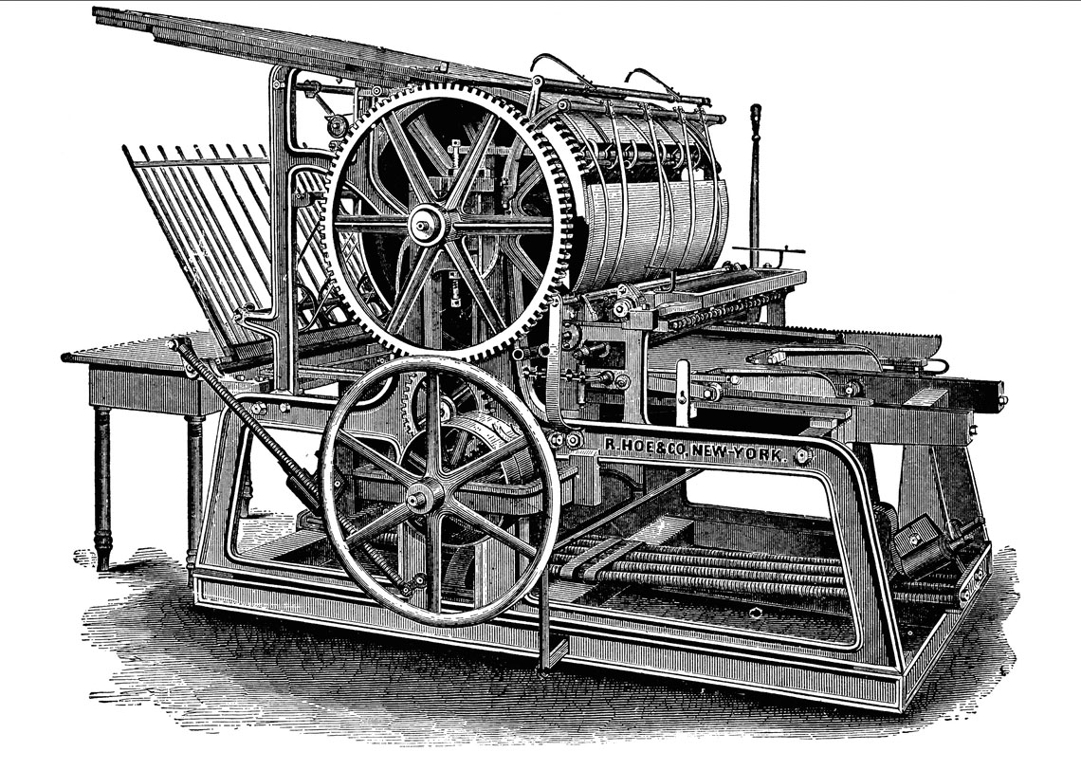
New presses
In 1837 the Sun was now under ownership of Day’s brother-in-law, Moses Y. Beach.
The newspaper bought a state-of-the-art Hoe cylinder press.
It could produce 4,000 papers an hour.
Not hundreds of thousands, as we saw later—but a lot for the time.

Slide 19
Street sales
A key to success of the Sun was to emphasize single-copy sales.
The encouraged the growth of street sales.
Vendor bought the newspapers at a discount, sold them for a penny each.
This gave incentive to street hawkers in large cities, particularly boys who could make a little money screaming out the headlines.

Slide 20
Design
Street sales required new design ideas—editors now had to compete with others to attract attention of passers-by.
The Penny Press style tried more lurid headlines, more attractive makeup, more readable text—at least more readable for the time.

Slide 21
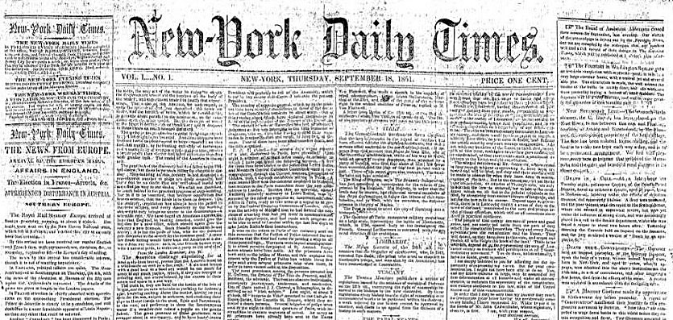
Partisan press losses
Those Party Press newspapers devoted to opinion and political issues began to see their popularity wane.
Non-partisan, news-based newspapers became the new standard for success.

Slide 22
Evolving ideals
Publisher could see growing interest in this new style of journalism.
While “objectivity” didn’t at the time exist in journalism, we did see the growth of an ideal emphasizing separation of news and opinion.
These papers might take up issues, but the difference was this: the newspapers generally were not politically partisan, or the views of one person, as they had been before.

Slide 23
News as a commodity
In fact, publishers could see that “news” might be marketed as a commodity, a product.
It could be gathered, manufactured, and sold like any other commodity.
One of those who became most successful using this new model was James Gordon Bennett.

Slide 24
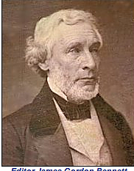
James Gordon Bennett
Bennett launched the New York Morning Herald in 1835.
It originally was a one-man operation like the Sun, emphasizing sensationalism.
Bennett, however, added new twists.
Crime reporting was heavily emphasized.

Slide 25
Robinson-Jewett case
Bennett’s Herald became famous for its 1836 crime story, the Robinson-Jewett murder case.
A well-known, rich New York celebrity was accused of murdering a prostitute in a brothel.
The perfect storm of sensationalism.

Slide 26
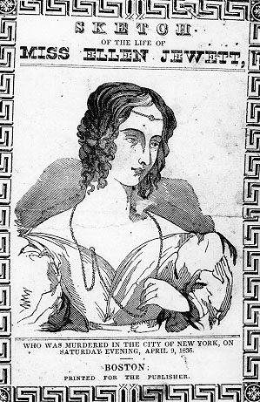
Robinson-Jewett case
The Herald devoted entire front pages to the case, in 6- or 7-point dense type.
Apparently “the masses” had a greater attention span than we do today.
A characteristic phrase: “We give the additional testimony up to the latest hour...The mystery of the bloody drama increase—increases—increases.” (June, 4, 1836).

Slide 27
Price increase
The Herald in 1836 raised its price to two cents.
Bennett argued his readers could get more for their money than anywhere else.
He also developed a financial section, and more serious editorials.
He even offered some sports news, long before other editors saw a need.

Slide 28
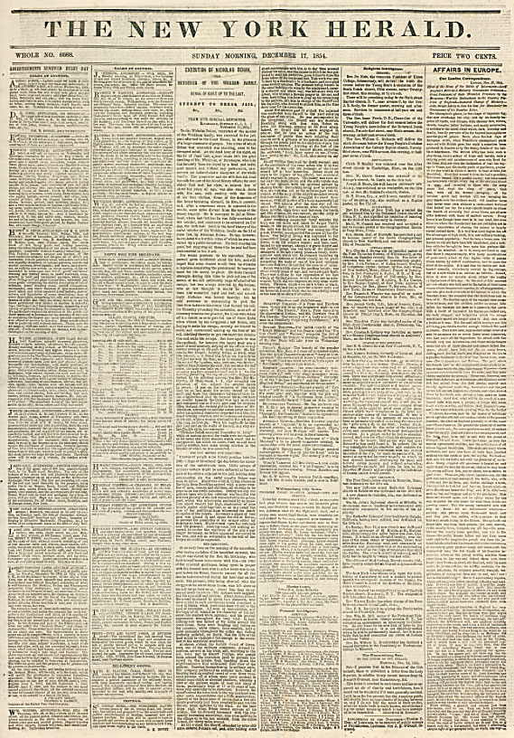
World’s largest
Bennett’s work as a journalism innovator drove the Herald to establishing the world’s largest circulation by 1860, 77,000.
His competitors and morally conservative crusaders disliked the Herald, and urged a boycott, but that effort failed.

Slide 29
Penny Press elsewhere
The concept was tried in other major U.S. cities, but worked best in New York.
The more outrageous sensationalism wasn’t as well accepted outside of New York.

Slide 30
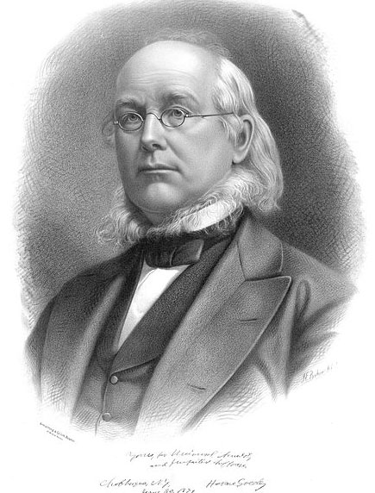
Horace Greeley
Greeley became the century’s most famous editor.
He established the New York Tribune in 1841.
He is best known for his ideas that seemed revolutionary for the time.

Slide 31
Greeley’s ideas
Greeley’s ideals so revolutionary at the time included these:
Women should be paid the same as men for equal work.
Labor should be organized for its protection.
Slavery should be abolished.
Capitalism should be directed as a force for improvement of society.

Slide 32
Greeley’s start
Greeley was self-taught, as were so many editors and other well-known people of his day.
He began work at age 15 as a printer’s apprentice, and read voraciously.
He tried publishing a variety of obscure newspapers before launching the New York Tribune in 1841 as a Penny paper.

Slide 33
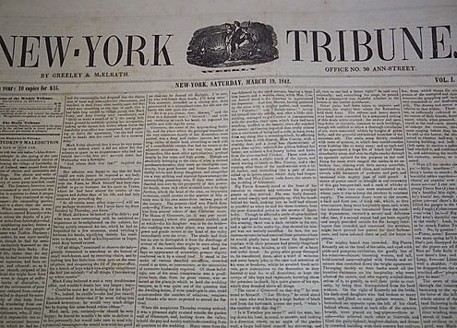
New York Tribune
The Tribune gained a circulation of 11,000, at the time considered respectable, though not nearly the circulation of the Sun.
But he was unable to make a profit, so raised his price to 2 cents.

Slide 34
Tribune weekly
What made Greeley successful, however, was his weekly edition.
It was priced at $2 a year, or $1 if “clubs” of 20 or more subscribed.
It had a huge influence outside New York, particularly in the Midwest.
Often, next to the Bible, it was the only thing pioneers read regularly.

Slide 35
Tribune debates
Greeley offered his paged for discussions of all sorts of radical ideas in the time, and was criticized for it.
People around the nation learned of these issues from Greeley’s Tribune.
Unlike the other big New York newspapers, the Tribune reached people west of Washington, D.C.

Slide 36
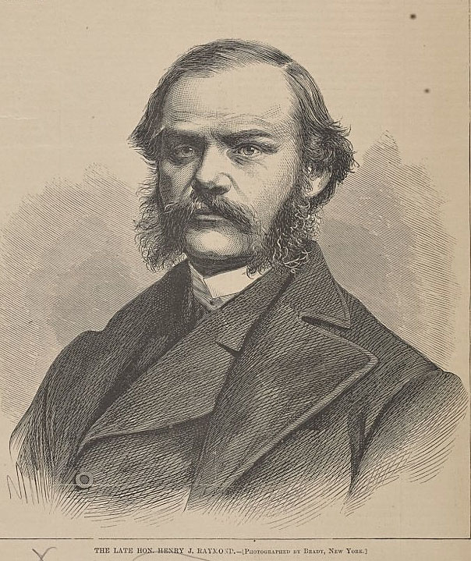
Tribune influence
Greeley was a promoter of culture and stimulating ideas, and so influenced other important publishers, such as Henry J. Raymond.
Raymond, founder of the New York Times, worked under Greeley.

Slide 37
Greeley’s Tribune
Greeley did not use sensationalsim, yet still attracted a fairly large audience.
As time went on, the Sun and Herald toned down their own sensationalism. In doing so, they became less a “mass media.”
Those who had an appetite for sensationalism were left without a newspaper until Pulitzer and Hearst in the 1890s reinvented it.

Slide 38
Henry J. Raymond
The founder of the New York Times also was not interested in sensationalism.
Raymond quit the Tribune because he didn’t get along with Greeley, worked for other newspapers before founding the Times.
In 1851 Raymond and a colleague, George Jones, launched the Times as a penny newspaper—but without sensationalism.

Slide 39
Times and foreign news
Raymond was particularly interested in foreign news.
His newspaper quickly established a reputation for reason and careful reporting.
He did, however, criticize Greeley, particularly his political views.

Slide 40
Deterioration of Times
Raymond died young, in 1869, and the Times fell victim to the Yellow Journalism battles of the 1890s.
By 1897 the Times and sunk to a low of only 9,000 paid circulation. Its future seemed dim.

Slide 41
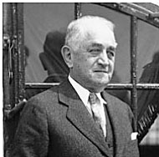
Adolph Ochs
Adolph Ochs, a Tennesee publisher, bought and revived the Times.
He reset the paper as a contrast to the sensationalism of the time, emphasizing solid , fact-based news coverage.
By the 1920s circulation had increased to 780,000.

Slide 42
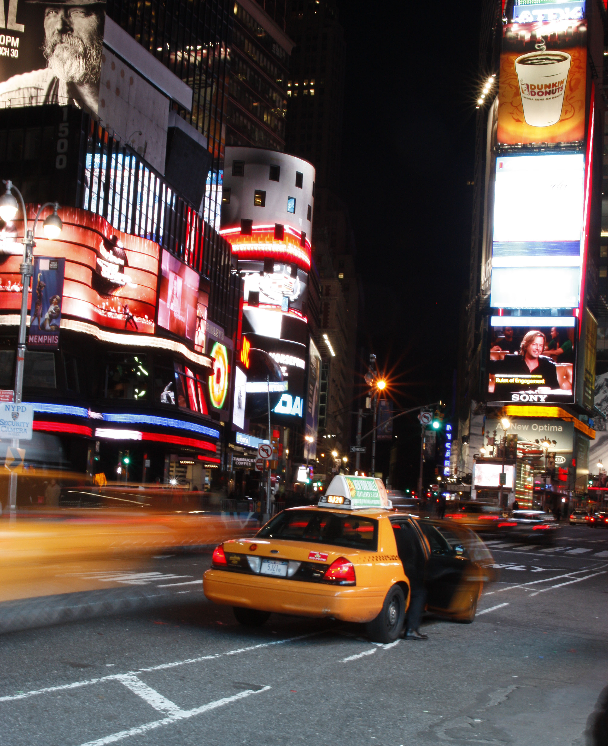
Times Square
When Ochs moved the operation to Longacre Square in Manhattan in 1904, the area soon became known as Times Square.
The newspaper is no longer there, but the name has become famous.

Slide 43
Great change
The decades before the U.S. Civil War was a time of great change for American journalism.
It was the beginning of the idea that the press could truly be a “mass medium.”
We truly have extended that today, it seems, as the Internet has become the “mass medium.”
Do we see some influence from the beginnings of mass media in our concept of journalism today?

