Slide 1
The muckraking era
Yellow journalism, Progressivism and digging the dirt.

Slide 2
The muckraking era
The Industrial Revolution in the United States and Europe had produced immense change—and great upheaval.
Uncontrolled capitalist expansion created powerful tycoons and enormous poverty.
Workers who helped to create wealth toiled long hours in dangerous conditions for little pay.
In the early 20th century, two-thirds of U.S. workers made less than $600 a year—poverty line at that time.

Slide 3
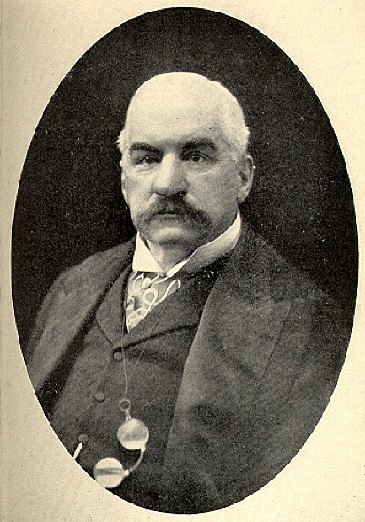
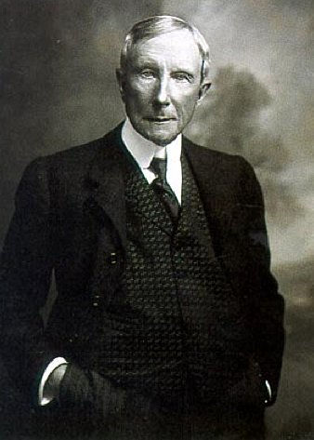
The muckraking era
Manufacturers combined into huge trusts to control wages and prices.
The entire nation’s wealth fell into two groups: the Morgan group and the Rockefeller group.
Labor unions, socialists and others grew to battle the abuses of capitalism. The media joined the fight.

Slide 4
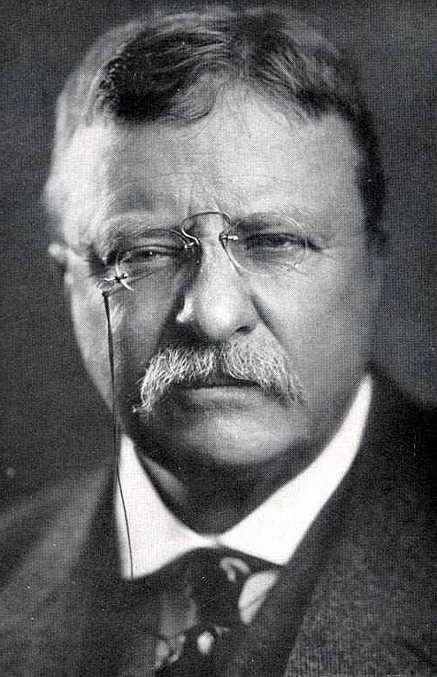
The muckraking era
President Theodore Roosevelt was known for his battle against huge concentrations of corporate wealth. http://www.youtube.com/watch?v=ch5XlY4nKJI&feature=related
U.S. Government organizations such as the Federal Reserve Board, Federal Trade Commission, and Food and Drug Administration were created to battle abuses.
It was an uphill battle; many conservative politicians were financially supported by big business.

Slide 5
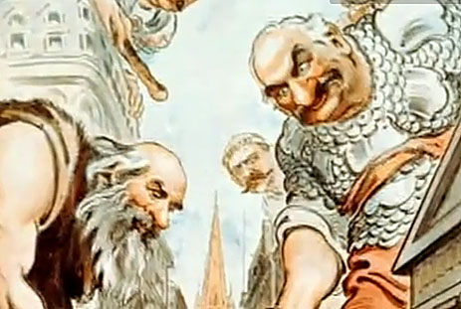
J.P. Morgan
The perception that corporate tycoon J.P. Morgan was becoming more powerful than the federal government itself led to calls for greater regulation of banking. http://www.youtube.com/watch?v=IhoeurGDnG0

Slide 6
The muckraking era
The press was in a crusading mood.
The battle was for the little guy—the “masses” that formed the base of subscribers for many large-circulation newspapers.
It was a battle against corruption, abuse, false advertising, and for a more fair distribution of wealth, a better deal for farmers, a decent wage and work week, and the end of child labor.

Slide 7
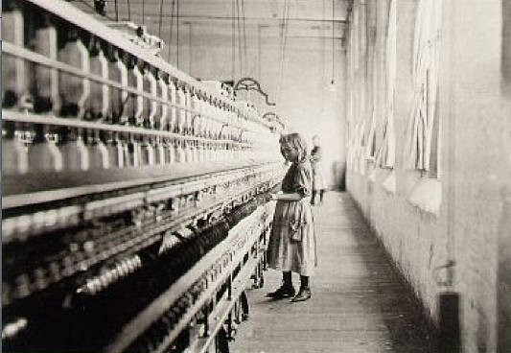
The muckraking era
Photography was a powerful part of the fight against abuse.
Lewis Hine was one of those whose photos of child labor shocked Americans. http://www.youtube.com/watch?v=bFH6fpxzTBU (Turn off sound.)

Slide 8
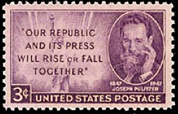
The muckraking era
One crusading newspaper was the New York World, and publisher Joseph Pulitzer.
Pulitzer supported socialist William Jennings Bryan for president.
He opposed the power of tycoons, particularly J.P. Morgan.

Slide 9
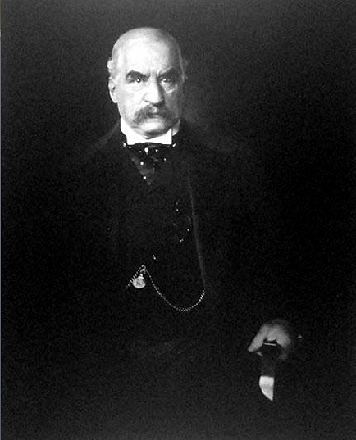
The muckraking era
Morgan was a financial and industrial tycoon who defined wealth and arrogance of the “Gilded Age,” around 1900, as seems to be reflected in the famous photo by Edward Steichen.

Slide 10
The muckraking era
In 1904 Joseph Pulitzer, who was in fragile health, named as his editing successor Frank J. Cobb, 35. But he had a great rival.
The New York Journal, under William Randolph Hearst, also purported to be the voice of populism, that is, the voice of the common person.

Slide 11
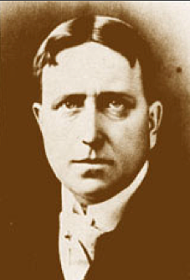
The muckraking era
Hearst favored greater change than Pulitzer.
He believed the public ought to own major industries such as railroads, coal mines and telegraph lines.
He strongly supported labor unions, schools, and an income tax.

Slide 12
The muckraking era
Hearst’s incessant attacks on conservatives backfired. The Journal wrote of Republican President William McKinley, “if bad institutions and bad men can be got rid of by killing, than killing must be done.”
Four months later McKinley was assassinated (1901).
The Journal could not overcome the stigma, eventually changed its name to the Morning American.

Slide 13
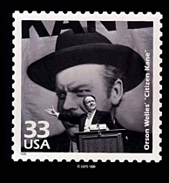
The muckraking era
Both Hearst and Pulitzer featured sensationalism in their newspapers. Pulitzer explained his was only to attract the masses to the important news.
Hearst, on the other hand, was himself a flamboyant character, portrayed by Orson Welles in the famous film “Citizen Kane.” [http://www.youtube.com/watch?v=tzhb3U2cONs]
While Pulitzer was honored by a postage stamp, Hearst never has been. His character in “Citizen Kane” was, however, as part of the 1999 “Celebrate the Century” series.

Slide 14
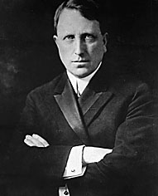
The publishing tycoon
We remember Hearst on the same pantheon as the tycoons of the Gilded Age (late 19th-early 20th century), along with J.P. Morgan, Rockefeller or Carnegie. He reigned when newspaper journalism ruled the world of media. http://www.youtube.com/watch?v=otzmmr8iidI&playnext=1&list=PLZ2BGHNTKJI7Se0Fqq5Ijut2WW4iJmJXM&feature=results_main

Slide 15
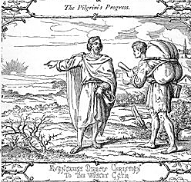
The muckraking era
E.W. Scripps newspapers also became famous for crusading journalism.
But mostly the muckrakers were part of magazines.
Theodore Roosevelt coined the term, based on a character with a muckrake in Pilgrim’s Progress.

Slide 16
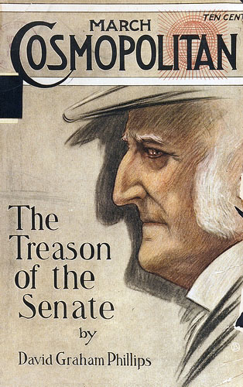
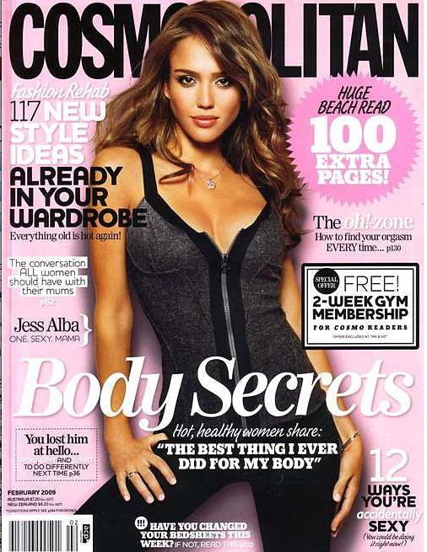
The muckraking era
Muckrakers worked to expose corruption and graft at the turn of the last century.
Large-circulation magazines such as McClure’s, Cosmopolitan and Munsey’s became known for these exposés. Boy, has Cosmo changed over the decades.

Slide 17
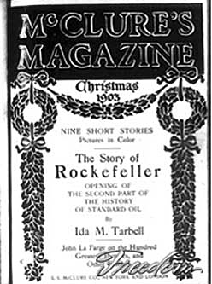
The muckraking era
Magazines during this age circulated in the hundreds of thousands, around the country, the only truly national journalism.
S.S. McClure published some of the most important muckrakers: Ida Tarbell, Ray Stannard Baker and Lincoln Steffens.

Slide 18
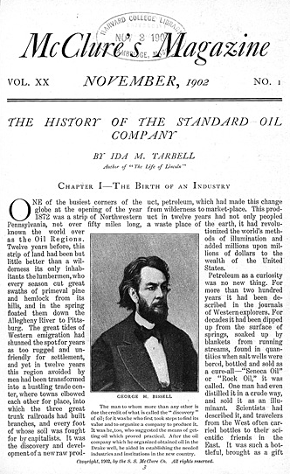
The muckraking era
Tarbell exposed the corruption and abuses of Rockefeller’s Standard Oil Co. in a series of articles.
Steffens attacked corrupt state and city governments.
Baker considered racism and problems of the working class.

Slide 19
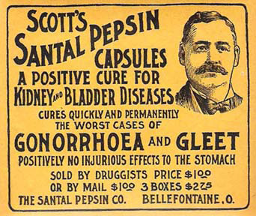
The muckraking era
Cosmopolitan, a Hearst magazine, exposed U.S. Senate abuses and International Harvester Co. corruption.
Collier’s exposed the lies of patent medicine advertisers.
Ladies’ Home Journal joined Collier’s, showing the medicines were useless, or contained alcohol, morphine, or cocaine.

Slide 20
The muckraking era
Patent medicine claims became subject to a political debate between those critical of their claims, and those upholding usefulness of the medicines.
Nevertheless, in 1906 the Pure Food and Drug Act limited claims.
In 1912 the federal Newspaper Publishing Act required any publication sent through the mail to clearly separate advertising from editorial content using the word “advertisement.”

Slide 21
The muckraking era
Muckraking diminished after the first decade of the 1900s.
Partially it is claimed publishers were hounded into silence by threats from tycoons like Morgan and Rockefeller; partially some abuses had been addressed.
The era may have been one response to the newspaper abuses of the decade before that: the Yellow Journalism Era.

Slide 22
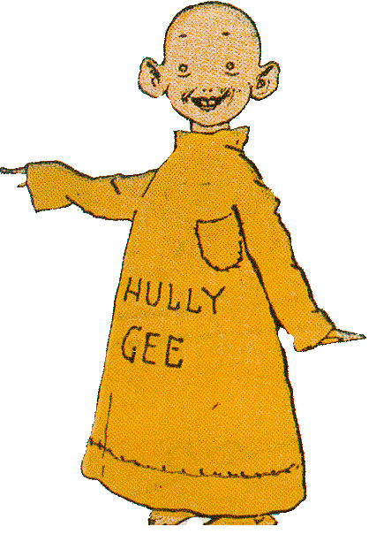
Yellow journalism
It is surprising to see a social consciousness appear in journalism so soon after the abuses of the yellow journalism era.
The era was apparently named after a famous cartoon of the time, the “Yellow Kid.”

Slide 23
Yellow journalism
The most famous newspaper publishers of yellow journalism were Pulitzer, and his rival, Hearst.
The most famous story was the Spanish-American War of 1898.
Cuba rebelled against Spanish rule in 1895.
The Spanish resisted.

Slide 24
Yellow journalism
These major newspapers thoroughly sensationalized the story.
Spanish military rule led to repressive measures, angering the United States.
Sensationalized stories printed details of Spanish torture, supposedly collecting ears of victims as trophies, but few substantiated reports.

Slide 25
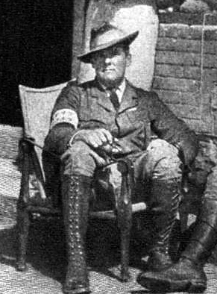
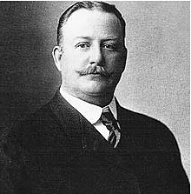
Yellow journalism
Pulitzer’s World sensationalized first.
Hearst’s Journal leaped in to compete.
Hearst hired famous reporter Richard Harding Davis and famous artist Frederic Remington to go to Cuba.

Slide 26
Yellow journalism
Legend calls this “Hearst’s war” based on a story involving Remington. Supposedly the artist called Hearst to say nothing was going on.
Hearst replied, “Please remain. You furnish the pictures, I’ll furnish the war.”
While this seemed in character for Hearst, careful historical research shows no evidence it ever happened.

Slide 27
Yellow journalism
Hearst’s motto was “While others talk, the Journal acts.”
The problem was finding something to act on.
The case of “the most beautiful girl in all of Cuba” gave the newspaper its cause.

Slide 28
Yellow journalism
Evangelina Cisneros was accused of attempted murder of a Spanish officer, sentenced to 20 years.
The Journal took up her case of supposed injustice.
The World, on the other hand, declared the Journal had greatly exaggerated.
In return, the Journal accused the World of being unpatriotic.

Slide 29
Yellow journalism
Who would help the poor woman?
The Journal would!
A Journal reporter actually succeeded in freeing Cisneros from a Cuban jail, and smuggling her to New York.

Slide 30
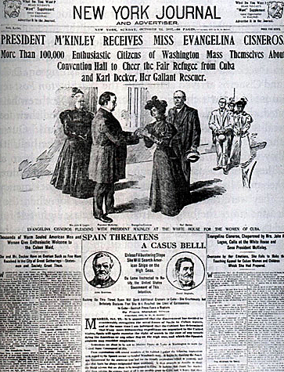
Yellow journalism
President McKinley found it necessary by force of public opinion to greet Cisneros at the White House.

Slide 31
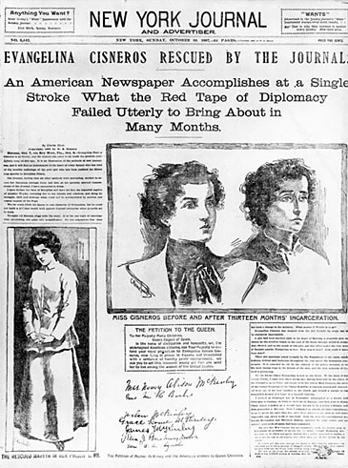
Yellow journalism
The Journal exploited the story to the level of 375 column inches. The New York Times, 10 col in; 12½ for the World.

Slide 32
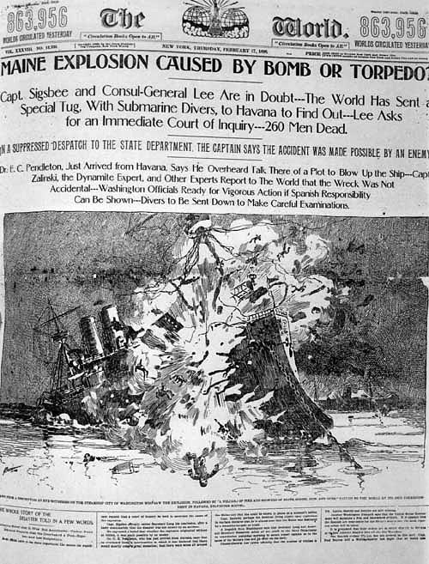
Yellow journalism
War still did not look likely…until the sinking of the USS Maine in Havana Harbor.
The U.S. battleship exploded, killing 266 Americans. Who was responsible?

Slide 33
Yellow journalism
The Journal suggested it was the Spanish.
Both World and Journal thoroughly sensationalized coverage.
Both sent reporters to Cuba to conduct private investigations.

Slide 34
Yellow journalism
The newspapers became annoyed when United States and Spanish authorities decided to conduct their own official investigation.
Fault was never found. No matter. Only one day after the explosion, the Journal’s headline read:
The Whole Country Thrills with War Fever

Slide 35
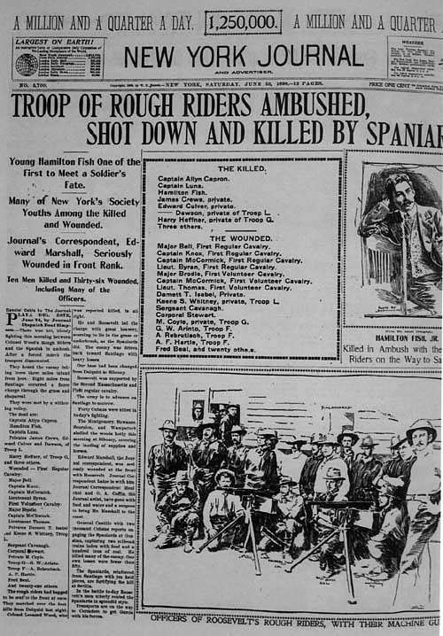
Yellow journalism
Gradually other newspapers swung to a pro-war stance against Spain.
Finally, the U.S. Government declared war.
Some 500 journalists flocked to Florida.

Slide 36
Yellow journalism
Hearst himself joined his staff of 20, revolver at his side.
As a battle ended, Hearst leaped off his yacht to capture a band of Spanish sailors huddled on the beach.
Did the newspapers persuade the United States to go to war? Was this a“newspaper war?”
Research says no: President McKinley did not pay attention to the sensational press.

Slide 37
Yellow journalism
By 1900, about one-third of U.S. dailies used the yellow journalism style.
It subsided within a decade, but the color, the photos, the big headlines stayed to become a newspaper standard.
Two years after the Spanish-American war, Pulitzer dropped the sensationalist style in his World, fearing it was eroding public confidence in newspapers.
Both the World and Journal continued to champion the “common man,” however.

Slide 38
Yellow journalism
Jazz journalism in the 1920s saw the style reborn in tabloid form.
Standard news values today, such as prominence, conflict, human interest—all were created during the Yellow Journalism era.
The idea of “big story” today also traces back to this era.

Slide 39
Yellow journalism
But what news sources today champion the voice of the “common man?”
And why did the country “thrill” to follow a minor war in a little country of small importance to the United States? To find the answer, we’ll have to look back to journalism of the nineteenth century.

