Slide 1
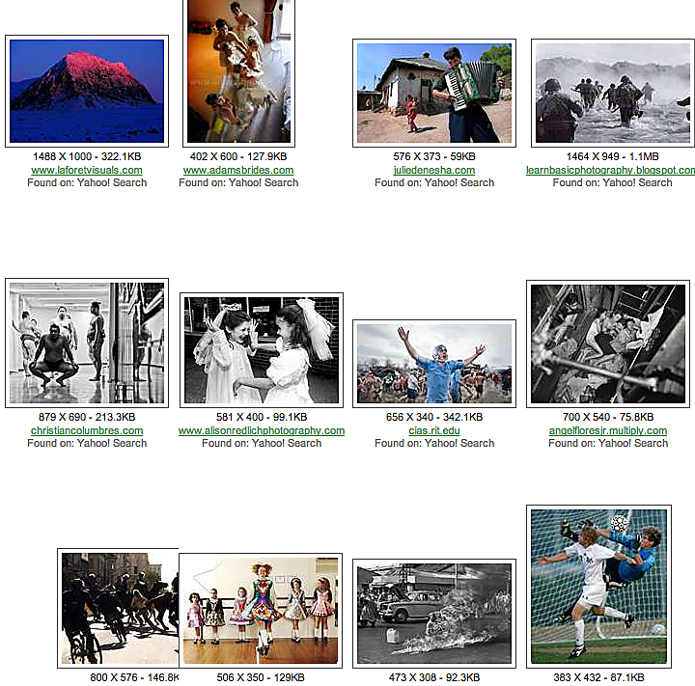
Modern photojournalism
The twentieth century

Slide 2
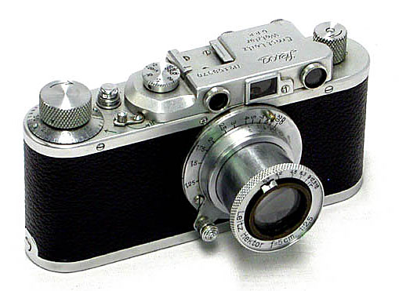
Modern photojournalism
The birth of modern photojournalism took place in 1925, in Germany.
The event was the invention of the 35 mm camera, the Leica.
Photographers no longer needed bulky equipment.

Slide 3
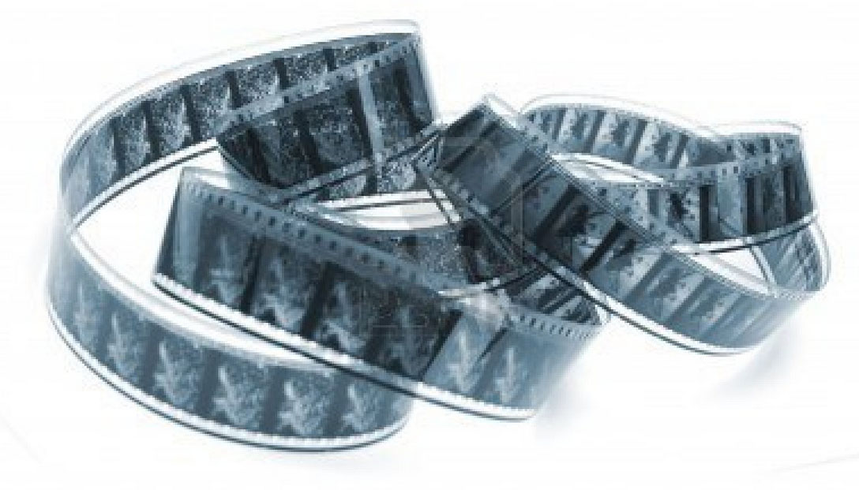
Modern photojournalism
The camera actually was made to use leftover movie film.
Candid photography became easier. You could be unobtrusive, tell a story as it really happened.

Slide 4
Modern photojournalism
About this time also in Germany the concept of photojournalism was born.
Photojournalism, a term coined later by journalism historian Frank Luther Mott, meant telling a story through photos.

Slide 5
Modern photojournalism
Photos could be published beginning in the 1890s.
But they were isolated illustrations.
They were laid out as in a photo album, all the same size, placed next to each other.

Slide 6
Modern photojournalism
In Germany new magazines tried a collaboration of journalism and photos.
Photographers would shoot many photos, facilitated by the 35 mm camera.
Editors working from contact sheets would choose images to tell a story.

Slide 7
Modern photojournalism
Cutlines, or captions, would explain significance of photos.
Photos would be laid onto pages to tell the story visually: a large, theme-setting photo, details, faces, and activities.
Copy was limited.

Slide 8
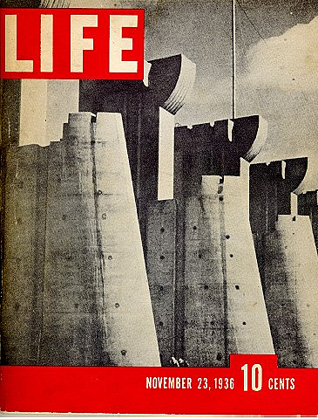
Modern photojournalism
Hitler’s rise in 1933 served to suppress and harass many of these editors. Some fled to the United States.
But the most famous photojournalism magazine was started by an American, Henry Luce. It was called Life.

Slide 9
Modern photojournalism
Henry Luce also created Time and Fortune.
The first issue of Life was launched in the teeth of the Great Depression, Nov. 23, 1936.
It featured the building of the Ford Peck Dam in Montana.
Photos by Margaret Bourke-White.

Slide 10
Modern photojournalism
The photos pictured the shanty town sprung up by the dam, and a way of frontier life Americans thought had vanished.
Life immediately became popular, and emulated by many others, including Look, Picture, See, and Click.

Slide 11
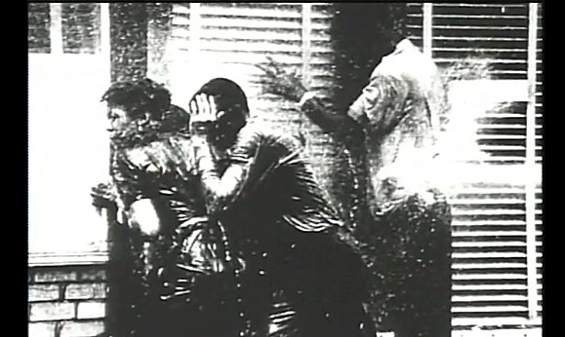
Modern photojournalism
By World War II, Life was the most influential photojournalism magazine in the world.
The most dramatic photos of that war came not from newspaper photographers, but from Life. http://www.youtube.com/watch?v=qEXFBPUZYPE

Slide 12
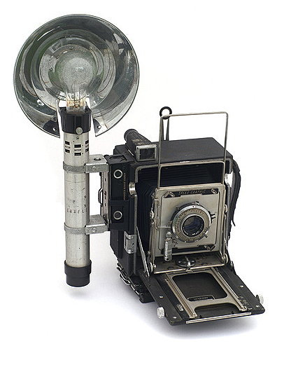
Modern photojournalism
Not all photographers at that time used 35 mm. Many newspaper photographers used the Speed Graphic, or Crown Graphic, large-format cameras with a big box and a bellows.

Slide 13
Modern photojournalism
The 120 format, normally a Rolleiflex, became popular in the 1950s.
By the 1960s 35 mm was standard, as it is today, now actually a digital format.

Slide 14
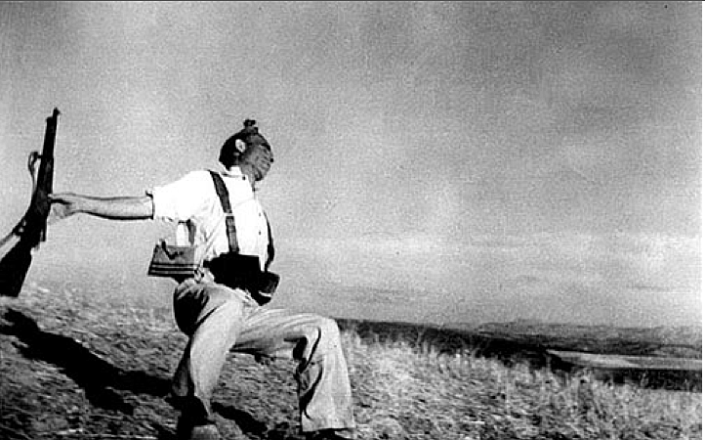
Modern photojournalism
Two of the most famous World War II photographers: Robert Capa and W. Eugene Smith.
Capa became well known for his gritty, close-up battlefield scenes. [http://www.youtube.com/watch?v=S4qO7fquMyM]

Slide 15
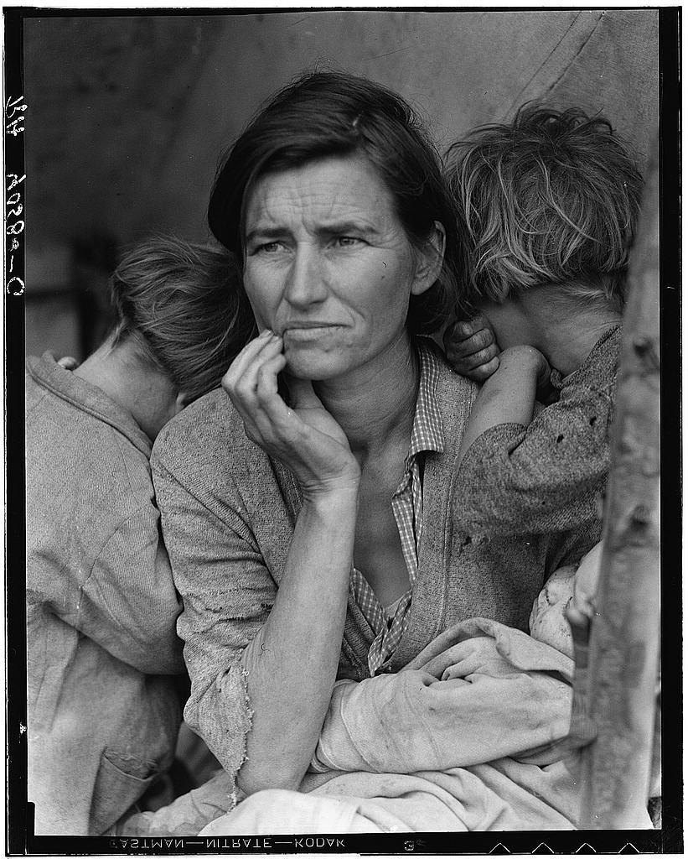
Modern photojournalism
In the 1930s, the Farm Security Administration hired photographers to document the plight of Midwestern farmers.
Dorothea Lange’s “Migrant Mother” was part of this program.

Slide 16
Modern photojournalism
The 150,000 FSA images are available through the Library of Congress.
They are available for download: http://memory.loc.gov/ammem/fsahtml/fahome.html

Slide 17
Modern photojournalism
The pinnacle of photojournalism seemed to extend from 1935 to about 1975.
Life magazine went out of business in 1972. It came back in 1978 as a monthly, then disappeared. Its logo is still featured on special issues.
TV helped accelerate the demise of photojournalism magazines.
Life still lives online.

Slide 18
Modern photojournalism
Photojournalism was usually published in black and white until the 1980s.
Color photography meant photojournalists needed to be more careful about lighting and color balance.
The candid photos of the past became more and more carefully lit and staged.

Slide 19
Modern photojournalism
Photojournalism became more and more a design tool.
Digital photography replaced most film-based technology by 2000.
The Web became common platform for photojournalism.
Photojournalists were expected to shoot both still and video for websites.

Slide 20
Modern photojournalism.
A controversy regarding today’s digital photojournalism is the criticism that it does not have the credibility of past photos.
It’s to easy to fake a photo.
Some websites explore this in detail, by asking people to guess: real or fake? http://www.pbs.org/wgbh/nova/sciencenow/0301/03-fakeorreal.html

Slide 21
Modern photojournalism
Web-based photojournalism tells a story in a way dramatically different from that of the old photo magazines.
Multimedia presentations aim to include photos with videos and graphics. http://www.poyi.org/65/37/index.php
But are these more powerful than the published still images of the past? http://www.youtube.com/watch?v=XONXeUndHl8

