Slide 1
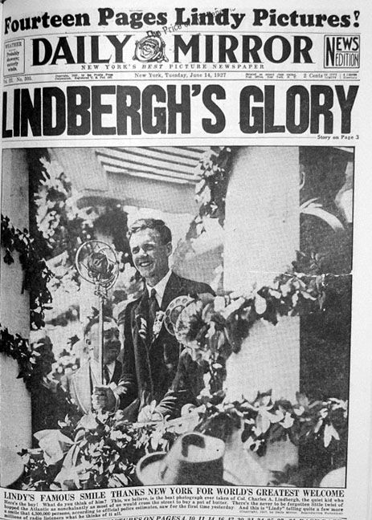
Jazz journalism
And the rise of objectivity.

Slide 2
Objectivity
The word “objectivity” as applied to journalism was not generally known at the beginning of the 20th century.
By the 1930s it was a common concept.
This is in contrast to the sensationalism of the era—or perhaps in response to it, and against the widespread propaganda of World War I.

Slide 3
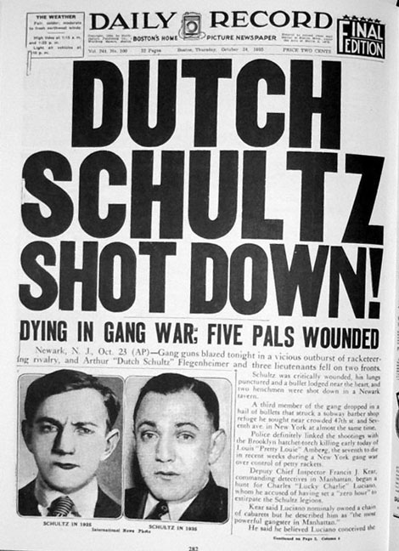
Jazz journalism
The rise of sensationalist “tabloid journalism” dates from this era, the 1920s.
It was a time of radio, movies, gangsters, Prohibition, celebrities, sensationalism, and enormous growth of mass media.

Slide 4
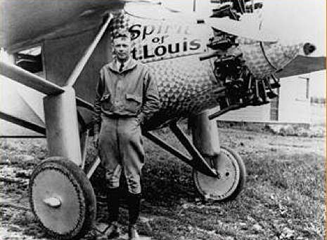
Jazz journalism
Celebrities became great successes through the reach of radio, and attention of mass circulation press.
Charles Lindbergh, the first person to fly across the Atlantic, in 1927 became an enormous celebrity.

Slide 5
Jazz journalism
Tech advancements in photography and printing allowed more photos, larger photos, candid photos and, beginning in 1927, movies with sound.
The first movie with sound, “The Jazz Singer,” seems astoundingly dated today. [http://www.youtube.com/watch?v=bkyvstNrkHo]
But sound improved, and actors from the silent era who couldn’t make the transition found themselves to be out of style and out of work.

Slide 6
Jazz journalism
The tabloid press excelled in sensational headlines:
“He Beat Me—I Love Him.”
“I Know Who Killed My Brother.”
“For 36 Hours I Lived Another Woman’s Love Life.”
Sex, celebrity, murder scandal, all staples of the jazz journalism age.

Slide 7
Jazz journalism
The New York Daily Graphic was the symbol of “gutter journalism,” as it was nicknamed.
The Graphic editor in 1925, Emile Gauvreau, found coverage of the Kip Rhinelander trial particularly lurid, and so interesting.
The rich socialite Rhinelander charged in court that his wife of a few months was actually black. This was grounds for divorce at the time.

Slide 8
Jazz journalism
Mrs. Rhinelander partially disrobed in front of the jury to prove she was not black.
The Graphic, obviously, was barred from photographing such a thing.
But no matter: Gauvreau set up a bare-backed woman between several male reporters, photographed it, pasted photos of court participants on reporters’ faces, and called the sensational result a “composograph.”

Slide 9
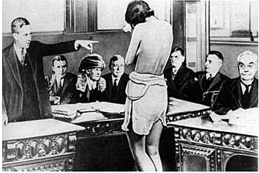
Jazz journalism
The result fooled many, as the disclaimer “composograph” was in small print.
In fact, Mrs. Rheinlander won the case, but did agree to a divorce four years later. (http://mulattodiaries.wordpress.com/2010/03/19/alice-disrobed/)

Slide 10
Jazz journalism
We should not exaggerate the extent of this kind of lurid sensationalism, however.
It was mostly based in New York.
And after 1930s, and the Great Depression, it diminished.

Slide 11
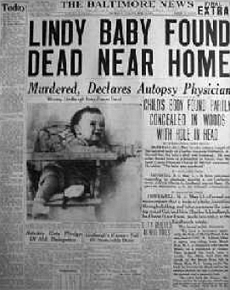
Jazz journalism
The idea of the “big story,” also beginning in the 1920s, did not die out, however.
The idea that journalism should cover a “big story” with hundreds of journalists and miles of newsprint expanded in the 1930s. The big story usually involved crime and celebrities.
In 1934 Bruno Hauptmann was tried for the kidnap and murder of the Charles Lindbergh baby. The trial drew 300 reporters, who wired 11 million words in 28 days.

Slide 12
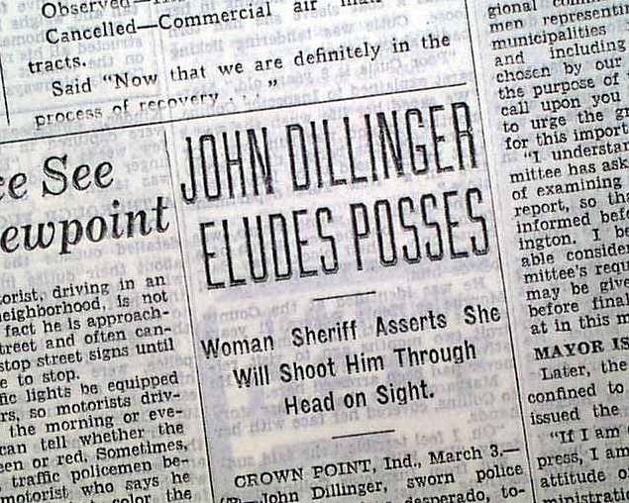
Jazz journalism
Other big stories of the 1930s involved the birth of the Dionne Quintuplets and the hunt for gangster John Dillinger.
Prohibition led to creation of gangsters and the Mafia that provided sensational copy.

Slide 13
Jazz journalism/objectivity
At the same time, more reputable voices were advocating more objectivity, and more interpretation in journalism.
Many people after World War I’s propaganda campaigns despaired that the growth of reason in society had taken a setback, and emotion ruled people’s lives.
The senseless death of 27 million in that war seemed to prove emotional appeals and propaganda could triumph over reason.

Slide 14
Objectivity
Public relations became widespread. Journalists did not know how to trust facts, which facts to trust.
The traditional belief that governments and universities should not engage in public relations was changing. Governments such as the United States had undertaken huge propaganda campaigns for World War I.

Slide 15
Objectivity
Before World War I Congress by law was forbidden to hire public relations staff.
Even as late as the 1950s Minnesota was among many states forbidding universities to use tax money for public relations purposes.
The seeming power of propaganda over reason seemed to be creating a new irrational world.

Slide 16
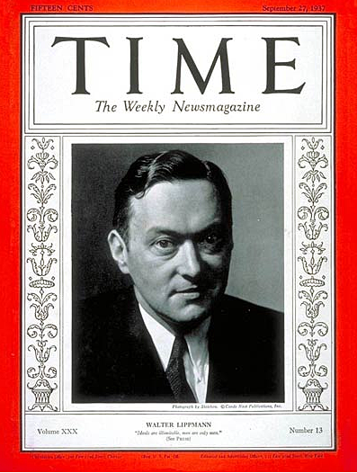
Objectivity
Walter Lippmann, in particular, worried of the growth of propaganda, emotional appeals and irrationalism.
He argued for greater standards of objectivity.
Lippmann also wanted to see more interpretative reporting, journalism for people who needed to know “why.”

Slide 17
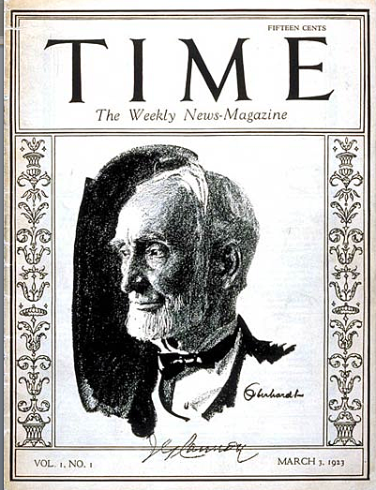
Objectivity
Time magazine was founded in 1923 to condense and interpret news for busy people.
It was successful as it reflected the age: people were more in a hurry, needed more interpretation.

Slide 18
Objectivity
Time, however, was clearly opinionated: founder Henry Luce did not believe the facts would speak for themselves.
Luce (who founded Time with Briton Hadder) did not believe objectivity was possible, said those who did were deceiving themselves.

Slide 19
Objectivity
But not all journalists agreed with Luce’s emphasis on interpretation over objectivity.
To maintain credibility in the face of sensationalism, they emphasized the goal of facts, objectively reported.
Lippmann emphasized objectivity was difficult. The way to it might be “scientific.”

Slide 20
Objectivity
“Scientific” journalism would require
Journalism schools to teach professionalism.
Better identification of news sources.
Establishment of non-partisan news agencies and institutes.

Slide 21
Objectivity
The idea of teaching journalism in schools as a way to objectivity and credibility began much earlier, however.
Joseph Pulitzer endowed the Columbia School of Journalism in 1904.
Pulitzer said he did want to set up “classes” of journalists: the educated who showed integrity, and those not fit to be journalists.
He advocated journalism as a profession, like doctors or lawyers, beyond the “taint of money.”

Slide 22
Objectivity
Yet the concept of journalism as a proper university program was controversial. It still is today.
The first undergraduate degree in journalism was offered by the University of Missouri, Columbia.
The idea spread, and widened to include public relations, advertising and now New Media.

Slide 23
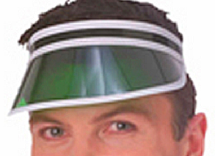
Objectivity
The controversy continued: critics called journalism schools “trade schools.”
Many branched to mass communication or communication programs, and began to emphasize research.
Some practical instructors disdained the researchers, rivalry between the “chi-square” and “green-eye shade” groups.
Editors used to wear green eye shades to cut the glare from overhead lights.

Slide 24
Objectivity
Today the “chi-squares” seem to be winning.
But Lippmann’s vision of an educated mass media force certainly has become true: few media practitioners today do not have university degrees.
Lippmann hoped education would rescue journalism from sensationalism.
Has this increased the integrity of practitioners in the media profession?

Slide 25
Objectivity
To assure greater objectivity, Lippmann argued journalists must approach the profession scientifically.
The scientific journalist “has conquered his desire to have the world justify his prejudices.”
Professional journalists showed maturity, detachment, disinterestedness.
Lippmann crystallized the idea of objectivity in the 1920s.

Slide 26
Objectivity
But few reporters were as rigorous as Lippmann advised; the ideal was not so popular in the 1920s and 1930s.
The idea was a response to the subjectivity and cynicism of journalism during the jazz age.
If World War I had showed the power of propaganda, perhaps objectivity could show the ideal of journalism.

Slide 27
Objectivity
In a world of growing propaganda, public relations and “spin,” how should the press respond?
Henry Luce advocated establishing a commission to examine this question.
In 1942 Robert M. Hutchins, University of Chicago chancellor and most famous academic of the time, established a commission to study the issue.

Slide 28
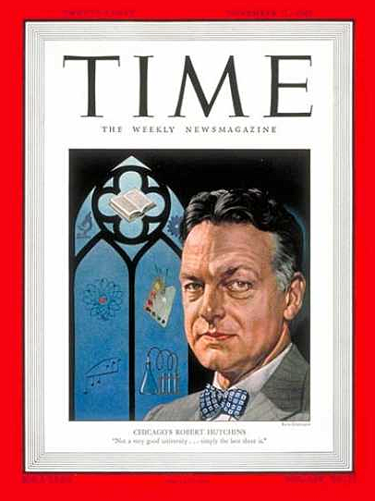
Objectivity
Did the massive pr campaigns of “big government” now mean government controlled the news?
Could a free press still be free?
Hutchins was asked to investigate.

Slide 29
Objectivity
The commission produced a two-volume study. But they side-stepped the question of propaganda and public relations.
Instead, they set up a set of ideals, “demands of society” for journalism.
The ideas included comprehensiveness and interpretation.

Slide 30
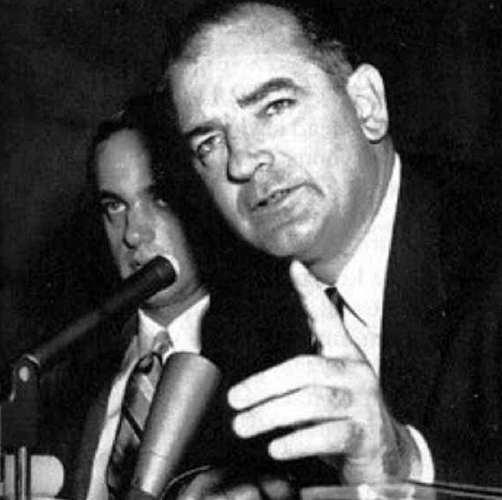
Objectivity
But the press really never implemented interpretation, and objectivity’s limits became clear during the next decade, the “McCarthy Era.”
Is objectivity a value whose time has passed?

