Slide 1
The dawn of photography
1839-1900

Slide 2
Dawn of photography
Photography’s announcement in 1839 greeted by great enthusiasm.
It was a reflection of the beginning of the machine age.

Slide 3
Dawn of photography
Goal of art at this time was realism.
Photography offered a solution to that—using science.

Slide 4
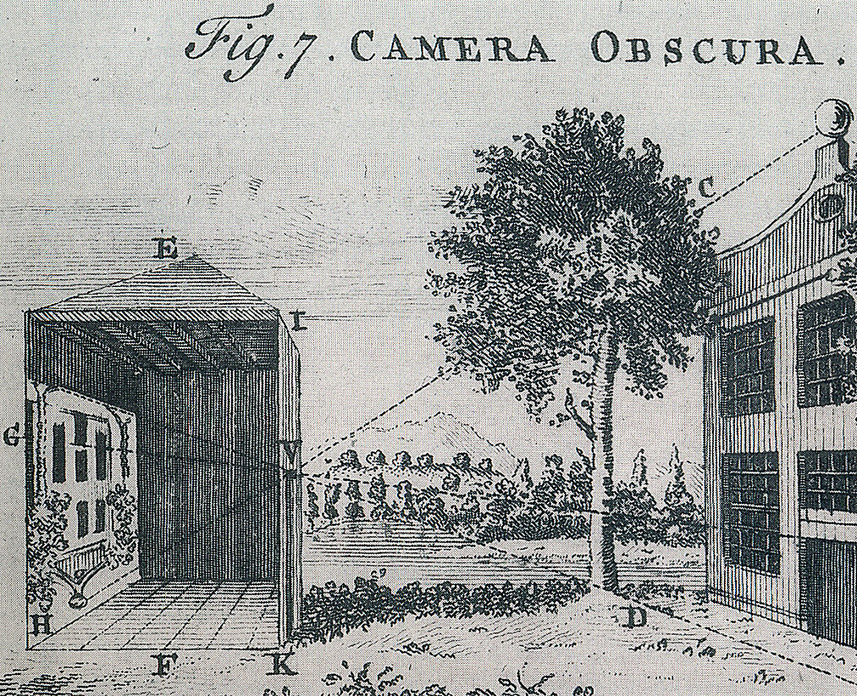
Dawn of photography
Principle of a camera goes back to 1500s.
Camera obscura projected an image.
Artists could use the principle to sketch.
The original photographers were artists.

Slide 5
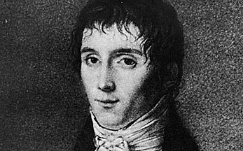
Dawn of photography
Nicéphore Niépce of France became interested in “fixing” the image.
Chemicals before this time were known to turn dark when exposed to light.
But no one knew how to make the image permanent, to “fix” it.

Slide 6
Dawn of photography
Niépce tried laying light-sensitive chemicals on a metal plate.
In 1826-27 he produced the first photograph, the “heliograph.”
The exposure took eight hours.

Slide 7
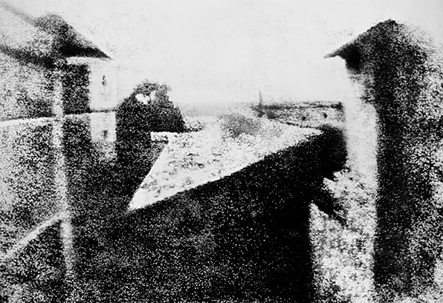
Dawn of photography
Below is considered the first photo.

Slide 8
Dawn of photography
Niépce was not in good health, so proposed a collaboration with Louis Jacques-Mandé Daguerre.
Daguerre’s process used vapor of mercury and salt, a different one from Niépce’s.
Niépce died, Daguerre continued experimenting for 11 years.

Slide 9
Dawn of photography
In 1838 Daguerre was ready: a sheet of copper was coated with silver, made sensitive to light with iodine vapor, exposed, developed with vapor of mercury, fixed with salt solution.
Like most new technologies, this one took a while to attract attention.

Slide 10
Dawn of photography
Finally Daguerre persuaded the French government to give him a pension to work on the process.
François Arago, a well-known scientist of the time, promoted Daguerre’s process.
In 1839 the daguerreotype was announced. We consider this date to be the beginning of photography.

Slide 11
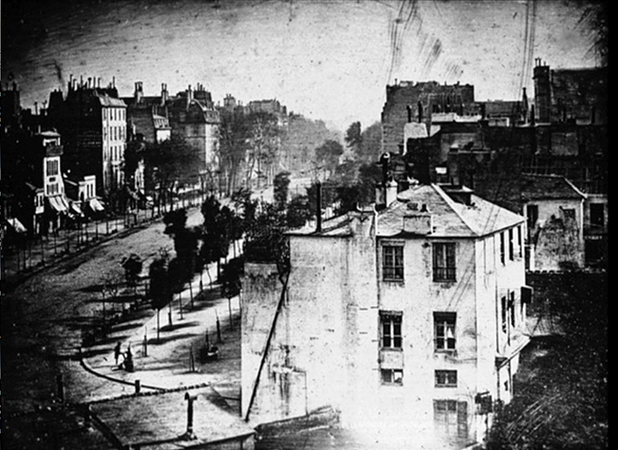
Daguerre’s first photo
Photos originally required such long exposures that people would not register, unless they paused, as in the case below.

Slide 12
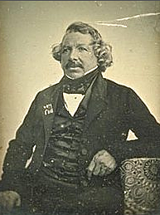
Dawn of photography
Like the sled that reached the top of the hill, Daguerre’s process finally became the rage of the era.
New processes reduced the exposure from 20 minutes to only 30 seconds.

Slide 13
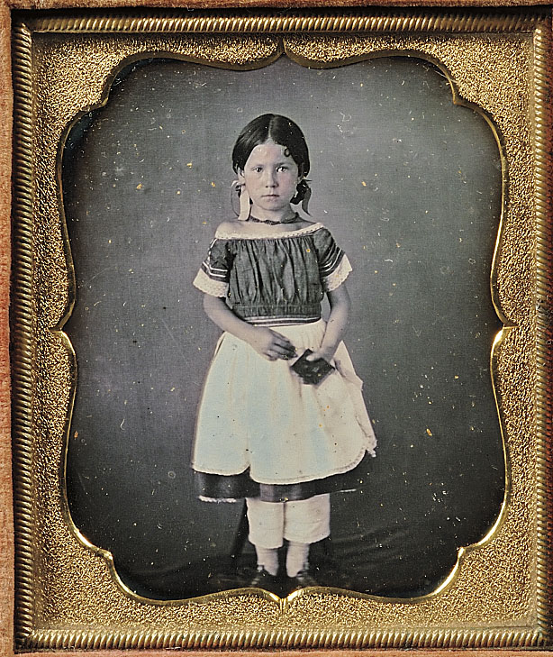
Dawn of photography
No one minded sitting still for 30 seconds. A photograph was a kind of immortality!

Slide 14
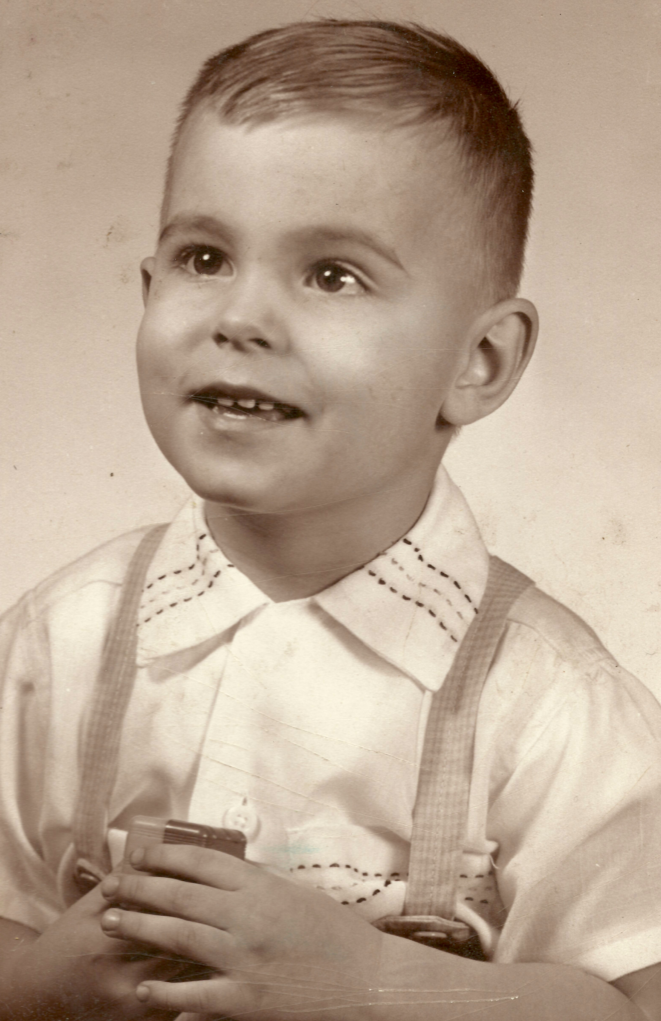
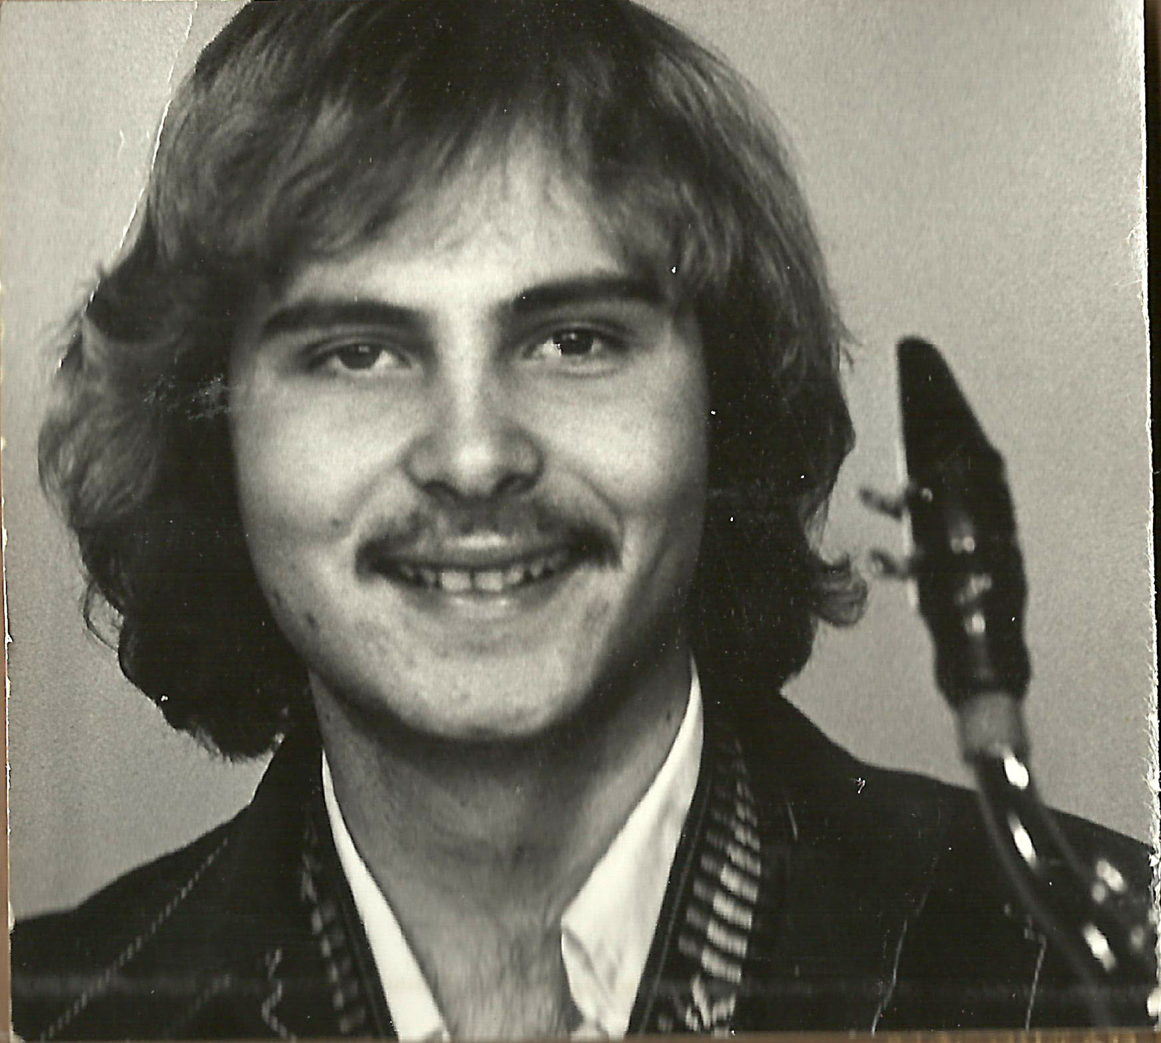
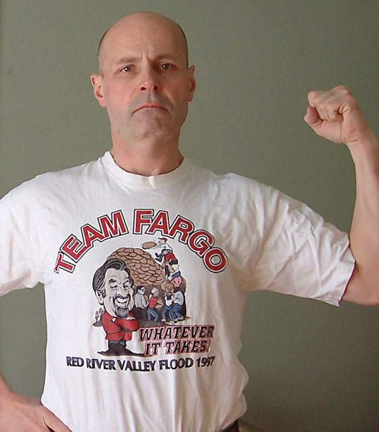
First photos
Moreover, for the first time in history, people could actually see what they and others looked like in younger days. (One must wonder if that’s such a good thing.)

Slide 15
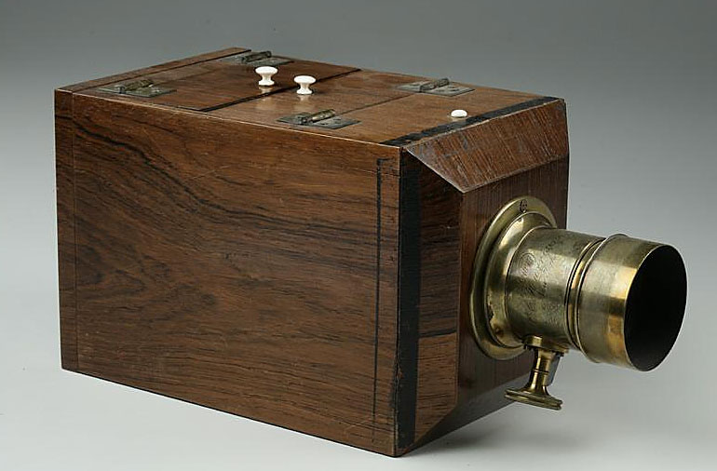
Dawn of photography
Artists quickly realized this new invention was more than a simple aid for artists. It was a new medium.
The quest for realism had been won—by a machine.

Slide 16
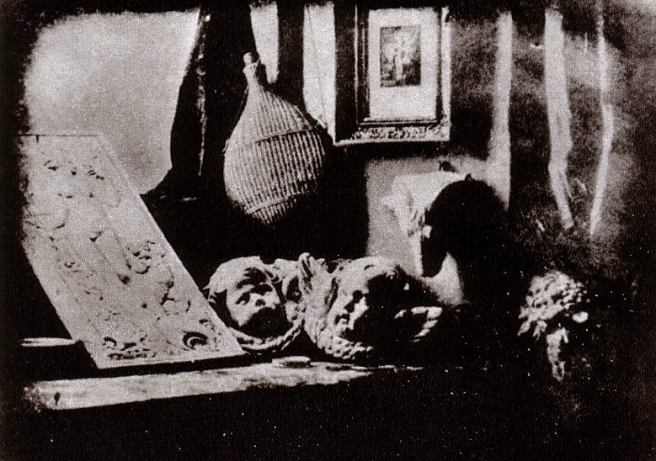
Dawn of photography
Was photography really an “art?” Many artists said no.

Slide 17
Dawn of photography
The debate continues today.
Some art shows still do not allow photography.
Is it simply a machine producing images?

Slide 18
Dawn of photography
Despite their criticism, in the next 30 years many artists clearly were influenced in composition and use of lighting by photography.
Artists reached a crisis: the quest for realism was now pointless. What should art be?
Art moved into the realm of abstraction and interpretation.

Slide 19
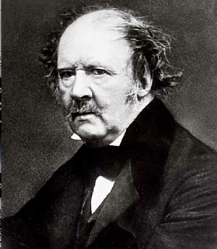
Dawn of photography
William Henry Fox Talbot in England also was developing a photo process when Daguerre announced his.

Slide 20
Dawn of photography
Fox Talbot’s process was different: he dipped paper in salt and, when dry, in silver nitrate to form silver chloride, light sensitive.
This formed an image in a camera. It was fixed with a salt compound.
This produced a negative image, called a calotype.
It was the basis of all modern photography until digital imaging.

Slide 21
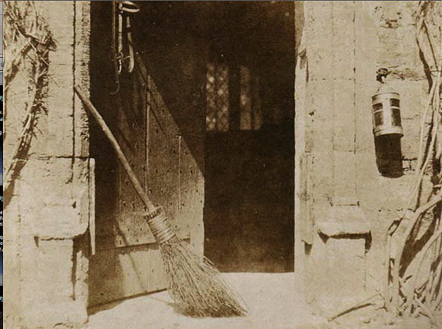
Dawn of photography
Fox Talbot’s images were luminous, but soft, because printed through paper.

Slide 22
Dawn of photography
Daguerre gave his process to everyone.
Fox Talbot patented his, and gave it to few, meaning it grew more slowly.
Fox Talbot published Pencil of Nature to show his process. http://www.youtube.com/watch?v=MxFZSrKdokA

Slide 23
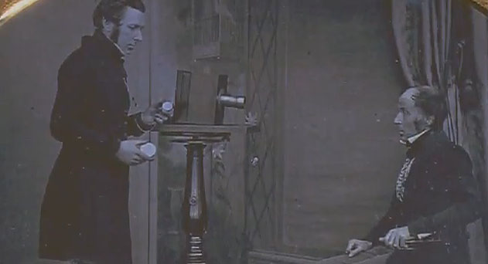
Who discovered photography first? Some would say Daguerre. Some Fox Talbot. I would say Niepce. http://www.youtube.com/watch?v=QVvw1f0sGc0&feature=related

Slide 24
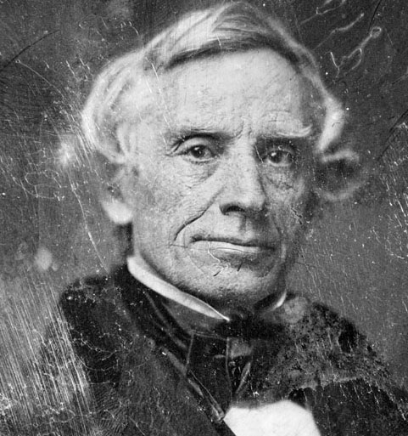
Dawn of photography
At Daguerre’s unveiling of 1839 was an American, Samuel F. B. Morse.
Morse, of telegraph fame, returned to New York to write about photography, and to teach the process.

Slide 25
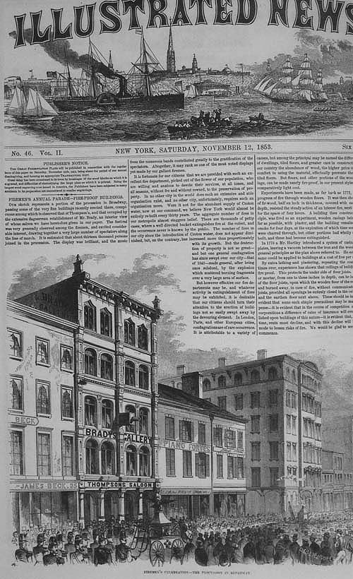
Dawn of photography
One of Morse’s students was Mathew Brady.
Mathew Brady opened the world’s first photographic portrait studio in New York, in 1840.

Slide 26
Dawn of photography
Daguerreotypes were popular for about a decade.
Everyone wanted one.
But one disadvantage: they were unique, one-of-a-kind images on metal.

Slide 27
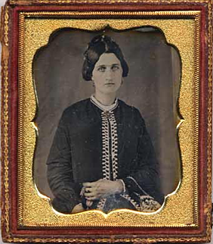
Dawn of photography
They were also fragile, so had to be protected in cases.

Slide 28
Dawn of photography
The calotype offered more flexibility. The problem was the fibers of the paper. These were transmitted to the print, which softened the image.
The quest: to find a way to keep light-sensitive emulsion on glass.

Slide 29
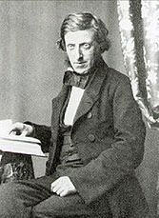
Dawn of photography
How to suspend silver nitrate on glass? Honey? Jam? Egg white?
Finally in 1851 Frederick Scott Archer in Britain tried “collodion”: guncotton, ether and alcohol.
It worked! And exposure was fast, two to three seconds.
Guncotton (nitrocellulose) is explosive. Potassium cyanide also was used in fixing the image. It’s poisonous. Don’t try this at home.

Slide 30
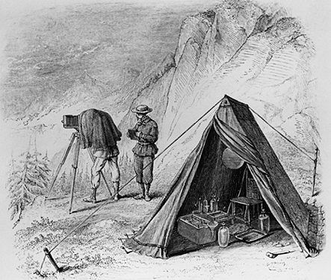
Dawn of photography
…the collodion could not be allowed to dry before processing.
This meant photographers had to haul portable darkrooms where ever they went.

Slide 31
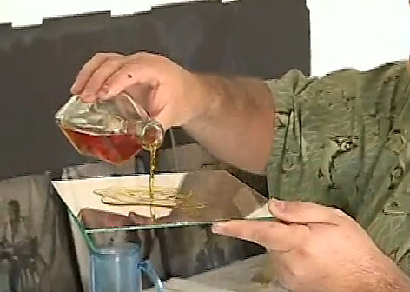
Collodion process
A few art photographers (willing to risk their health) still use the process today. http://www.youtube.com/watch?v=Gyf8fQOdvDs

Slide 32
Collodion
The glass negatives could produce as many prints as needed.
Printing paper was made using albumen, that is, egg whites.
Millions of eggs were separated for photography, the yokes given to bakeries, hog farms, or thrown out.

Slide 33
Dawn of photography
Wet-plate photographers brought their portable darkrooms to wars, mountains, monuments, and kinds of other locations.
Roger Fenton was the first war photographer, in the Crimean War of 1855.

Slide 34
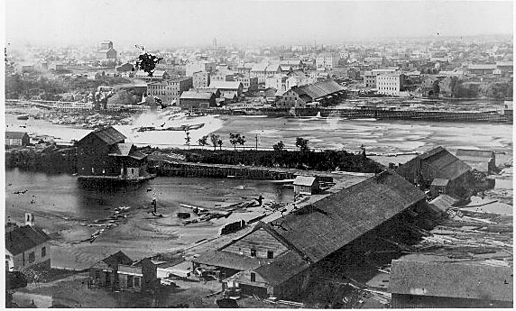
Early regional photography
Alexander Hesler was important in Minnesota. In the 1850s he photographed Fort Snelling, St. Anthony Falls, other places. (Sawmill, St. Anthony Falls, 1873).

Slide 35
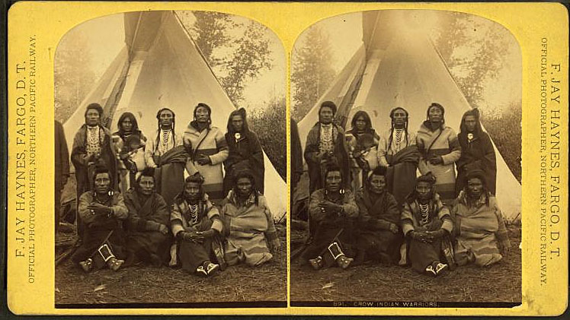
Early regional photography
F. Jay Haynes originally set up a studio in Moorhead, moved to Fargo, became a pioneer railroad photographer of western images.

Slide 36
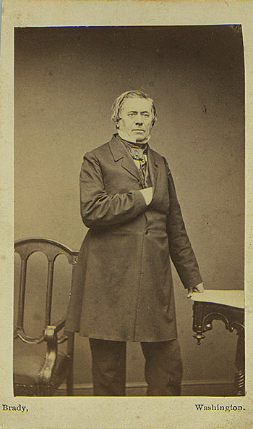
Mathew Brady
Photographers used mules to drag darkrooms to everywhere from the Egyptian pyramids to the frontier American West.
Mathew Brady and assistants were famous in the United States for photography of the U.S. Civil War, 1861-1865.

Slide 37
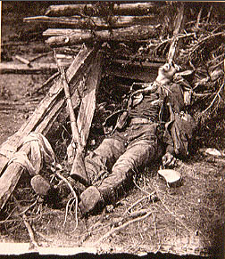
Mathew Brady
Brady hired a team of photographers to cover every major battle.
His gruesome, haunting photos of battle aftermath shaped our understanding of the war. http://www.youtube.com/watch?v=30bDcvDqBXY&feature=related&fmt=18%22

Slide 38
Brady and U.S. Civil War
Brady was unable to sell his photos after the war, and went broke.
The U.S. war department acquired them after paying some of his bills, but did not take care of the glass negatives. The majority were lost.

Slide 39
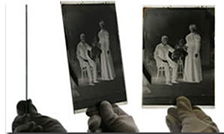
Cameron and others
Other well-known wet-plate photographers:
Julia Margaret Cameron.
Nadar (Gaspard Felix Tournachon).
Timothy O’Sullivan.
Eadward Muybridge.

Slide 40
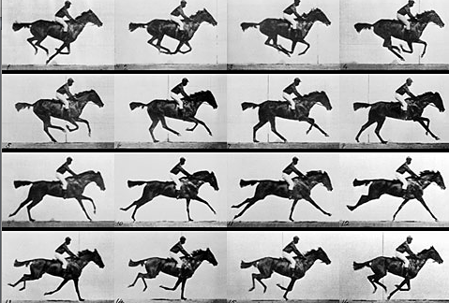
Dawn of photography
Muybridge tried to evaluate how animals and people moved using photography. He called these “locomotion studies.”

Slide 41
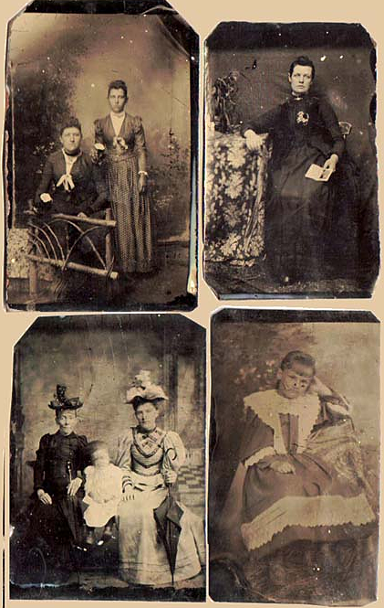
Dawn of photography
In the 1870s technology again revolutionized photography: the dry plate replaced the wet plate.
Tintypes became popular, and stayed popular into the 1930s.

Slide 42
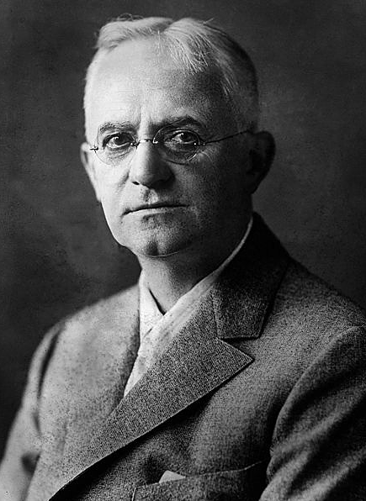
George Eastman
A manufacturer of dry plates was George Eastman.
Eastman considered an improvement: if only he could make emulsion on a flexible roll.
Most people credit the invention of the roll film to Eastman, in 1888. This is not quite true. It was invented in North Dakota!

Slide 43
David Houston
David Houston of Hunter, N.D., sold a patent to his 1881 roll film holder to Eastman in 1889, for $5,000. It was not a wise business decision.
Eastman unveiled the Kodak camera in 1888 under the slogan, “You push the button, we do the rest!”
No one is sure of how Eastman came upon the name “Kodak,” but one explanation is that it’s a variation of “Dakota,” as Houston’s invention was a basis for Eastman’s success.

Slide 44
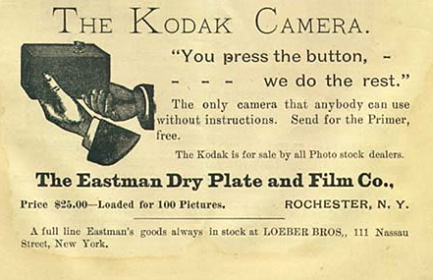
The Kodak
The original Kodak included a 100-exposure role. Users had to send the camera back to Kodak for processing.

Slide 45
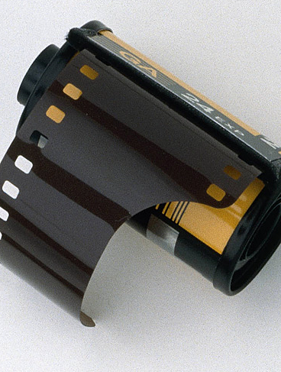
Roll film
The new roll film technology was so good that for the first time in history, you could take pictures without a tripod.
Photography was no longer for professionals. Now anyone could take pictures.
Roll film revolutionized photo technology—again. It lasted a century.

