Slide 1
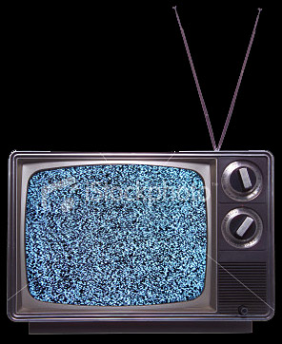
The Dawn
Of television

Slide 2
Dawn of television
Television technology actually was developed shortly after radio, in the 1920s.
Commercial broadcasting experiments began in 1939, on the East Coast.
But most people remember it from the 1950s. Why the delay?

Slide 3
Dawn of television
World War II delayed the introduction of TV.
In 1935 the Federal Radio Commission became the Federal Communications Commission (FCC), and declared television airwaves to be a public property. Therefore television broadcasters needed a license to operate.

Slide 4
Dawn of television
By 1948, both NBC (National Broadcasting System) and competitor CBS (Columbia Broadcasting System) had developed news programs.
NBC had Camel News Caravan with John Cameron Swayze, sp0nsored by the cigarette. [http://www.youtube.com/watch?v=xfczfHjfn9k]
CBS had “Television News” with Douglas Edwards, sponsored by Oldsmobile.
Both were 15-minute programs.

Slide 5
Dawn of television
Both were basically text-reading services. Video was through newsreels. Meanwhile ABC had fallen badly behind in news shows.
Early television was heavily controlled by advertisers. Camel News Caravan never showed “no-smoking” signs.

Slide 6
Dawn of television
In fact, early entertainment shows were actually produced by advertisement agencies, which controlled content.
“Man Against Crime” starring Ralph Bellamy debuted in 1949. It was produced by the William Esty ad agency.
These shows were always produced live.
Television programming was based on radio. Many radio shows moved to television.

Slide 7
Dawn of television
FCC was slow to approve television station licenses from 1948-52. Why?
Feared the national cultural upheaval that television might produce.
  Hazel-Bishop Lipsticks turned a small company into an enormous success through TV advertising from 1948-52. [http://www.youtube.com/watch?v=RZFbVXxDumc]
Feared Communist infiltration into a powerful new medium.

Slide 8
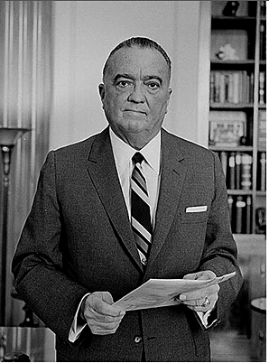
Dawn of television
FBI anti-Communist head J. Edgar Hoover told the FCC to deny permits, as many were from supposed Communist sympathizers.

Slide 9
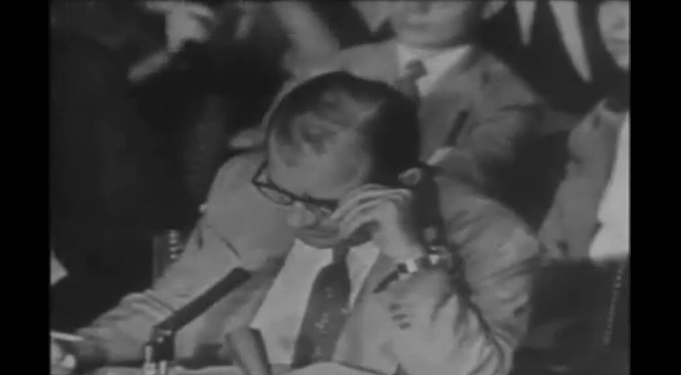
Dawn of television
Accusations during the “Red Scare” period of the 1950s delayed television’s progress. Wisconsin Sen. Joseph McCarthy in particular accused many media people of communist sympathies, harming careers and destroying lives.

Slide 10
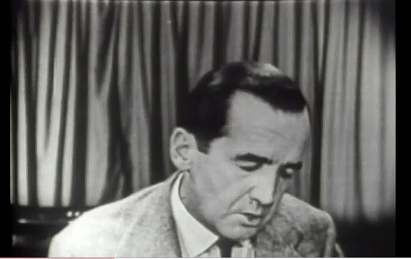
Dawn of television
If television was delayed by Communist “Witch Hunts,” so television exposed those doing the hunting.
Edward R. Murrow, who became famous for his World War II radio broadcasts, decided to take on McCarthy in his news program, “See It Now.”
http://www.youtube.com/watch?v=anNEJJYLU8M

Slide 11
Dawn of television
Murrow’s efforts to expose the damage “Red Scare” mongering was doing to society let to two things:
People realized that television was more than entertainment; it was important to society, and everyone needed it.
Television’s power to expose led to Congressional hearings that exposed McCarthy’s attacks. In 1955 the Senate passed a vote censuring him for his attacks.

Slide 12
Dawn of television
Quiz shows became the rage in the 1950s.
By 1959 the top-rated show was a western, “Gunsmoke.”
In 1960 the first presidential debate was televised, Nixon and Kennedy. Television was found to be a crucial factor in presidential campaigns.

Slide 13
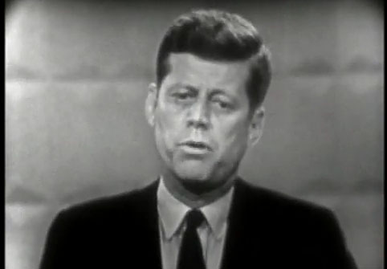
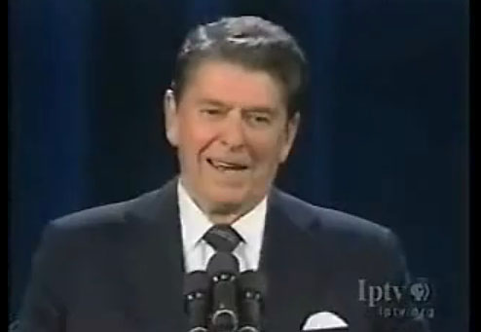
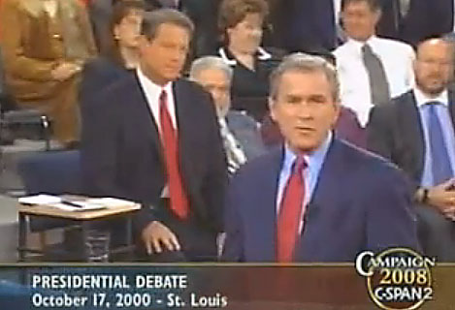
Presidential debates
Presidential debates on television emphasized image and sound bites, and so changed election dynamics.
1960 [http://www.youtube.com/watch?v=cn9B28yYyIE]
1980 [http://www.youtube.com/watch?v=It0Dtm1gFFQ]
2000 [http://www.youtube.com/watch?v=LUiZIIHWbjg]

Slide 14
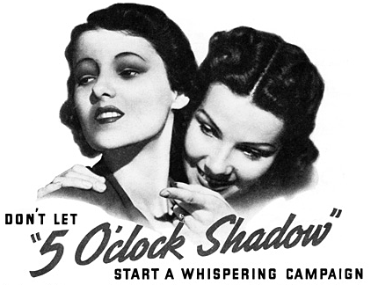
Dawn of television
Nixon sounded good on radio, but did not always look good on TV. He wastired and looked haggard, making his famous 5-o’clock shadow look even more sinister. In one debate he tried “Lazy Shave,” a pancake makeup. It ran in the hot lights, a disaster for his image.

Slide 15
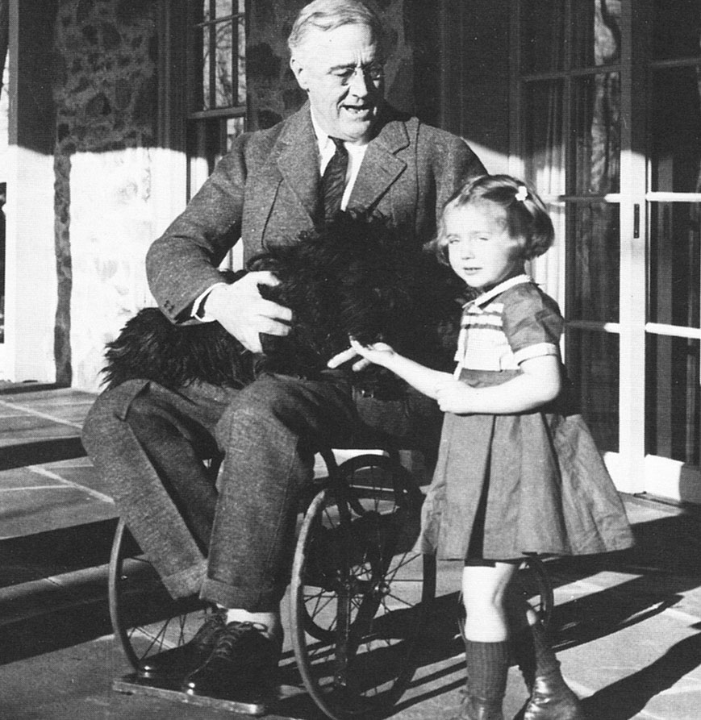
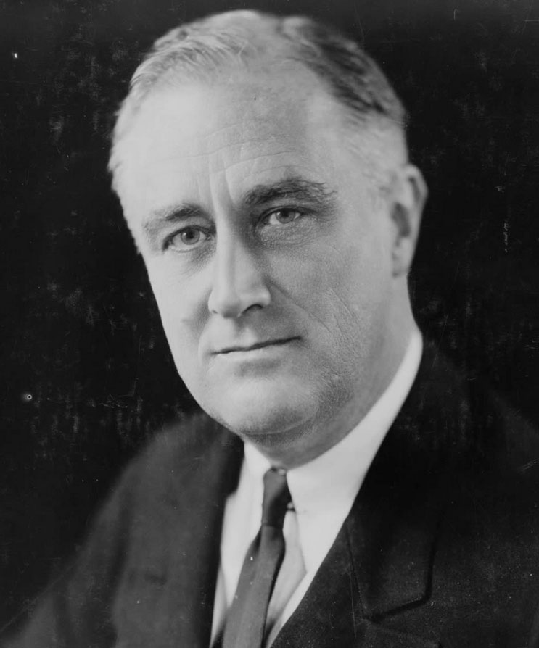
Dawn of television
Television inaugurated the age of presidential image.
Could Franklin Roosevelt have been elected in the age of television, given his disability? Would he have looked “vigorous” enough for the job?

Slide 16
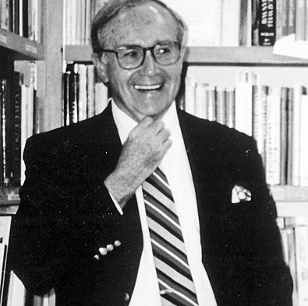
Dawn of television
In 1961 Kennedy appointed Newton Minow as chair of FCC.
He declared television had become a “vast wasteland.”
[http://www.youtube.com/watchv=K_BuN7bJLAI&p=E09FA139C6071D1F&playnext=1&index=6]

Slide 17
Dawn of television
Violence on television became a particular public concern in the 1960s.
This was true in programming but the news, too, showed violence: the violence of the Vietnam War.
Day after day, the war came to Americans’ living rooms through television. Its popularity waned as Americans became shocked at what war really looked like. [http://www.youtube.com/watch?v=vDy0Z3HSkTE]

Slide 18
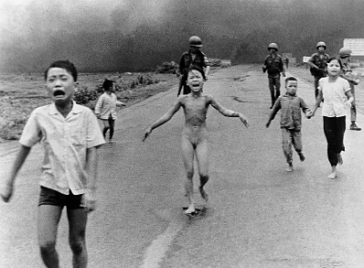
Dawn of television
U.S. Army accidental napalm bombing of Vietnamese civilians became famous for the shocking effect it had on Americans. [http://www.youtube.com/watch?v=Ev2dEqrN4i0]
Television had power to change lives and society.

Slide 19
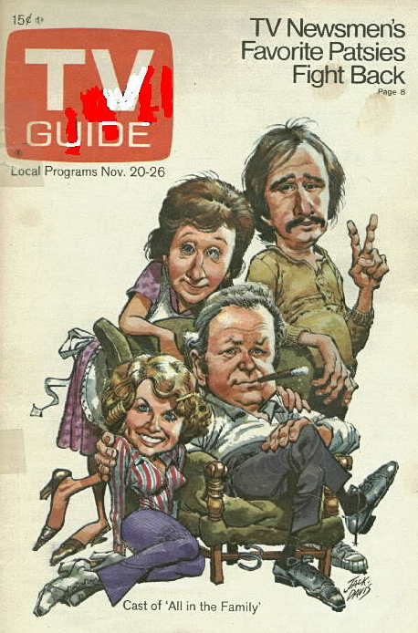
Dawn of television
People began to demand “relevant” television.
More ethical diversity.
More attention to social issues.
“All in the Family,” the first program which considered controversial issues, was Number One in 1974. Norman Lear invented the series.

Slide 20
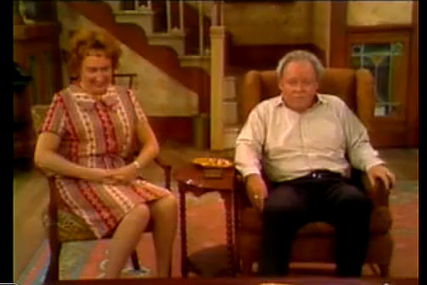
Relevant television
Here is Archie Bunker, played by Carroll O’Connor, on gun control (early 1970s). [http://www.youtube.com/watch?v=CLjNJI54GMM]

Slide 21
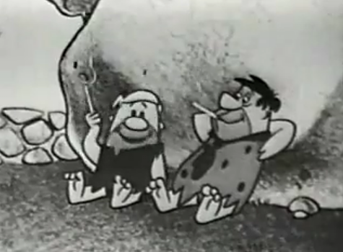
Dawn of television
Also in 1970 Congress banned cigarette advertising from television. It’s not hard to see why. http://www.youtube.com/watch?v=mZvHiiWFbBU&feature=fvwrel

Slide 22
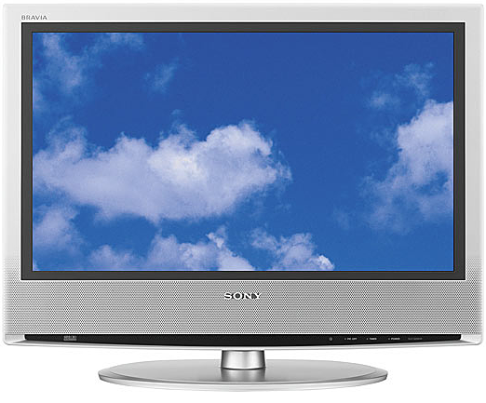
Dawn of television
Television’s power was anticipated, and those predictions turned out to be true. Is it as powerful today?

