Slide 1
The historical biography
How to write someone’s story, or even your own.

Slide 2
Popular history
Biography is a popular way to write history.
We try to tell a larger story though a sort of case study of one individual.
We are interested in biographies of celebrities or famous people from history.

Slide 3
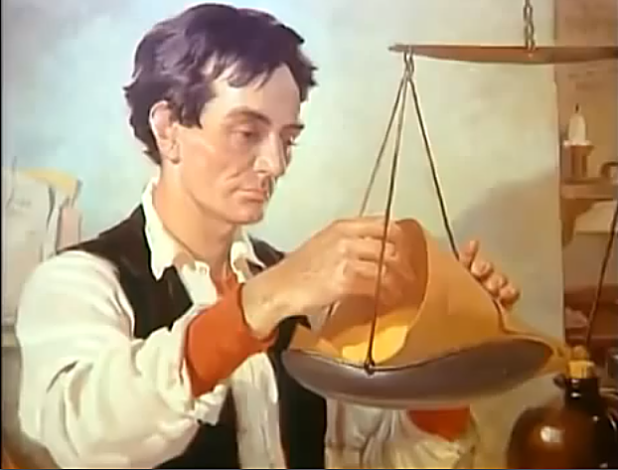
Biopics
We can even find television channels devoted to biography, or “lifestyles.”
Documentaries are often biographies, such as recent documentaries of Abraham Lincoln or Albert Einstein.

Slide 4
Other people’s lives
We like to learn about other people’s lives, either in articles, books or biopics. That’s biography.
Autobiography, of course, is writing one’s own life.
How do we go about writing a biography?

Slide 5
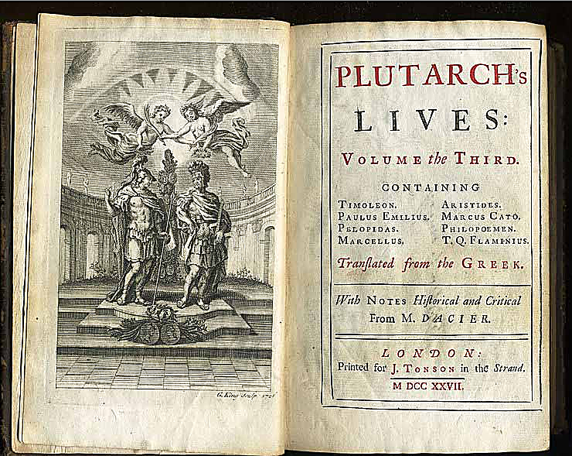
Over the centuries
The approach to biographical writing has been a topic of debate for centuries.
The style goes back thousands of years. Plutarch’s Lives was actually a series of biographies.

Slide 6
“Lives”
Biographies, or “lives,” as they used to be called, was popular as a way to write about saints in the Middle Ages.
These were called hagiographies.
They were designed to offer instruction on virtue, of how to lead a good life.

Slide 7
Hagiographies
Today, hagiographies [“hag” or “haj,” both pronunciations are used] are not so popular.
The word has evolved to suggest (usually negatively) any adulatory, uncritical account of someone’s life.
Sometimes we read such biographies of celebrities, but they don’t seem to hold much respect among readers.

Slide 8
General approach
Through the past and today, biographers have developed accepted approaches to their work.
We can identify five basic principles to writing a historical biography.

Slide 9
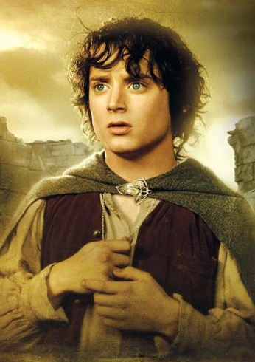
1. Truth
We agree that a biography should be based on truth. It’s not a novel.
We can’t write about, say, Frodo Baggins of Lord of the Rings, because he didn’t exist. That’s fantasy.

Slide 10
Finding truth
Biographers work hard to find evidence for their work—even Plutarch 2,000 years ago knew he needed persuasive evidence for the stories in his Lives.
But what is truth?

Slide 11
What is truth?
Sometimes biographers reconstruct dialogue that likely happened based on memories or anecdotes. Is reconstructed dialogue truth?
Sometimes biographers make up meetings or encounters which never actually existed. Is that truth?

Slide 12
Docudramas
Most historians would say that is not biography, but fiction.
In television and films we might call that a “docudrama.” That’s something that looks true, but actually is enhanced drama based on fictional aspects.
To be a biography, the story must be entirely true, as much as possible based on evidence.

Slide 13
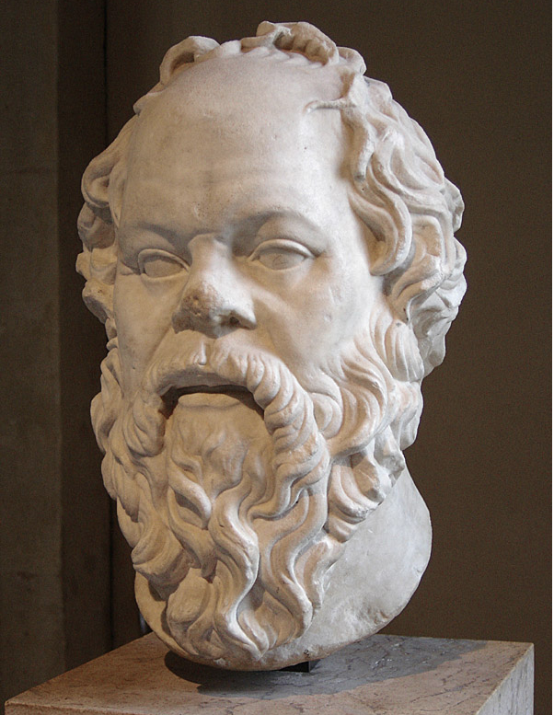
Finding truth
But finding truth can be difficult.
If you’re writing a biography of Socrates, you won’t be able to find many primary sources for your account.
We’re also short on photos from that era.

Slide 14
Evidence
Even for more modern subjects, primary evidence may be incomplete or biased.
Evaluating evidence is one of the challenges of writing biography.

Slide 15
2. Objectivity
A biography should be objective. Although we know complete objectivity isn’t possible.
Our biases color our approach—and some of those biases we don’t even recognize in ourselves.
Biases are shaped by our culture and the time in which we live.

Slide 16
Bias
We may choose evidence based on what we want the person to be.
We may choose based on whether we like the person.
Sometimes we don’t have very much evidence to go on, making objectivity even more difficult.
Sometimes the evidence is hidden or destroyed.

Slide 17
Bias
What we can do is begin with:
“A belief that a reasonable degree of objectivity is achievable, that a properly designed and controlled narrative element belongs in history and can communicate truth as far as it is known.”
—James Startt

Slide 18
Knowing the subject
Do you need to personally know the subject to write a good biography? Some say yes.
But obviously that’s not always possible.
It also can introduce bias if you are a relative or friend of the subject.

Slide 19
3. Frank and revealing
Many writers say a biography must be completely honest, the so-called “warts and all” approach.
This was not common in times past, when virtue in public life was what was significant, not private behavior.

Slide 20
Revelations
Today what we might call the “obituary” approach is not popular. People obviously crave to know the personal lives of celebrities.
People today seem less interested in maintaining privacy.
People seem to have less respect for the distinguished and esteemed among us.
Biographers of integrity do try to maintain a measure of dignity, however.

Slide 21
4. The whole life
A principle of modern biography is to emphasize not only the famous or significant parts of a life, but the whole life.
This would include childhood and presumed immaturity and, if the person is old, retirement and possible senescence.

Slide 22
Childhood and quirks
Today we acknowledge that someone’s childhood experience may strongly color his or her adult choices.
So biographers will try to uncover a subject’s relationship with parents and siblings, their spouses and children, their hopes and fears, their quirks and sexual habits, their dreams and fancies, their habits with money and battles with illness.

Slide 23
Beginning where?
If we believe that a biography should try to uncover a whole life, should we always begin at the chronological beginning, such as “X was born…”?
Many biographies actually don’t.

Slide 24
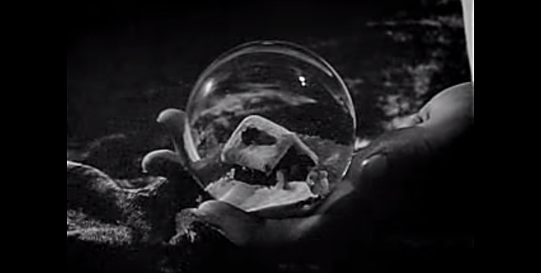
Ways to begin
Instead, we can begin with the end, and work back. Sometimes a way a subject died or circumstances of the last years can represent a life.
Alternatively, we can set up a biography based on themes, such as a painter’s stylistic periods.
Here’s a famous “biography” that began with the end.
http://www.youtube.com/watch?v=LZOzk7T93wE

Slide 25
5. Sources must be included
Traditional biographers carefully cite their sources.
Typically this was done by footnoting.
Today many publishers know readers do not like footnotes. Other ways to cite sources include endnotes, a source list, or a Web site with sources.
Few historical biographies will forego source references, however, as it establishes the accuracy and credibility of the work.

Slide 26
Confidential sources
Biographers sometimes face the same problem as journalists—sources who don’t want to be cited.
Anonymous sources must sometimes be used, but they do weaken the credibility of the biography, as readers know sources may be exaggerated—or completely made up.

Slide 27
Weakness of biography
Some historians are critical of biography.
They say it does not help people to understand the significance of events and trends.
It is easy to write a biased account, to make things up, or to speculate on scant evidence. Biographies with reconstructed dialogue and scenes give more weight to this criticism.

Slide 28
Value of biography
On the other hand, as a sort of historical case study, a biography can focus on details as a way to illustrate general culture and society.
Some historians question the value of “great man” history—that a few individuals are responsible for historical change.
Still it’s clear that sometimes an individual can affect the course of history. Adams, Pulitzer or Lippmann in media, for example.

Slide 29
Finding context
The biographer tries to offer context by interpreting the age.
None of us live in a vacuum. Our understanding of the world is shaped by our time and culture.
The biographer should reflect this.

Slide 30
Spirit of the time
Thing about your own culture and times.
What presumptions do you bring to your own life?
How might they differ from the accepted wisdom of another age?
How do you look at life differently from your parents? From someone centuries ago?

Slide 31
Present-mindedness
Biographers have to be aware of “present-mindedness”: the tendency to judge past events based on our attitudes of today.
We often take our unexamined worldview for granted—until someone forces us to re-examine our views. That’s not always easy.
Writing biography, or even autobiography, can give us an opportunity to do that.

Slide 32
Tips for biography
Begin with the early years.
Note family social and professional background.
Who were the person’s influential mentors?
What else influenced how he/she saw the world?

Slide 33
Tips for biography
Did wealth or social position offer advantage to success, or disadvantage?
What early mistakes did the subject make?
How did the subject learn from these mistakes?
—Robert Davies, author of Baldwin of the Times.

Slide 34
Standard questions
Based on these ideas, list some standard questions you would ask the subject of a historical biography.

