Slide 1
Advertising
Its growth and development

Slide 2
Advertising
Modern advertising proposed a solution to new demands of the industrial age of the 1800s.
Advertising had existed before, of course, small and modest.
But the needs of industry demanded more, large ads, widespread marketing.

Slide 3
Advertising
Before industry could turn out many products quickly, most sellers found no need for it.
If you can only produce one hand-sewn pair of shoes a week, and have a demand for 10, why advertise? You don’t need more business.
But if you now can manufacture a hundred by just throwing a switch, what are you going to do with all those extra? Answer: try to find more customers.

Slide 4
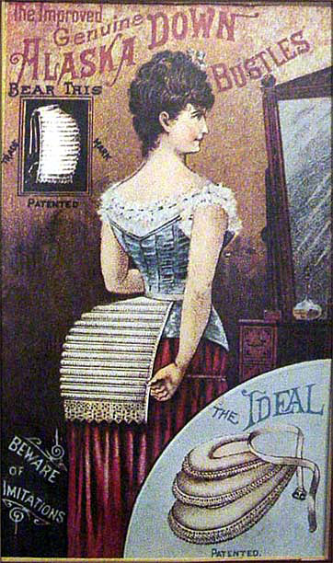
Advertising
But how do you sell to people you don’t know in other towns, and to people who don’t know your product?
Advertise, of course!

Slide 5
Advertising
Modern advertising required several technological innovations. They all became possible by mid-19th century:
A way to deliver goods purchased, answered by the railroad.
Assurance people will read the ad, answered by mass education.
A way to reach many thousands, answered by development of mass media.
A way to produce many newspapers, answered by the development of cheap wood-based newsprint, high-speed presses and machine typesetting.

Slide 6
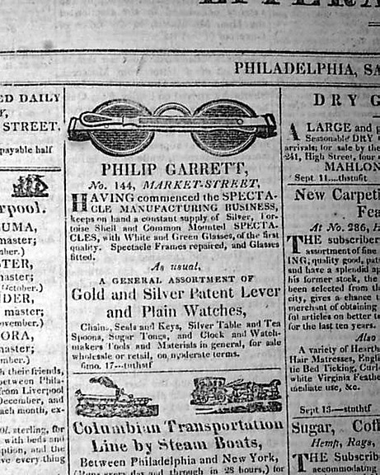
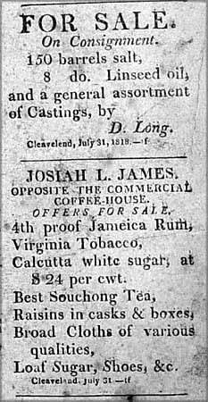
Advertising
Before modern display-style advertising, most ads were actually announcements, often similar to classified ads today.

Slide 7
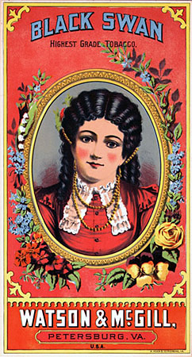
Advertising
Manufacturers who produced products at an industrial rate realized consumers thought all products were the same: flour was flour, tobacco was tobacco, soap was soap.
As supplies grew, however, people started to recognize the difference between products.
After the Civil War (1861-1865), manufacturers started to develop brands to identify their products. Cards and posters supplemented newspapers and magazines.

Slide 8
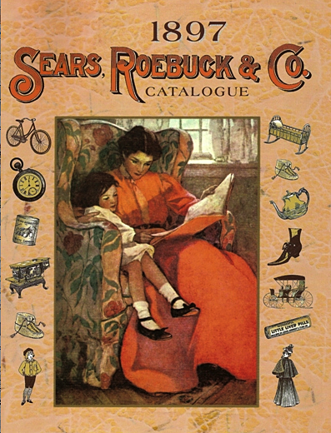
Advertising
Huge mail-order companies and large department stores grew to attract new consumers.
Mail-order was particularly popular in frontier America—such as Fargo—where few stores were available.

Slide 9
Advertising
Particularly significant to advertising history was the growth of patent medicine.
Manufacturers of pills and elixirs realized their brand name was their most valuable asset.
“Patent,” or branded medicine makers began taking out huge advertisements to promote their name.
As we know, the medicine itself was not regulated. Many contained alcohol, cocaine, or worse.

Slide 10
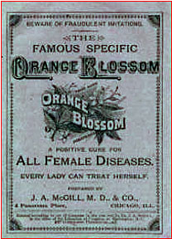
Advertising
Patent medicine makers nevertheless performed a key role in the growth of professional advertising copywriters and agencies.

Slide 11
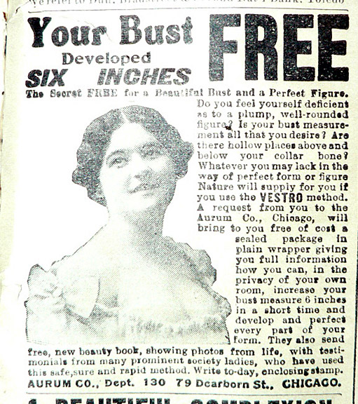
Advertising
Ad copyrighting before the late 19th century normally was a job for free-lancers.
Ads tended to be wordy, dull, often inaccurate.
Claims were wildly exaggerated.

Slide 12
Advertising
Advertising agencies developed in the late 1800s as a go-between for advertisers and media.
By 1900 agencies also employed writers, and actually began preparing ads for the advertisers.
Agencies began to emphasize the idea of creating a simple slogan or theme to sell a product.
Good copywriters could become wealthy.

Slide 13
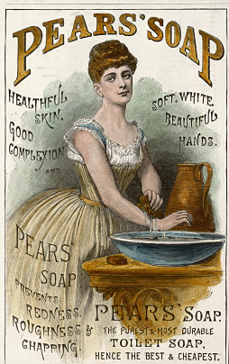
Advertising
The most famous, and successful, slogan ad of the era was for Pear’s Soap. It read:
“Good Morning! Have you used your Pear’s Soap today?”
It became so well known that people became afraid to say “Good Morning.”

Slide 14
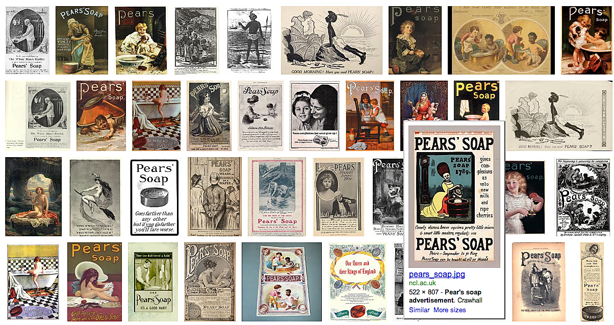
Pear’s Soap art
Pear’s Soap featured some of the greatest early art advertising in the mass media.

Slide 15
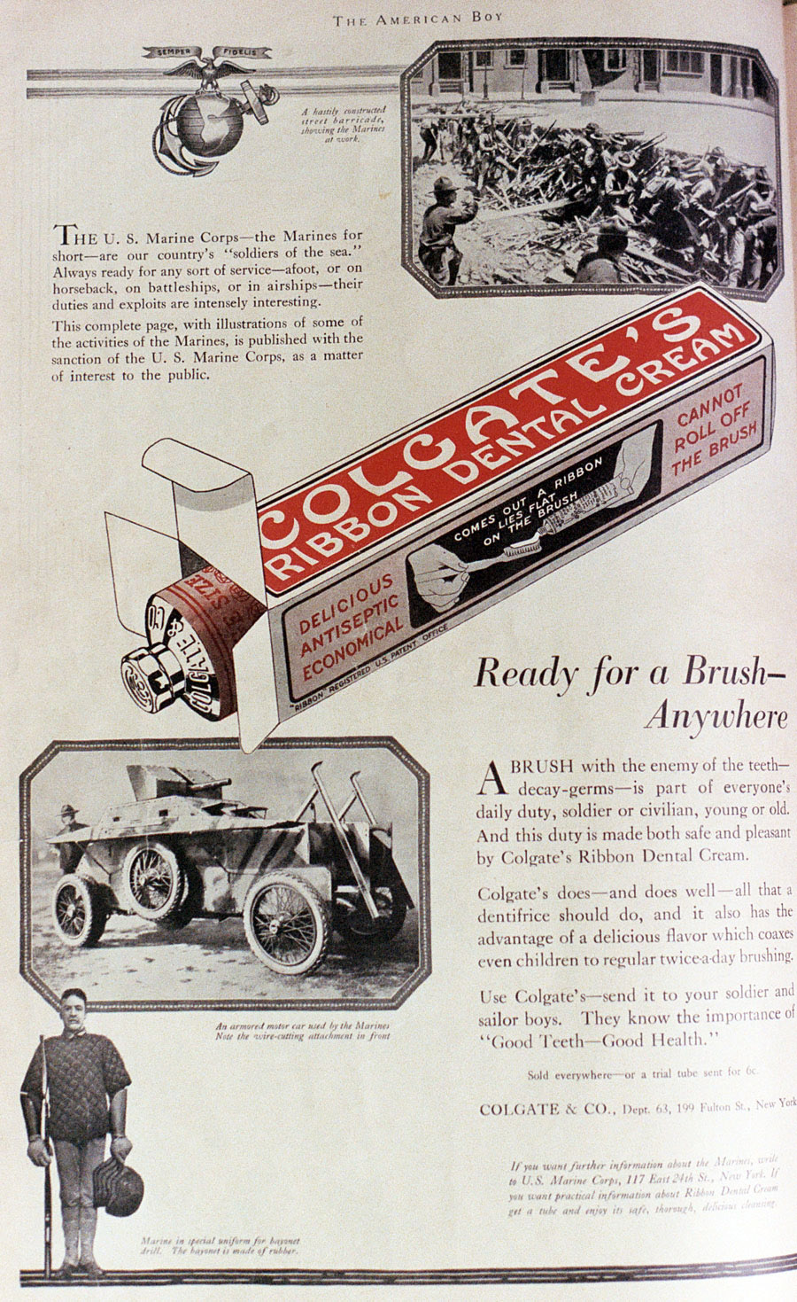
Advertising
Pear’s was one of the earliest brand-name advertisers. It promoted a concept then new to Europe and America: daily bathing!
Other hygiene products promoted enormously after the last century’s turn included shampoo, mouthwash, deodorant and toothpaste.

Slide 16
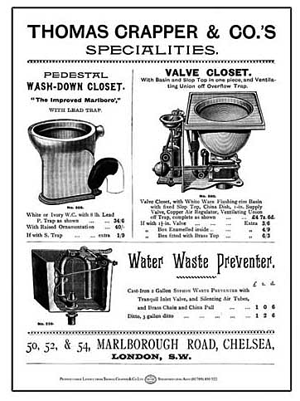
Advertising
In fact, many historians consider the twentieth century growth in personal hygiene to be a response to the tremendous amount of advertising for these products in the early part of the century.
Pear’s soap led to great growth in demand for indoor plumbing and indoor bathtubs.

Slide 17
Advertising
Other products seeing enormous early advertising included
Cars and tires;
Kodak cameras;
Cigarettes.
Slogans of 1907 included
“Time to Re-Tire.” (Firestone Tires).
“Watch the Fords Go By.” (Fort Motor).

Slide 18
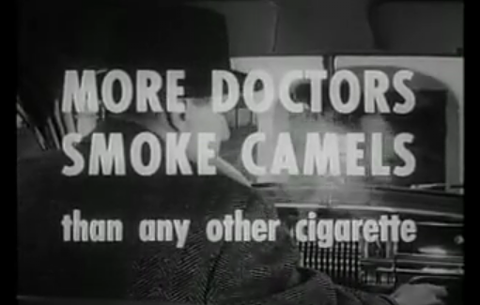
Advertising
Advertising has been given credit for building cigarettes into an integral part of American culture during the twentieth century. [http://www.youtube.com/watch?v=fIN8MmMloZE&NR=1]

Slide 19
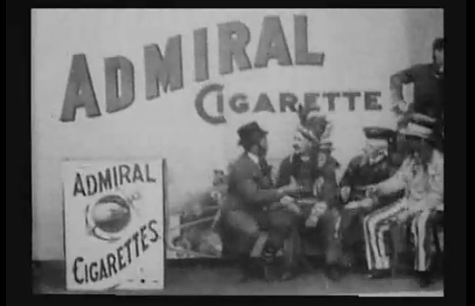
Advertising
In fact, what may be the first motion picture ad from 1897, promotes a brand of cigarettes.

Slide 20
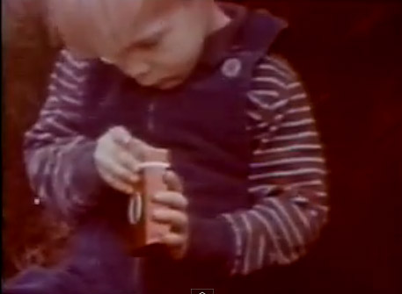
Anti-smoking ads
As it became clear in the 1960s that cigarettes were not for nothing nicknamed “coffin nails,” anti-smoking groups realized they needed to use advertising to counter the mighty cigarette manufacturers. Here’s a famous ad from 1967. http://www.youtube.com/watch?v=cmzDLzqQ-A0

Slide 21
Advertising
Many early ad copywriters were newspaper reporters out to make some extra cash.
“Ad-smithing,” as it was then called, attracted the likes of Henry J. Raymond, founder of the New York Times, and P.T. Barnum. They both wrote patent medicine copy.
By the 1890s ad-smithing became a huge industry in New York.

Slide 22
Advertising
John E. Powers was one of the most influential early ad copy-writers.
Powers wrote ad copy for the John Wanamaker Department store in Philadelphia, one of the most influential of early department stores.
Powers said people needed a reason to buy a product. His ad copy is called “reason-why” copy.

Slide 23
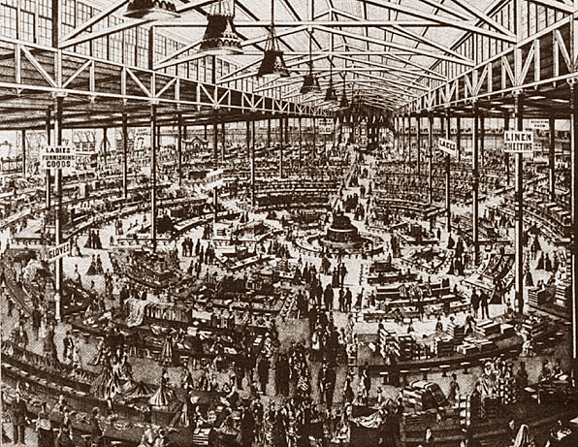
Advertising
The Powers Style promoted a pithy argument on why you need a product. Powers became one of the original “Mad Men.”
Today it’s not so common, because many advertising copywriters have moved to the idea of creating an image rather than arguing a point.

Slide 24
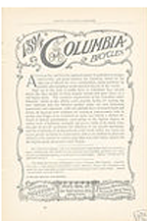
Advertising
A competing early advertising writer, Nathaniel Fowler, emphasized long, detailed arguments.
He advocated finding one idea, a major theme, and then emphasizing it over and over, called the “Fowler Idea.”

Slide 25
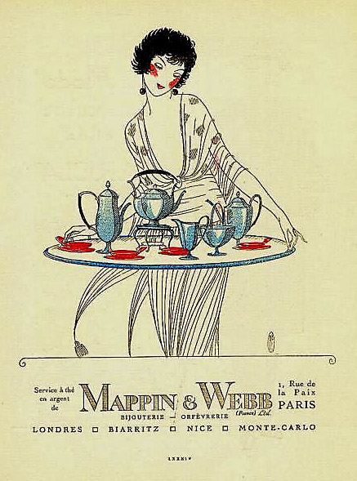
Advertising
After World War I people’s understanding of propaganda power and the power of emotion led to a shift in ad technique.
What really sold a product? Appeal to a universal emotion: sex, greed, fear, envy, pride.
Ad copy shifted from “What we do” to “What you are.”

Slide 26
Advertising
Ads for intimate hygiene products after World War I became heavily based on fear, fear of rejection in society.
In a 1923 advertisers’ meeting in Atlantic City, the common aphorism was “appeal to reason in your advertising, and you appeal to about 40 percent of the human race.”
Still, the worst of misleading patent medicine advertising had been tamed. FDA controlled their claims.
Health care products remained heavily advertised, as they still are today.

Slide 27
Advertising
1920s ad copywriting became more chatty and anecdotal:
“His heart quickened at the soft fragrance of her cheeks. But her shoes hid a sorry case of athlete’s foot.”
Listerine mouthwash invented a new word, “halitosis.” Slogan: “Even your friends won’t tell you.” Lost love, lost jobs, all due to halitosis.
Picture of medical operation. Headline: “And the trouble began with harsh toilet tissue.”

Slide 28
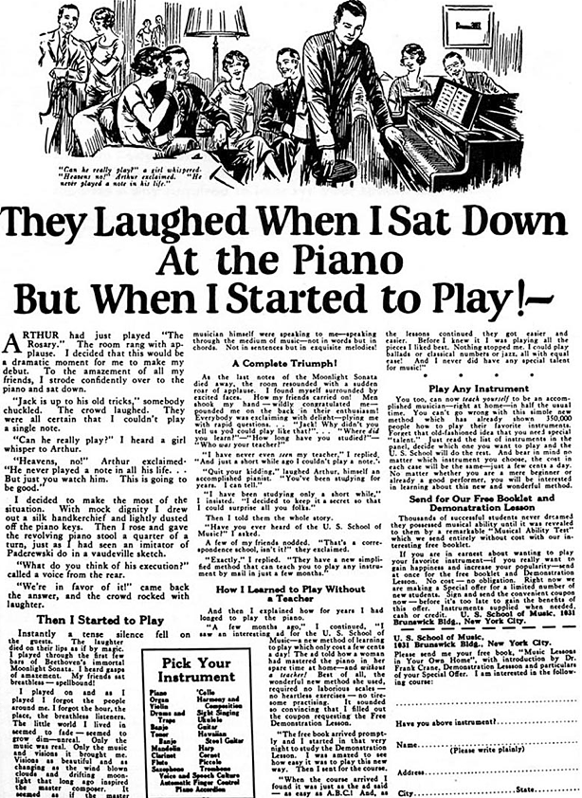
Advertising
One of history’s most successful campaigns ran from the 1920s to the 1950s with the slogan written by John Caples for the U.S. School of Music in 1925: “They laughed when I sat down at the piano….”

Slide 29
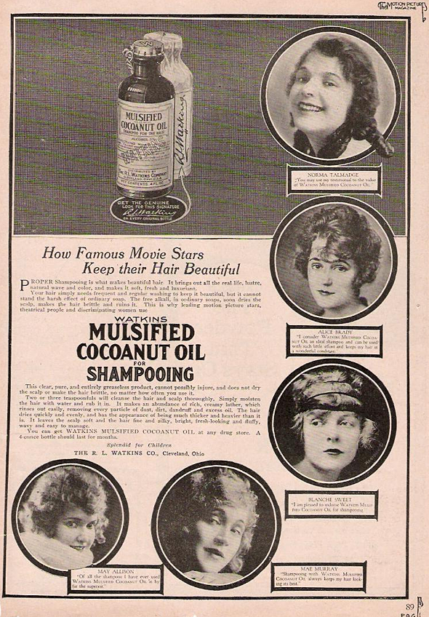
Advertisers
Shampoo also was made popular by advertisers beginning in the 1920s. Before this, people just used it for dandruff.
Soap was soap—before advertising.

Slide 30
Advertising
After World War II, Ted Bates promoted a new ad concept: the USP, or Unique Selling Proposition.
Bates argued many products were essentially the same.
To sell, you had to come up with something to make your product stand out.
It didn’t matter if everyone did it the same way: you would be the one to advertise it as a USP.

Slide 31
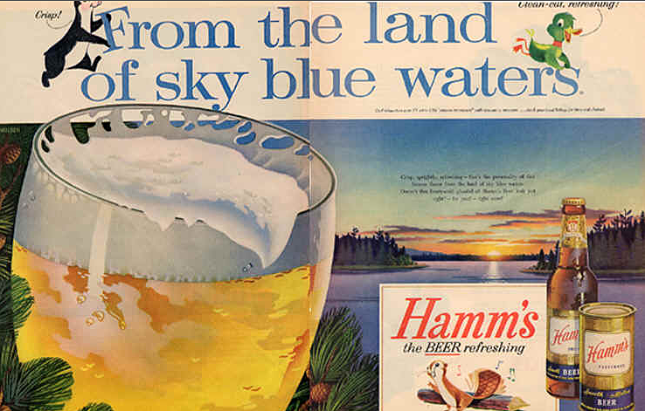
Advertising
Beer at the time proved to be a problem: it all tasted about the same back then.
The USP would emphasize the idea of pure, clear water “from our local source.” Even if that source was the tap.

Slide 32
Advertising
Advertising has clearly enjoyed great popularity and persuasiveness in American society. Some have criticized this. They say advertising
Creates false wants.
Encourages unnecessary consumption people can ill afford.
Is wasteful, diverts money from more important things.

Slide 33
Advertising
Defenders counter that ads
Are economically necessary for society.
Help people become informed about products.
Stimulate economy, production, employment.
And... people can ignore them if they don’t like them.

Slide 34
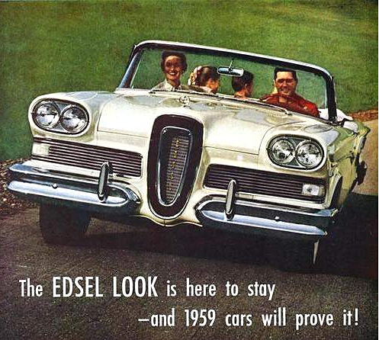
Advertising
It is clearly true that advertising’s central function is to create desires that previously did not exist.
Does this mean that our desires are aroused and shaped by manufacturers, and less by needs of society?
Yet not all advertising is successful. In the 1950s, the Ford Motor Co. introduced its new model: the Edsel.

Slide 35
Advertising
The Edsel was based on marketing studies asking people what they wanted to see in a car.
It ideally matched people’s stated tastes.
Except when the Edsel came out, it didn’t sell. Despite massive advertising, people just didn’t like despite what they told researchers. Advertising has great persuasive power—but how and when is sometimes hard to predict.

