Slide 1
Typography
Anatomy and usage of type for publication

Slide 2
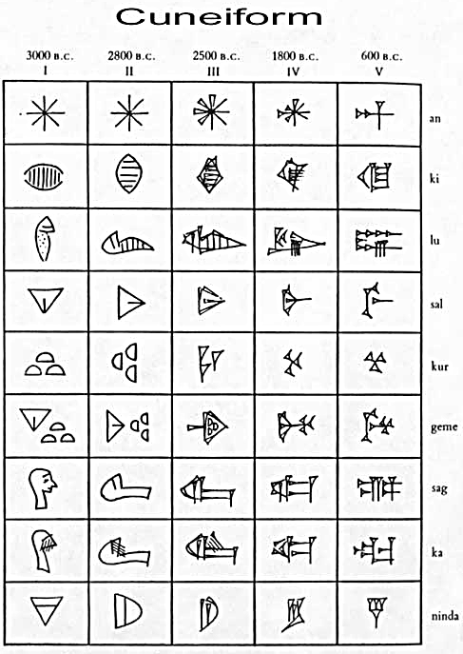
Typography for designers
Words and pictures once were the same.
Pictographs, such as Egyptian cuneiform, also formed a system of writing. Pictographs are still used in some Asian cultures such as China and Japan.

Slide 3
Typography for designers
The Phoenicians are credited with inventing the first alphabet based not on the way things looked, but on the way they sounded when pronounced.
This was about 1600-1000 B.C.E.
Question: Where was ancient Phoenicia?

Slide 4
Typography for designers
Phoenicia was on the Mediterranean, occupying present-day Lebanon, Syria, and northern Israel.
Attaching letters to sounds meant that letters no longer had a visual representation of the word. They were simply arbitrary designs. “Dog” does not look like a dog.

Slide 5
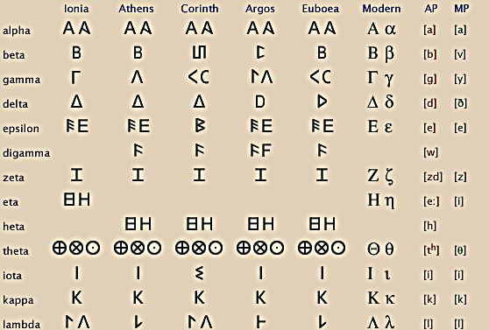
Typography for designers
Between 900-400 B.C.E. the ancient Greeks added vowels to a written language borrowing aspects of Phoenician.

Slide 6
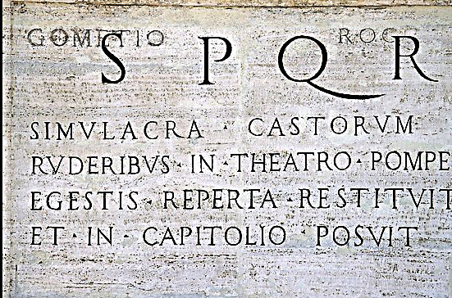
Typography for designers
Romans borrowed from Greek, but changed eight letters: C, D, G, L, P, R, S and V. They also added F and Q.
The Roman alphabet is still used today, not much changed from ancient times.

Slide 7
Typography for designers
The Roman style influenced what we today call majuscules, or capital letters. They were related to writing in stone.
Minuscules, or small letters, developed more slowly, tied to writing with a pen.
But design of both were related to the way Romans held stone tools.

Slide 8
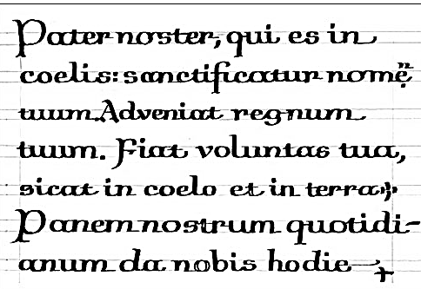
Typography for designers
After the fall of the Roman Empire (467 C.E.),western writing styles split based on areas of Europe.
Cursives are slanted letters, and uncials are rounded letters, written by hand. They became popular from 300-900 C.E.

Slide 9
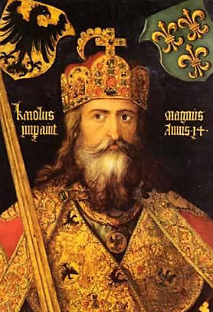
Typography for designers
During the Middle Ages regional writing styles developed in Britain, France, Italy, Spain, and Germany.
Charlemagne tried to re-unify the old Roman Empire in Europe, and re-unify writing styles.
Charlemagne’s style came from the Abbot of York, in England. The new idea: combine the minuscule with the majuscule.

Slide 10
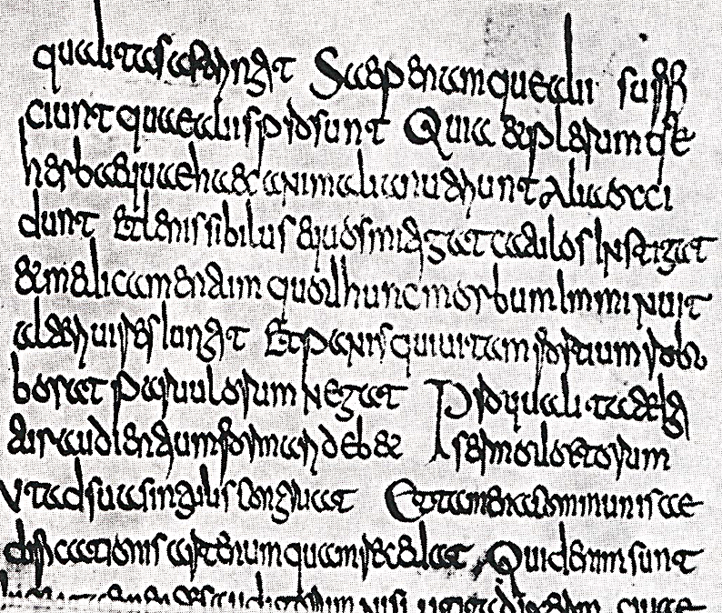
Typography for designers
This was called Carolingian script.

Slide 11
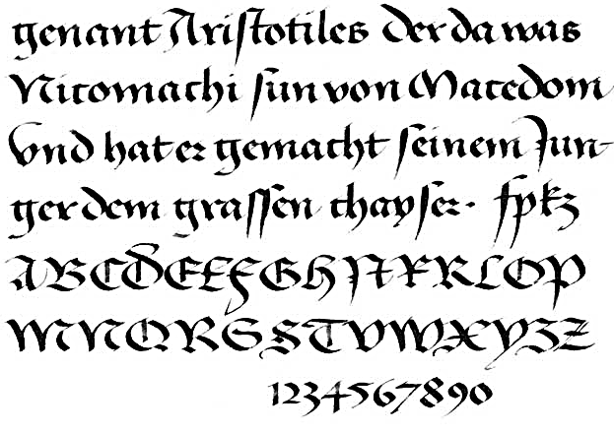
Typography for designers
After the Carolingian empire fell, the Catholic church of Rome emerged as the dominant force in Western Europe.
The church style in type an architecture was Gothic: soaring cathedrals and “blackletter” typeforms.

Slide 12
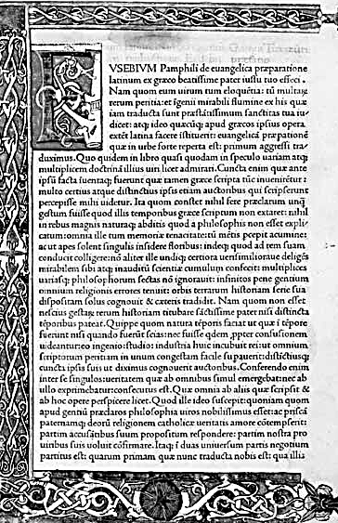
Typography for designers
But the earlier Carolingian script finally prevailed in Renaissance Europe.
We call that “humanistic hand.”
This emerged at the dawn of movable type, in the late 1400s.

Slide 13
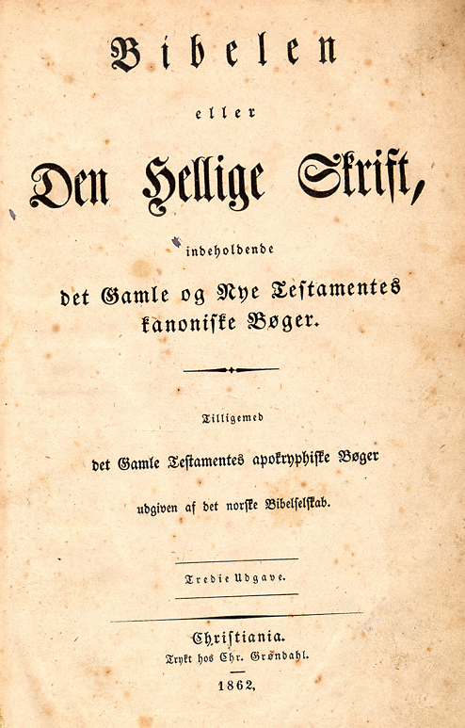
Typography for designers
Germany and Scandinavia did not immediately move to humanistic hand. In fact, blackletter continued to be used into the early 20th century.
Your family Bible might be in the old-style blackletter.

Slide 14
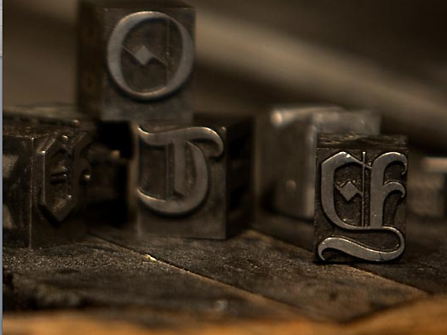
Typography for designers
The invention of printing emphasized conformity of type. It had to be carved from wood or metal.
Three letters were added to the alphabet in the early years of movable type: I, U and W.
Punctuation and diacritical marks also were added.

Slide 15
Typography for designers
Before this time, it was often thought unnecessary to use punctuation, or even spaces between words.
Thetextwasstillreadablebutitmusthavegotteniringhavingtoconcentratesomuchallthetime.

Slide 16
Typography for designers
Italic type emerged during age of incunabula (before 1500).
Today we use it for emphasis; then it was used to fit more letters onto a page.
Early printing was often done on expensive hand-made paper, or even vellum— a processed calfskin, and very expensive.

Slide 17
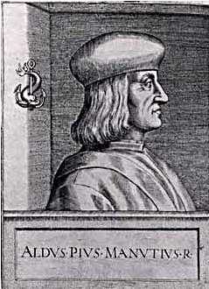
Typography for designers
An Italian, Aldus Manutius, originally designed italics by slanting letters to squeeze more type on a page.
Aldus worked in Venice, a center of early type design and printed books.

Slide 18
Typography for designers
Italic text in publication design is not just a slanted form of roman. It is a separate design.
The equivalent for sans serif typefaces is called oblique. Oblique, on the other hand, is simply a slanted form of the letters.

Slide 19
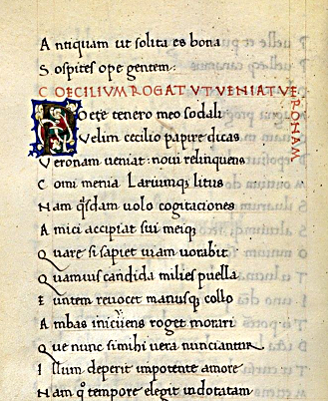
Typography for designers
Also part of early design is the drop cap. Its influence comes from the days before the invention of moveable type, when all manuscripts were hand copied.

Slide 20
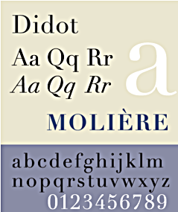
Typography for designers
By the 1700s type design moved more and more away from influences of calligraphy, and became more scientific in proportion and based on machine-design abilities.
A French design family, Didot, designed modern faces reflecting the Age of Enlightenment. Along with Fournier they also invented the pica system of measurement.

Slide 21
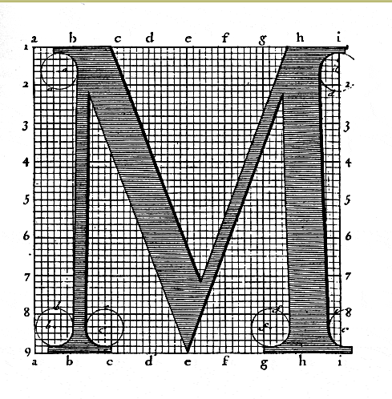
Typography for designers
Modern type grew in the early 1700s to reflect the rise of rationalism.
Louis XIV in France decreed that type should move away from calligraphy.
The French academy designed a grid of mathematical proportions to create modern type styles.

Slide 22
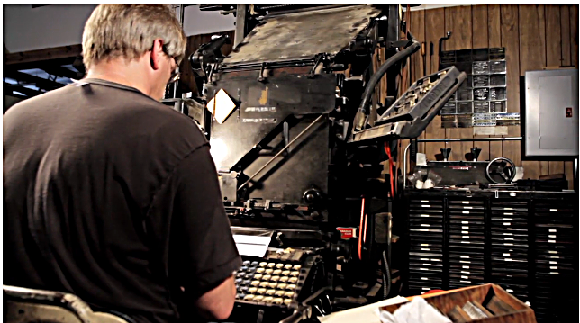
Typography for designers
In the 1880s the Linotype machine made it possible to set metal type automatically. Ottmar Merganthaler’s machine is one of several inventions from this period that made mass media possible. [http://vimeo.com/15032988]

Slide 23
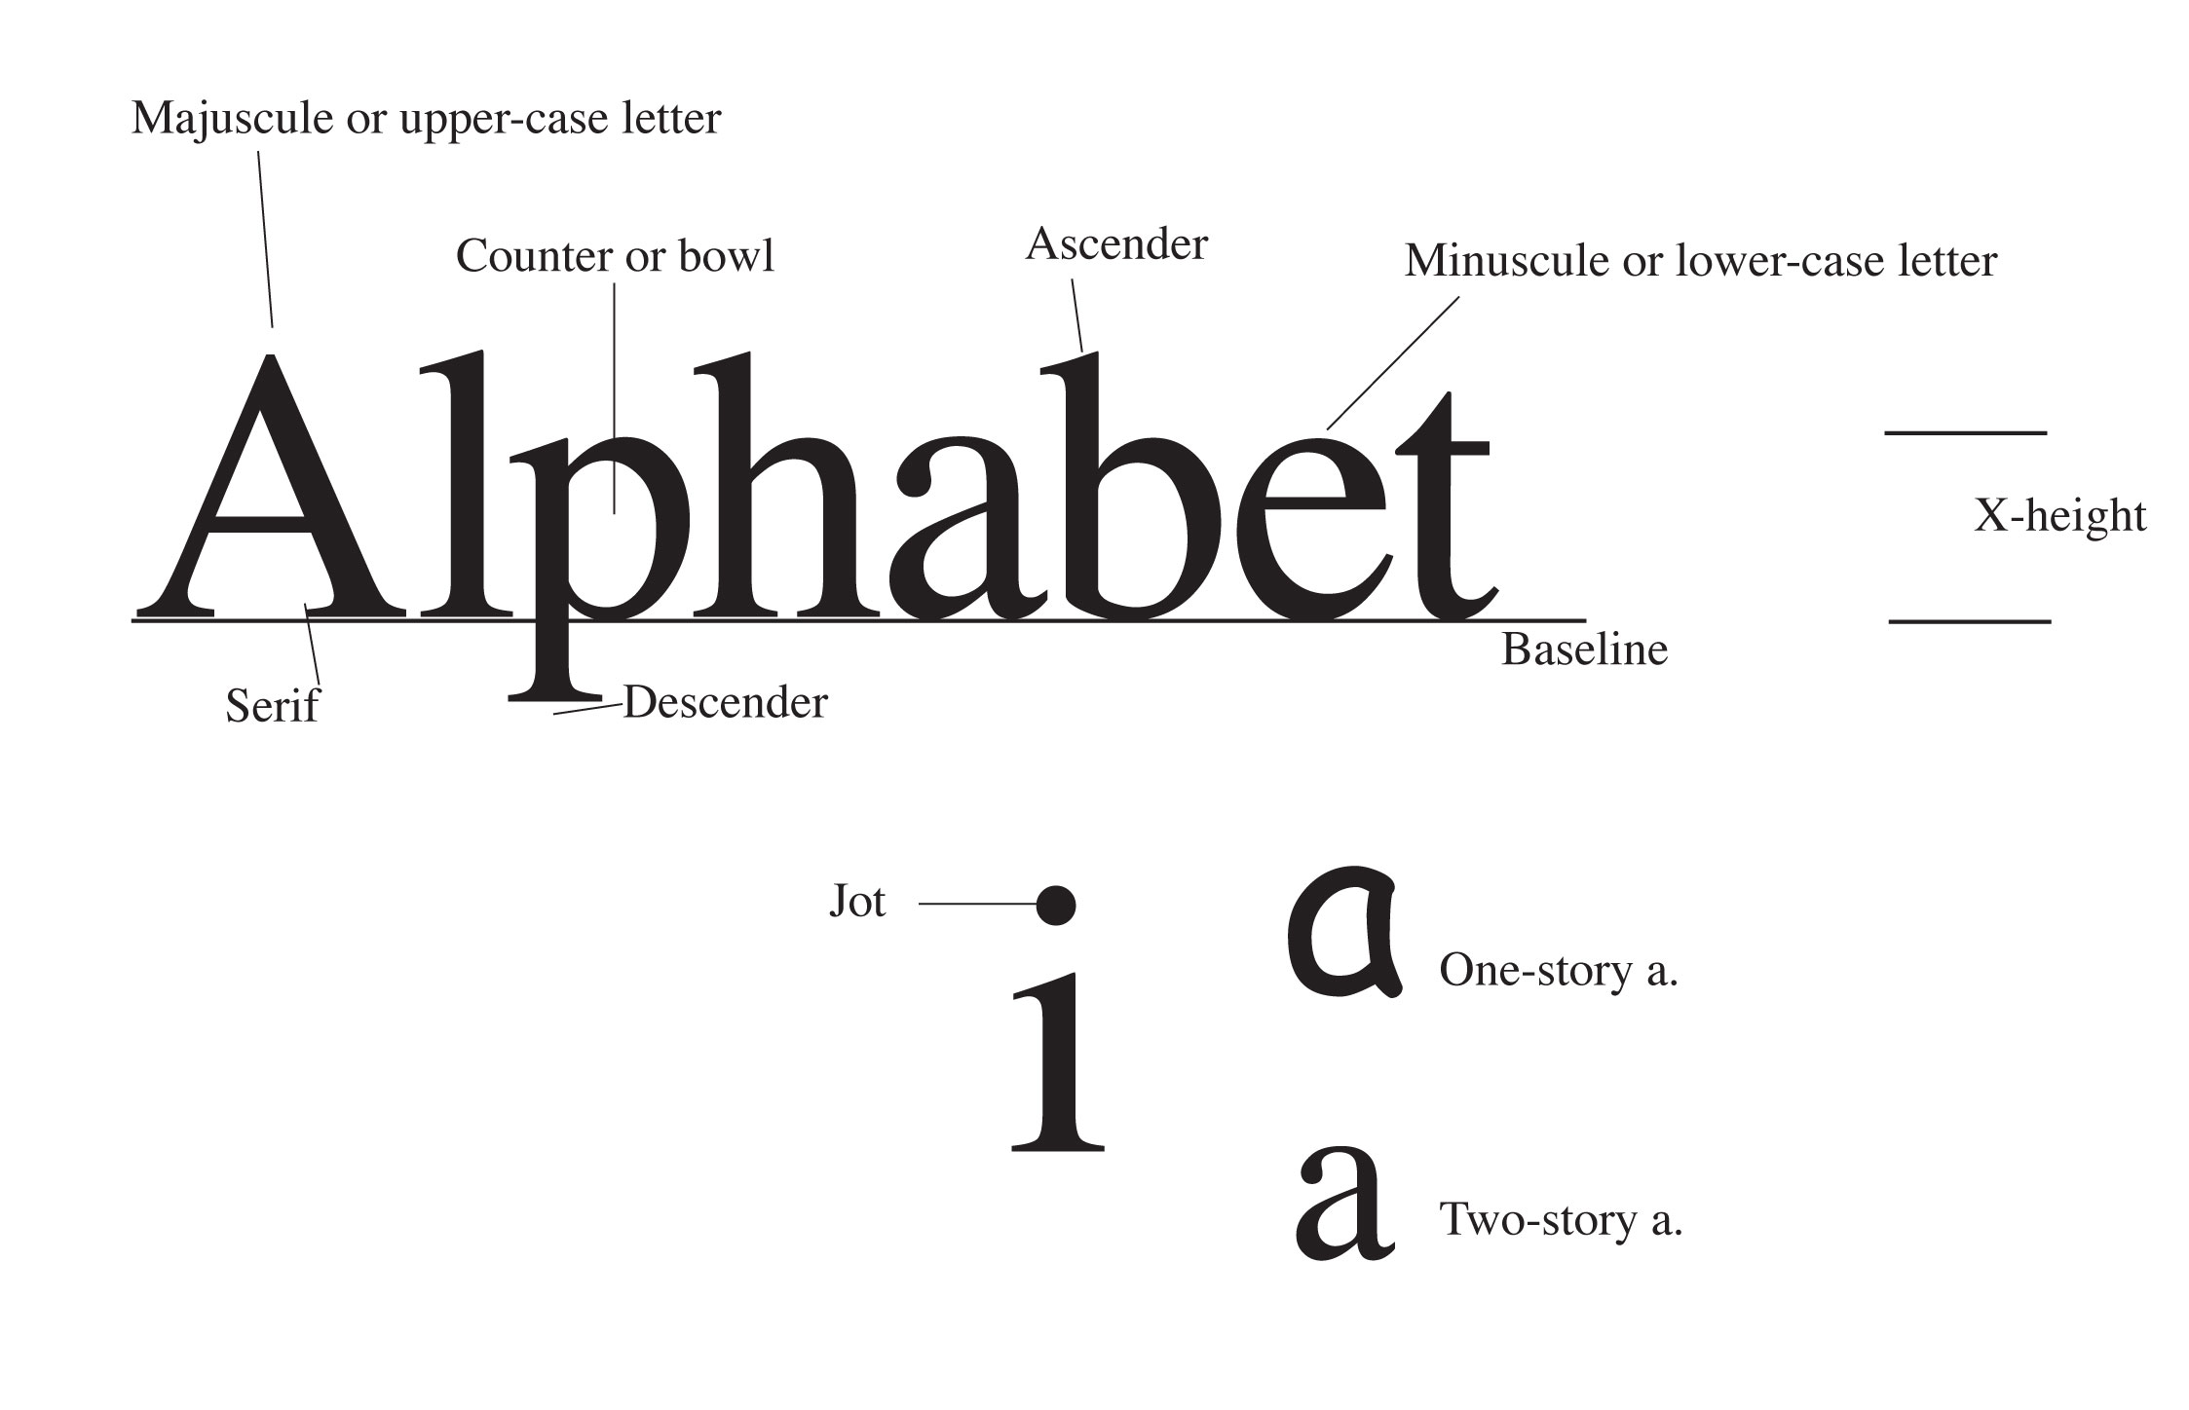
Typography for designers
Type terminology is based on the machine age, and so seems quaint in the computer age.

Slide 24
Typography for designers
Type in the U.S. is measured in points and picas.
12 points (pts)=1 pica (p); 6 picas=1 inch.
Display type is generally measured in units of 6 or 12 pts.
“Agate” type is very small, about 5 pt. Other body type is between 7 and 12 pts.
Display type is 14, 18, 24, 30, 36, 48 pts. Etc.

Slide 25

Typography for designers
Type is measured on the amount of space it sits on, the “stamp.”
Type of the same point size can be larger or smaller depending on its x-height.
Note below two examples of a lower-case x, helvetica and times. Both are 24 pt.

Slide 26
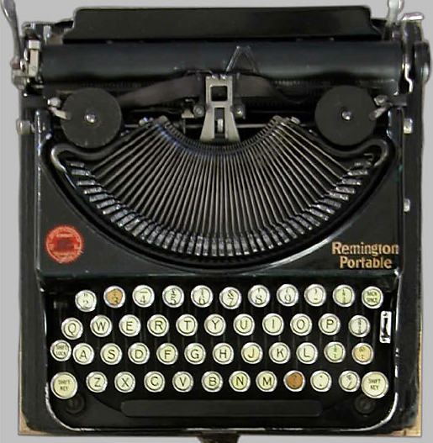
Typography for designers
A “font” is strictly speaking one size, one style of type, like a typewriter keyboard.
A typeface is all possible permutations of one font, as designed by a type designer.

Slide 27
Typography for designers
Leading (“ledding”) is the amount of space between each line of type.
Expressed in points: 12 pt type with 3 pts of leading between each line is called “twelve on fifteen,” 12/15.
Type with no leading, such as 12/12, is “set solid.” But it still has space between each line, due to size of the (now imaginary) stamp.

Slide 28
Typography for designers
Kerning is adjusting the amount of space between letters. (Strictly speaking, kerning is reducing space; letter spacing is increasing.) Applies mostly to display text.
Tracking is the spacing between letters in body text.

Slide 29
Typography for designers
We can separate typefaces into six broad categories or “races”:
Roman
Sans serif
Egyptian (slab serif)
Script
Blackletter
Novelty

Slide 30
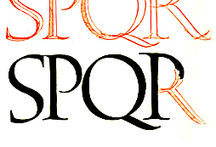
Typography for designers
Roman (spelled with lower case “r”) dates from the beginning of printed books (“incunabula,” before 1500)
As a serif style, it is still extensively used today.

Slide 31
Typography for designers
Roman is so important that it is separated into three categories:
Old style
Transitional
Modern

Slide 32
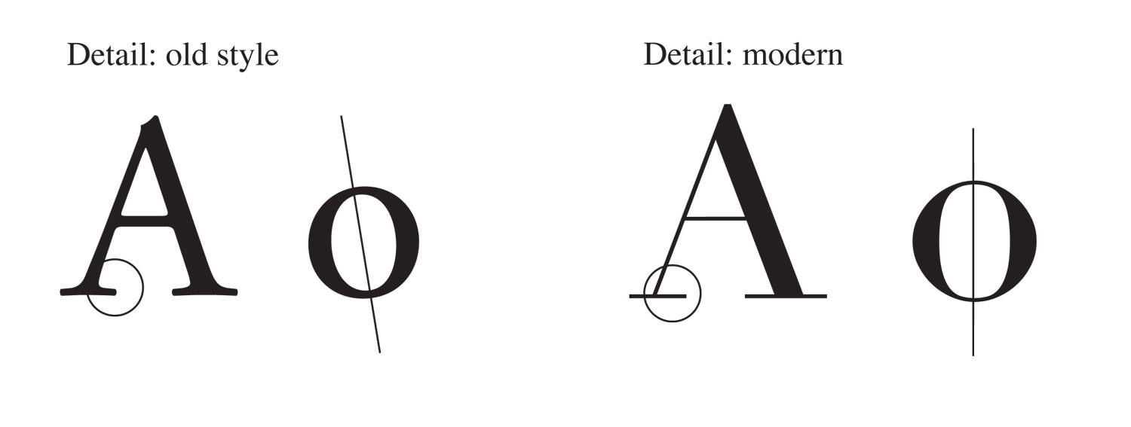
Typography for designers
Old style is closest to calligraphic writing.
Thick and thin areas slanted (oblique)
Little brilliance (difference between thicks and thins).
Brackets.
To remember this think “SLOBB”: SLanted Obliquely, Brackets, Brilliance.

Slide 33
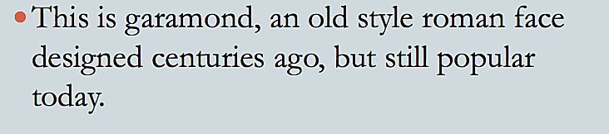
Typography for designers
Old style roman:

Slide 34
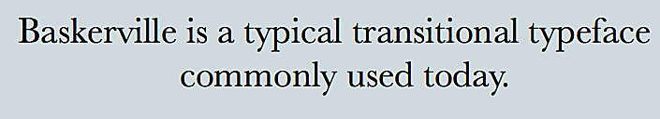
Typography for designers
Roman transitional is less slanted, more brilliant, and less obvious brackets. It dates from 1700s-early 1800s.

Slide 35
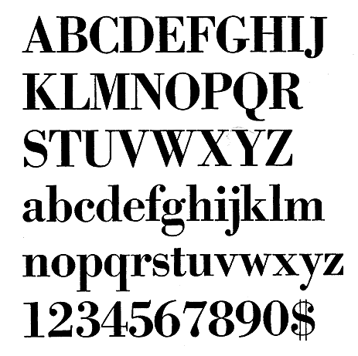
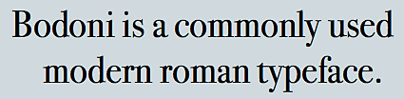
Typography for designers
Roman modern reflects machine-age ability to create metal type with no slant, strong brilliance, and no brackets. It dates from 1700s as well.

Slide 36
Typography for designers
Sans serif typefaces, or “sans,” date from the early 1800s, but became popular mostly in the last century.
“Form follows function,” Bauhaus popularized sans.
Helvetica is a popular sans serif style
designed in the 1950s. It is so widespread that it’s featured in a film, “Helvetica.” [http://www.youtube.com/watch?v=LL60GEGjj_Q]

Slide 37

Typography for designers
Egyptian, or “slab serif,” was the rage in nineteenth-century America and Europe, as it supposedly resembled Egyptian cuneiform at a time when Egyptology was popular.
Rockwell, with its blocky slab serifs, has a 1920s feel.
Exaggerated slabs shout like an Old-West poster:

Slide 38

Typography for designers
Publishers like to use slab serif faces because they call attention to themselves. They SHOUT.

Slide 39

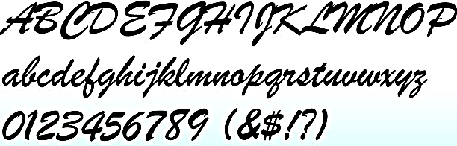
Typography for designers
Script resembles hand writing.
Useful for advertising and specialized publications.

Slide 40
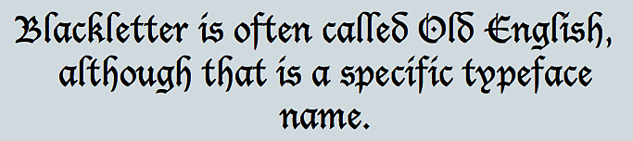
Typography for designers
Blackletter resembles original Church-based gothic style of the middle ages.
Used in Germany until the twentieth century.
Mostly decorative, advertising and specialty pubs.

Slide 41
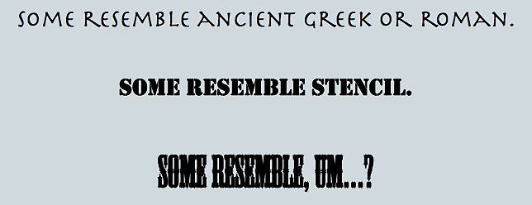
Typography for designers
Other decorative styles are used sparingly, and never for body text.

Slide 42
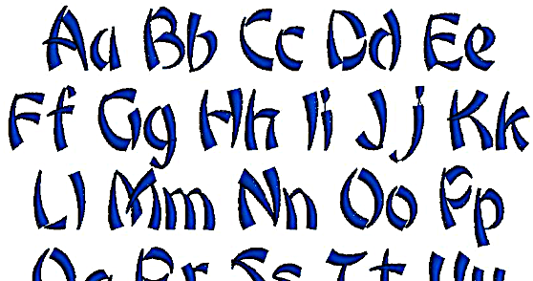
Typography for designers
Fancy fonts can be typographic clichés, and graphic artists try to avoid cliché designs, as writers try to avoid cliché expressions. For example, bamboo to depict Asian themes.

Slide 43

Typography for designers
“Dingbats” are typographic flourishes like arrows, stars, pointing hands, etc. Also called “pi” faces.
Called glyphs in InDesign.
Most familiar is Zapf dingbats, designed by Hermann Zapf, a well-known type designer.

Slide 44

Typography for designers
Most type is designed to be proportional, that is, a different amount of space for each letter to make it more attractive.
Monospaced typefaces are similar to typewriter-style faces, giving the same amount of space to each letter.
Monospaced fonts are often used for screen fonts, seldom for printed material.

Slide 45
Typography for designers
Choosing body type and leading are critical to the personality and readability of your publication or website.
Old style type is nostalgic, eloquent, trustworthy, personal, traditional, sincere, informal.
Modern type is crisp, dressy, technical, modern, formal.

Slide 46
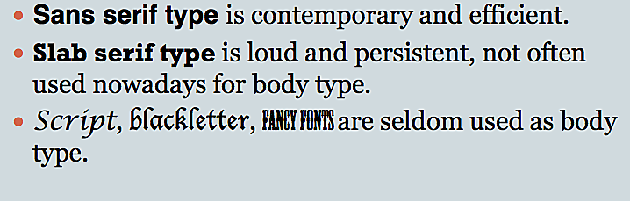
Typography for designers

Slide 47
Typography for designers
Note that the amount of space between each line (leading) is critical to the personality of your publication.
InDesign’s Auto Leading will give you about one-third space above, two-thirds space below. But many designers set their own leading.

Slide 48
Typography for designers
Old style typeface

Slide 49
Typography for designers
Modern typeface

Slide 50
Typography for designers
Sans serif typeface

Slide 51
Typography for designers
Egyptian typeface.
(Also called slab serif.)

Slide 52
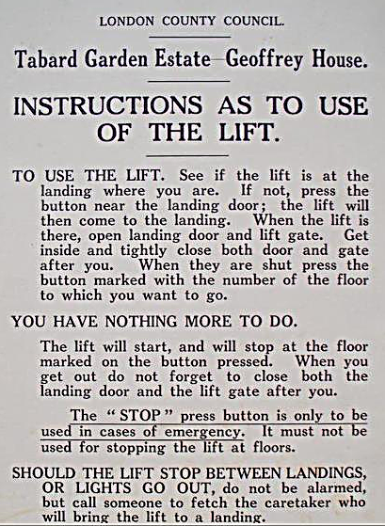
Typography for designers
Type choices also reflect historical usage and cultural tastes.
Cheltenham, a late-transitional face, was popular in the 1920s, and so newspapers from that period are identified with “Roaring 20s.”

Slide 53
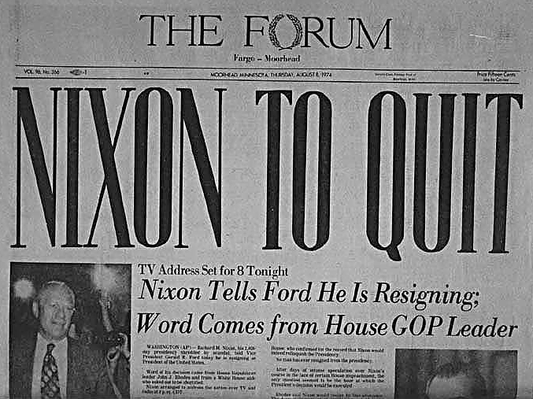
Typography for designers
Bodoni was popular for headlines in the 1960s-70s.

Slide 54

Typography for designers
Helvetica was popular in the 1970s-80s for text. It’s still popular in display sizes.

Slide 55
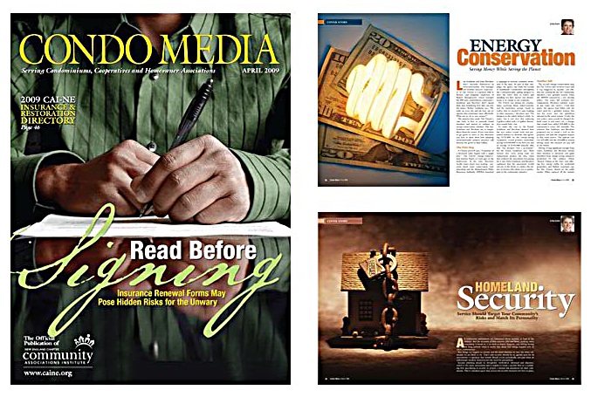
Typography for designers
In choosing type, we need a sensitivity not only to our style of publication, but to zeitgeist—spirit of the day.

Slide 56
Typography for designers
Readability studies beginning in the 1920s have shown:
Legibility and readability are different; blackletter may be legible but not readable.
ALL CAPITALS OR Capitalizing Every Word is Less Readable.
Very short or long lines are less readable: one and one-half alphabets (39 characters) maximum.
Tinted backgrounds, justified type make no difference.

Slide 57
Typography for designers
Basic rules for type:
Never mix faces of the same race, especially if they are similar; bodoni and century schoolbook on the same page, for example, looks uncomfortable; readers will feel something is wrong.
Use one family for headlines, another family for body text; allow one family to dominate.
To maintain harmony yet add variety, choose display same typeface in boldface (bf), italic (ital), expanded, condensed.

Slide 58
Typography for designers
Typographic pitfalls:
Poor spacing, particularly in justified text.
Two spaces after each sentence.
“Rabbit-ear” quotes instead of typographer’s quotes.
Two hyphens —or one—instead of an em-dash (Option-shift-hyphen).
Hyphen instead of en-dash for time expressions, such as 8–5 p.m. (Option-hyphen).
Wrong apostrophe for year contractions: ‘99 should be ’99 (Option-shift- ]).

Slide 59
Typography for designers
More typographic pitfalls:
Relying on “Auto” leading. Choose a leading so that if you make text larger, space will stay the same.
Leaving the same amount of space above and below a headline. Leave a little more above, a little less below.
Punctuation outside quotes, such as “The Golden Rule”. Always punctuate first (U.S. style), except for semicolons and colons.
Inconsistency: spacing should be the same between photos and cutlines, heads and text, subheads, etc.

Slide 60
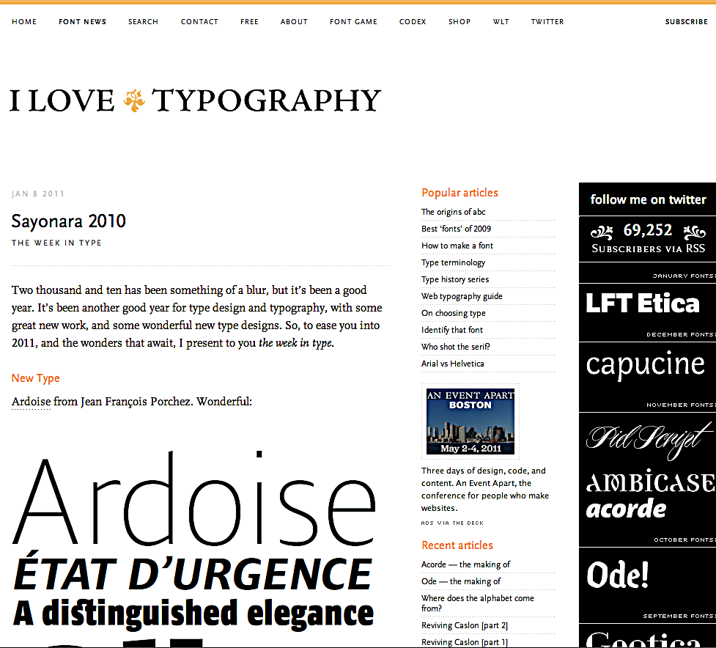
Typography for designers
If you want to know a lot more, and have a lot of fun, with typography, check out www.ilovetypography.com.

