Slide 1
Covers and papers
Considerations for covers, paper, and binding

Slide 2
Magazine covers
The cover of a magazine is most important. It has to attract readers quickly.
A good cover should identify magazine, set it apart from others.
It should attract attention of primary audience.
It should encourage the reader to open the magazine.
It should set the tone, the mood of the magazine.

Slide 3
Magazine covers
Usually on a magazine cover you need to include:
A logo and/or nameplate.
Date, volume number.
Price, if sold, and UPC (scan) symbol.
Room for address label, if mailed.

Slide 4
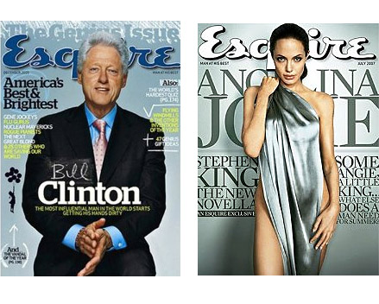
Magazine covers
Research shows depiction of a famous person on a cover will sell more magazines. If a celebrity is shown wearing less clothing, it will sell even more magazines!

Slide 5
Magazine covers
Two styles of magazine cover:
Separate cover.
Self cover.
A separate cover is usually heavier, glossier, and more colorful.
A self cover uses the same paper stock as the rest of the magazine. It not only is cheaper, but allows a graphic artist to use the same spot or process colors on the entire 8-, 16-, or 32-page signature.

Slide 6
Magazine covers
Magazine covers are designed to sell magazines.
Most contain teasers or blurbs to entice readers into the magazine. A blurb can follow a teaser.
Teasers and blurbs should never be longer than three lines, and never take longer than five seconds to read.
Teasers used to be placed on the left, so that they would show on a magazine rack. But the system has changed; now they can be anywhere.

Slide 7
Magazine covers
Back and inside covers have traditionally been used for advertising. Back and front cover have highest readership.
If your publication has no advertising, consider a consistent element on these spaces, something repeated from issue to issue.
Elements may include table of contents, introductory blurbs, editor’s note, list of authors, photos or illustrations.

Slide 8
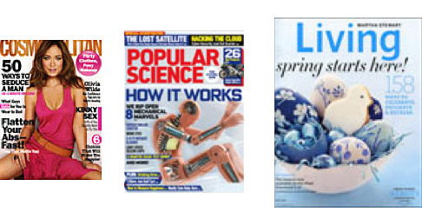
Magazine covers
Some familiar magazines.

Slide 9


Magazine covers
Some magazines that don’t need to compete with others may sometimes forgo the teasers.

Slide 10
Magazine covers
Keep in mind that, except for the front and back cover, readers always see a spread—that is, two pages at the same time. This means that magazine page design is actually a horizontal space, not a vertical space.
Many designers consider this space using the ATSI guidelines: begin with Art (photo or illustration), then Title (headline), Subhead (deck) and Initial capital letter.

Slide 11
Magazine covers
Draw a rough of a possible magazine cover design for a class magazine project, based on the guidelines below. Then create a rough using InDesign. Incorporate at least one idea from other magazine designs you have seen.
Distinctive look.
Tone or mood.
Logo/nameplate.
Photo or illustration/possible bleeds.
Teasers and blurbs.
Separate cover or self cover.

Slide 12
Paper and binding
We tend to take paper and binding for granted. But the “stock,” as printers call paper, can enhance your design—or detract from it.
A little history: “Paper” came from “papyrus,” an ancient Egyptian word. But Egyptian paper was not like modern paper.
Egyptian paper (papyrus) was made as early as 3000 B.C. by weaving reedy plant stalks together and pasting with sticky juice, then pounding to thin and smooth.

Slide 13
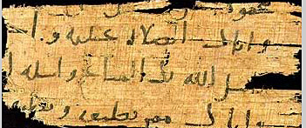
Paper and binding
An Egyptian papyrus fragment.

Slide 14
Paper and binding
Chinese invented real paper in second century A.D.
Ts’ai Sun is giving credit for floating vegetable fibers such as mulberry bark and bamboo, allowing them to settle, then drying as a sheet.
The technique reached the West about 600 years later, as Arab conquerors in Central Asia brought back a few papermakers.
From North Africa the technique reached Europe , reaching England in 1494.

Slide 15
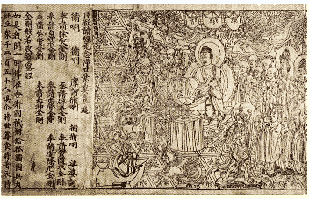
Paper and binding
This is the oldest dated printed book on paper that we know of: the Diamond Sutra of the Chinese Tang dynasty, 868 A.D.

Slide 16
Paper and binding
No paper makers were living in the American colonies before 1690.
Before paper, in the West books were written on vellum.
Vellum is a smooth, processed calf skin designed for writing.
“Vellum,” meaning a modern type of translucent writing paper, is not the same thing! (Can you imagine how expensive it would be?)

Slide 17

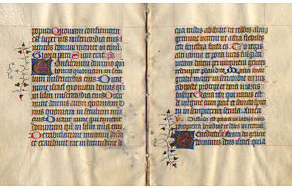
Paper and binding
A medieval illuminated manuscript on calf skin vellum vs. modern “vellum” paper.

Slide 18
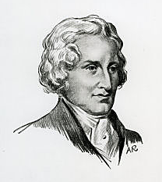
Paper and binding
Real paper today is a kind of cellulose. While all plants contain some cellulose, most paper today is based on cotton (rag) or wood (pulp).
Before the invention of an automatic paper machine in 1798, patented in 1801 by Henry Fourdrinier, paper was made by hand, sheet by sheet, normally using cotton or linen rags. Paper was expensive.

Slide 19
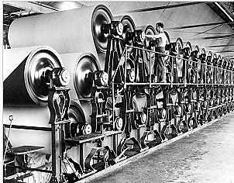
Paper and binding
The automated wood pulp process using the Fourdrinier machine as shown below allowed paper makers to turn out 500,000 cheap sheets instead of 5,000 expensive ones.

Slide 20
Paper and binding
Development of paper based on wood pulp made mass media possible. Before this, newspapers and magazines were expensive, and of limited circulation.
Wood-pulp based paper has a disadvantage. It is processed in an acid bath. Some acid remains in the paper. Exposed to air and light, the acid breaks down the fibers until the yellowed paper crumbles.
The is especially the case for cheap papers, such as newsprint.

Slide 21
Paper and binding
Entire libraries are crumbling, and conservation of our heritage has become a major concern.
Note that books printed in the early 1800s or earlier are generally in much better shape than those printed later.
Acid-free, archival quality stock is available, but it is more expensive. It is seldom used for day-to-day mass media publications.

Slide 22
Paper and binding
To manufacture paper, cotton (rags) or wood pulp is “cooked,” that is, ground with chemicals and bleached to make white pulp.
The fibers are beaten to produce a gelatinous mass that will stick together. At this point, the pulp is more than 90 percent water.
The slurry is strained through a fine screen. As it goes through the screen, fibers line up, giving the paper a “grain.”

Slide 23
Paper and binding
The paper includes short and long fibers. Short fibers give paper smoothness; long fibers give paper strength.
The caustic soda used to produce short fibers, and the sulfates or sulfites used to produce long fibers explain why paper degrades in the air.
The paper is dried on a conveyer belt, squeezing and blotting between felt cloth rollers. The side facing the roller is called the “felt side”

Slide 24
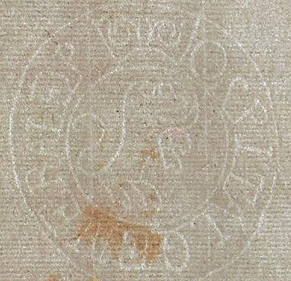
Paper and binding
During drying paper can be pressed with a design called a “dandy roll” to produce a watermark. Note: graphic designers should always use paper with the watermark facing right side up, not reversed.

Slide 25
Paper and binding
The paper is dried to a maximum of 7-10 percent moisture, and rolled.
Sizing may be added to the paper process, producing stock with more “ink holdout,” that is, less dot gain.

Slide 26
Paper and binding
Heated rollers can polish a paper surface, called “calendering,” note, not the same spelling as the calendar on your wall.
Fillers may be added to make the paper more smooth, particularly cheap quality newsprint that has to absorb ink quickly. The use of caustic soda and greater short fibers in this process explains why newsprint degrades so quickly.

Slide 27
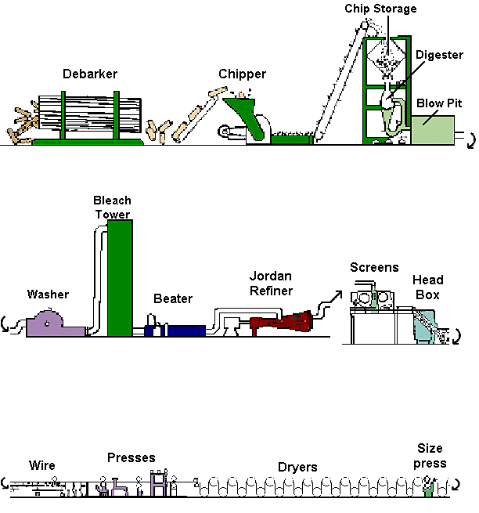
Paper and binding
Here is a sketch of the paper-making process.

Slide 28
Paper and binding
The shiny paper used for many high-quality magazine covers is called coated stock.
Coated stock is paper made shiny by coating with mostly calcium carbonate—that is, clay.
Dull coated stock is also available, less glare so easier to read.
Coated stock is needed for high quality photo reproduction, because the ink dries by oxidation, and not soaking into the paper.

Slide 29
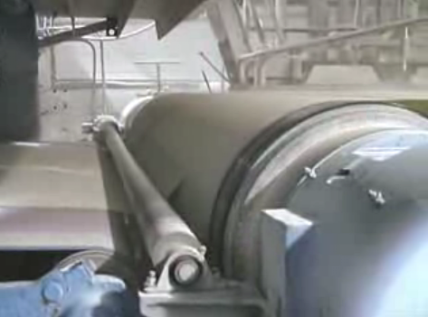
Paper and binding
Here is a quick tour of a Wisconsin paper mill. [http://www.youtube.com/watch?v=7SdJtYkAzTw&feature=related]

Slide 30
Paper and binding
Most graphic designers rely on four basic kinds of stock:
Newsprint.
Book.
Writing.
Cover stock.

Slide 31
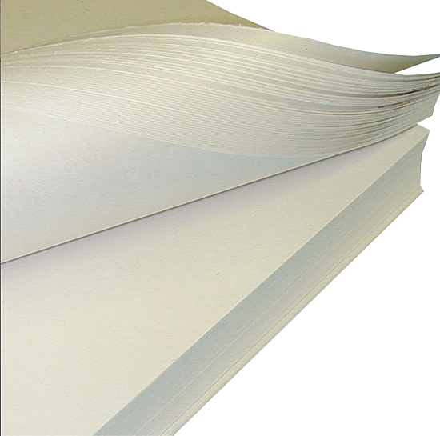
Paper and binding
Newsprint is most common. It is cheap, and can be used for publication which must be distributed within hours of their printing.
It has low strength, and little permanence.

Slide 32
Paper and binding
It also tends to look cheap, and so not a good choice for a higher quality publication.
Newsprint produces a “genre” of newspaper; if a graphic designer uses it, people will presume a quickly produced publication.

Slide 33
Paper and binding
Book stock is offered in a huge variety of styles and sizes. It is most common in our classrooms and offices. Standard size is 25 inches by 38 inches.
Book may be wove or laid. Wove means the texture is smooth. Laid means the texture has a “tooth,” or rougher feel, more like hand-made paper. It is produced using a dandy roll.

Slide 34
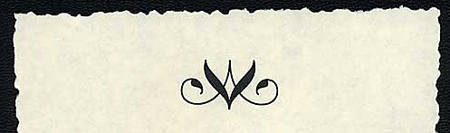
Paper and binding
Laid stock sometimes has deckle edges—rough, ragged edges simulating hand-made stock.

Slide 35
Paper and binding
Writing paper is high-quality stock for stationery or invitations. The highest quality is called bond, and it usually contains cloth or rag content. Standard size is 17 inches by 22 inches.
Highest quality is 100 percent rag; other quality may be 75 percent, 50 percent, or 25 percent.

Slide 36
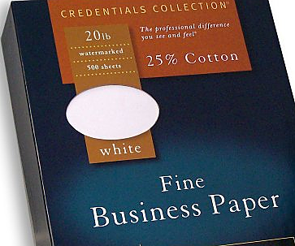
Paper and binding
Usually the paper contains a watermark indicating its rag content.
Rag stock paper has a crisp feel of quality.

Slide 37
Paper and binding
Cover stock is basically thick versions of writing papers. Standard size is 20 inches by 26 inches.
“Bristol board” is actually not cover stock. It is a solid or laminated heavy weight paper for posters, business cards, folders, or other items requiring extras strength.
It is normally 6 mils (.006 of one inch) thick.

Slide 38
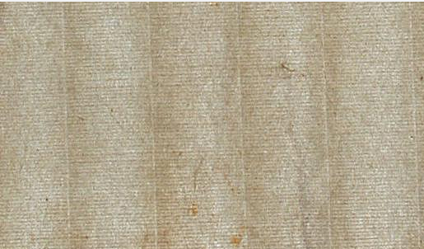
Paper and binding
Here is an example of high-quality laid paper.

Slide 39
Paper and binding
Paper is ordered by weight, measured in “caliper” or thickness, based on mils. One mil is one one-thousanth (.001) of an inch. For example, 8 mil caliper is .008 of an inch.
“Basis weight” is the weight of one ream, or 500 sheets, cut to industry standard. For example, if industry standard for book is 20 by 26, and 500 sheets of that weighs 80 pounds, you have 80-pound basis weight paper.

Slide 40
Paper and binding
The M-Weight is the weight of 1000 sheets cut to a specific size. So if you read a label such as “Basis 80 text, 25” X 38”—160M,” you know 1,000 sheets of that paper, that size, weights 160 pounds. Paper is sold by the pound.
But the industry standard changes for different kinds of paper, making comparisons difficult. Best bet: examine samples.
“Make order” is paper cut to a non-standard size. The produces waste, so costs more.

Slide 41
Paper and binding
“Grain long” means the paper’s grain goes mostly the long way. “Grain wide,” the opposite.
“Opacity” is the ability of the paper to hold back light. Paper you can easily see through might be difficult to read printed on both sides.
“Brightness” is ability of paper to reflect light. Does not indicate whiteness of paper.

Slide 42
Paper and binding
A graphic artist can make use of special features for a truly distinctive product—if they client is willing to pay the price. These include:
Perfs and scores. A perf is a perforation, such as a tear-off coupon or BRC (Business Reply Card).
Scores allow a user to fold the material easily, perhaps for mailing.

Slide 43
Paper and binding
Embossing actually raises the surface of the paper. (Debossing lowers the surface.) With heat the embossing can leave an inked textured logo or letter.
Foil embossing adds colored foil to the embossing, using heat.
Blind embossing uses no ink.
Foil stamping adds colored foil to a flat surface. All these techniques require heat.
If you have to make only a few copies, you can use a laser printer to apply foil stamps.

Slide 44
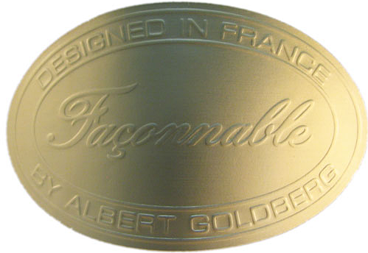
Paper and binding
A blind embossed label.

Slide 45
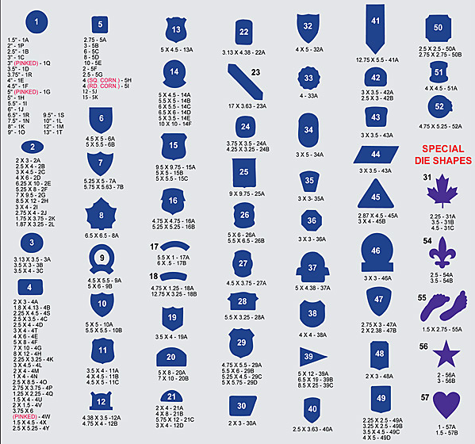
Paper and binding
Die cuts create a decorative pattern or shape, as a cookie cutter.
Both die cuts and embossing require creation of a special brass or steel die. They are, as you might expect, expensive.

Slide 46
Paper and binding
Most graphic artists do not understand the binding process.
Note that paper is produced in long rolls. These are cut by printers to a standard size, say, 25 X 38 for book paper.
These large sizes allow the printer to produce a number of pages on one sheet, using both sides of the paper. In fact, the number may be 4, 8, 16, 32 or 64 pages.

Slide 47
Paper and binding
These large pages are then folded, and trimmed to size.
The multiple-page sheets are called signatures. So a 32-page signature contains 32 pages, 16 on each side.
Note a graphic artist who wishes to create a signature must place items on the correct pages, and facing the correct direction, so they will line up correctly after folding, This is called imposition.

Slide 48
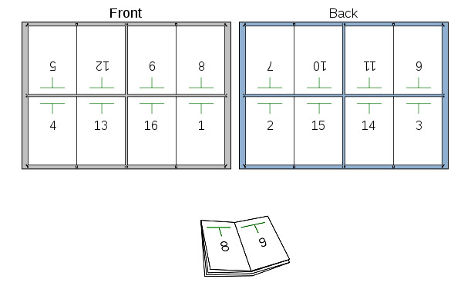
Paper and binding
Imposition of a 16-page signature.

Slide 49
Paper and binding
Printers try to set up pages to have as little waste possible. This is why page sizes have been standardized, and printers do not want to add an entire signature for, say, 20 more pages. It costs money.
Note if you design a book of, say, 70 pages, you will use two 36-page signatures. Two pages at the end will be blank.
Most of the time, the printer will handle imposition. But InDesign can do it for you automatically, if necessary.

Slide 50
Paper and binding
Printers fasten pages of a publication in five basic ways:
Saddle stitching.
Side stitching.
Perfect binding.
Sewed-case binding (soft or hard).
Mechanical binding.

Slide 51
Paper and binding
A stitch is printer terminology for a staple.
Folding pages in half, and stapling them at the fold and through the publication’s spine, is called a saddle stitch.
Magazines are often saddle-stitched.
On the plus side, it is cheap, and pages lie flat.
On the minus side, it only works to about 32 pages. Also, it is not very strong—pages tend to fall out in hard use.

Slide 52
Paper and binding
Side-stitched publications have staples through the binding through the sides. Sometimes the spine is also glued.
This method is fairly cheap, and produces a hardier publication than saddle-stitching.
A drawback is that it works only up to about a half inch in thickness. Also, pages don’t lie very flat, and large photos on inside pages are hard to see.

Slide 53
Paper and binding
“Perfect” binding is not so perfect, but this was once a trade name for a glued spine binding.
It is fairly cheap, will work for larger books, and allows books to stay flat for reading.
It is not very strong; pages have a tendency to fall out.
Most paperback books are perfect bound.

Slide 54
Paper and binding
The sewed-case binding is the traditional “gold standard” of bindings.
Works primarily with publications printed in signatures. Signatures are gathered and sewn together at the spine.
This allows the book (as it usually is) to open flat for readability, yet produces a tough book.
Hard-cover bindings add a cover glued to the binding using tough end papers.
Sewed-cased bindings are expensive, however.

Slide 55
Paper and binding
Mechanical bindings require the printer to punch holes in the paper and insert a plastic (“comb”) or spiral wire binding.
Also called loose-leaf bindings, these are favored for workbooks that lie flat, and for books in which pages can be easily added or removed. The bindings are tough.
On the negative, the spine normally can’t be used to print the book title. Also, loose-leaf bindings do not suggest a quality book.

