Slide 1
The eye and the mind
It appears that our eye determines an image: we merely open our eye, and there it is!

Slide 2
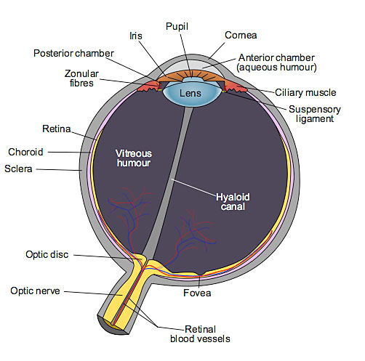
The eye and the mind
How does the eye work?

Slide 3
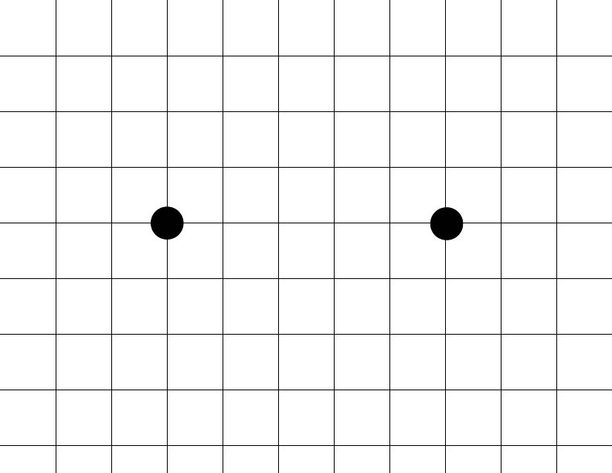
The eye and the mind
But the eye is not that perfect
• Upside down images.
• Curved lines.
• Blind spot.

Slide 4
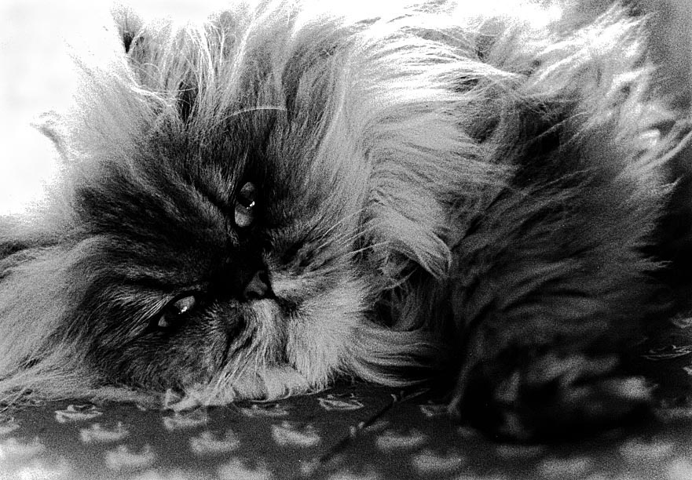
The eye and the mind
Apparently what we see is not necessarily what is there. This is a principle of Gestalt psychology.
What do you see in the image below?

Slide 5
The eye and the mind
Most of us would see a cat.
But research with people who were not used to black-and-white photography might see only inky black smudges. And, of course, they would be correct.

Slide 6

The eye and the mind
We see what we learn to see, to read photos.
What do you see in the photo below?

Slide 7
The eye and the mind
Here is a cutline:
Muslims celebrate Eid Al Adha, the feast of sacrifice, on a street in Fez, Moracco. One of the two most important Muslim holidays, it is celebrated by each family. A live sheep is ritually slaughtered in the kitchen as a symbol of sacrifice. The sheep head often ends up charred on a street-side brazier while children play in the sun with glistening sheep intestines.

Slide 8
The eye and the mind
The image can’t be understood without knowledge of Muslim practices.
We learn to see what we see.

Slide 9
The eye and the mind

Slide 10
The eye and the mind
Visual cues based on “genre” sometimes tell us what we are seeing.
We see what we’re told we are seeing. This is why in mass media you normally are expected to use cutlines.
Designers use visual cues to define publications.

Slide 11
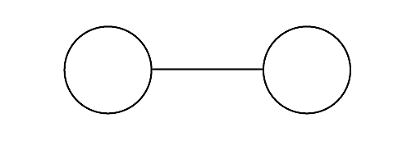
The eye and the mind
In another Gestalt experiment, people were briefly shown the drawing below. Then they were asked to draw what they saw.
Half the group was told “Draw the eyeglasses.” The other half, “draw the dumbbells.”

Slide 12
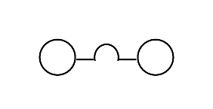
The eye and the mind
Here’s what the first group drew.

Slide 13
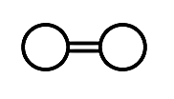
The eye and the mind
Here’s what the second group drew.
Both, of course, were wrong. But people saw what they were told to see.
We see what we expect to see, what we’re told to see, or what we want something to mean.

Slide 14
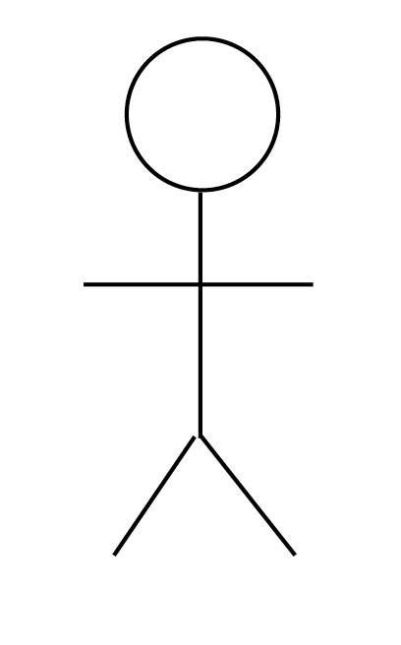
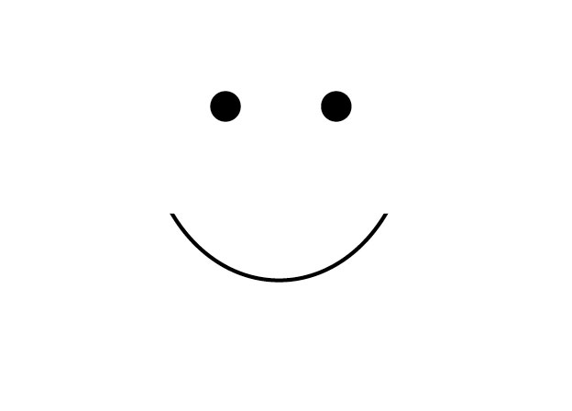
The eye and the mind
We add or subtract information from a visual image until it makes sense to us.
The brain tries to make an image “make sense.” [http://www.youtube.com/watch?v=MrAwr-ReuVA]

Slide 15
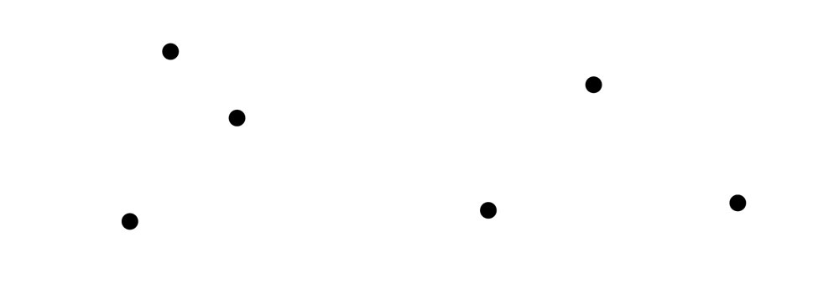
The eye and the mind
But knowledge and learning don’t limit the brain’s ability to perceive visual information: the brain reacts emotionally and instantly to patterns and relationships.
What do you see in the drawing below?

Slide 16
The eye and the mind
Many people say they see two triangles. But it’s not. It’s six dots.
Our brain associates objects that are near to each other, called the principle of proximity:
“The closer an object is to another, the more it will be perceived as one.”

Slide 17
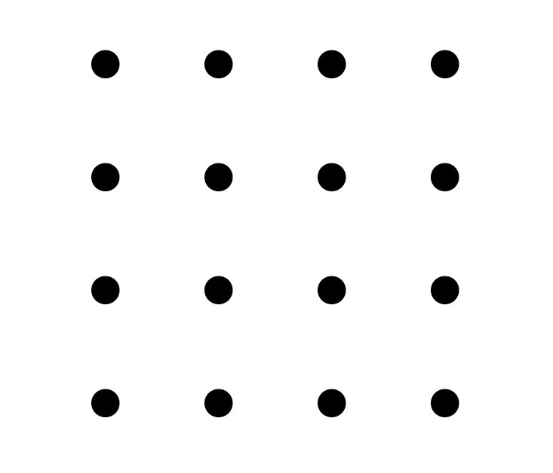
The eye and the mind
Drawings of equidistant objects do not appear associated.

Slide 18
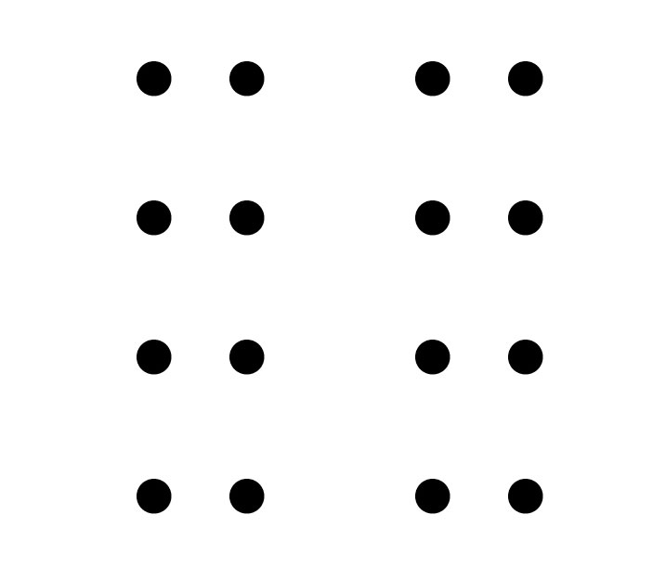
The eye and the mind
Move two rows, however, and now we appear to see two vertical lines.

Slide 19
The eye and the mind
We can play games with proximity. Are these numbers or letters?

Slide 20
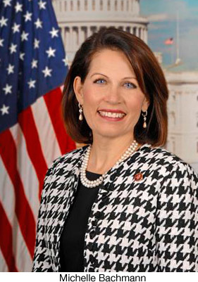
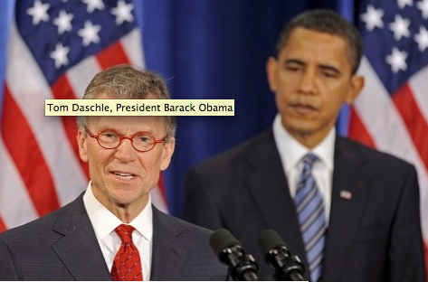
The eye and the mind
This principle can be applied to photographs. We associate people with backgrounds. Political publicists know this, and so try to put politicians in patriotic settings. Both parties do this, of course.

Slide 21
The eye and the mind
Temporal proximity can be used by film makers to suggest two scenes that occur together are related.
Proximity is a powerful tool, but can be manipulated to make false relationships…. [http://www.youtube.com/watch?v=Av5Ap3nxToM&feature=related]

Slide 22

The eye and the mind

Slide 23
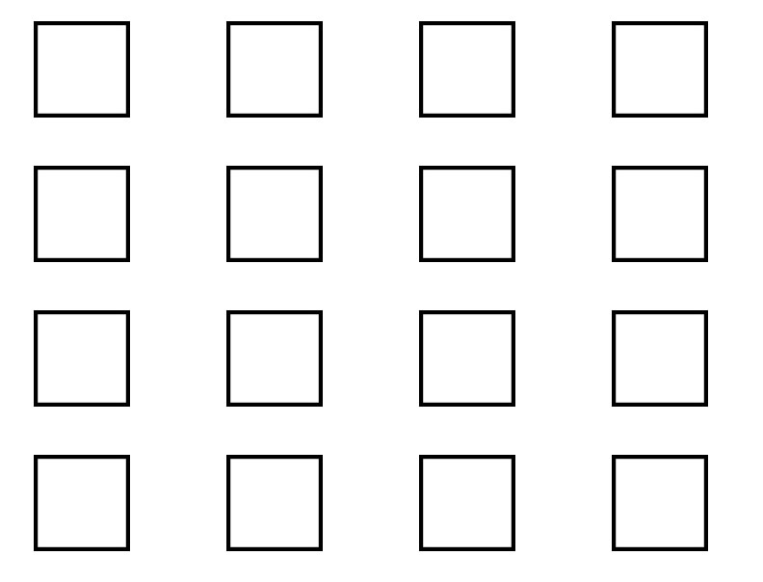
The eye and the mind
We can suggest relationships in other ways. The principle of similarity suggests:
“similar visual elements appear to be related.”
The first drawing below shows no relationship.

Slide 24
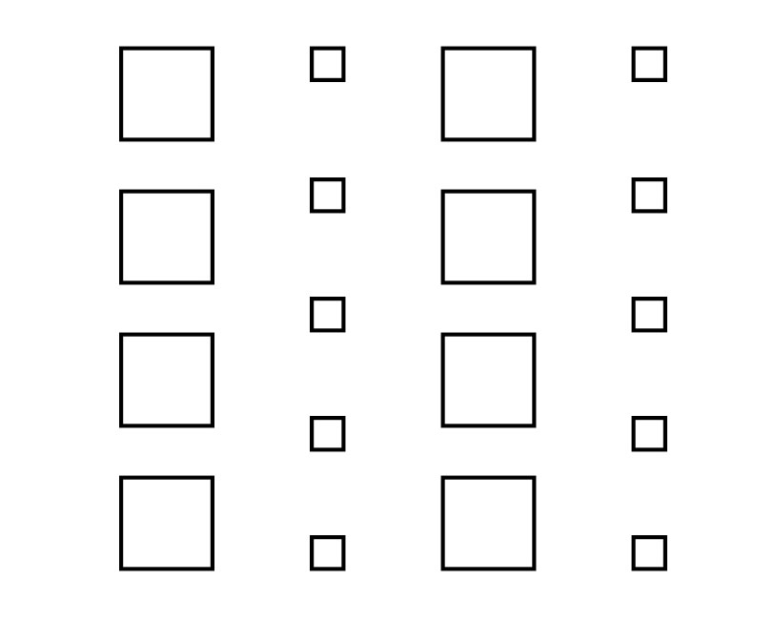
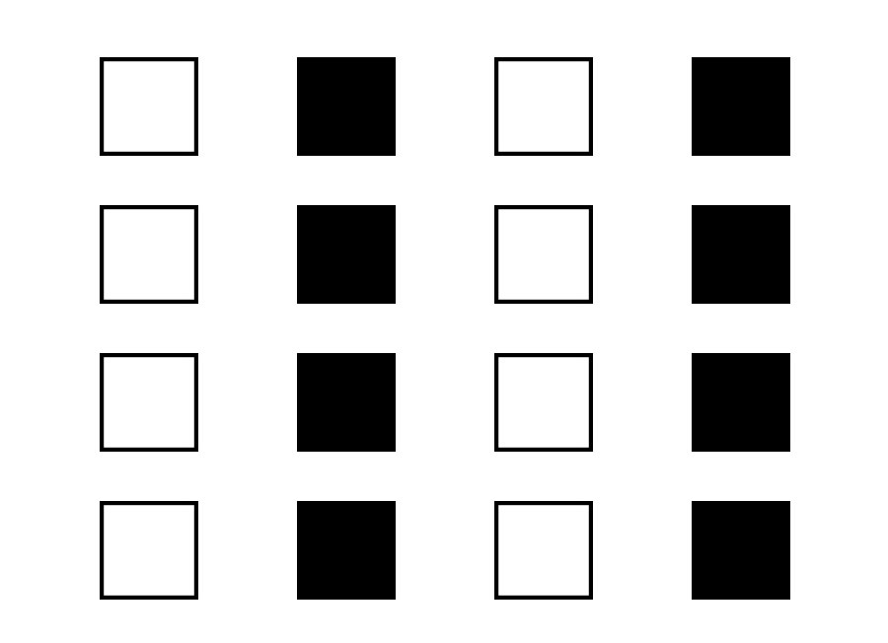
The eye and the mind
The drawings below appear related by size or color.

Slide 25
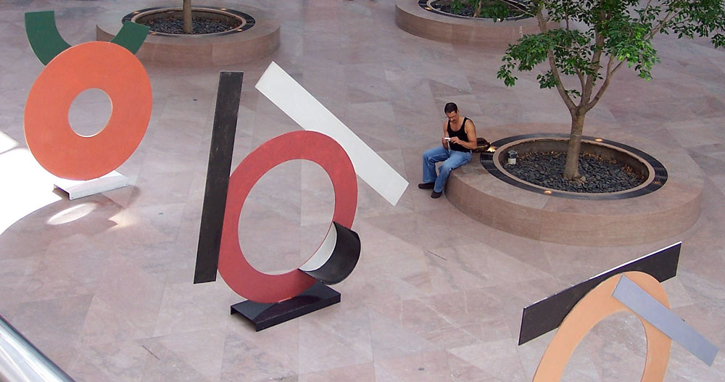
The eye and the mind
Similar shapes appear to be related. The sculptures in a Washington, D.C., museum below seem to be related to the tree planters.

Slide 26
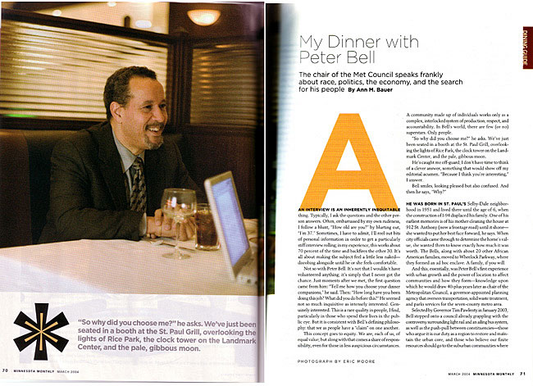
The eye and the mind
Graphic artists can use proximity and similarity to design publications and pages that feel unified.

Slide 27

The eye and the mind
Similarity used as repetition can suggest objects are related. These related objects can lead the eye. This is the Gestalt principle of continuity:
“The eye will follow a pattern of similar shapes or lines.”

Slide 28
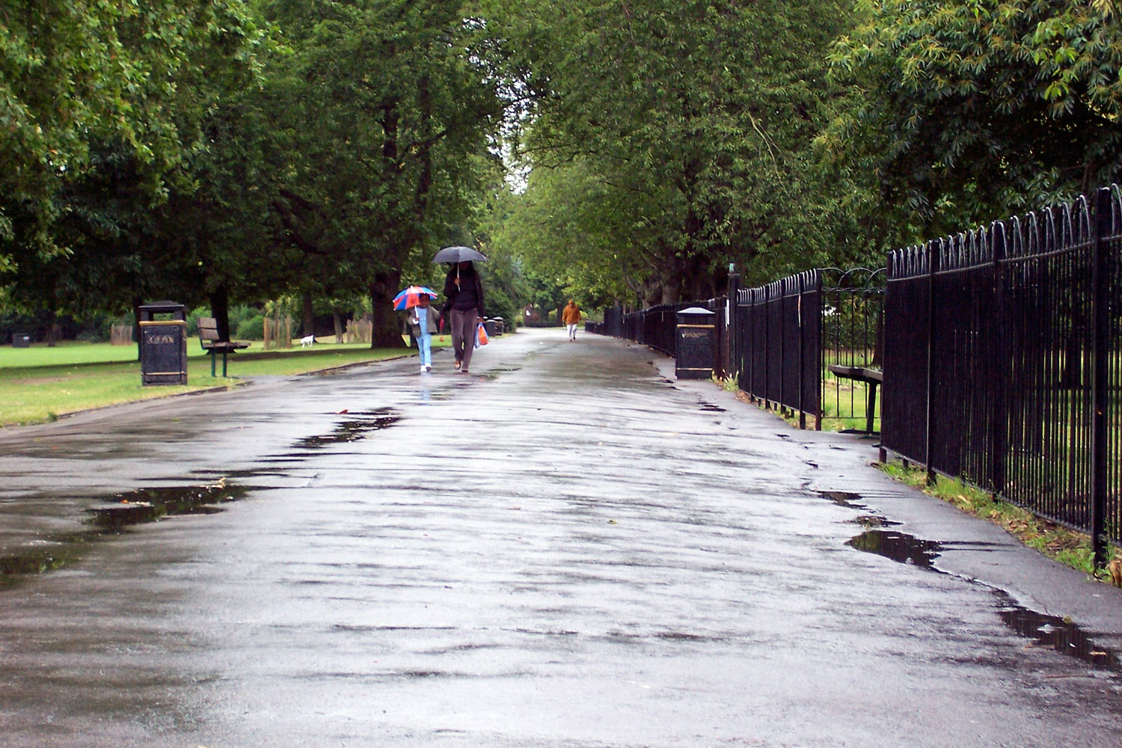
The eye and the mind
We can direct viewers to areas of a design or photograph we consider most important using continuity: we follow lines made by roads, fences, or shapes.

Slide 29
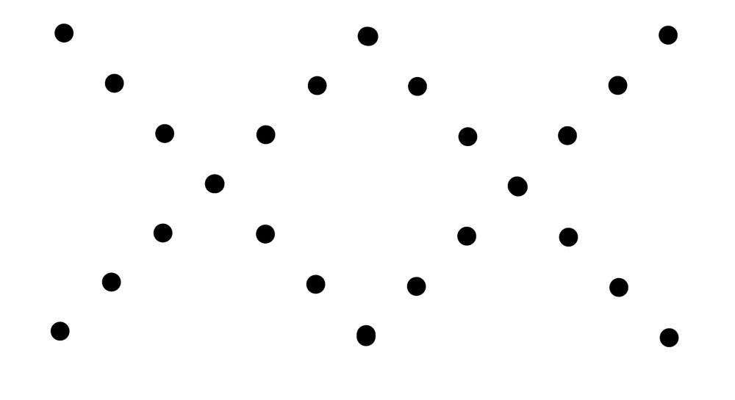
The eye and the mind
Our brain tends to assume lines going straight will continue going straight.
What d0 you see in the illustration below?

Slide 30
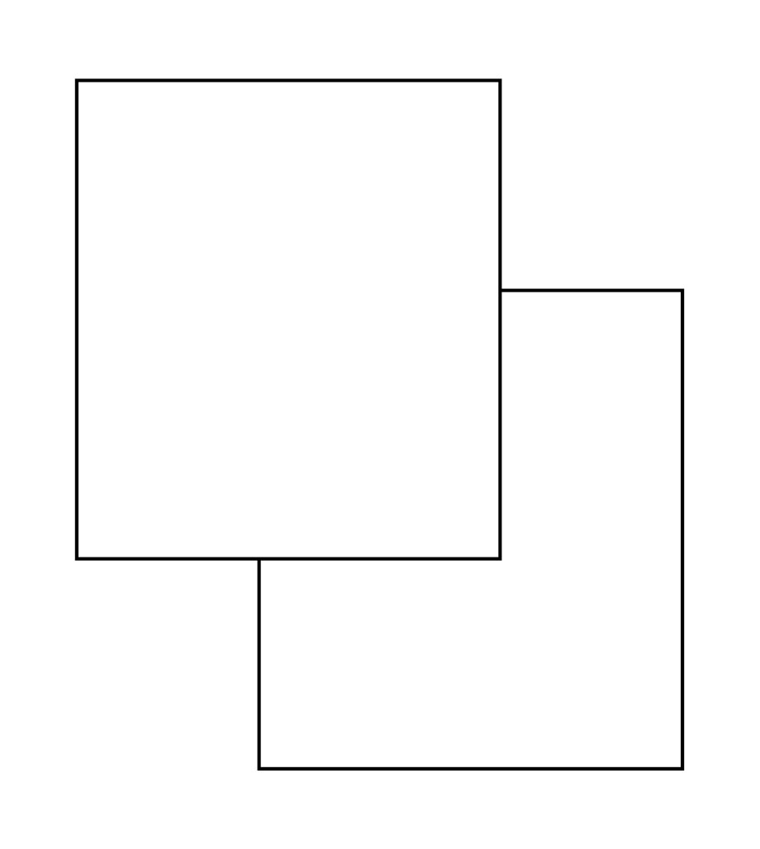
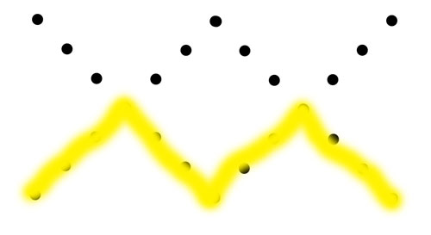
The eye and the mind
Most people would say two Xs, based on the principle of continuity.
But we also could see an M or W. What about the second image?

Slide 31
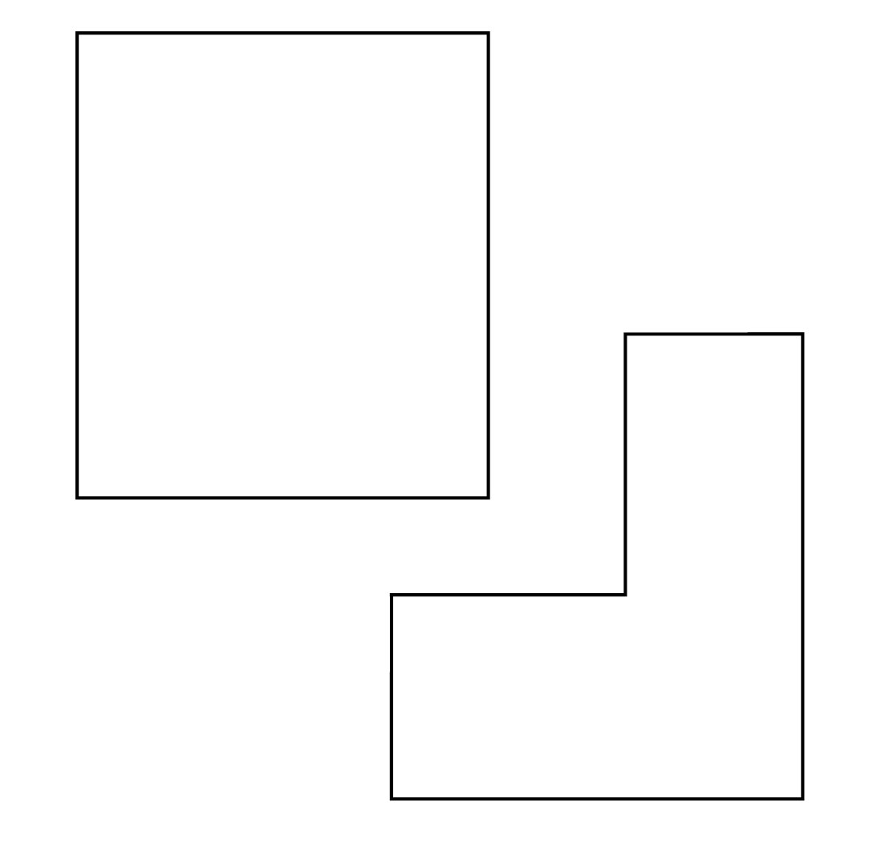
The eye and the mind
Most of us would see two rectangles, one atop the other. But that’s not what it is.

Slide 32
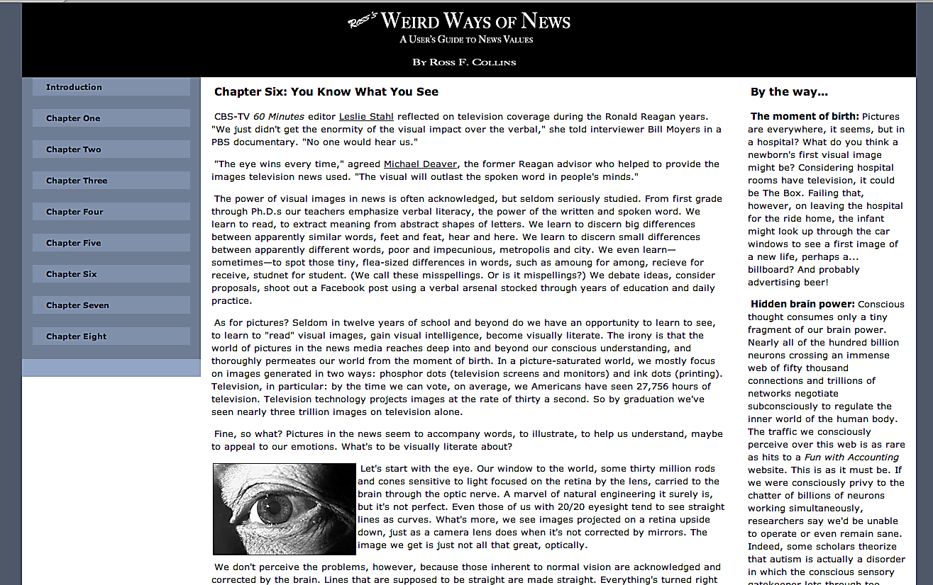
Find out more!
Ross’s online text: http://www.weirdwaysofnews.com/wierdwaysofnews6.html

Slide 33
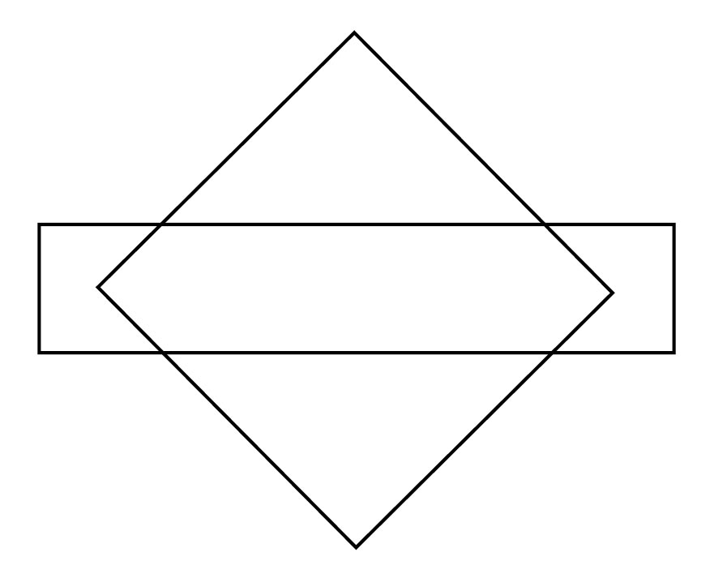
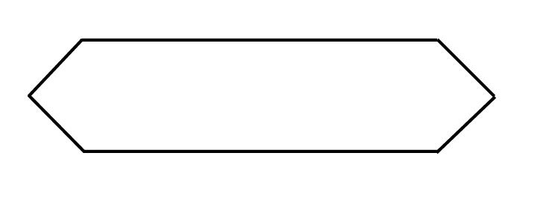
The eye and the mind
Our expectation of straight-line continuity leads us to assume the image must exist in three dimensions.
Below is a famous Gestalt experiment. Participants were shown the left image over and over. Then they were shown the second image. They described a diamond and rectangle, but…

Slide 34
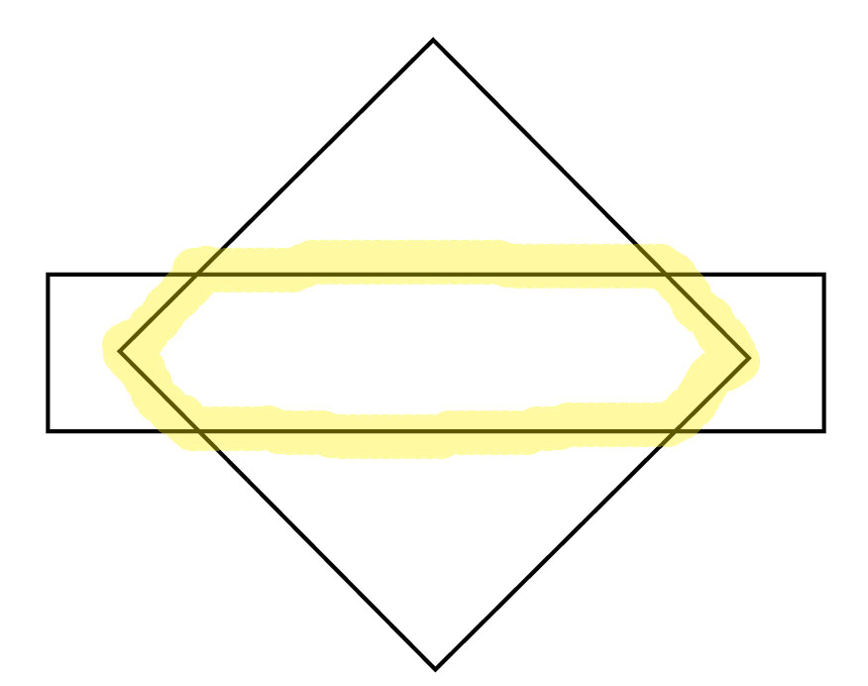
The eye and the mind
…look closely: the center points of the diamond in the rectangle for the exact bullet shape so familiar to the participants.

Slide 35
The eye and the mind
Why don’t we readily see the lozenge shape? Because the rule of simplicity tells us:
“Given a level of visual complexity, we see the least complicated image possible that still makes sense to us.”

Slide 36
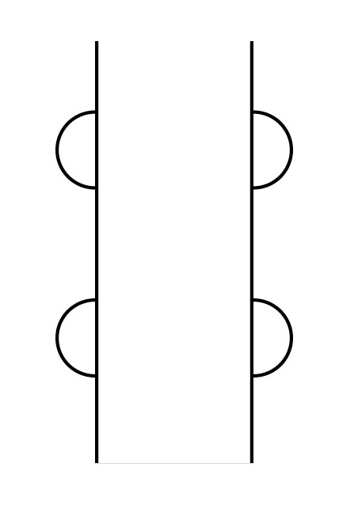
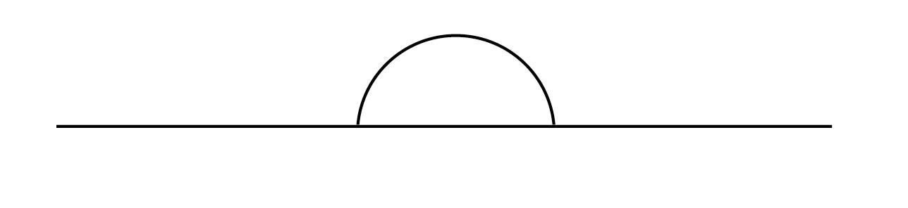
The eye and the mind
Given an ambiguous image, we imagine the simple possibility first. What do you see below?

Slide 37
The eye and the mind
Bald man behind a wall.
Bear climbing a tree.
Heh! But why do we find this old children’s game amusing?

Slide 38
The eye and the mind
All the tricks our brain uses to build an image could not match the ambiguity of the design.
People react with amusement, confusion, or anger to visual ambiguity. But they seldom react with disinterest.
We feel more interested if we can play an active role in a visual dialogue.
Fine arts rely on this to engage a viewer in the visual conversation.

Slide 39
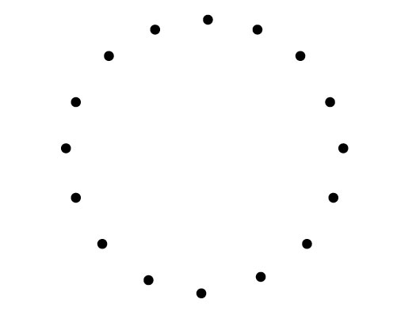
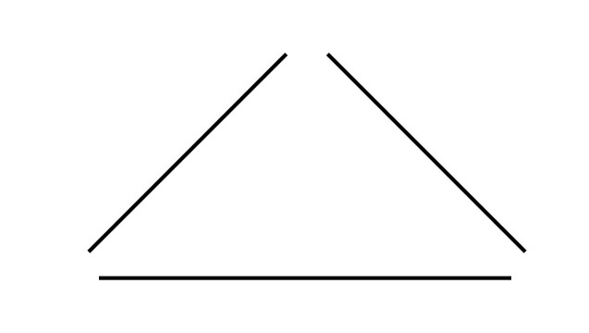
The eye and the mind
Mild ambiguity adds interest. For example,
“Nearly complete familiar images are seen as complete.” What do you see below?
Most people see a circle and triangle although, as you now know, it’s really a set of dots and lines.

Slide 40
The eye and the mind
This is the principle of closure.
People seem to get some feeling of satisfaction viewing visual images that are not quite complete, giving them the opportunity to participate more actively in the viewing experience.

Slide 41
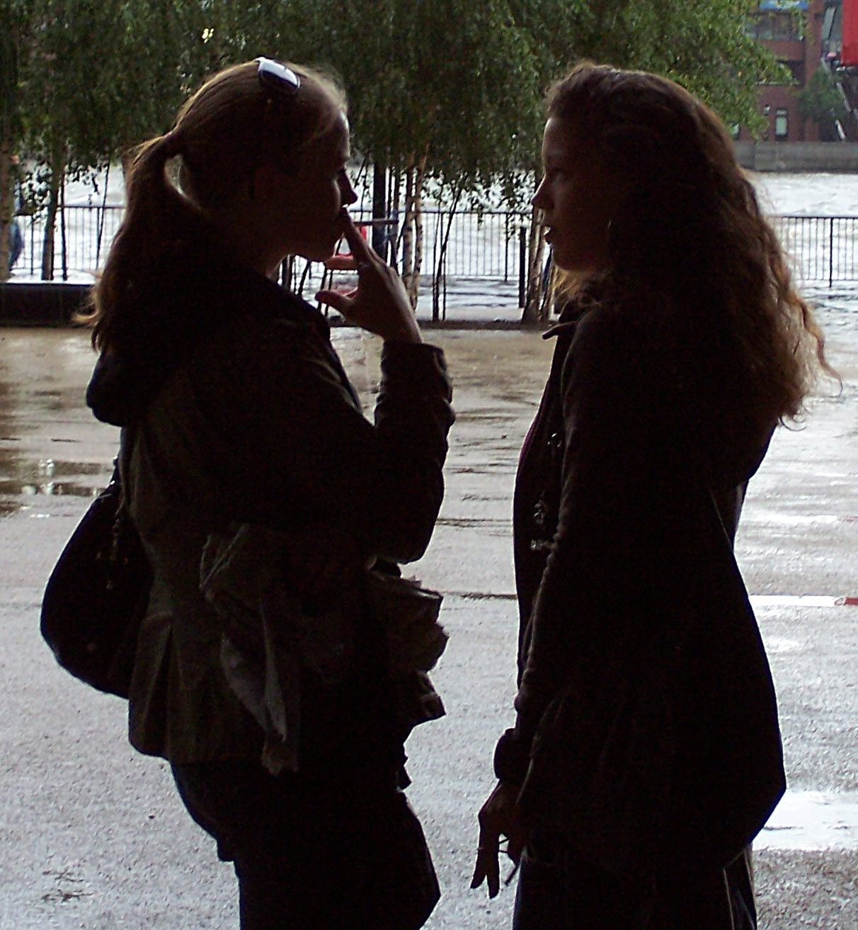
The eye and the mind
Faint detail gives meaning to shadows.
Gestures suggest possibilities.

Slide 42
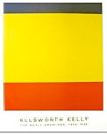
The eye and the mind
Sometimes, as in non-representational art, we become frustrated with great ambiguity. Artists such as Ellsworth Kelly below are greeted by some viewers with frustration and finally disdain: “My kid could paint like that!”

Slide 43
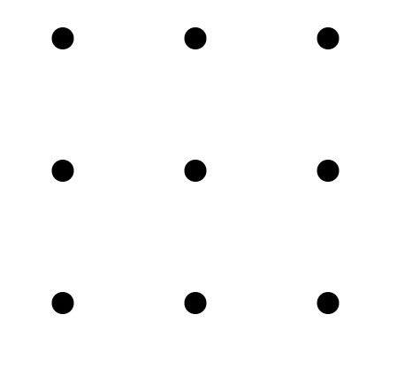
The eye and the mind
But perhaps what has happened is that the viewer was unable by experience or culture to join the visual conversation.
A danger of our visual perception’s unconscious principles is that it can limit our imagination as designers. Draw four straight lines to connect the dots in the sketch below. Do not lift your pen from the paper.

Slide 44
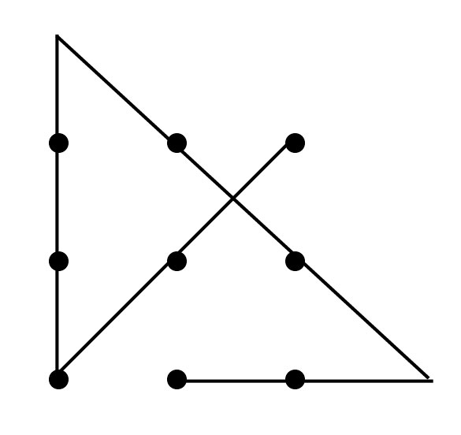
The eye and the mind
Our mind sees the dots as a square, based on principles of proximity and closure. But if you look at the puzzle this way, you can’t solve it.
To understand how our mind processes visual images is to understand what influences us, and how we as designers can influence our viewers.

Slide 45
The eye and the mind
Graphic artists use Gestalt principles in every design, whether they are aware of them:
Proximity
Similarity
Continuity
Simplicity
Closure

Slide 46
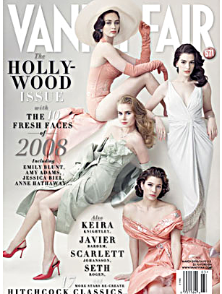
The eye and the mind
Let’s try to identify some Gestalt principles in famous publications.
Vanity Fair.

Slide 47
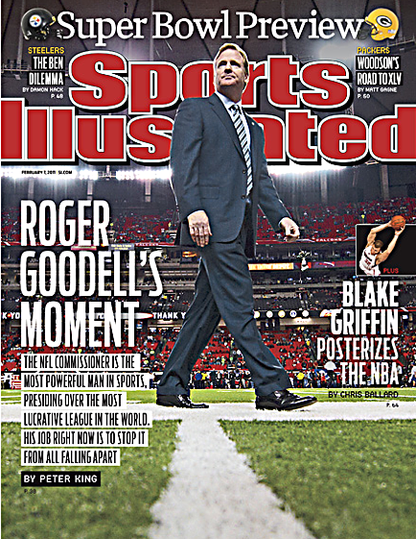
The eye and the mind
Sports Illustrated.

Slide 48

The eye and the mind
National Enquirer.

