Slide 1
Emphasis
The Most important element on a page should be the most prominent.

Slide 2
Emphasis
People in media have decided that the public needs help to decide what’s most important in a publication.
Editors determine relative importance, and then instruct designers to emphasize this visually.

Slide 3
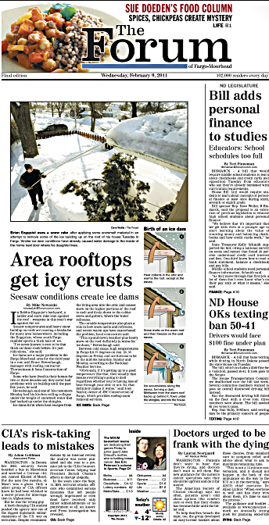
Emphasis
The newspaper is the most obvious example of this visual hierarchy.
How has the newspaper design at right emphasized a visual hierarchy?

Slide 4
Emphasis
Web design emphasis is not as striking, unless a publication is presented as a pdf.
A table of contents style does not convey emphasis in as obvious a way.
An obvious point of entry is not as clear.

Slide 5
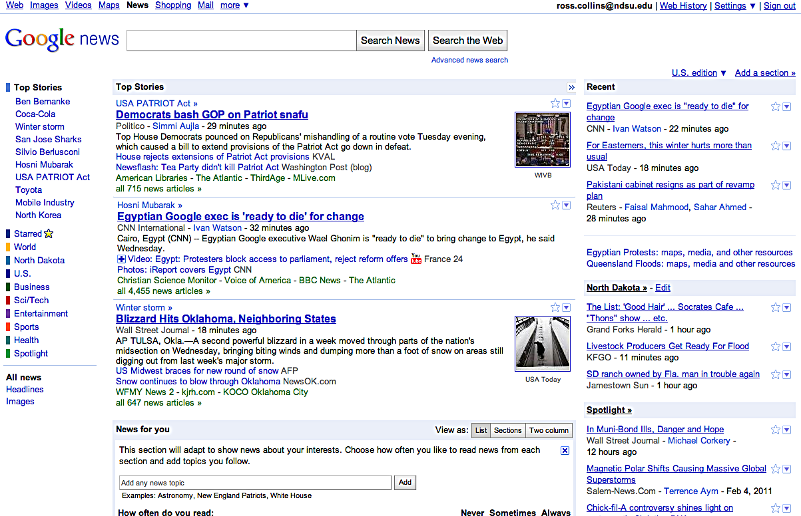
Emphasis
Google news emphasizes important stories with slightly larger heading. But it is basically a list.

Slide 6
Emphasis
Graphic artists in print usually don’t work this way.
Page design tries to orient a reader to visual information.
This helps attract a reader to a publication, and helps him or her move through the pages.
Of course, it also takes some decisions away from readers, making choices for him or her.

Slide 7
Emphasis
We create emphasis in many areas of life.
If you are talking to a friend, that person is emphasized. Other conversations in the background, lights, other activity is secondary or even distracting.
Designers use many elements to give emphasis.
The Gestalt principles of visual perception also can help us to create emphasis.

Slide 8
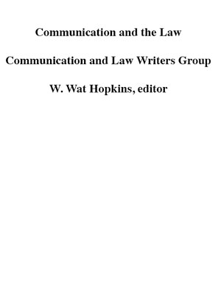
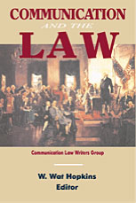
Emphasis: what is most important?
Consider your elements to form a visual hierarchy.
What is most important? Second? Third?

Slide 9
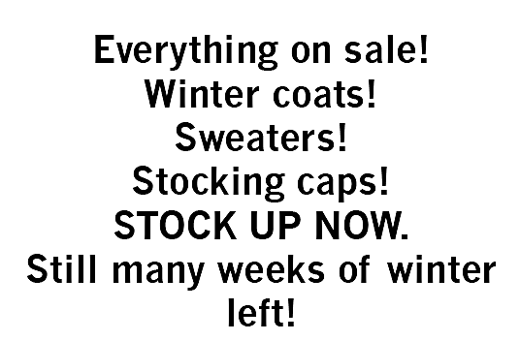
Emphasis
Emphasis suggests some things must be subordinate.
If we emphasize everything, nothing is emphasized.

Slide 10
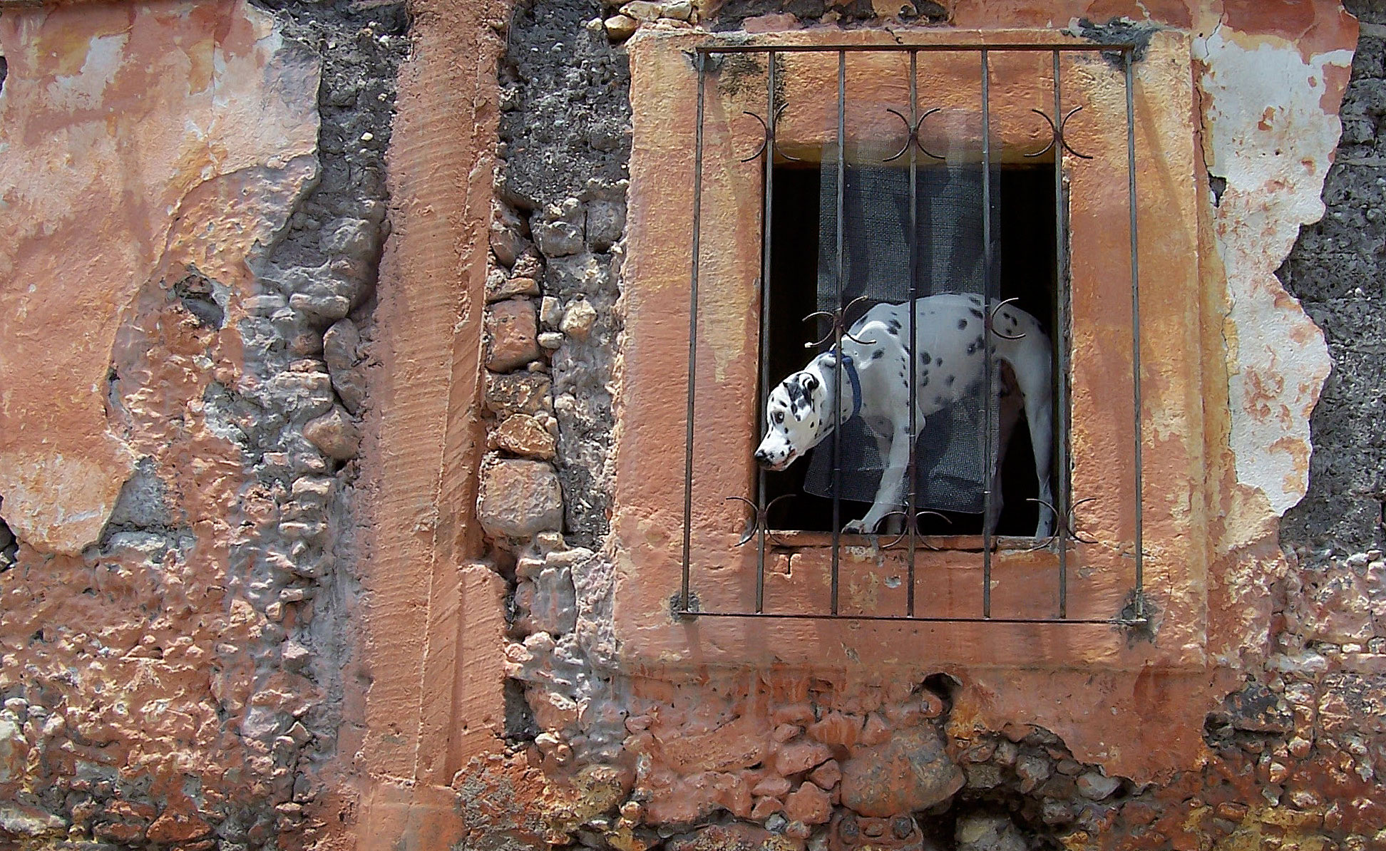
Emphasis: techniques
Look for a focal point.
Add accents. (Photo: San Miguel de Allende, Mexico, 2008.)

Slide 11
Emphasis: more techniques
Bold type.
Big type.
Bright colors.
Texture.
Make it look different.
Surround by white space.
Use continuity: other elements bring the eye to the focal point.
Tilt at an angle.

Slide 12
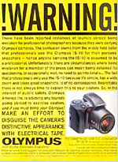
Emphasis
Type

Slide 13
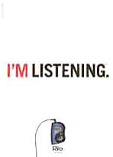
Emphasis
Use of white space.

Slide 14

Emphasis
Bright colors, tilt at an angle.

Slide 15
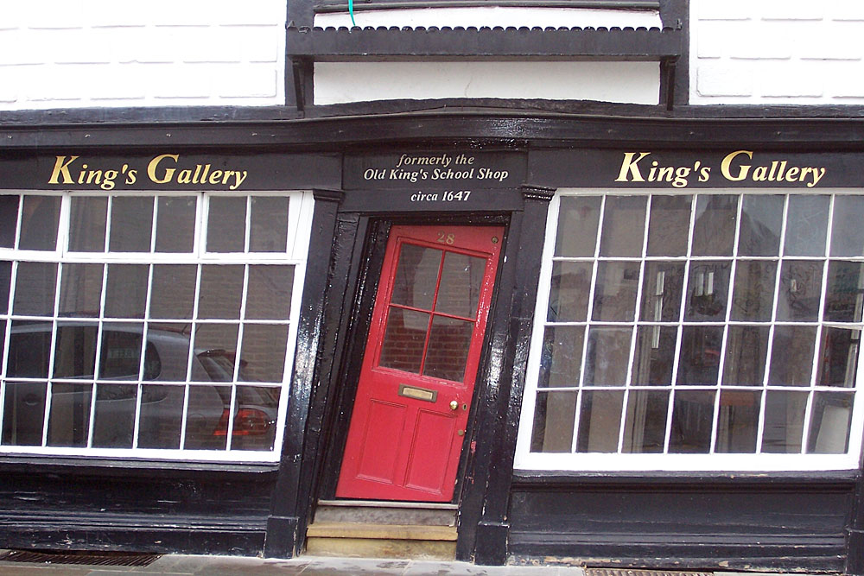
Emphasis
Make it look different. (Photo: Canterbury, UK, 2008)

Slide 16
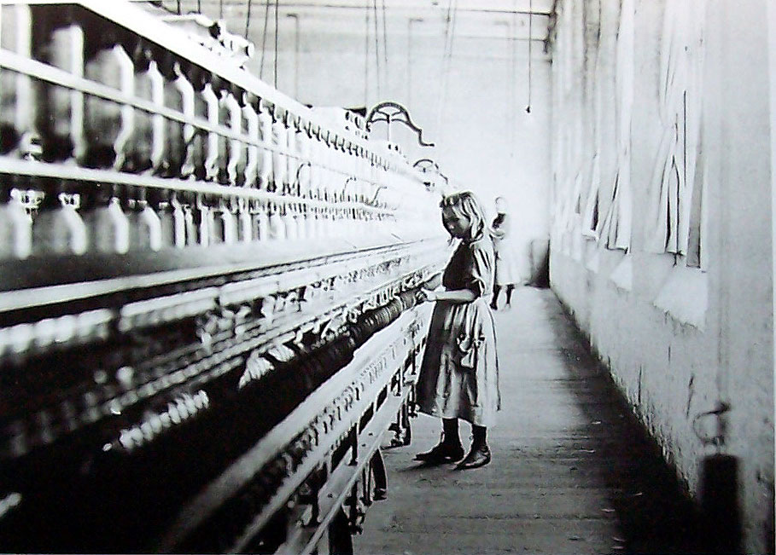
Emphasis
Use continuity to emphasize a strong focal point. (Photo by Lewis Hine.)

Slide 17

Emphasis
More ideas for emphasis in graphic design. [http://www.youtube.com/watch?v=MwsDTvLVpm8]

Slide 18

Emphasis
What catches your eye and makes you look at this ad? That is, what is emphasized?

Slide 19

Emphasis
What catches your eye in this ad?
How is emphasis used?

Slide 20
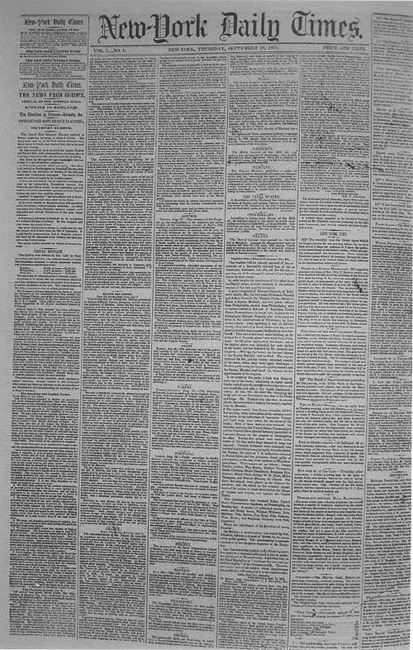
Emphasis
Before the U.S. Civil War, newspapers did not consider design elements to be important. (First issue of the New York Times, Sept. 15, 1851.)

Slide 21
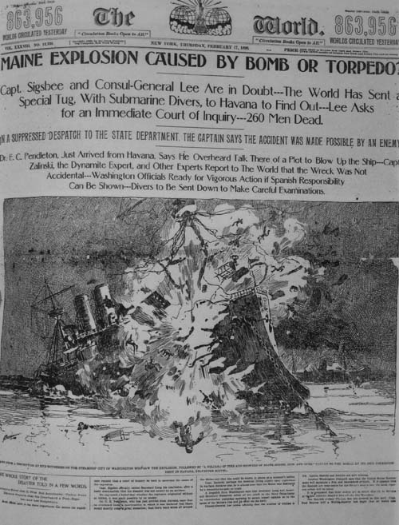
Emphasis
By the 1890s, emphasis became a central aspect of newspaper design. (New York World, Feb. 18, 1898.)

Slide 22
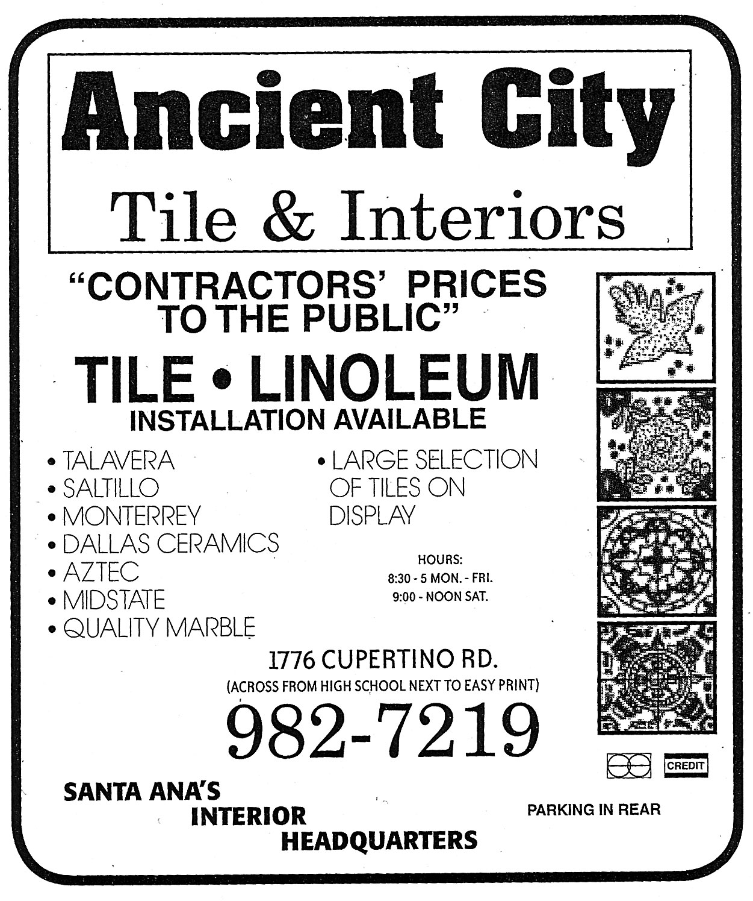
Emphasis
How could you add emphasis to improve the advertisement below?

Slide 23
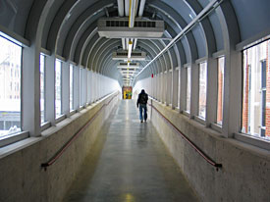
Emphasis
Let’s review. Which of the visual tools we’ve discussed can we find in the photo below (by former student Travis Kroh)?
Similarity.
Proximity.
Continuity.
Closure.
Emphasis.

