Slide 1
Graphic design history
A visual solution to an editorial problem.

Slide 2
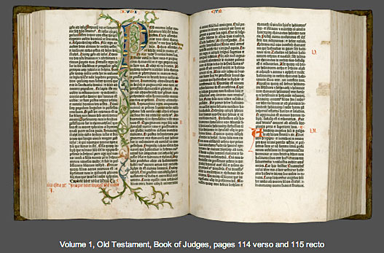
A revolution: movable type
Gutenberg’s Bible revolutionized communication, 1450.

Slide 3
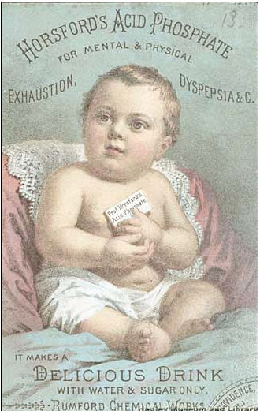
Advertising exploded after Civil War
“Patent” medicine advertised heavily.

Slide 4
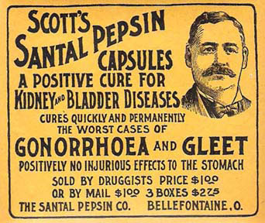
Patent medicine ads

Slide 5
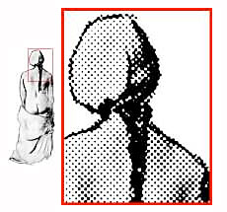
Halftones made direct printing possible
Invention of 1880s turned continuous tones into dots.

Slide 6
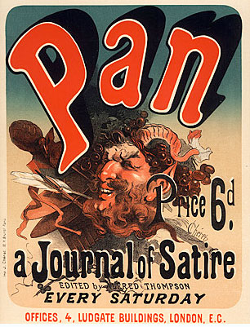
Posters were important by 20th century
Art Nouveau began in France, associated with posters.
Jules Chéret is considered the “father of the modern poster.”

Slide 7
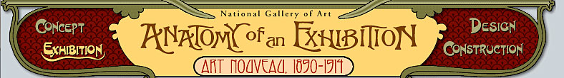
Art nouveau influenced graphic arts
The curvaceous figures of art nouveau influenced publication design and brought more art into publication design.

Slide 8
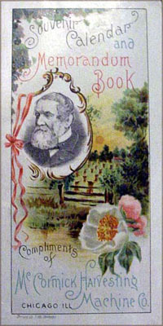
Art nouveau

Slide 9
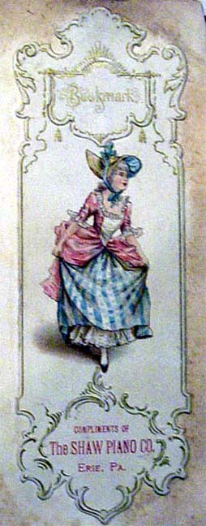
Art nouveau

Slide 10
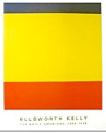
Last century questioned everything
Realism was questioned: what is art?

Slide 11
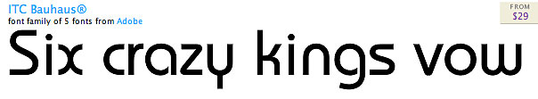
Gestalt questions vision
Psychological research questioned what we see.
Bauhaus movement tried to simplify. [http://www.youtube.com/watch?v=F8zuGsX_z_Y]

Slide 12
Bauhaus: form follows function
Extremely common typefaces, such as helvetica from Switzerland, are based on these concepts.
What does “form follows function” mean to you?

Slide 13
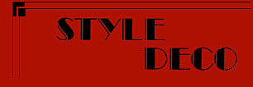
Art deco grew out of cubism
Art deco, with its angular forms, influenced contemporary graphic arts for its crisp, industrial look.

Slide 14
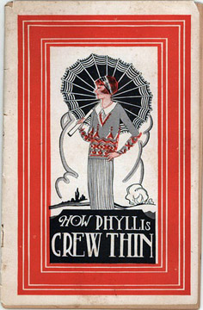
Art deco

Slide 15

Today: overlap and intertwine
Computer-generated design made it easy to overlap and mix images and parts of images, commonly used in today’s design.

