Slide 1
Design and visual literacy
We think we know it all, because we’ve seen so much.

Slide 2
Visual literacy
Graphic design is a way of learning to understand and manipulate objects in a visual medium.
The challenge in trying to teach this: most of us think we already know it all.
Why? Consider our background in the twenty-first century.

Slide 3
Visual literacy
From the time we were born, we’ve been bombarded with visual images.
Television and video is the answer to humanity’s centuries-old quest for realism in the visual world.
What might be the first images we see as infants?

Slide 4
Visual literacy
In fact, we’ve been swimming in a sea of images all our lives.
How many images would we see in just an hour of television?
In fact, the estimated number of images we see on TV by the time we are 18 is three trillion: 3,000,000,000,000.

Slide 5
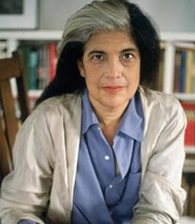
Visual literacy
That doesn’t include the flood of publications, billboards and, of course, the internet.
Susan Sontag, philosopher and visual critic, observed how strangely influential the visual representations in our world seem to be.

Slide 6

Visual literacy
Sontag noted that for many people the image is more important than the reality.
People will visit a famous site like the Grand Canyon and exclaim, “That’s pretty as a picture.”

Slide 7
Visual literacy
We see so many images, and at a young age we also seem compelled to make our own.
We get coloring books, and paper to do our own art.
Children ask for these materials, if we don’t furnish them.

Slide 8
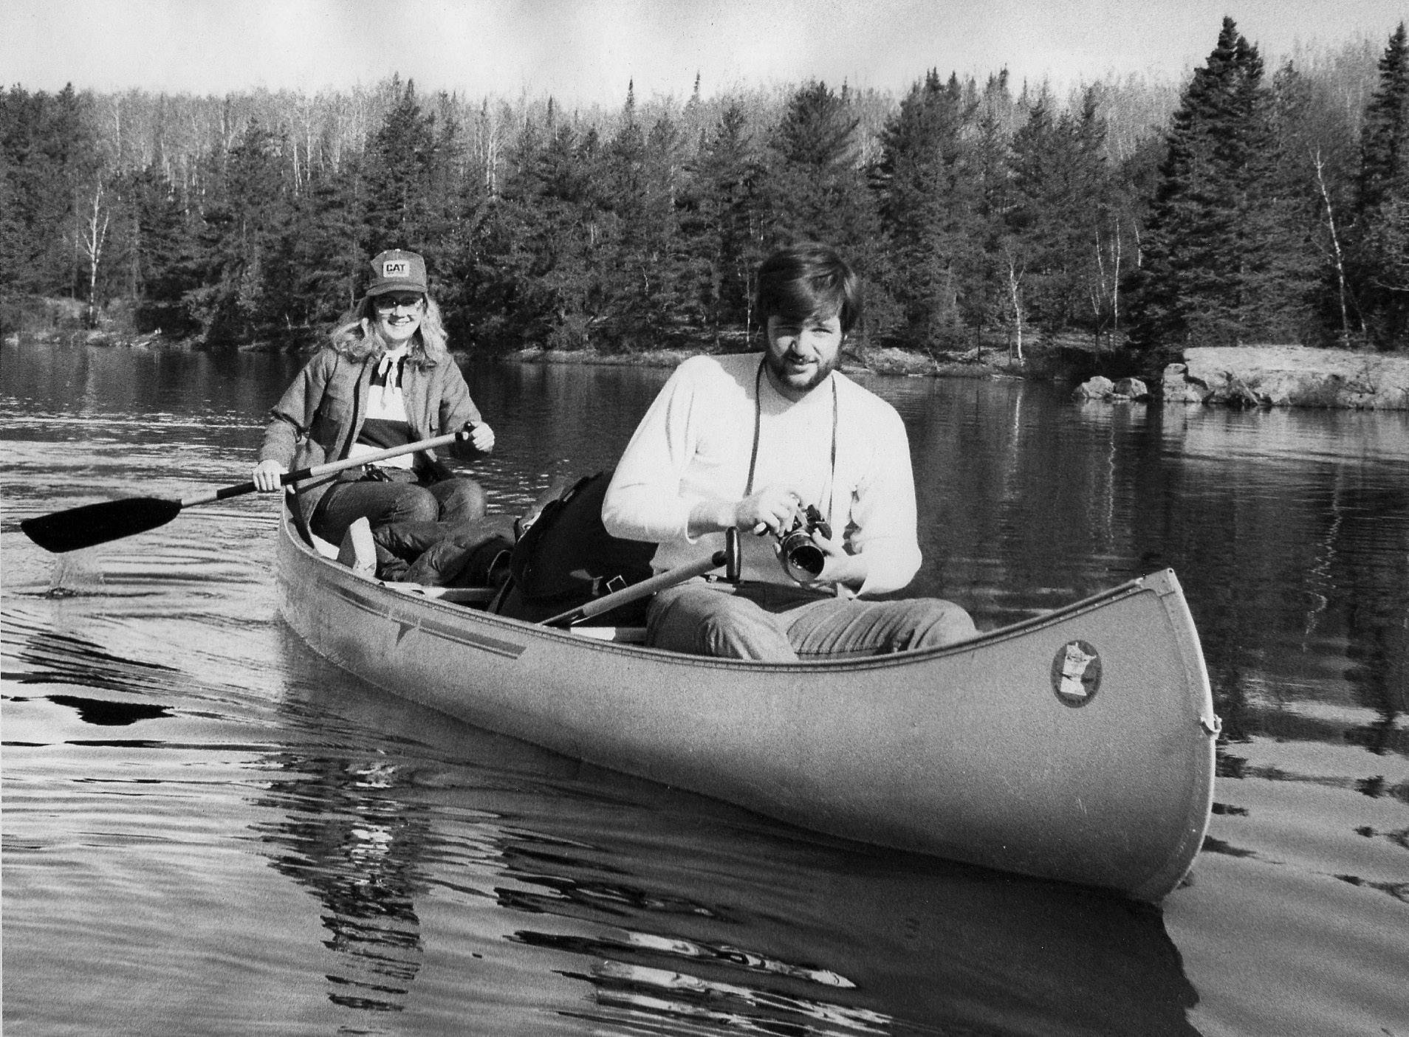
Visual literacy
As we get older, many of us start getting self-conscious about our drawing ability.
So we turn to a machine able to make images for us: a camera.

Slide 9
Visual literacy
The camera can give us good images without the need to learn how to draw.
At one time the ability to draw was considered part of an educated person’s background, particularly women.
People were encouraged to travel and draw what they saw. Today we take pictures.

Slide 10
Visual literacy
Are we compelled to create images because we are surrounded by them?
You’d think so. But it does not seem to be necessarily true.
People were driven to make images thousands of years ago.

Slide 11
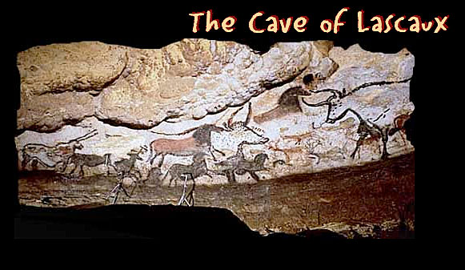
What is design?
Society has always been compelled to create images. The Lascaux cave images are 15,000 years old.

Slide 12
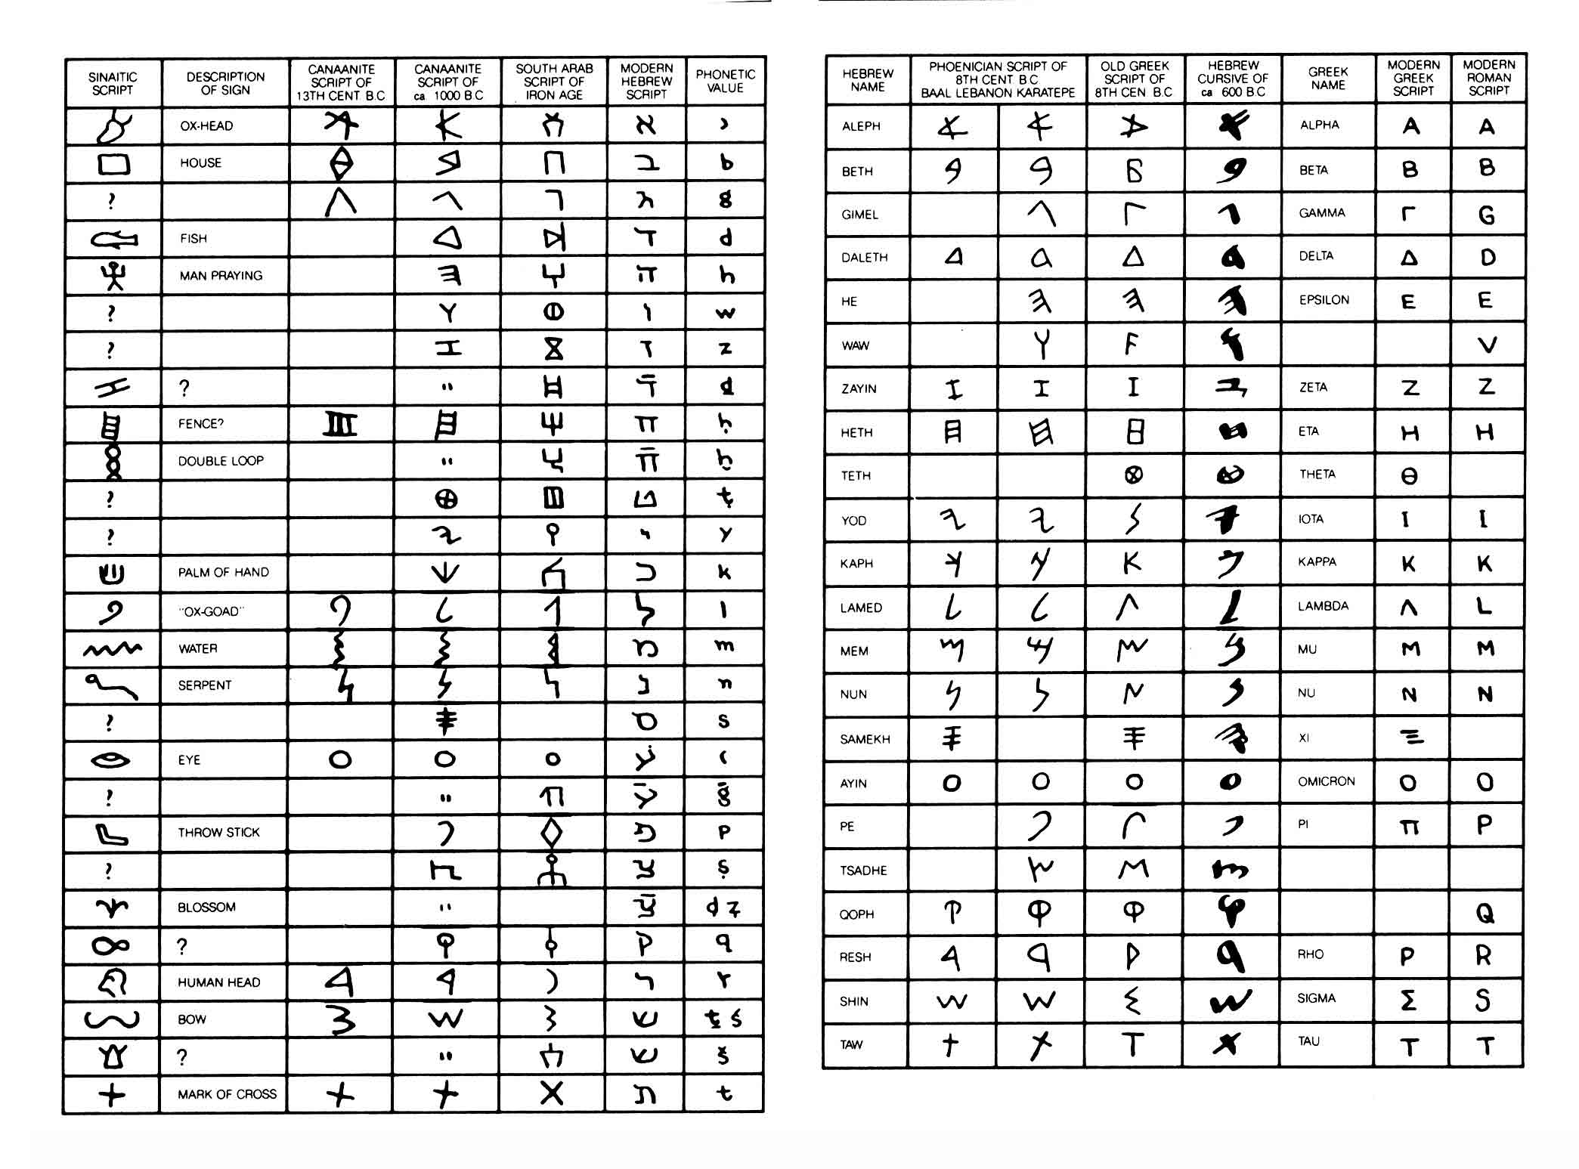
What is design?
Language developed from pictures.
Phoenicians first divided pictures and words.
The table below how picture writing evolved into text.

Slide 13
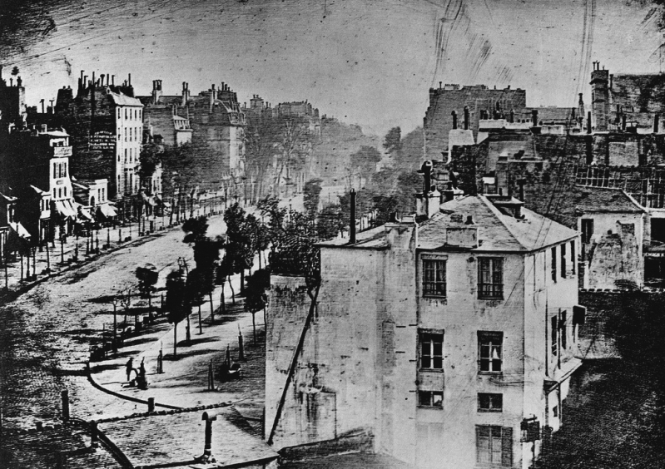
What is design?
The camera’s principles were long known.
Fixing the image dates to 1839, with the Daguerreotype.
Roll film brought images to the masses.
Movies are based on “persistence of vision.”

Slide 14
What is design?
We are verbally literate, and visually experienced. But are we visually literate?
We are taught verbal literacy. Not so often are we taught visual literacy.
And yet we all recognize the power of the visual image in our society.
Is a visual image more powerful than words? Many researchers think so.

Slide 15
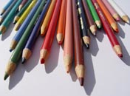
What is design?
But this is a graphic design class.
What is graphic design?

Slide 16

What is design?
We live in a sea of visual images. But what do graphic artists do? [http://www.youtube.com/watch?v=oeRwFkjQe6s]

Slide 17
What is design?
Design: a response to editorial objectives.
Fine art: communicates an artist’s intentions.
A fine artist draws from within himself or herself to produce a paricualr view of reality.
That reality is translated to the visual medium.
The fine artist asks viewers to engage in a dialogue.
That dialogue may be challenging.

Slide 18
What is design?
Graphic artists, on the other hand, are responsible for clear communication an audience can understand.
Graphic artists try to translate the editorial goals and objectives of a publication to a mass audience.
If the audience does not understand that, the graphic artist has failed.
If the audience does not understand a fine artist’s work, however, he or she has not necessarily failed. Perhaps we as viewers have failed.

Slide 19
What is design?
Graphic artists are usually different from illustrators. Illustrators draw freehand art, or illustrations using computer programs. Graphic artists use this art to design publications.
Like a graphic artist, an illustrator too tries to translate editorial goals.
A graphic artist may or may not also be an illustrator, but the education is different. And fine artists seldom are also graphic artists.

Slide 20
What is design?
People with background in mass communication study do have an advantage in the graphic arts field. They already understand the larger picture of presentation to a mass audience, and the expectations of practitioners in the field.

