Slide 1
Leads
and active voice

Slide 2
Leads (ledes)
The lead is one of four ways journalists use to encourage people to read a story.
The others are:
Photograph or illustration;
Headline (or heading for online material);
Deck, subhead or pull quote.

Slide 3
Attracting readers
We hope readers will pause at a compelling photo or illustration, and so read an equally compelling headline or heading.
From there, we hope they will give the story a try by reading the first line (lead) or first graf (first paragraph, or “nut graf.”)
Sometimes we add a deck (second headline) or pull quote to further entice.

Slide 4
Reading on
If readers are still interested after checking out the lead, they will often read the story.
If the lead is boring, they will likely not read the story.

Slide 5
First impressions
It is critical, then, to hit hard and start strong at the beginning.
Note this is not true for some kinds of writing. Academic writing can be slow because (perhaps) the audience will read the research regardless.
Still, it usually can’t hurt to try to find a good beginning. I call it “snagging and dragging.”

Slide 6
Good beginnings
Novelists and historians have known throughout written history that they need to snag readers from the beginning.
The historian Herodotus in 440 B.C.E. knew he would have to attract readers by showing them right away how important his work was:

Slide 7
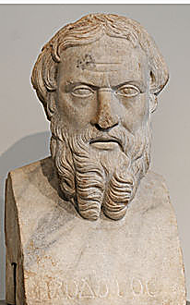
Early beginnings
“These are the researches of Herodotus of Halicarnassus, which he publishes, in the hope of thereby preserving from decay the remembrance of what men have done, and of preventing the great and wonderful actions of the Greeks and the Barbarians from losing their due meed of glory….”

Slide 8
Early beginnings
Note that Herodotus did not write:
“The Greeks met several times with the Barbarians a while ago….”
Novelists also know a good first line will drag their readers in:
“It was a bright cold day in April, and the clocks were striking thirteen.”—George Orwell, 1984.
“Someone must have slandered Josef K., for one morning, without having done anything truly wrong, he was arrested.”—Franz Kafka, The Trial.

Slide 9
Slow leads
People have so much to read nowadays, to say nothing of television, video games, smartphones, etc. Why should they read your story?
The answer is usually “no reason,” unless you make it sound interesting to them.
The lead can do that.

Slide 10
SAVE formula
To help us write and edit better leads, I suggest considering Ross’s SAVE formula, to SAVE your readers from boring leads. A good lead out to be:
Specific.
Accurate.
In active Voice.
And use Energetic verbs.

Slide 11
Specific
Grand general statements may be okay for term papers and academic articles. For example:
“Interpersonal skills have been the subject of scholarly study for three decades.”
This lead is boring, and in the passive voice as well. But academics don’t need snagging. They’ll read the research regardless (well, maybe).

Slide 12
Specific
Mass media editors in journalism, public relations or advertising need to work harder on the beginning.
If mass media is about people doing things, often the best lead is to look for something specific that people did!

Slide 13
Specific
One common slow lead is based on meeting articles. We often see these leads written as if a secretary was taking minutes:
“The Burleigh County Commission met Monday at its regular meeting. Agenda issues were discussed. A motion was made to increase property taxes 50 percent. It passed unanimously.”

Slide 14
Specific
Most editors will recognize that as a “buried lead.” That is, the most important part of the story is not at the beginning. An editor will bring it to the top:
“The Burleigh County Commission Monday voted unanimously to raise property taxes 50 percent.”
Another common example: “The CEO of Acme Mills held a press conference today.” So what? Be specific:
“Acme Mills will expand production of its popular candied kale, CEO Irving Nern said today.”

Slide 15
Accurate
Inaccurate statements are most glaring when part of a headline or lead. They are becoming more common in the world of social media, because for many journalists (or non-journalists) speed trumps accuracy. But at the expense of a media operation’s credibility.
We are not writing fiction here. If people don’t believe you, what’s the point?

Slide 16
Voice
Mass media editors and writers need to use active voice about three-fourths of the time, I think. Or more.
It’s livelier, more immediate. It’s closer to the way people talk.
It emphasizes the verb, the action word. And mass media is about people doing things.

Slide 17
Voice
What is active voice? Most people think they know. But don’t be too sure about that. Which of the sentences below is in active voice?
“Collins decided yesterday to fly a kite after work, because he so often told others to go fly a kite.”
“A kite was flown by Collins yesterday after he decided to heed his own words to go fly a kite.”

Slide 18
Voice
We know the first is in the active voice. In passive voice, the direct object, “kite,” becomes the subject:
“He flies a kite.” “A kite is flown by him.”
So in active voice, the subject performs the action: Subject, verb, direct object.

Slide 19
Passive voice
Passive voice uses a form of the helping verb “to be”:
“Coffee is served every morning before work.”
“An optimistic assessment of state spending was offered by the governor.”
“The East Gulch School District website is updated twice a month.”

Slide 20
Present/past tense
Note that the passive voice has nothing to do with verb tense. You can write in the past tense and still be in the active voice:
“The Cass County Commission met at its regular meeting Tuesday.”
Is the above typical lead in active voice? Yep. That doesn’t mean it’s not boring! But it would be even worse in passive voice:
“A regular meeting was held Tuesday by the Cass County Commission.”

Slide 21
Uses for passive voice
We said in media writing we should use active voice at least three-fourths of the time. So what about the other quarter of the time?
Passive voice is sometimes useful in three situations:
1. The writer or editor doesn’t know who performed the action, or the person performing it isn’t as important.

Slide 22
Uses of passive voice
Often you’ll see passive voice used in crime stories. The victim is more important, and the perpetrator often unknown:
“The mayor was robbed at gunpoint today in the city hall parking lot.”
Who did the robbing? Don’t know. And the victim was more significant.

Slide 23
Uses of passive voice
Accident stories are often in passive voice:
“Two students were injured Friday in a bicycle crash south of Barry Hall.”
Who did the injuring? We I guess we could come up with active voice:
“A cement curb injured two students yesterday….”
But most editors would prefer passive voice in this case.

Slide 24
Uses of passive voice
2. Need to vary sentence structure.
Writers look for variety, and the passive voice can occasionally offer that. It sometimes offers a less awkward way of structuring a sentence, and a way to emphasize a significant word. For example:
Miss Brooke had that kind of beauty which seems to be thrown into relief by poor dress.”—George Eliot, Middlemarch.
We could turn the second half into passive voice, but would it be as strong? Probably not.

Slide 25
Uses of passive voice
3. You’re not sure of the facts, or want to hide the performer of the action.
You can write, in active voice, “George Jones hit Sam Smith with his cane.” But what if you are not certain George did it? Passive voice gives you a way to avoid assigning blame:
“Sam Smith was hit with a cane.”

Slide 26
Uses of passive voice
Academic researchers working as teams often use passive voice because the results are most significant, not the team:
“An experiment was performed. Results were analyzed. Conclusions were made.”
Probably readers are more interested in results, so this use of passive voice is reasonable.
But not always.

Slide 27
Hiding behind passive voice
In business and politics, particularly, it is easy to hide behind passive voice. This gives an opportunity to avoid assigning blame.
“A decision was made to lay off 100 workers.”
Who made that decision? We don’t know.

Slide 28
Hiding behind passive voice
A case study in passive voice can be made from the 1986 Space Shuttle “Challenger” explosion.
Investigators studying documents tried to find blame regarding the manufacturing problems and subsequent decisions among the contractors that led to the disaster.
It was impossible to assign responsibility, however, because documents were written in the passive voice: this decision was made, that action was taken, this was done.
Through passive voice, company executives could avoid taking blame.

Slide 29
Energetic verbs
The fourth letter of our SAVE formula, Energetic verbs, asks us to move beyond tired, overused or bland verbs.
Try to avoid forms of the verb “to be” used as a main verb. Usually it is week and overused:
“There are good reasons to graduate from college.”
Swimming is a good way to keep fit.
These shoes are mostly brown or black.

Slide 30
Energetic verbs
Usually we can find alternatives to the verb “to be,” and to other common verbs.
For example, the verb “to walk.” It’s used over and over. How many alternatives can you think of for this verb? Why not use some of them instead of relying on the same tired verb?

Slide 31
Leads: beyond the SAVE formula
We’ve already talked about “buried leads.” The most significant thing is not at the top of the story.
We see this often in stories written in a hurry. Writers needs a chance to warm up, and the lead ends up in the second graf.

Slide 32
Buried lead
Example:
“Businesses nowadays need to get bigger to succeed. America has seen quite a few mergers, and has lost quite a few small businesses in recent decades.
“Reflecting this trend, XYZ company has announced that it will absorb a competitor that has been in Fargo for nearly a century.”
Note you can delete the entire first paragraph without losing a thing.

Slide 33
Backed-into lead
The backed-into lead puts the most significant aspect at the end of the sentence. Example:
“The chancellor Wednesday said she will authorize a $3.1 million addition to Morrill Hall.”
What is the news here? Not the chancellor.
“More than $3 million will go toward remodeling Morrill Hall, the chancellor said Wednesday.”

Slide 34
Short leads
Try to keep your leads short. Declarative sentences without clauses often work best to attract attention. Journalists often forget that, particularly in political or financial news. Here’s a typical example from USA Today (online Sept. 17, 2014) that weighs in at hefty 54 words:
“The Federal Reserve reassured financial markets Wednesday that a key interest rate will stay near zero for "a considerable time" after its bond purchases end next month, deferring for now a clear signal on how it will begin to shift away from low-rate policies it's had in place since the 2008 financial crisis.”

Slide 35
Short leads
CNNMoney (online) took a different approach to the same story:
”‘Two Words’ is a track on Kanye West's debut album. It might as well be the theme song for the market and Federal Reserve too. When the #Fed issues its policy statement Wednesday afternoon, the only two words that may matter to Wall Street are ‘considerable time.’”
I do think bringing in Kanye West is a stretch. But the lead certainly is short.

Slide 36
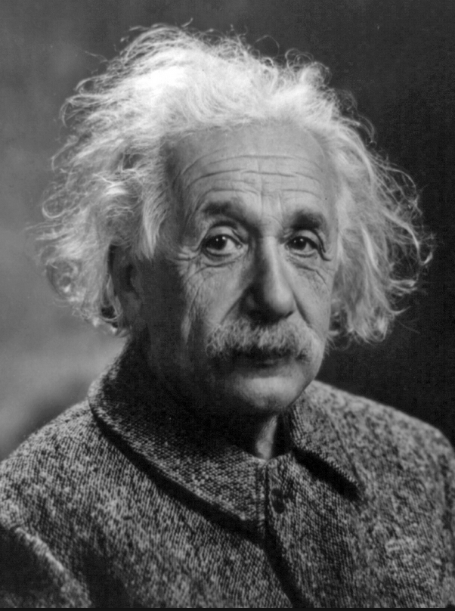
Simple, relatively
Of course, you still have to be specific and accurate. And many short sentences and paragraphs sound choppy.
“Keep things as simple as possible. But not simpler.”—Albert Einstein.

