Slide 1
“The Desk’ll Catch It”
Now you’re the desk.

Slide 2
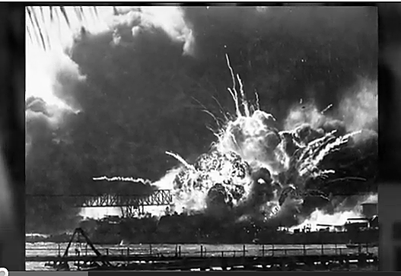
Why study editing?
Well, of course, because—it’s DRAMATIC!
{http://www.youtube.com/watch?v=VziDEBoD07c&list=UU1MN7rBkZ0-q_ZJTOD1Ea-Q&index=5&feature=plcp]

Slide 3
Desk: assure accuracy
Brittany Spears or Britney Spears?
Jon Hoeven or John Hoeven?
Sanford Hospital or Sandford Hospital?

Slide 4
Desk: trim unnecessary words
1.7 million words to 100,000.

Slide 5
Desk: fix grammar errors
We can’t rely on spill chuck.

Slide 6
Desk: identify fact errors
Inconsistencies.
Missing names.
Unanswered questions.
“Use your BS detector.” –Editor

Slide 7
Desk: keep consistent style
Associated Press (AP) standard.
Arbitrary decisions when several are correct.

Slide 8
Desk: catch libel
Editors can save publishers from a costly lawsuit.
Editors can save publishers from embarrassing plagiarism.

Slide 9
Desk: define good taste
Know your audience.
“Have a dirty mind.”—Editor.

Slide 10
Desk: ensure good leads
Snag ’em and drag ’em.
Fairness.

Slide 11
Desk: supervise writers
Know writers’ skills, motivate.

Slide 12
Desk: a view of reality
Determine news mix based on publication’s view.
Monitor social media: trending, memes.
Consider SEO. Where do people find your content?

Slide 13
Desk: other duties
Write headlines.
Choose illustrations, write cutlines.
Make up pages.
Design multimedia: be a “storybuilder.”
Work with printers.

Slide 14
Why is this important?
Consistency.
Credibility.

Slide 15
Consistency
Your publication is easier to read.
Easier reading=easier understanding.

Slide 16
Credibility
People will believe your publication.
Small “false” things harm your credibility.
Major publications seldom have typos.
Don’t believe me? Check out this.
[http://www.youtube.com/watch?v=OonDPGwAyfQ]

Slide 17
What about you?
What is the “view of reality” of a publication familiar to you?
Finance/economy, sports, celebrities, small-town events, crime, etc?
How does this compare/contrast to others?
What would you not expect to see in this publication?

