Slide 1
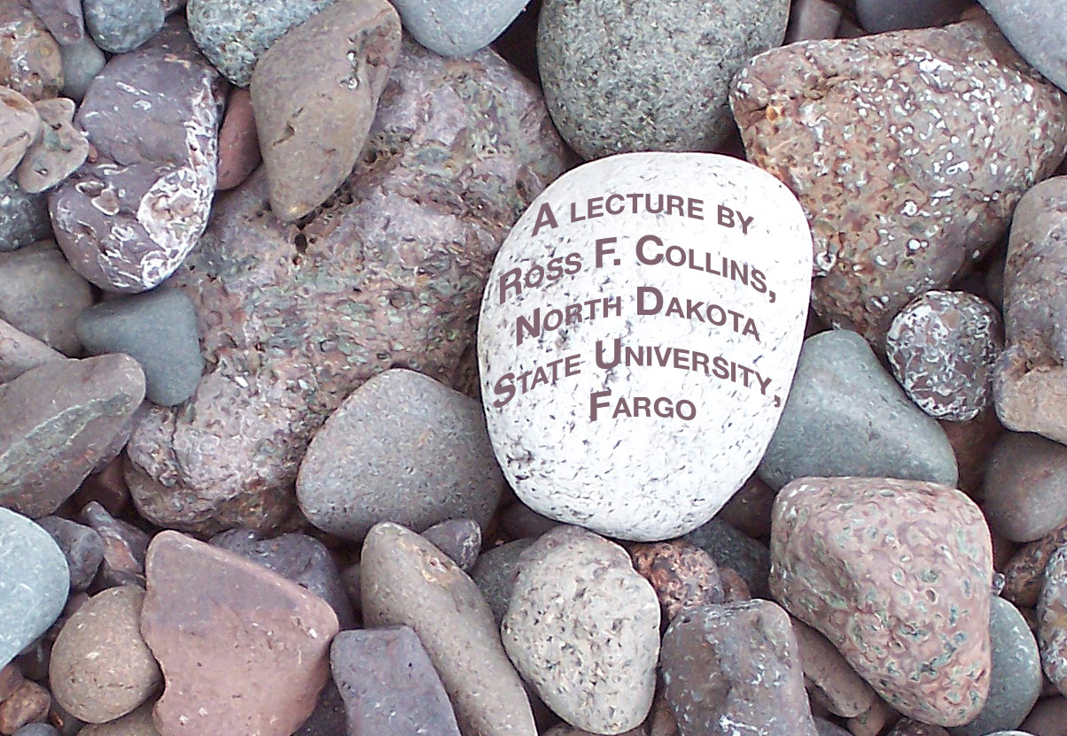
Photography
What is it?

Slide 2
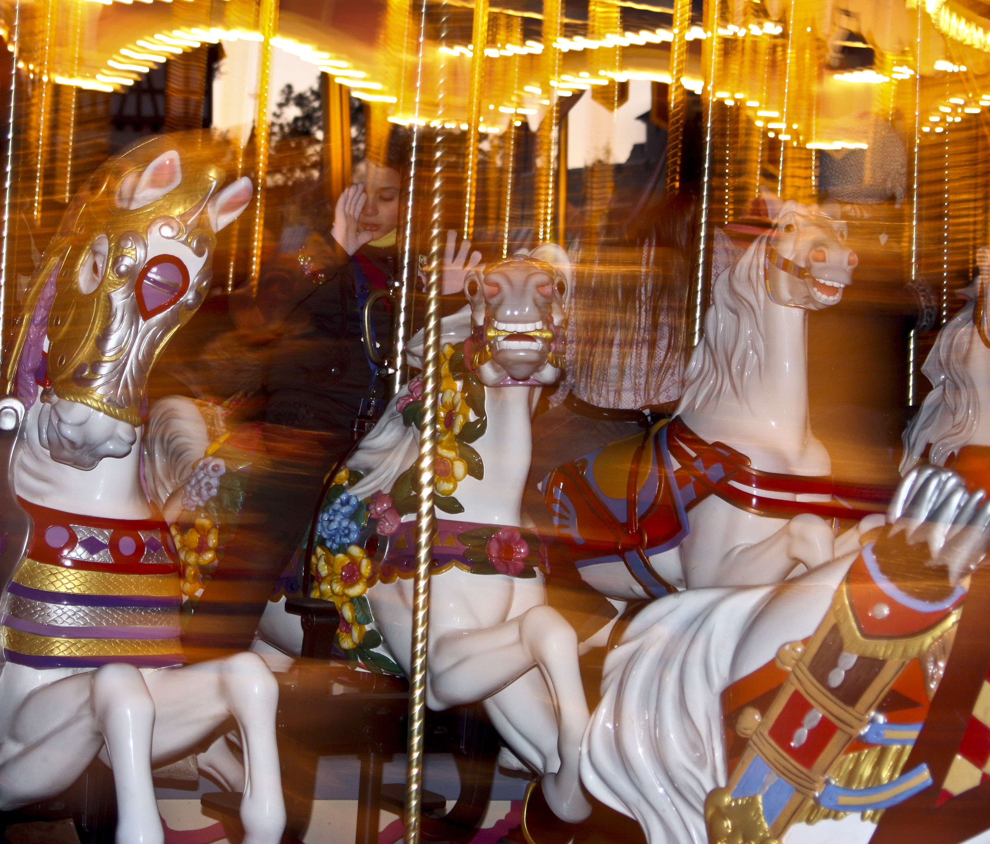
Photography
From the Greek, “writing with light.”
That is what we do, either on paper with chemicals, or on a computer screen with pixels.

Slide 3
Change
Photography has always been technology-driven.
Today we mostly produce photographs digitally.
But photography is still photography.

Slide 4
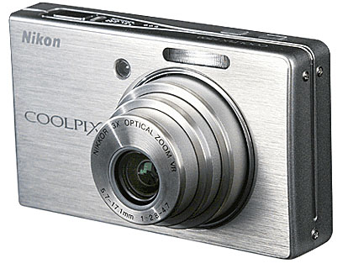
Getting started
Everyone has taken a picture.
Or, as professionals sometimes say, “made an image.”
Oftentimes nowadays the machine we use to do that is the cell phone or smartphone. We also might use a point-and-shoot camera.

Slide 5
Snaps
Everyone takes informal snaps of family and travels. Even the pros. No shame in that!
But the focus of a photography class, if we dare use that word, is to learn to take better pictures.
In this class, in particular, we try to learn and approach the standards expected of professional media.

Slide 6
Basic principles
To begin with, we need to realize this: Photography is at its core a technical process.
That is different from many other familiar visual media.
Painting or drawing, for example, aren’t mechanical. They require paint, brushes or pens. But the rest comes from the artist’s mind.

Slide 7
The machine
In photography, a machine makes the image—guided by the photographer, to be sure, a key point.
Other machines, or perhaps chemicals, process what the machine has recorded so we can see it as a picture.
So a photographer may be an artist, but is always also a technologist.

Slide 8
Becoming technical
So to become a better photographer, we have to be come better at the technology behind the art.
That means we learn physics, engineering and machines skills.
No math required. Well, almost none.

Slide 9
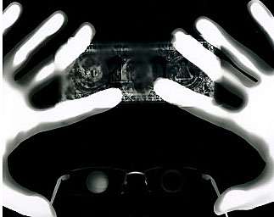
The camera
First stop, obviously, the camera.
We can use light to make an image without a camera, actually.
A photogram is made by manipulating light striking photographic paper.

Slide 10
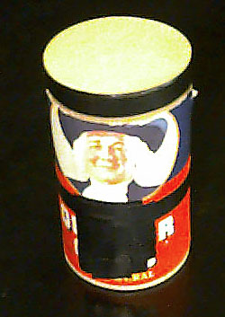
Real photography
But a photogram is not what we’d probably consider “real photography.”
For that we need a light-tight box to gather an image. Any old box will actually work.

Slide 11
Gathering the image
We need to gather the image into something we can view as a photo, and we need to preserve, or “fix” that image.
We can do this traditionally using light-sensitive chemicals. But film nowadays has become mostly a fine-art medium.
Nearly 100 percent of mass media photography nowadays uses a digital sensor, mostly in DSLRs.

Slide 12
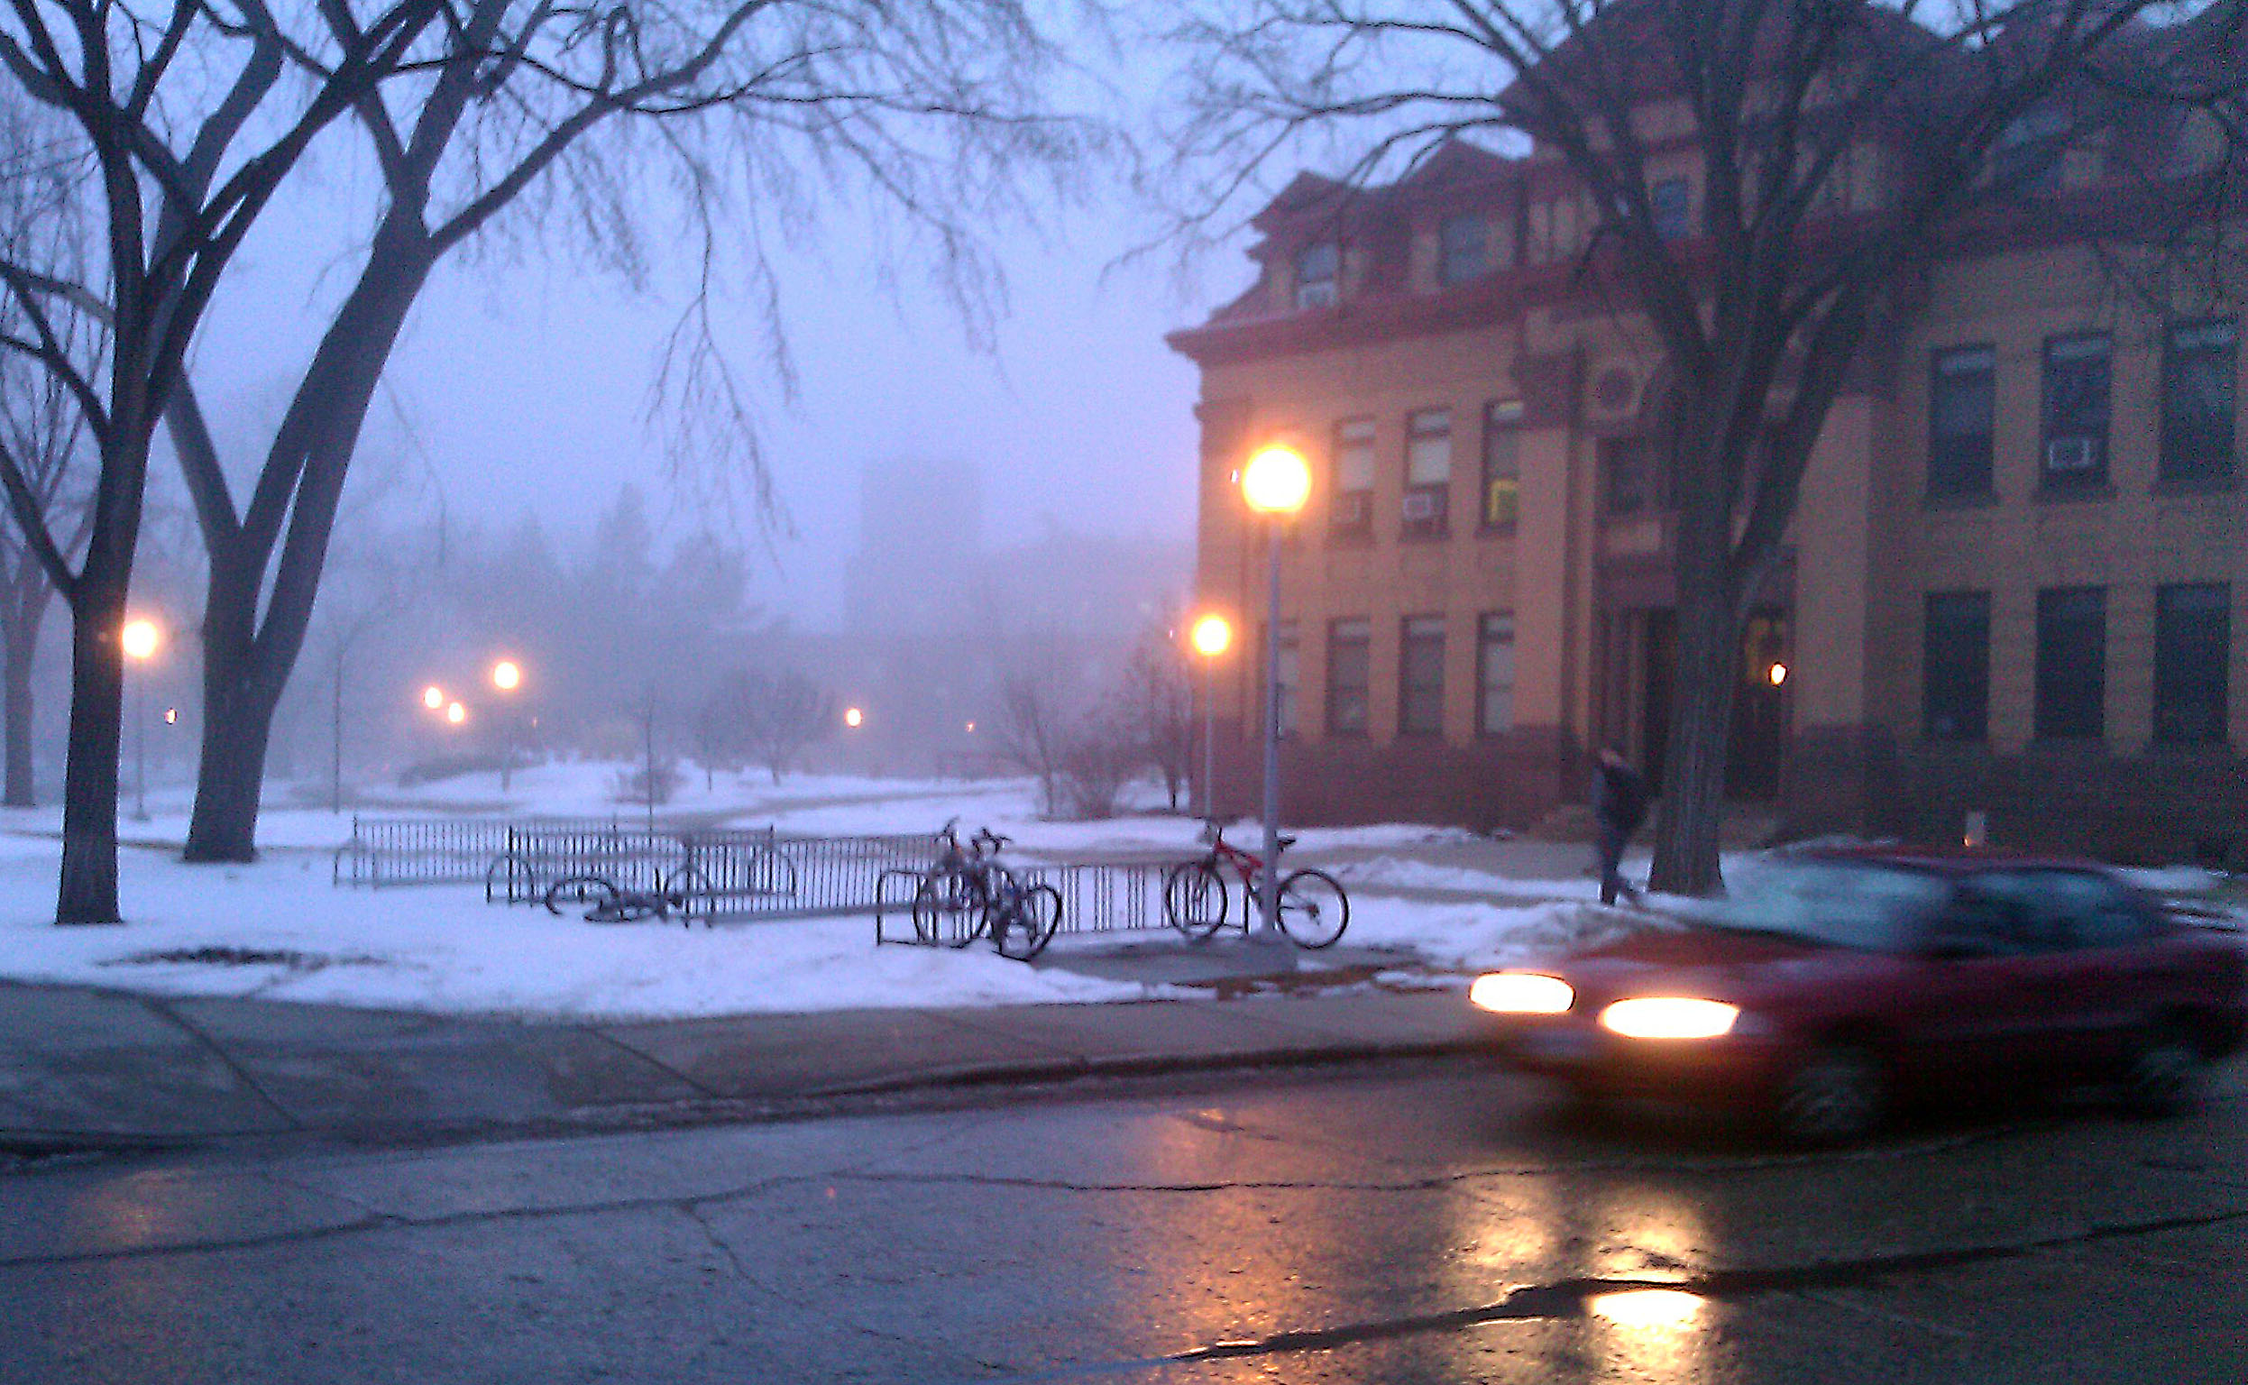
Light and dark
Light varies in intensity.
The lowest light the eye can detect is about 200 times less than the brightest.

Slide 13
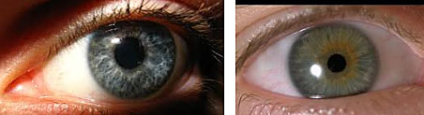
Controlling intensity
Unless we can control light intensity, gathering an image is impossible.
The eye controls intensity through its iris.

Slide 14
Controlling intensity
Cameras have two ways to control intensity:
aperture.
exposure.

Slide 15
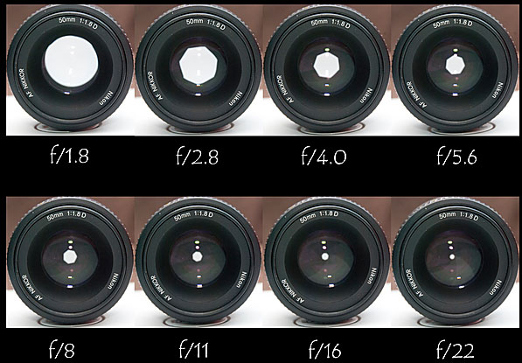
Aperture
Aperture controls light coming through a lens by phsycially blocking some of it.
Overlapping metal plates or equivalent can be controlled to leave a smaller or larger amount of space for the light to pass through.

Slide 16
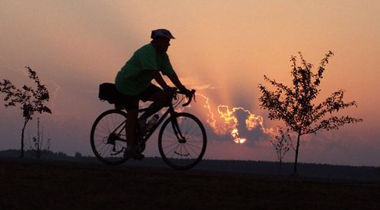
Exposure
Exposure is the length of time the light strikes the film or digital sensor.
The longer the time, the more light is gathered.

Slide 17
Controlling light
Aperture is controlled by f/stops.
Exposure is controlled by shutter speeds.
Both are dependent on the level of film or sensor senstivity.

Slide 18
Sensitivity
The more sensitive the surface that gathers the light, th eless light we need to record an acceptable image.
What is “acceptable?” An image that is neither too dark nor too light.
Too dark is called underexposure; too light is called overexposure.
That may be counterintuitive, but consider we begin with black (absence of light) and add to it.

Slide 19
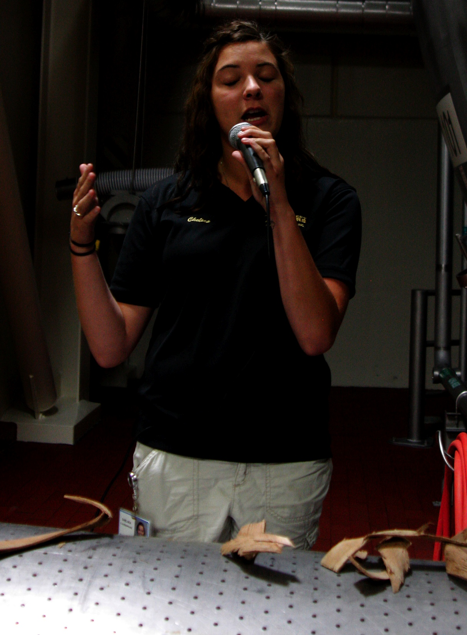
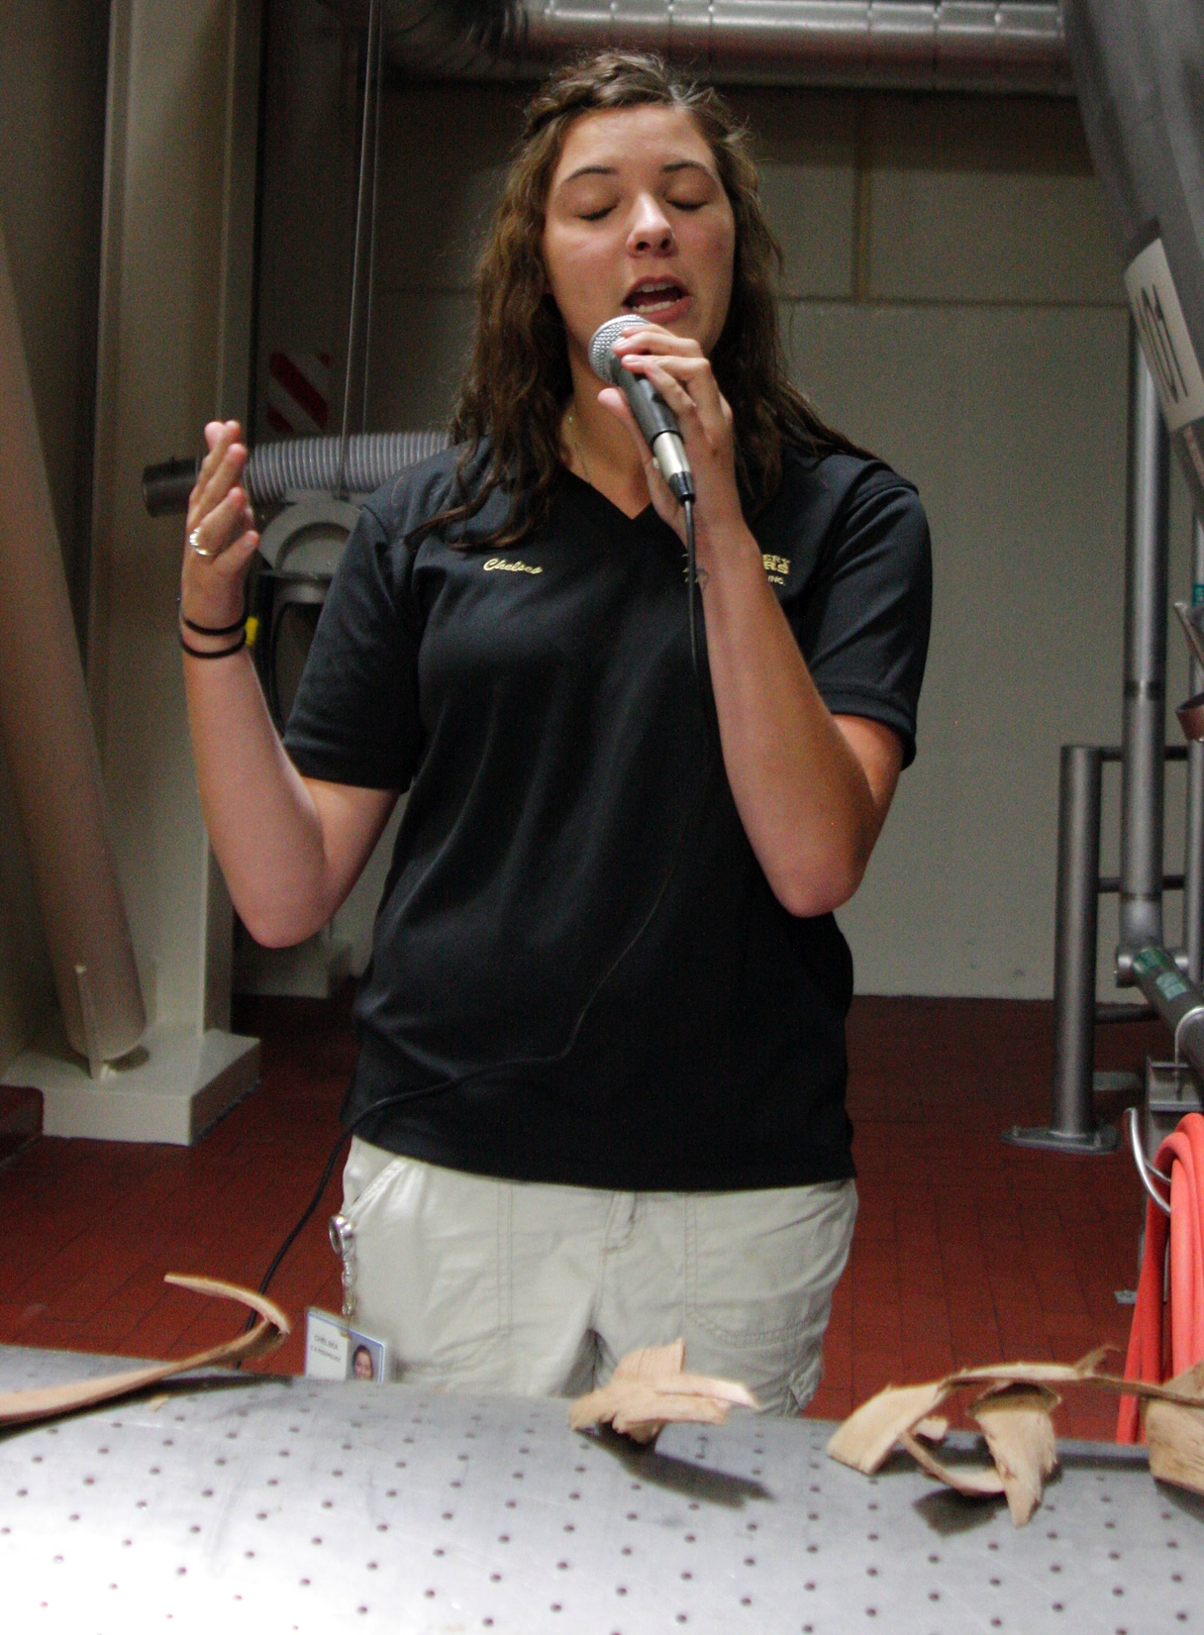
Acceptable exposure
Under or overexposure is of course a subjective judgment.
But professional photographers for the mass media are usually easily able to evaluate images for exposure.

Slide 20
Adjusting exposure
Photographers may or may not be able to control exposure; it depends on the camera.
Smartphones and point-and-shoot cameras normally select a combination of f/stop and shutter speed without photographer input.
These are called auto modes.

Slide 21
Simple auto modes
Some simple cameras offer few auto adjustments.
Some offer none at all. A fixed aperture/fixed exposure camera uses a combination that will work fairly well for many common lighting situations.
Most smartphones have no actual shutter to control shutter speed. The user must accept a lag time between pressing the button and taking the picutre.
That’s nearly useless if you’re trying to catch a moving subject.

Slide 22
Auto modes
Auto modes choose combinations of f/stop and shutter speed. But those combinations often don’t meet a serious photographer’s needs.
One step that moves the casual snapshooter toward the serious photographer is ther ability to turn off the auto mode.
Serious photographers usually manually control the amount of light reaching a sensor.

Slide 23
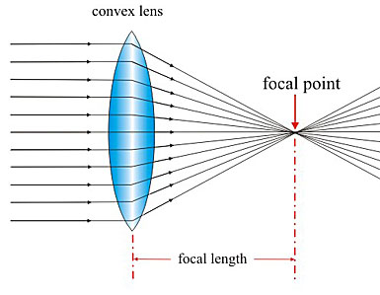
Physics and lens
Physics tells us that when light strikes a transparent medium such as water or glass, it may bend, or refract.
The camera lens is designed to control this refraction to obtain an image on a photo-sensitive surface behind it, called a focal plane.

Slide 24
Controlling refraction
The image should reach the focal plane at its narrowest point possible, called the focal point.
But that focal point changes, depending on how far the object is from the lens. We must control the gathering of light rays on the focal plane to produce a sharp photograph.
We call the mechanism focus.

Slide 25
Focus
To focus an image onto the sensor, we move actual elements in the lens forward or backward.
The principle is similar to a magnifying glass most of us have used—we move it forward or back until the image is sharp.

Slide 26
Ways to focus
Point-and-shoot cameras may not have a focus mechanism at all. They rely on depth of field.
Depth of field means that depending on how close we are to a subject, and what aperture we have chosen, we may fix a lens at one focus setting. Objects closer to and farther from that focus will appear to be in focus.
This works for mostly outdoor scenes in good light.

Slide 27
Ways to focus
But fixed focus lenses don’t give more serious photographers much flexibility. Subjects closer to the camera or in dim light may be blurry.
We rely on a lens that will focus.
Most modern lenses focus for us automatically, the Autofocus system.

Slide 28
Autofocus
DSLR AF systems focus based on sensors that detect contrast between subject and background. Motors move the lens elements.
The higher the contrast the sharper the focus.
Low light or low contrast may fool the AF system.
A photographer has the option of turning off the system and focusing manually using the ring on the lens barrel.

Slide 29
Sensitivity
The fourth major adjustment serious photographers want to control is film or sensor sensitivity.
A more sensitive sensor can make usable images in a dimmer environment.
Photographers don’t often have to deal with too much light—but they quite often deal with too little.

Slide 30
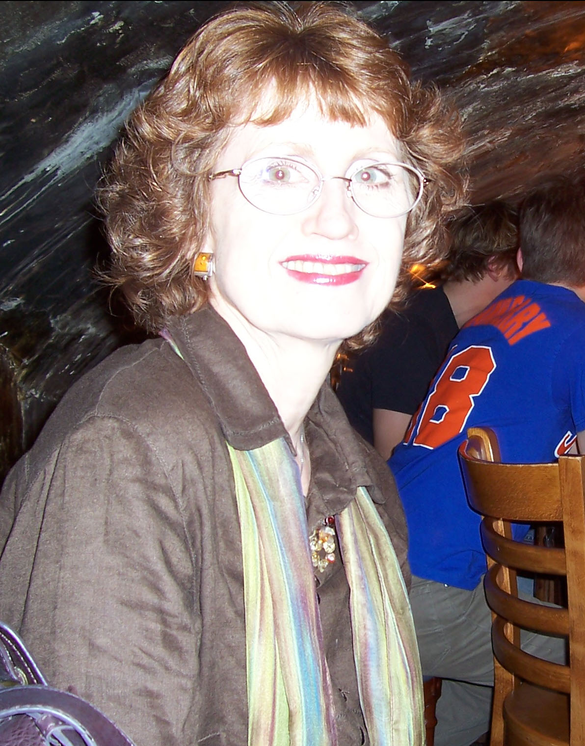
Sensitivity
We can use the pop-up electronic flash to add light. But that often produces poor quality, amateurish photos.

Slide 31
Adjusting the sensor
In chemical days, the film sensitivity was set, and expressed in a number, the ASA number.
In the 1970s we moved to ISO (International Organization for Standardization) numbers, but they corresponded to the old numbers.
Today we have borrowed the old system for digital sensitivity.
Normally point-and-shoot cameras either have no way to alter ISO, or do it automatically.

Slide 32
ISO
More advanced photographers prefer to control ISO.
ISO numbers can be changed to increase sensor sensitivity. Typically these numbers begin at 25, and double, ending at 1600 (higher in advanced DSLRs).
Each number indicates double the sensitivity to light. That means you can get the same exposure with half as much light.
So if it’s dark, you move the ISO to 1600. If it’s bright, leave it at about 100.

Slide 33
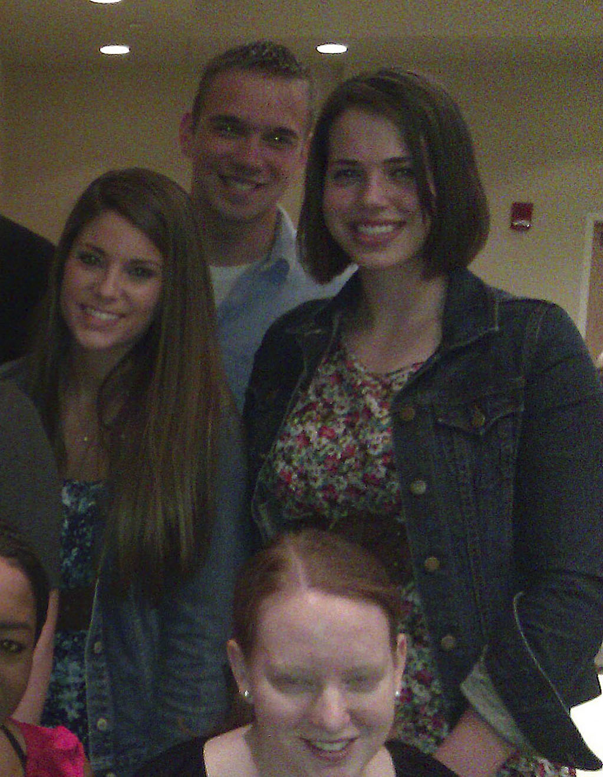
ISO
But like so much in photography, there’s a trade off. As we increase ISO, we also reduce image quality.
High ISO numbers introduce noise, that is, a grainy look to a photo.

Slide 34

The practice
So there you have the technical basics. Let’s consider a few picture-taking basics.

Slide 35
Steady
This might seem obvious, but it’s critical: hold the camera steady.
More images a ruined by blur than any other reason, it seems.
Smartphones and modern point-and-shoots encourage fuzzy images, because we hold them in front of us and compuse using the LCD panel.

Slide 36
Be solid
Composing through an LCD panel is a habit of amateurs.
Professionals use the viewfinder. They hold the camera against their forehead, and brace their elbows against their body.
This creates a kind of solid human tripod that makes a sharper image.

Slide 37
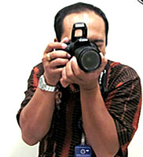
Stabilization
Some modern lenses offer image stabilization to help keep the image sharp, but it’s not a good substitute for keeping your hands steady at the camera.
Most professionals also own a tripod.

Slide 38
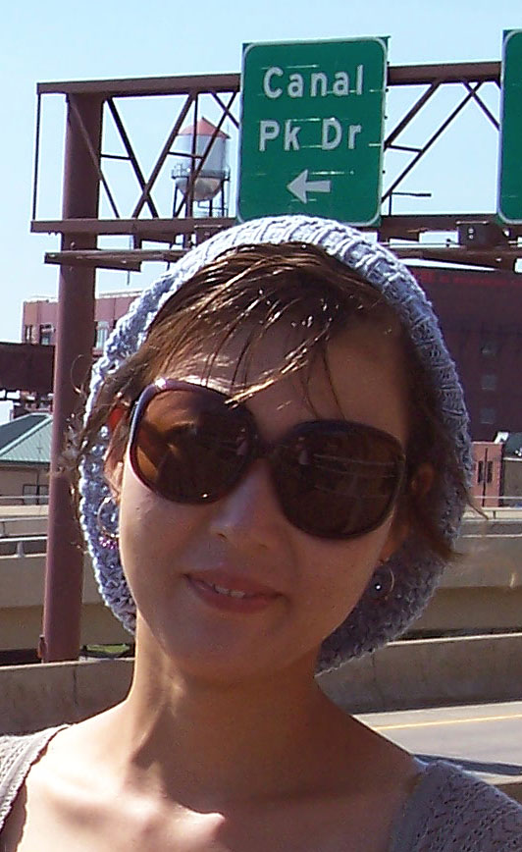
Background
General rule two: Pay attention to your background.
Our eyes are good at focusing on a center of interest while ignoring distractions behind it.
The two-dimensional camera isn’t, and distracting backgrounds ruin many otherwise good photos.

Slide 39
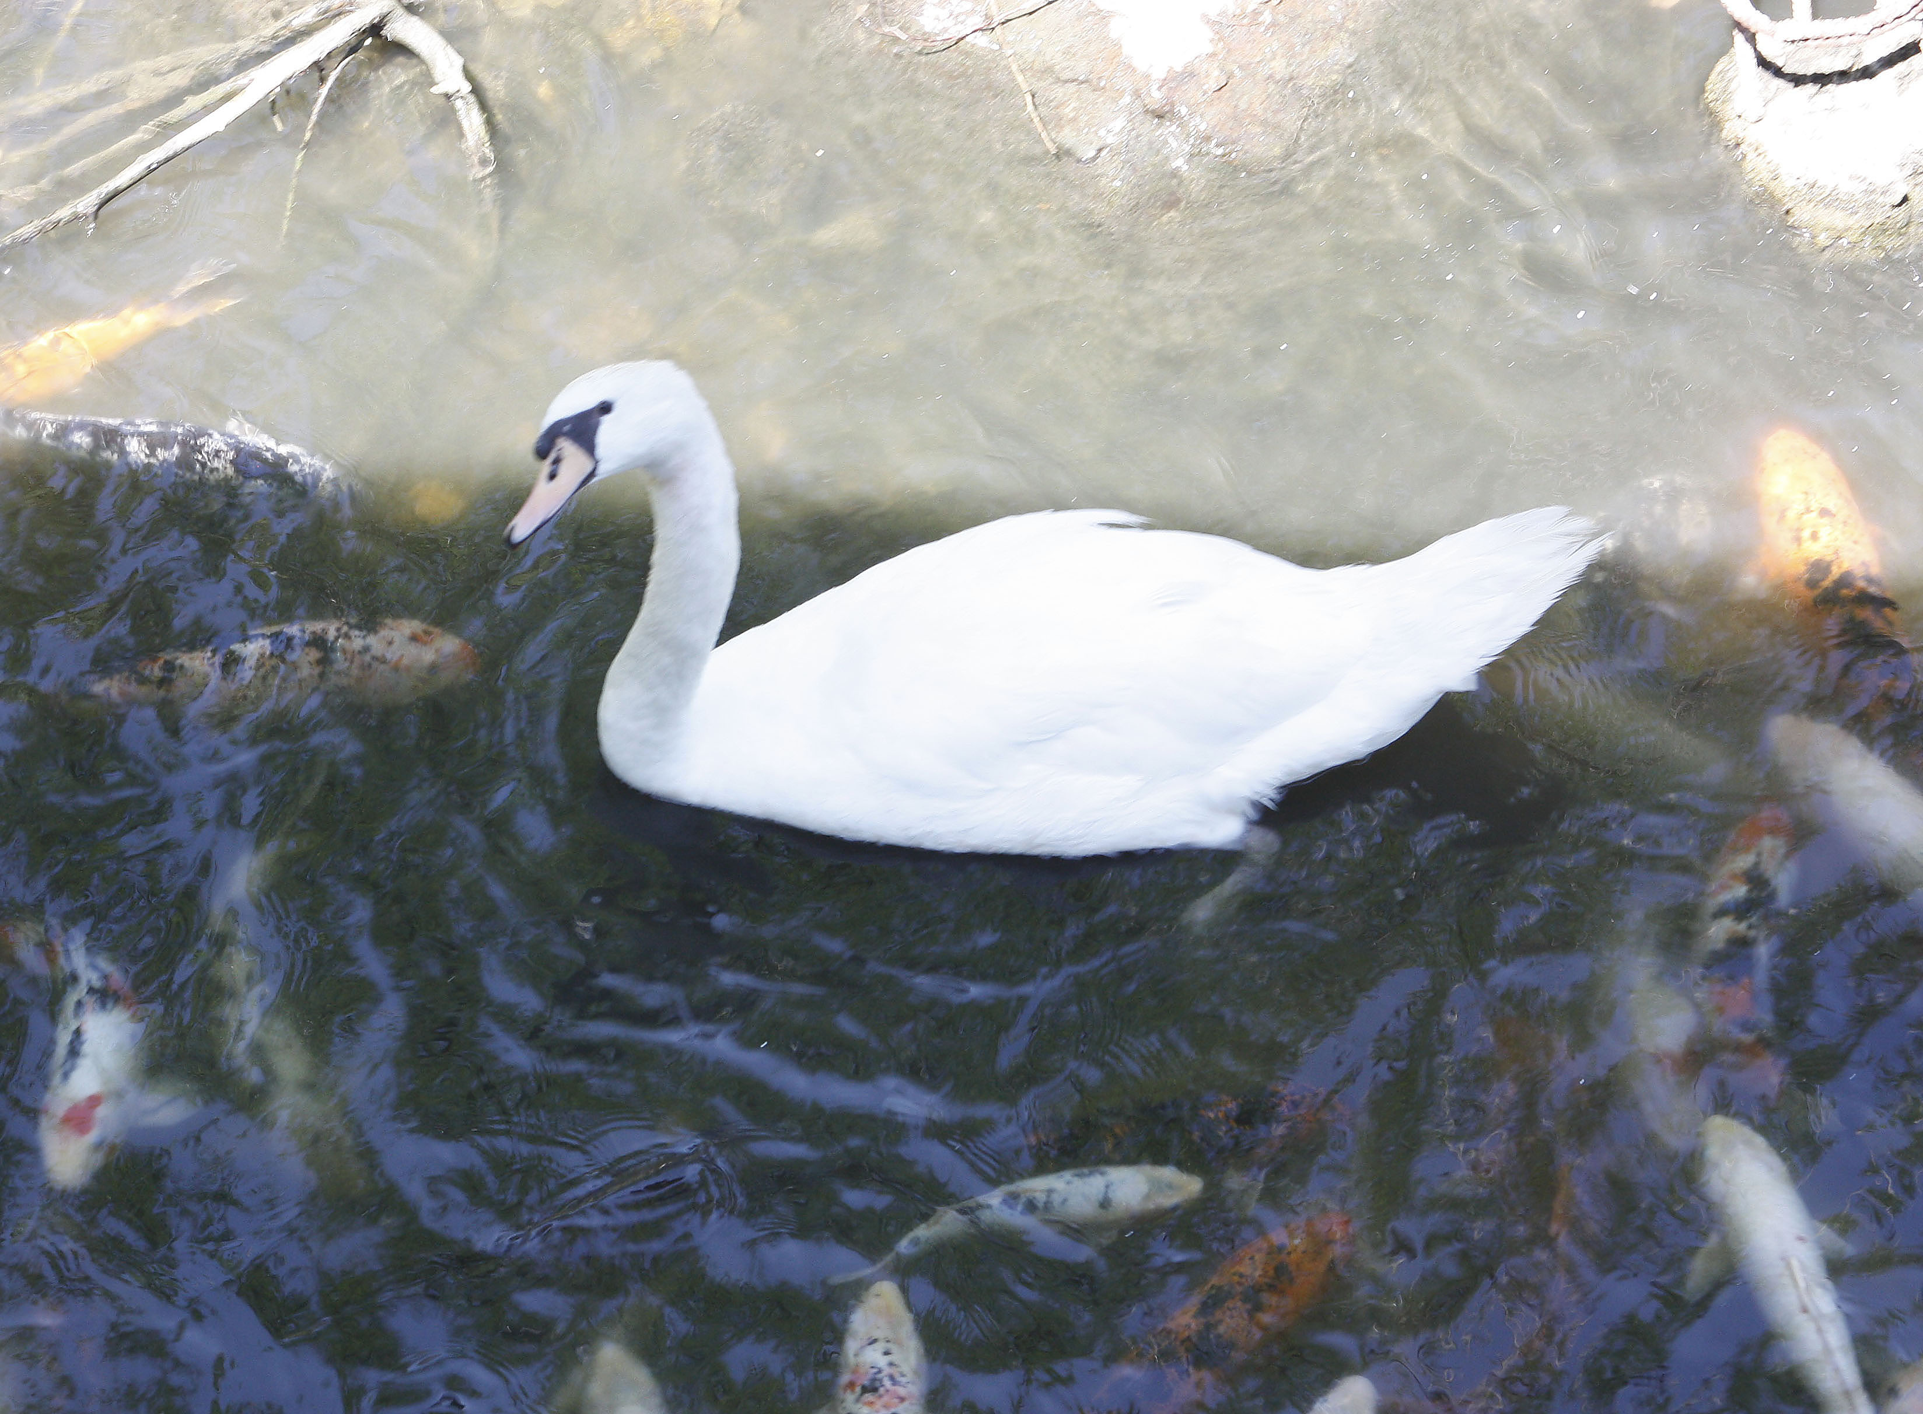
Move away from center
Rule three sounds ironic: the center of interest should generally not be in the center of the photo.
Centered subjects are usuallly boring and static. They look like amateur snaps.

Slide 40

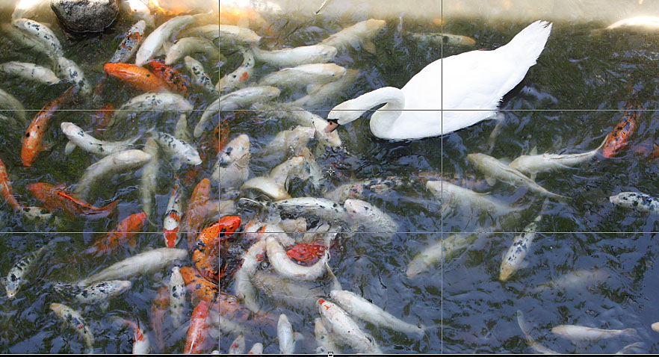
Rule of thirds
Many people have heard of the rule of thirds—place your center of interest on one of these imaginary lines for a more dynamic photo.

Slide 41

Heed lighting
Most non-photographers never really notice lighting, its instensity, direction or quality. But photographers “paint with light.”
We need to work on being more sensitive to the light in the day-to-day-world around us.

Slide 42
Lighting
Evaluate light by asking:
Where does the light come from?
Does it come from more than one source?
Is the difference between light and dark areas strong (high contrast) or weak (low contrast)?

Slide 43
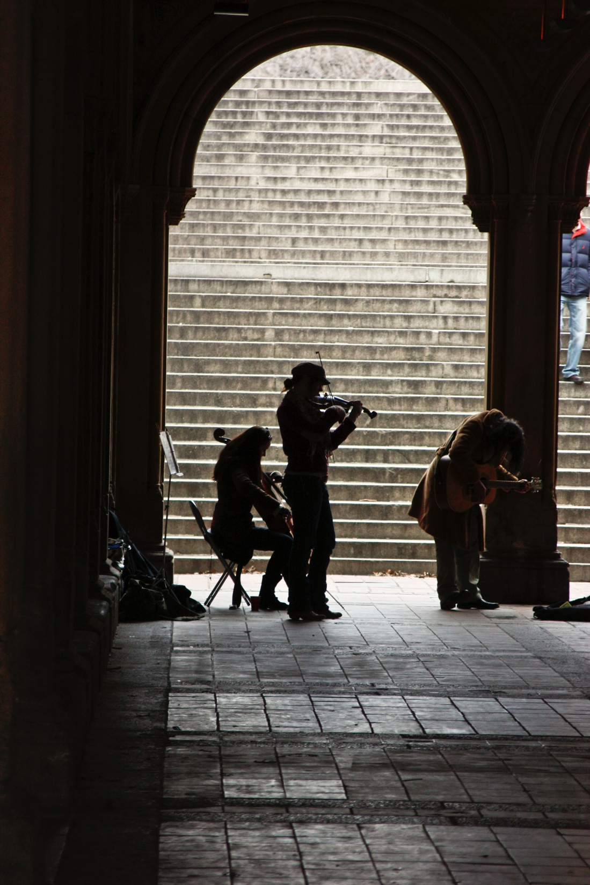
Lighting
How does the light change when I move the camera? When the subject moves?
Do I want to control this light? If so, how can I do that?

Slide 44
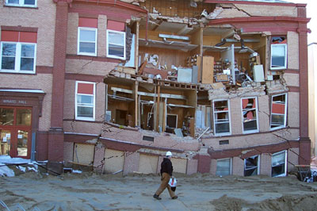
Experiment
And... look for something different!

