Slide 1
Controlling light
I. Lenses, apertures and shutter speeds

Slide 2
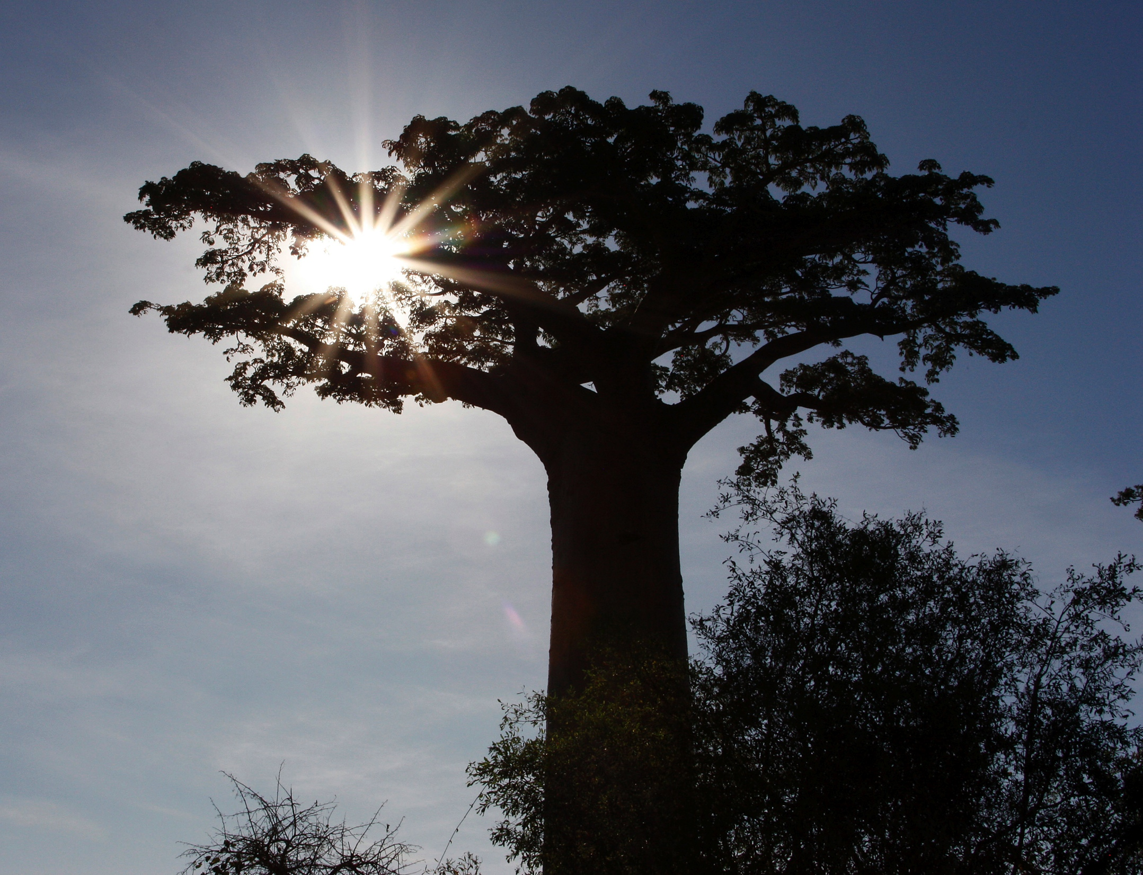
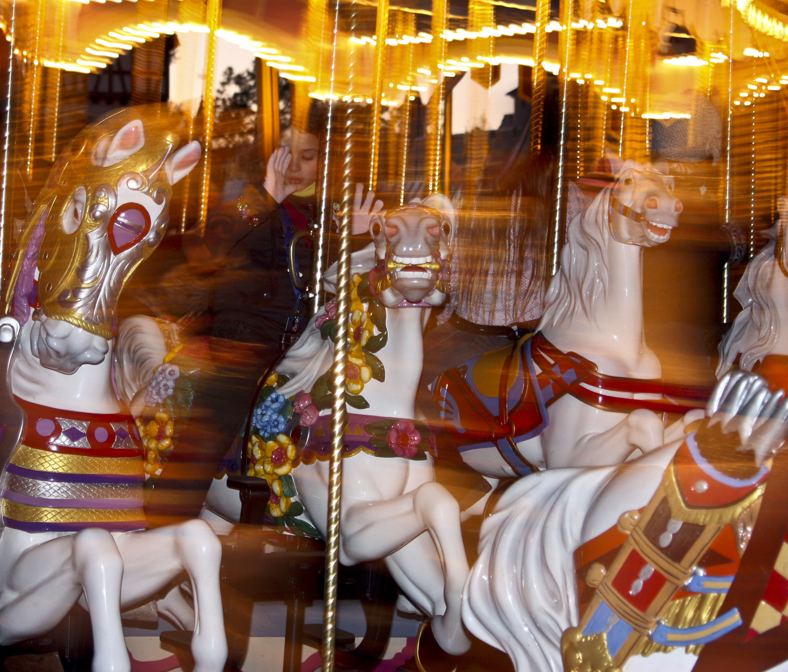
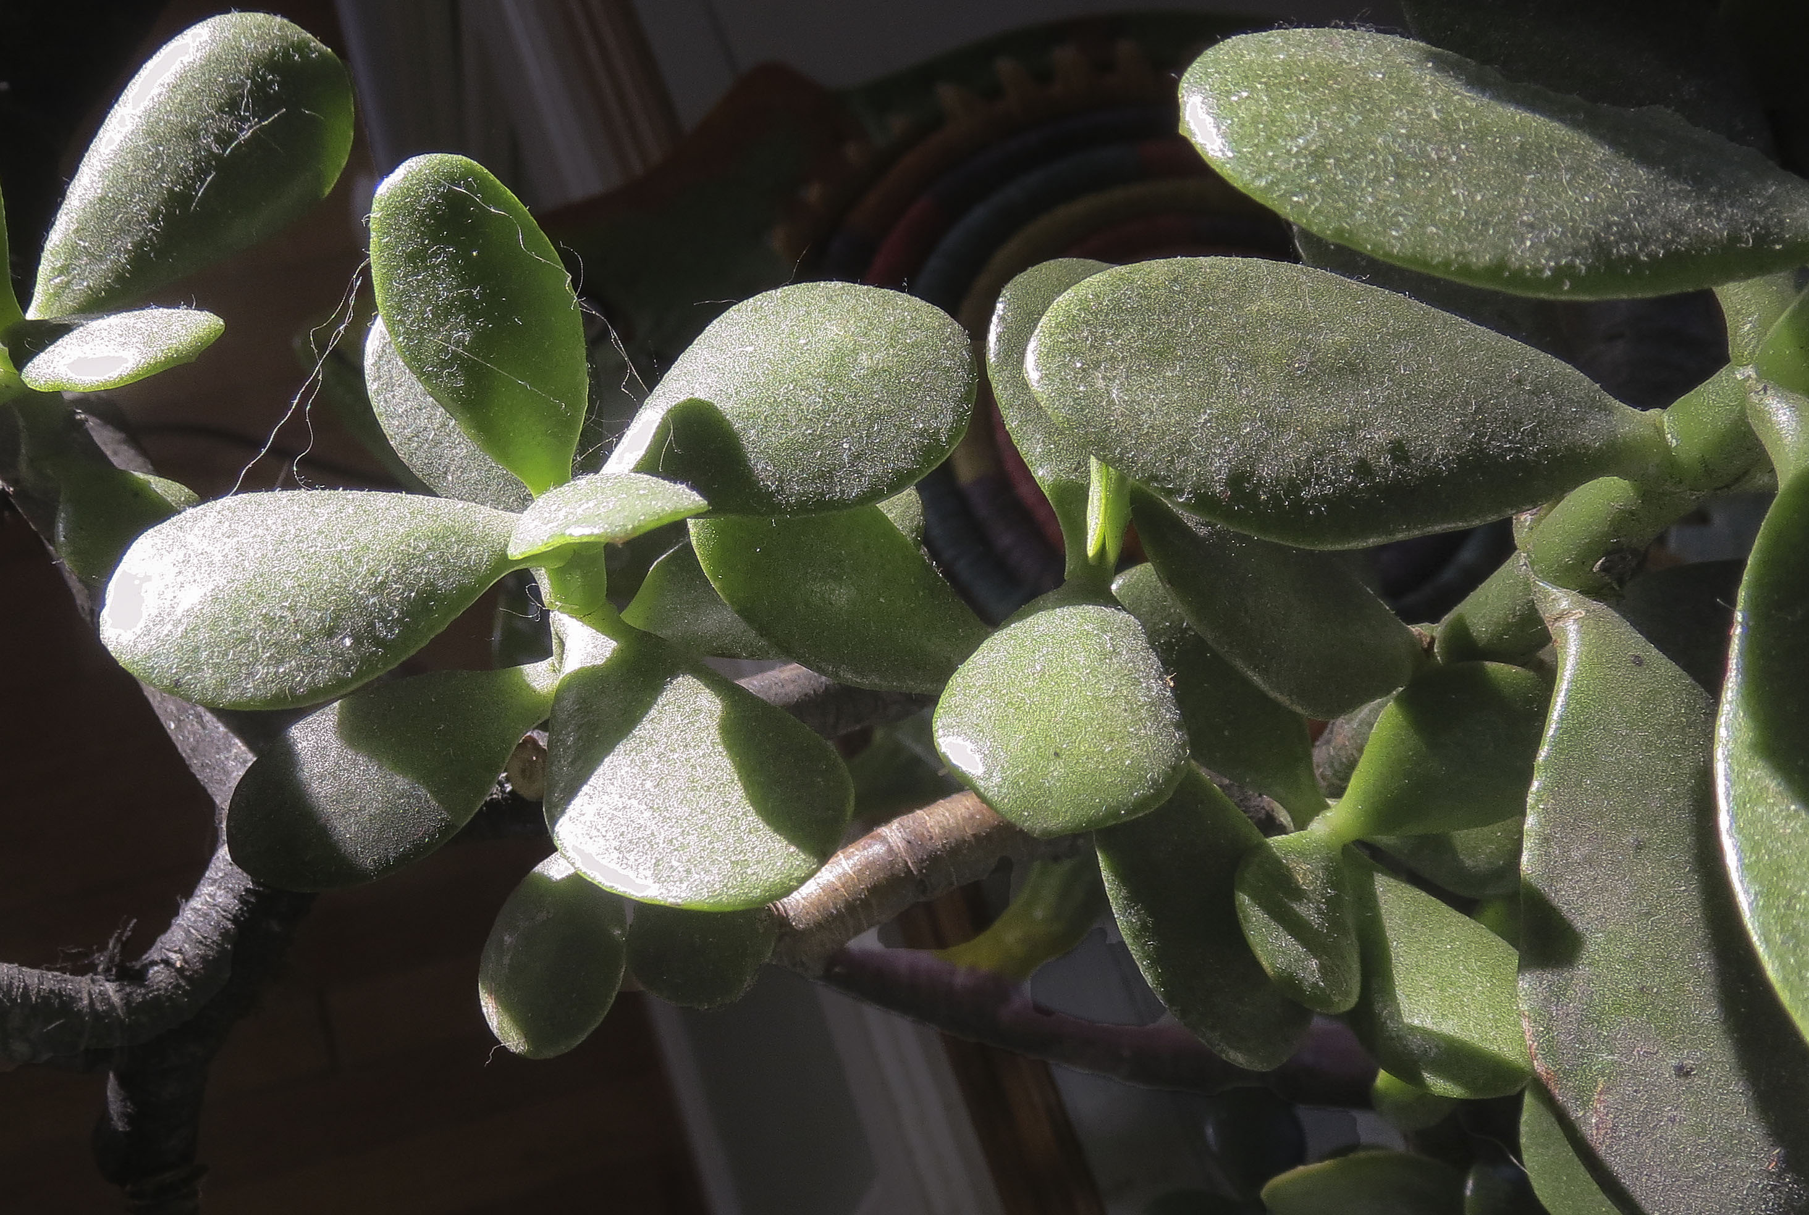
Controlling light
Light is usually all around us. It might come from many different sources.

Slide 3
Controlling light
But that light won’t give us photographs, not as it is.
It must be controlled.
Most of the controls on a camera are designed for just this purpose: to control light before it is recorded on a light-sensitive surface.

Slide 4
The lens
Most DSLRs—and indeed all cameras—today feature quite a few gadgets designed to help you take better pictures.
But the most critical part of the process is also the most expensive: it’s that chunk of glass we call the lens.

Slide 5
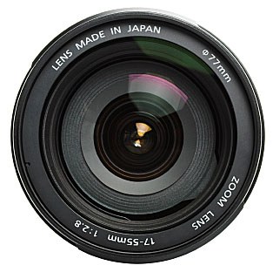
Lens quality
A good lens will get you sharper, better quality photos in a larger variety of challenging light conditions.
It will last a lifetime.
It will be costly.
It will break if it’s dropped!

Slide 6
How does a lens work?
The first question might be: Why can’t we just put a digital sensor in front of an object, and let it record the image?

Slide 7
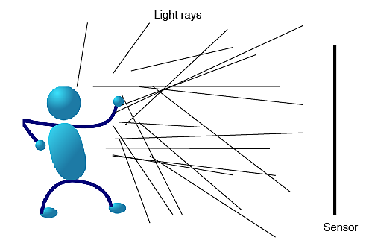
The lens
Let’s consider this drawing.

Slide 8
Light rays
Light rays strike the subject and reflect in all directions.
The light hits all parts of the sensor, everywhere, in a uniform pattern.
The light therefore gathers in no particular place that might serve to form an image.
The sensor (or film) is exposed to light, but merely turns dark. No image is obtained.

Slide 9
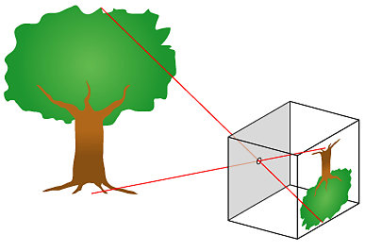
Directing light
We need to find a way to aim that light to form an image.
The most simple way to do this is by making a pinhole camera.

Slide 10
Pinhole images
The principle behind the pinhole camera was discovered apparently hundreds of years ago.
People realized that a small hole or crack in a darkened room would produce an image cast onto the opposing wall.
The image would be upside down and backwards.

Slide 11
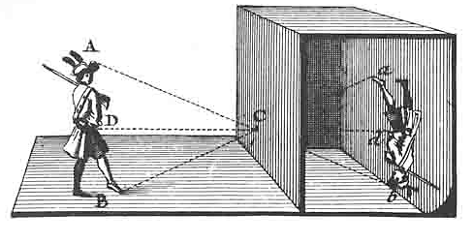
Camera obscura
This is the principle of the camera obscura (“room” “dark”).
The idea of sitting in a dark room watching the passing street scene became the rage of entertainment in the 1600s.

Slide 12
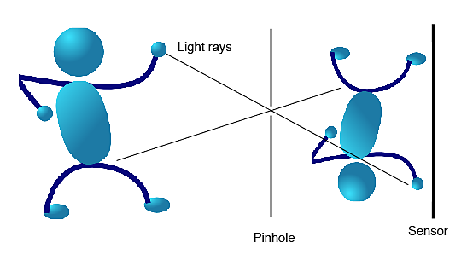
Why a pinhole?
The pinhole blocks all but a few of the light rays.
Those rays go straight through to form an image on the opposing wall—or light sensor.

Slide 13
Pinhole principle
Because only those rays that can go straight through the pinhole are recorded, only a few will strike the wall or sensor. The image is as in a mirror—upside down and reversed.

Slide 14
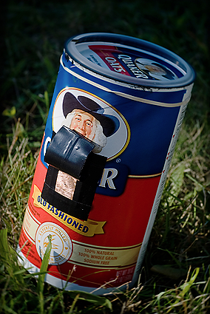
Pinhole camera
You can make a pinhole camera, and use film to record an actual image.
An oatmeal box used to be the traditional way to construct a homemade camera. Perfect kid’s learning project!

Slide 15
Pinhole limitations
The challenge of the pinhole is the size: to obtain an acceptably sharp image, the pinhole must be tiny.
But this means only a few light rays get through. To gather enough for an image, then, you need a long exposure—perhaps several seconds.

Slide 16

A larger pinhole
Why doesn’t the larger pinhole work?
As a few light rays go straight through the pinhole, they will cluster into a small circle on the sensor.
This is called the circle of confusion.
As more light is let in, the circles get bigger. They start of overlap.
This is called blur.

Slide 17
Pinhole limitations
So to get the sharpest image, you need the tiniest hole. But that won’t let enough light through.
So a pinhole isn’t a very efficient way to gather light for a photograph.

Slide 18
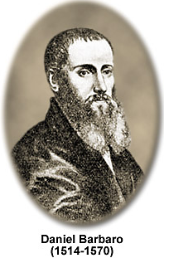
The lens
About 1550 or so an Italian named Daniel Barbaro was apparently enjoying his camera obscura one day.
He wondered how he might improve the image.
So he tried adding an old piece of convex eyeglass. Tah-dah!

Slide 19
The lens
Lenses both provide a sharper image and gather more light.
When light passes through glass is bends, or refracts, at predictable angles.
If concave, the light bends out.
If convex, the light bends in.

Slide 20
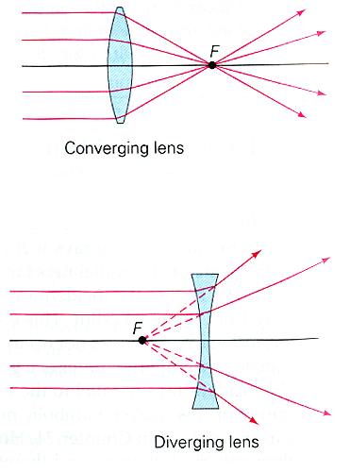
The lens
Only a convex lens will form an image on a flat plane.
A concave lens, however, can produce a clear image for the eye, small, sharp, and not reversed. It’s used for standard viewfinders.

Slide 21
The focal plane
A central question for photographers: do you want your subject to be a larger part of the frame, or a smaller part?
One way to change this is to move forward or backward.
A second way is to change the focal length of the lens.

Slide 22
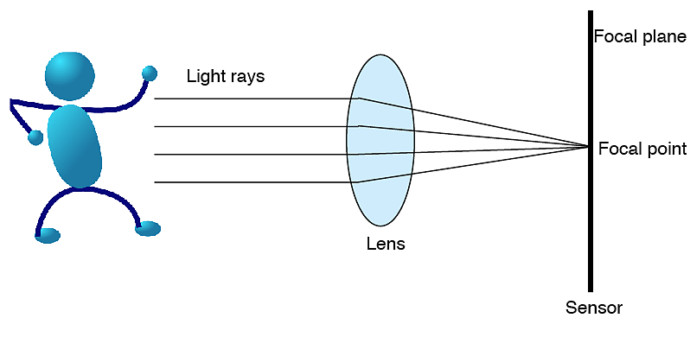
Focal point
The point of convergence of refracted light is called the focal point.

Slide 23
Focal point
The focal point may be adjusted so that it is exactly at the same point as the film or sensor.
This is called “in focus.”
But different lenses refract light at different focal points.

Slide 24
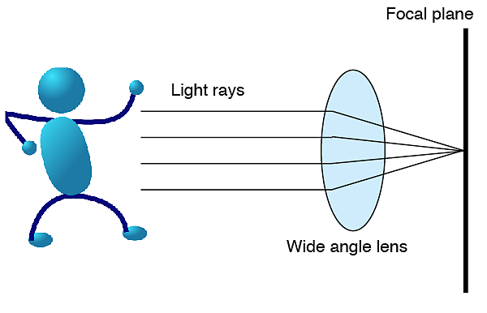
Refraction points
Some lenses bend light quite sharply. These are said to be “short” or “wide-angle” lenses.

Slide 25
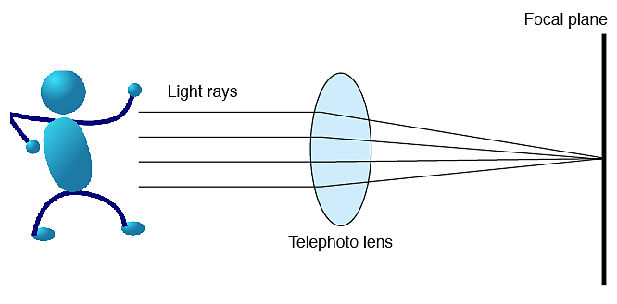
Refraction points
Others bend light more gradually, These are “long” or “telephoto” lenses.

Slide 26
Zoom lens
Focal length is the measurement of the space between the lens and the focal plane, expressed in millimeters. A fixed focal length lens is sometimes called a “prime” lens.
A lens that is capable of changing focal length is called a “zoom lens.”
Most zoom lenses sacrifice speed for flexibility. Also, they may be less sharp.

Slide 27
Lens speed
Speed is the ability of the lens to collect light. a “faster” lens collects more light, so can take photographs in lower light conditions.
Normally we want lenses to be as fast as possible, because it gives us more flexibility.
Photojournalists in particular need fast lenses for available-light photography.

Slide 28
Focal length
If a focal length is short, the image takes up less space on the focal plane (sensor or film).
If it is long, the image takes up more space.
Therefore, a long lens brings us closer to the subject, like a binoculars might.
The focal length of the lens is usually stamped on the lens barrel or ring.

Slide 29
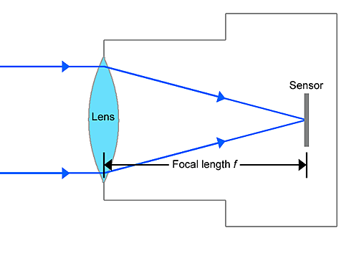
Normal focal length
“Normal” focal length for 35mm film is 50mm.
This means the lens will produce an image similar to what the eye sees.
How is “normal” calculated?

Slide 30
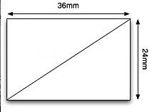
Normal focal length
Normal is calculated by measuring the diagonal width of the film or sensor.
For the 35mm standard of film or advanced DSLR sensors, it is about 43 mm. We round up to about 50mm.

Slide 31
Sensors
The “full frame” (35 mm film equivalent) sensor gives photographers the best quality. It’s not simply a matter of megapixels, as is often advertised.
Smaller sensors with a high megapixel count have smaller pixels stuffed into a smaller sized sensor. This reduces image quality.

Slide 32
Sensors
Full-frame sensors have no “crop factor.” That is, a 50mm fixed focal length lens delivers the same image as it would on film.
Smaller sensors have a crop factor. For example, an APS-C (about 24 mm by 16 mm) is about half the size of a full-frame sensor.

Slide 33
Sensors
The APS-C is common in many lower-end DSLRs and advanced hybrid/bridge cameras.
Because it’s half the size, the image is bigger. That means, for example, a 24 mm lens for a full-frame will be a 48 mm equivalent for half-frame.

Slide 34
Sensors
Other popular sensor sizes:
APS-H, about 28 mm by 19 mm; popular for many mid-level DSLRs, 1.3 crop factor.
Four thirds (about 17mm by 13mm), about one-fourth the size of full-frame.

Slide 35
Sensors
Tiny sensors are popular for low-end point-and-shoot cameras and smartphones, from 7.6mm by 5.7mm down to 5.37 by 4.04 (smartphones).
The smaller the sensor, the less control over depth of field and, of course, the lower the quality of image.

Slide 36
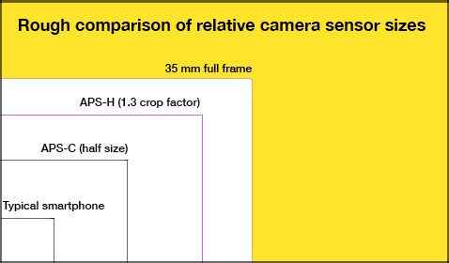
Sensors
Here is a rough equivalent for comparison.

Slide 37
Standard focal lengths
Because we used 35mm film for so long, we still often use it as a lens reference.
For example, a hybrid camera may indicate a zoom lens length from 6-24mm.
But it has a much smaller than full-frame sensor.
So practically speaking it is the equivalent of a full-frame 28-105mm. Moderate wide angle to moderate telephoto.

Slide 38
Other lenses
So for full-frame comparison anything larger than 50mm equivalent is telephoto; anything smaller is wide angle.
When you change the focal length of your lens, either by zooming or putting on a different lens, you make objects appear closer or farther away.
This presumes you do not move.

Slide 39
Perspective
Presuming you don’t move, then, the perspective doesn’t change, no matter what focal length you choose.
Perspective means your subject’s relationship to surrounding objects.
That is, how big or small they appear in comparison to the subject.

Slide 40
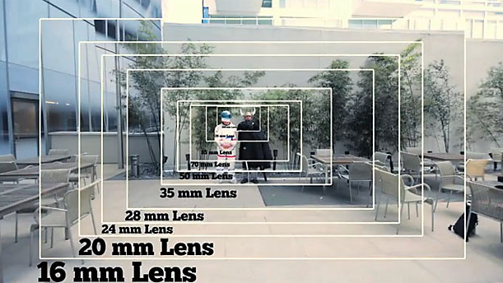
Pespective
Here is a comparison of perspectives.

Slide 41
Perspective
However, most people will both change a focal length AND move.
This changes perspective, sometimes dramatically.

Slide 42
Perspective
Let’s take an example. You take a photo down the street with a sign in the foreground, shooting with your zoom at 105mm.
Now you change your focal length to 28mm.
You walk closer to the photo, so the sign takes up the same amount of space in the frame as it was at 135mm.

Slide 43
Perspective
What happens? Your scene changes dramatically: objects closer to the lens appear much larger. Objects farther away from the lens appear much smaller.
Because we gauge dimension, or depth, in a two-dimensional scene primarily by comparing size of familiar objects, the wide-angle photo dramatically increases the feeling of depth.

Slide 44
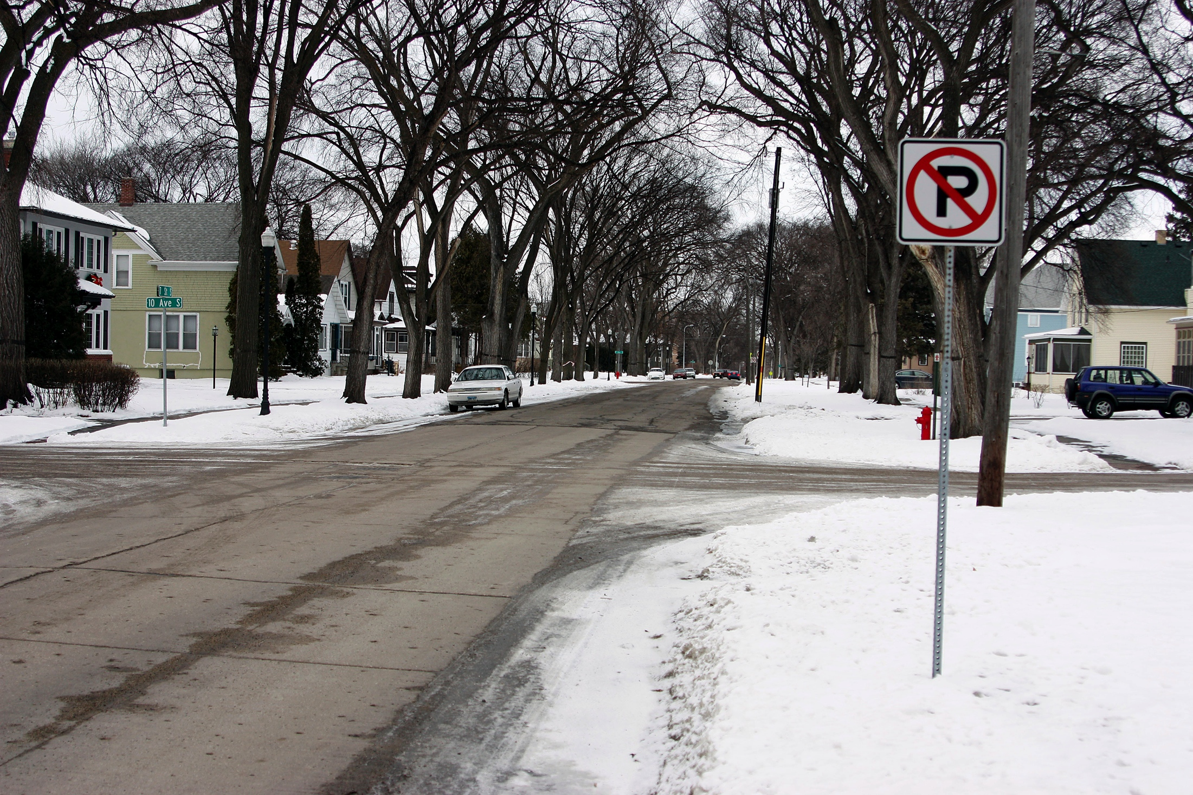
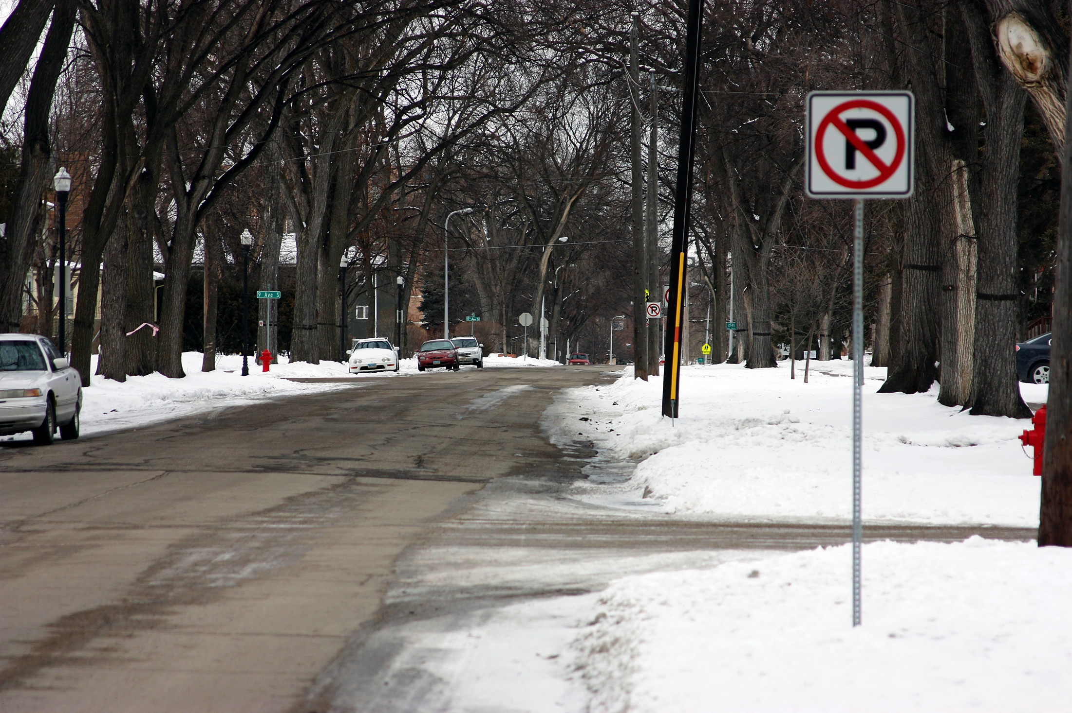
Wide angle and telephoto
28mm (wide angle) and 105mm (telephoto). Note sign is about the same size.

Slide 45
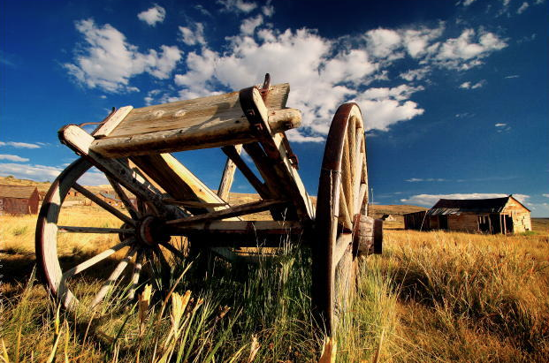
Perspective
Depth means the feeling of great distance in a photo, from foreground to background.
Sometimes we say “a short (wide angle) lens stretches objects in a scene.”

Slide 46
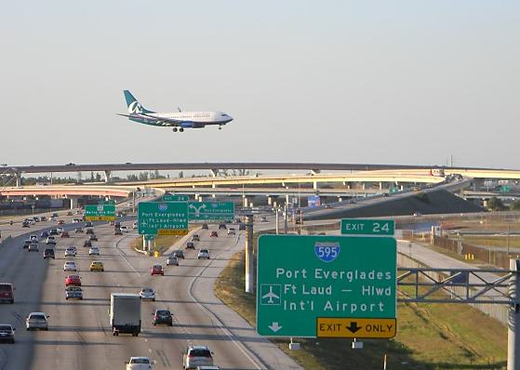
Telephoto stacking
A telephoto, or long focal length, lens gives appearance that objects are closer together. You’ve probably seen this startling effect on photos of airplanes that seem to be landing right on the highway.

Slide 47
Depth of field
So changing the focal length and moving can give you dramatically different results.
But the focal length of a lens also affects focus.
When we say something is in focus, we mean it looks sharp as opposed to blurry.
True focus is based on a central point, the focal point. But it’s not only there.

Slide 48
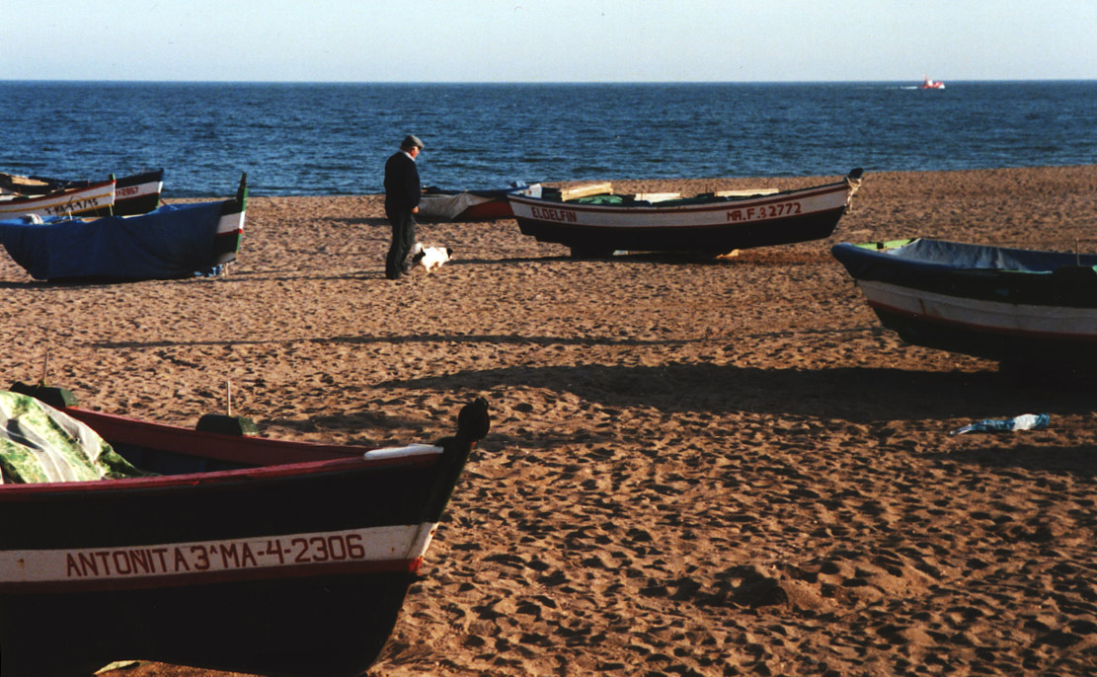
Depth of field
Our eye will not discern the small differences in sharpness around the focal point.
In fact, we can determine a certain distance from the focal point, foreground or background, that still will be acceptably sharp.

Slide 49
Depth of field
The area of a scene from foreground to background that will remain acceptably sharp when we focus on a subject is called the depth of field.
Depth of field is directly affected by three things:
Focal length.
F/stop.
Camera-to-subject distance.

Slide 50
Focal length and depth of field
Simple point-and-shoot cameras without a focus mechanism often have normal or wide-angle lenses.
This is because with these lenses depth of field is large, commonly between 5 feet and 15 feet (1.5 meters to 4.5 meters).
This means you can snap a subject anywhere in that area and be confident it will look sharp.

Slide 51
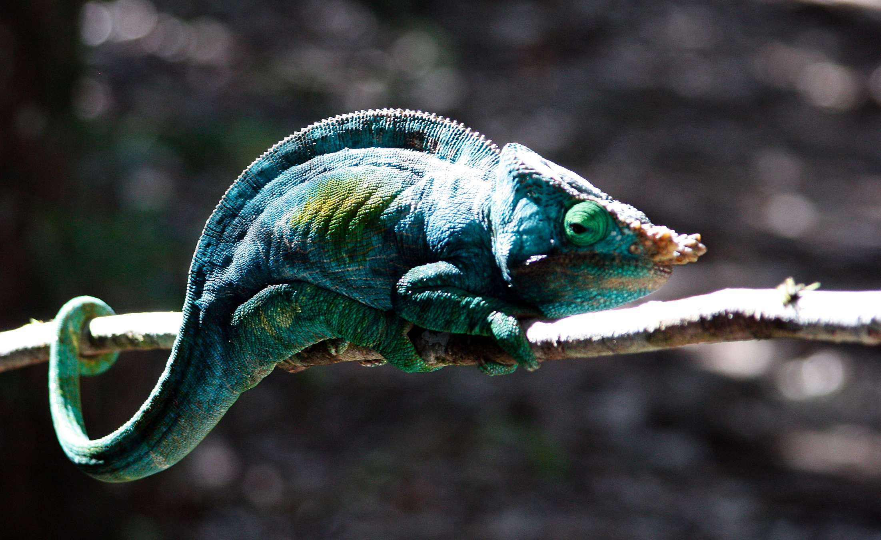
Depth of field and focal length
So if you have a wide-angle lens, your focus can be fairly sloppy and you can still get a sharp photo.
If you are shooting with a telephoto, however, depth of field is shallow. Not much beyond the actual subject will be sharp.

Slide 52
Depth of field and distance
When you get closer to a subject, the depth of field becomes more shallow.
When you get really close, depth of field may be nearly zero. That is why a macro (close-up) lens requires careful focusing.

Slide 53
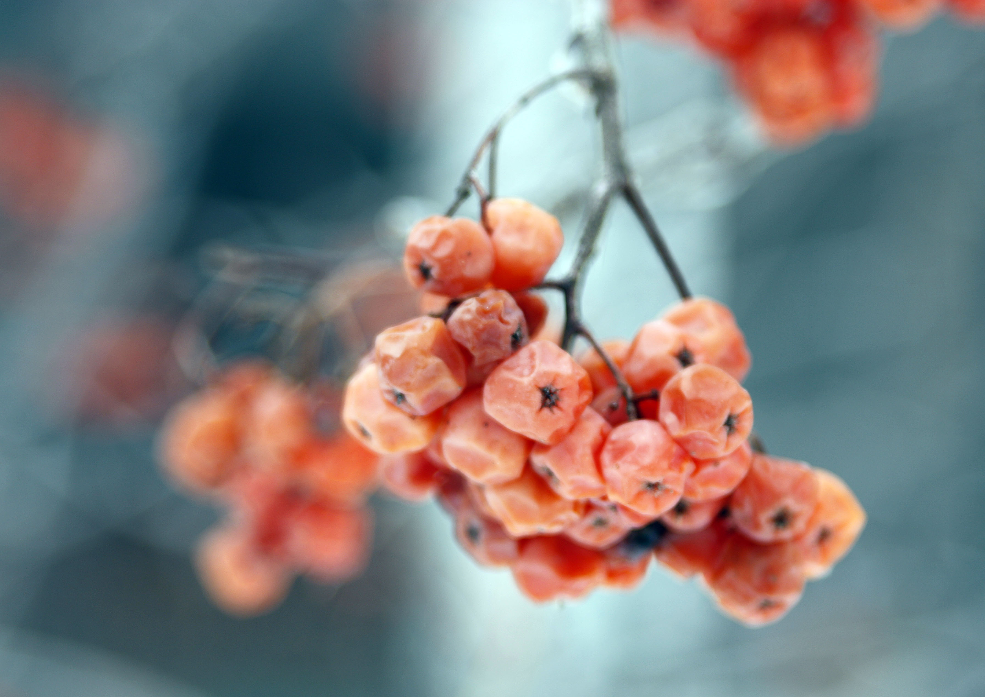
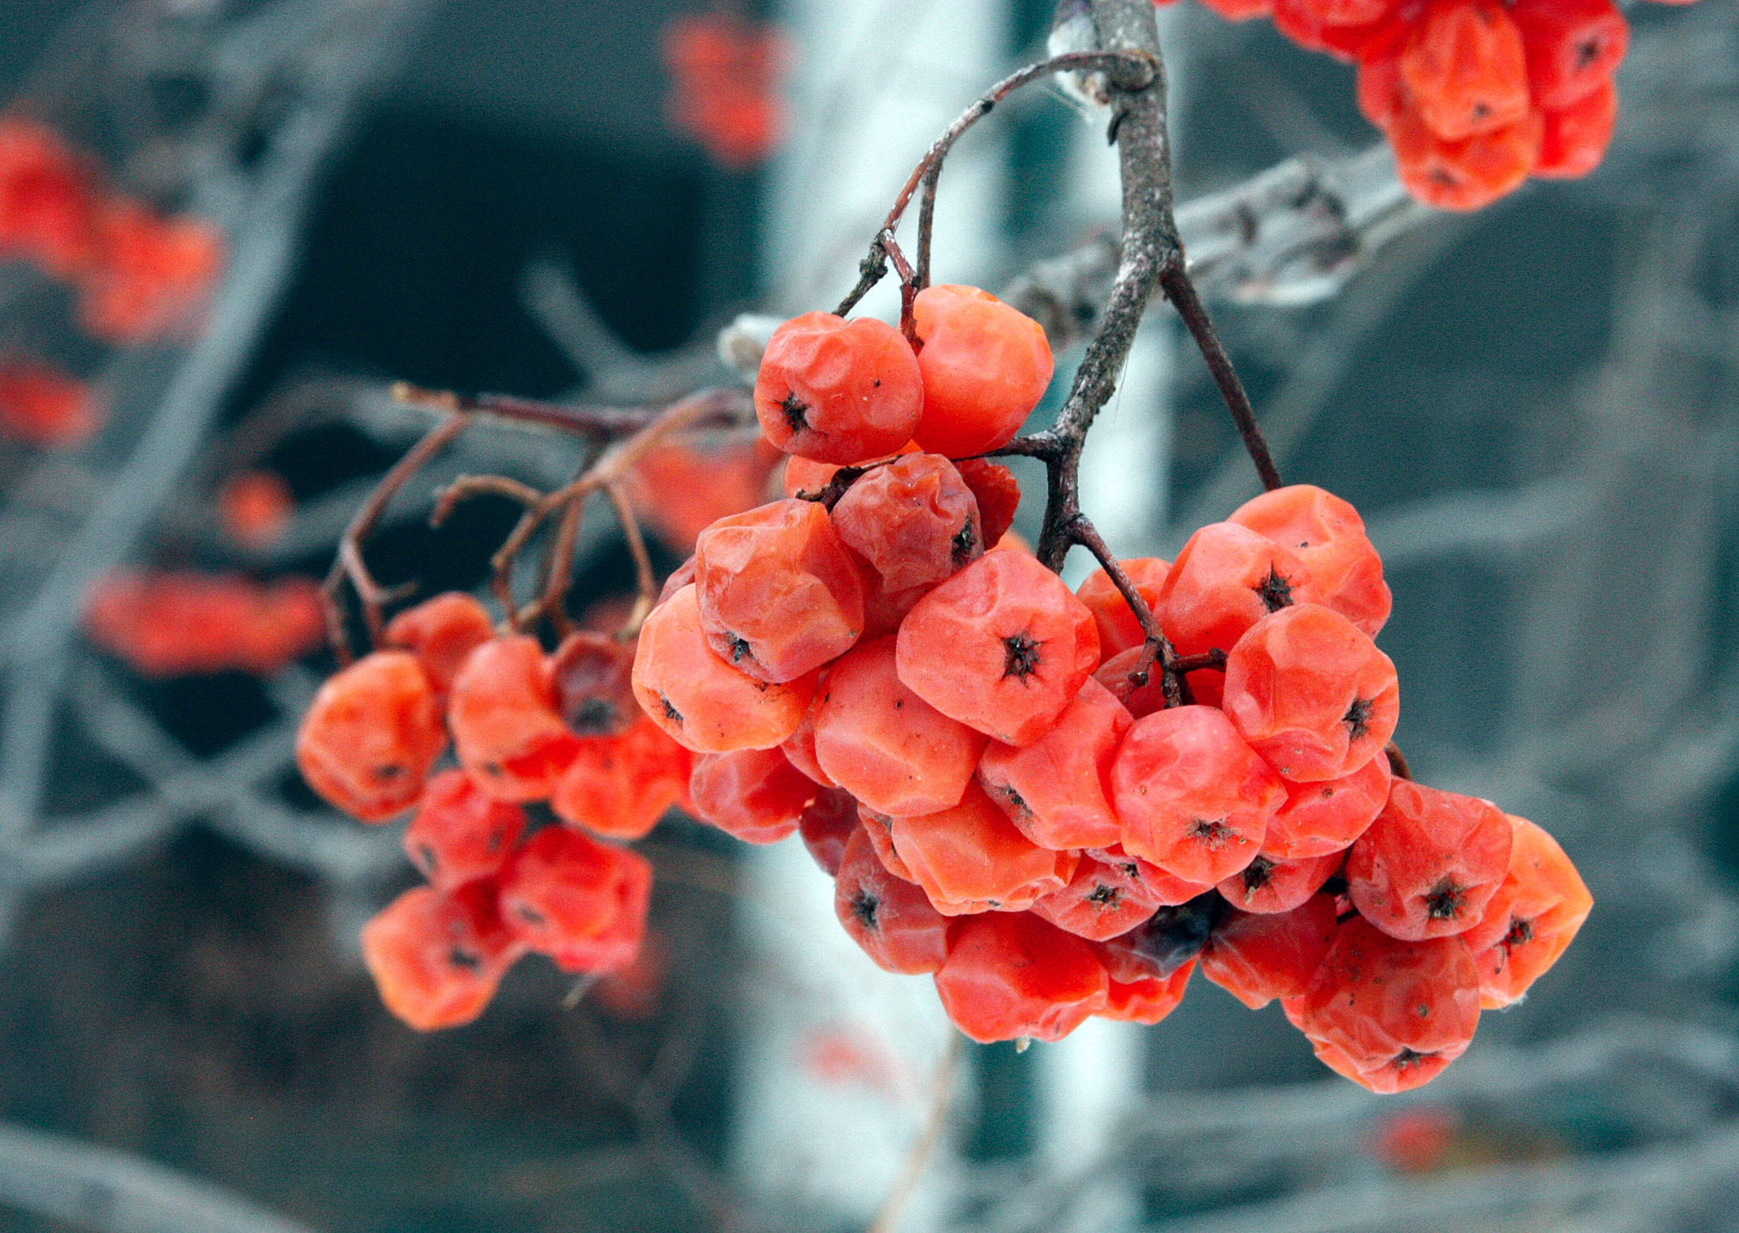
Macro and depth of field
Here is a close-up at f/4.5 and f/19.

Slide 54
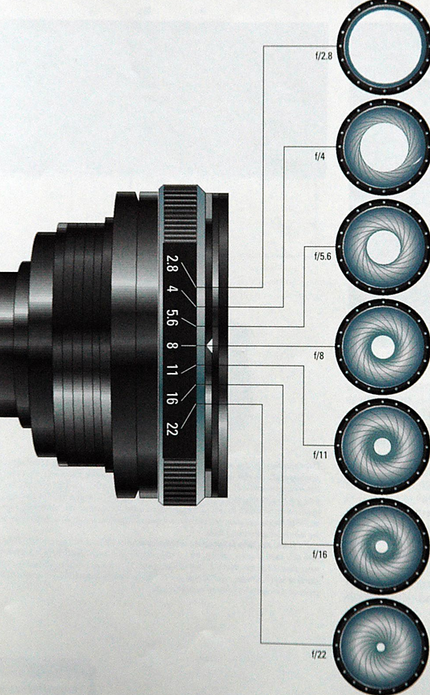
Depth of field and f/stop
Note the third way you can control depth of speed is through the aperture adjustment.
The aperture is the amount of light the lens lets into the camera, measured by f/stops.

Slide 55
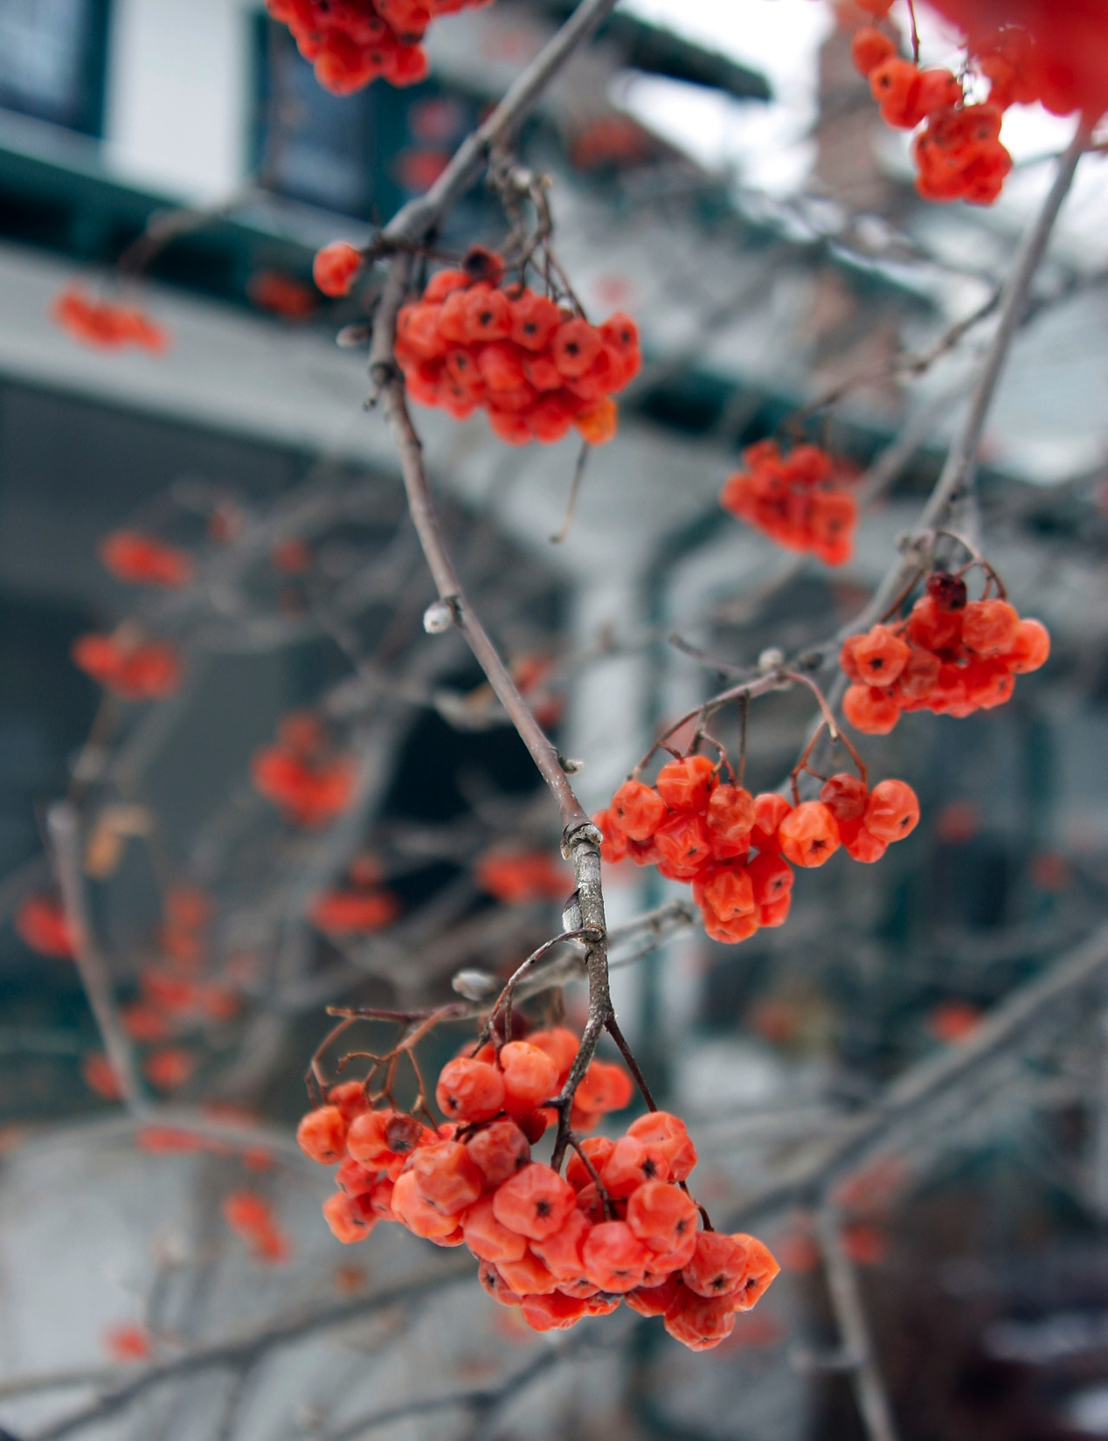
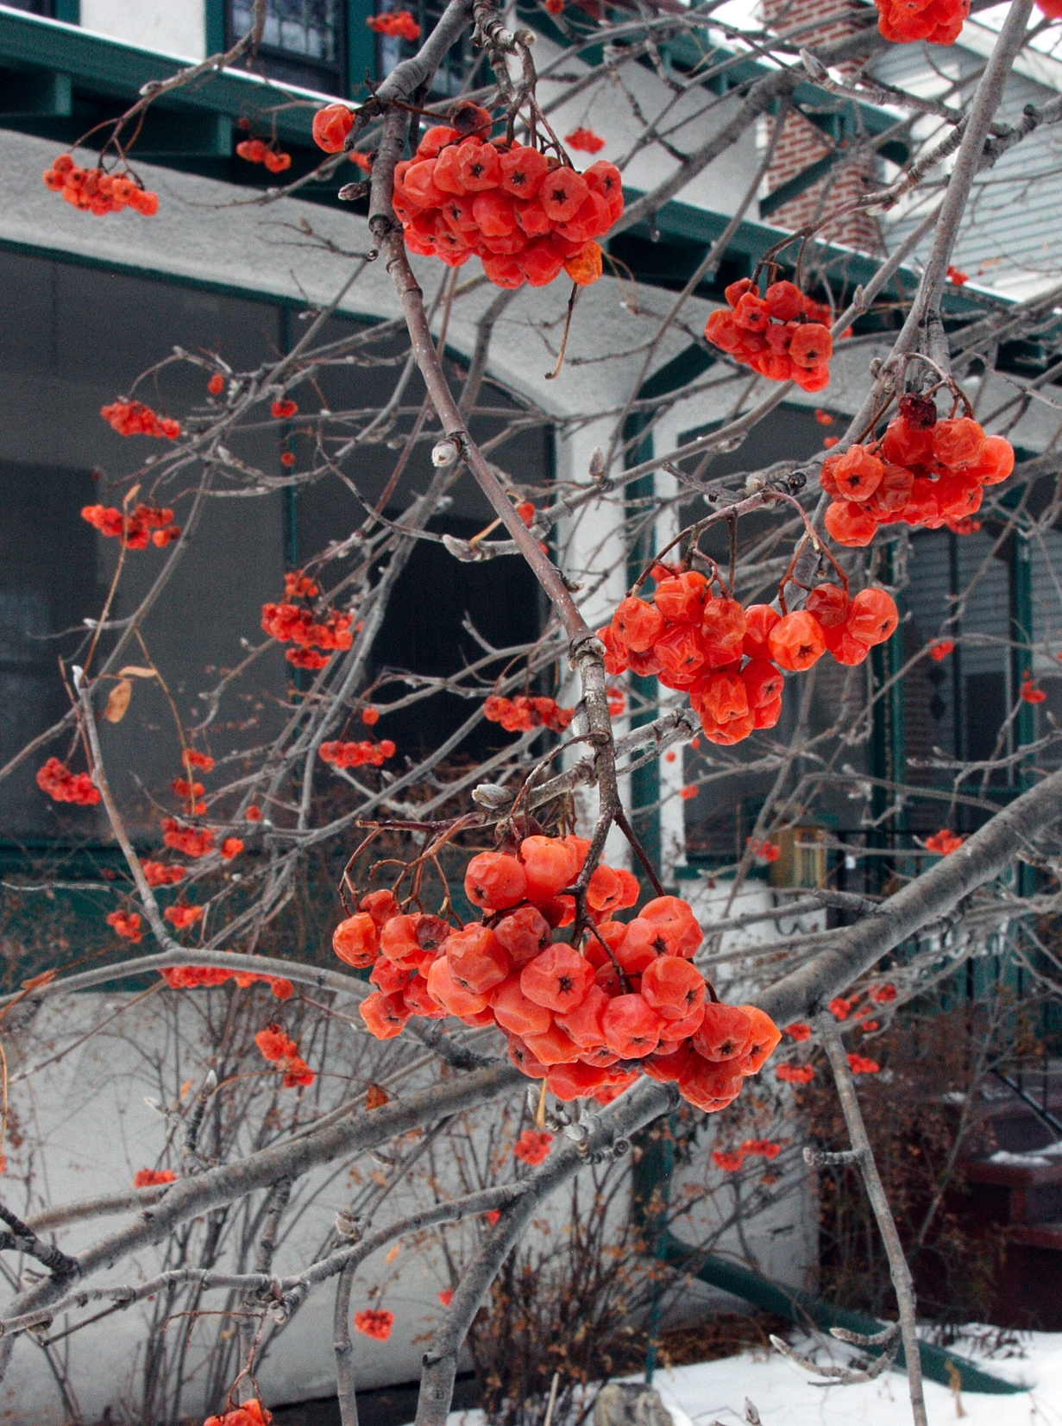
Depth of field
Compare depth of field at f/3.5 and f/22.

Slide 56
F/stops
The f/stop number represents the focal length of the lens divided by the diameter of the aperture.
For example, if you have a 100mm focal length lens, and its diameter is 50mm, the widest f/stop is f/2.

Slide 57
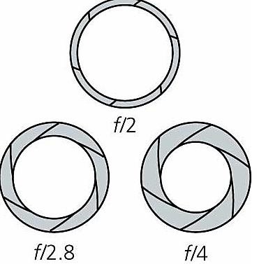
F/stops
If you close that aperture opening down so that it no longer represents a diameter of 50mm, the f/stop will get smaller:
100mm divided by 25mm=f/4.

Slide 58
f/stops and focal lengths
The longer the telephoto lens, the bigger in diameter it has to be to obtain the same f/stop.
To obtain f/2 with a 200mm lens, you need a diameter of 100mm.
This is why “fast” telephoto and zoom lenses become big heavy pieces of glass, and why they usually cost a LOT of money.

Slide 59
f/stops
“Slow” and “fast” in lenses means how much light they are capable of collecting.
The fastest lens, in theory, is 1.0 f/stop. That doesn’t exist, but 1.2 f/stop does. For a price.
Regular zoom lenses that offer a wide range will have a smaller possible f/stop number at the telephoto end than at the wide-angle end. Stamped on the barrel will be something like f/4-f/5.6.

Slide 60
f/stops
F/stops are standardized. You may presume f/4 collects the same amount of light with a 25mm lens and a 200mm lens.
What’s more, f/stop changes adjust the light to a precise degree. Each full f/stop lets exactly half, or double, the amount of light.

Slide 61
f/stops
For example, if you shoot your zoom lens at f/stop 5.6, and then change it to f/8, you are letting exactly half as much light strike the film or sensor.
The higher the number, the less the light you let into the camera.
Most SLRs let you control the light by half or one-third f/stops.

Slide 62
f/stops
Here are standard f/stops:
1.4, 1.8 (or 2), 2.8, 4, 5.6, 8, 11, 16, 22, 32, 45.
No one lens offers this entire range.

Slide 63
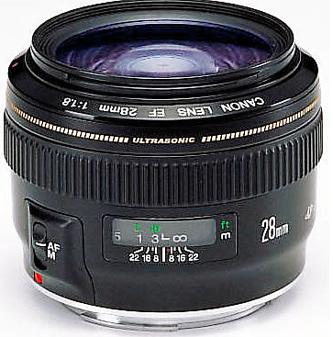
f/stops
Usually the lens speed, or widest possible f/stop, will be stamped on the barrel. Also depth of field at different f/stop and focus combinations.

Slide 64
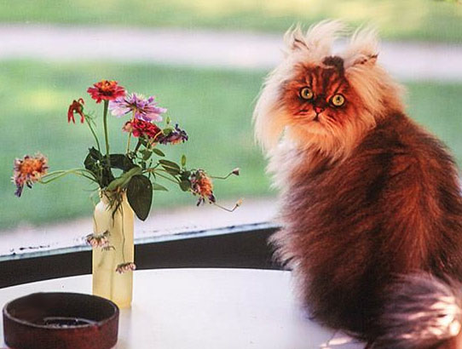
F/stop and depth of field
F/stop affects depth of field in predictable ways.
The larger the aperture (smaller the f/stop number), the more shallow the depth of field.

Slide 65
F/stop and depth of field
For example, if you want to blur a background to focus attention on the subject, you would choose a larger aperture, and so a smaller f/stop, such as f/2.8 or f/4.
If, on the othe hand, you want as much as possible in focus, you’d choose f/16 or f/22.

Slide 66
f/stop and depth of field
Your camera lens will tell you usually what your depth of field is for different f/stops.
Some cameras offer a depth-of-field preview button. This shows you in your viewfinder what will be in focus.

Slide 67
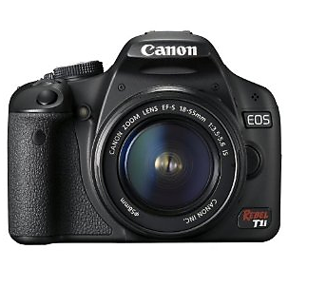
Lens information
Information you need is usually stamped on the front ring.

Slide 68
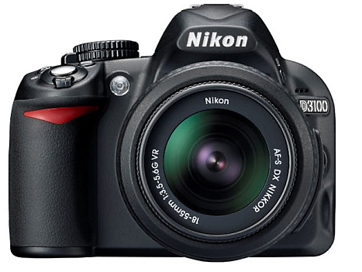
How to read a lens
The important information:
Zoom is 18-55mm.
Speed is f/3.5 (at 18 mm) to 5.6 (at 55mm).
VR means Vibration Reduction.
G means no aperture ring.
AF-S means Auto Focus-Single.
And of course, the model name is Nikkor DX.
Some cameras also include filter size.

Slide 69
Lens complexities
Modern lenses are made of some 20 elements, maybe more, for variable focal length (that is, a zoom).
More complex glass helps control chromatic aberration: the tendency of glass to shift colors toward the blue or yellow spectrum.
Lenses are ground to extremely close tolerances, a millionth of an inch.

Slide 70
Why a fixed focal length?
Most of us use zoom lenses nowadays, but fixed focal lengths (prime) have advantages:
They tend to be sharper.
They tend to be more simple in construction, so more trouble-free.
They are cheaper.
They are usually faster—the biggest reason they remain popular.
What is “fast?” Anything lower than about f/4.

Slide 71
Controlling light with time
So one way to control light coming to your film or sensor is through an aperture.
The other way is controlling how long the light strikes your sensor.
This is called the shutter speed.

Slide 72
Shutter speed Fractions
Shutter speeds are expressed in fractions of a second, but we usually drop the “1.”
So, for example, 1/60th of a second is 60 on most camera dials.
Shutter speeds, like f/stops, are standardized:
1 (second), 2 (one-half second) 4 (one-fourth second, etc.) 8, 15, 30, 60, 125, 250, 500, 1000, 2000.
Some cameras offer in-between speeds.

Slide 73
Stops
When you change a shutter speed or an f/stop by one full number, it’s called a “stop.”
Stops are directly related. Each full stop lets precisely half or double the amount of light into the camera.

Slide 74
Shutter speeds and f/stops
Most professionals don’t use the fully auto function of a camera, because they need to choose a combination of f/stop and shutter speed. The auto function chooses it for you.
One obvious reason to choose it yourself: Y0u wish to manipulate the depth of field.
[Note: low-end cameras with small sensors don’t offer much depth of field.]

Slide 75
Shutter speed-f/stop combos
For example, you wish to isolate a tree branch from its background. To do that, use choose an f/stop that gives you a shallow depth of field.

Slide 76
Combinations
But this means you must compensate by choosing a different shutter speed. Otherwise the photo won’t be properly exposed (under-exposed or over-exposed).

Slide 77
Combinations
In the example above, I set my camera to allow manual f/stop adjustments, but let the camera take care of shutter speeds. That is, “aperture priority.”
I set the aperture (f/stop) at 3.5.
The camera automatically set my shutter speed at 500 (1/500th of a second).

Slide 78
Combinations
But maybe I changed my mind. Maybe I want that background to be in better focus.

Slide 79
Combinations
So I set my f/stop to 22.
My shutter speed automatically compensates. By how much?

Slide 80
Shutter speed compensation
We recall that each stop is calibrated relative to each other.
f/3.5 (or 4), f/5.6, f/8, f/11, f/16, f/22.
That’s five stops.
What shutter speed will reflect a five-stop change in f/stop?

Slide 81
Shutter speed compensation
f/3.5 (or 4), f/5.6, f/8, f/11, f/16, f/22. Five stops.
500, 250, 125, 60, 30, 15. Five stops.
So at f/22 my new shutter speed is 15, or 1/15 second.

Slide 82
Shutter speed compensation
I decide 15 is too slow to hand-hold—my hand is a bit shaky and so the photo may be blurry. So I want to shoot at 60.
What will my f/stop now be?
15 is two stops from 60. Because we are letting in less light, we call this “stopping down.”

Slide 83
Shutter speed compensation
We were at f/22 and 15.
We are now at 60, two stops less light.
So we open the aperture two stops to compensate.
f/22, f/16, f11.
Our new shutter speed and f/stop combination is 60 at f/11.

Slide 84
Exposure combinations
You need to thoroughly understand this relationship.
If you don’t know how to control this, you won’t be able to control what the camera will do to your image.

Slide 85
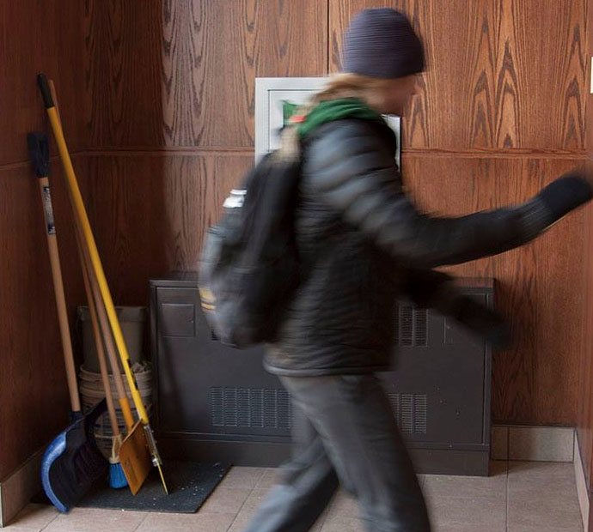
F/stop-shutter speed combos
Why would you choose one f/stop over another, and one shutter speed over another?
Here are some general rules.

Slide 86
F/stop-shutter speed combos
Rule One:
Always choose the highest shutter speed possible.
You do this to as much as possible avoid camera shake blur, or avoid subject blur in a moving subject.

Slide 87
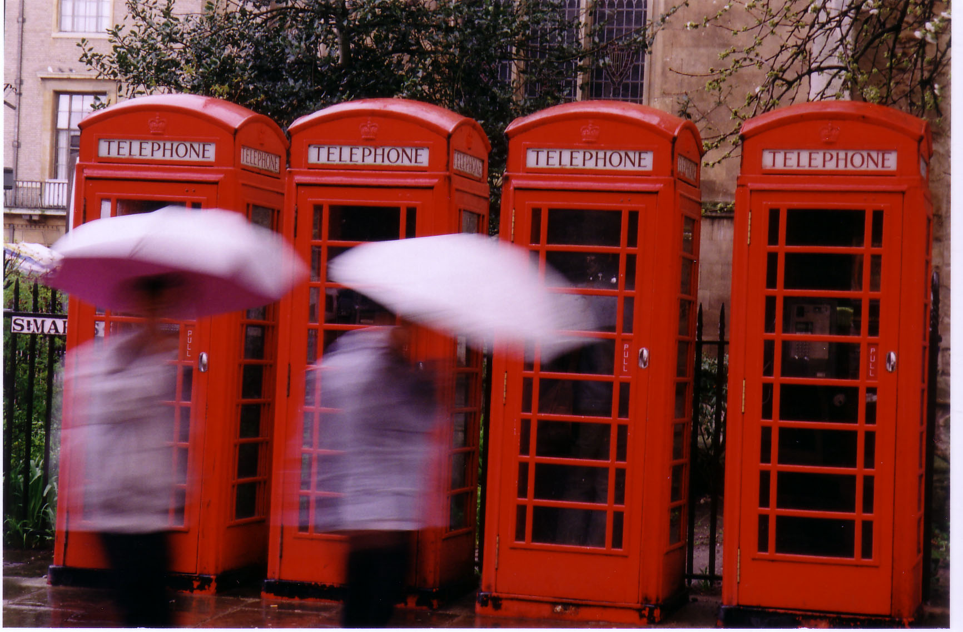
F/stop-shutter speed combos
In almost all photography, the rule is that something in the photo must be sharp, even if blurring can be used for an interesting effect.

Slide 88
F/stop-shutter speed combos
Hold your camera steady. Block it against your forehead and hold your elbows close to your body.
If necessary, lean the camera against a tree or chair.
A tripod may be required, particularly with a long lens.

Slide 89
F/stop-shutter speed combos
Image stabilized lenses can help cancel camera shake. But not subject movement.
The rule is: You can hand-hold a shutter speed one stop less than your focal length.
So at 28mm, you can hand-hold 15. At 105mm, you can hand-hold 60.
Note: This principle works imperfectly with zoom lenses, because the length and weight of a lens affects camera shake.

Slide 90
F/stop-shutter speed combos
Rule Two:
Use the smallest aperture possible.
The smaller the opening (larger the f/stop number), the more will be in focus (larger depth of field).
If you are shooting at f/22, you don’t have to worry as much, because pretty much everything will be in focus.

Slide 91
F/stop-shutter speed combos
Combining these two rules helps to eliminate the biggest single image quality problem: blurry subjects.
We will note sometimes you’ll want to blur motion, and sometimes you’ll want shallow depth of field. But these are exceptions to the rule.

Slide 92
The combination challenge
But you probably can already see the problem:
With both a fast shutter speed and small aperture you are not letting much light reach the sensor.
So you can only use this combination in bright light, such as a sunny day.

Slide 93
Low-light challenges
So what do you do when you don’t have that light?
Unless you want to add artificial light, you’ll have to make compromises.
Compromise One:
Use a tripod, and wait until the the subject is not moving.

Slide 94
Low-light challenges
Compromise Two:
Make sure the auto-focus zeroes in on your subject, and accept shallow depth of field.
Compromise Three:
Adjust the ISO.

Slide 95
Low-light challenges
ISO stands for International Standards Organization.
This agency originally evaluated film speeds—that is, sensitivity to light.
Today ISO numbers are set to correspond directly to f/stops and shutter speeds.

Slide 96
ISO settings
Most digital cameras feature ISO settings reflecting changes of one stop each.
The common settings:
100, 200, 400, 800, 1600, 3200.
This is a six-stop range.
Again, you can usually adjust in one-third increments. But it’s less confusing to stick to full stops.

Slide 97
ISO settings
You adjust ISO settings to make your digital sensor more sensitive, just as in the past you used higher-speed film. Speed is sensitivity to light.
So let’s say you were shooting volleyball. At ISO 400, you can shoot at f/4 and 30 (1/30th second).
But 30 won’t stop the action. You need at least 250.

Slide 98
Standard stops
Here are common standard stops again:
F/stops: 1.8 (or 2), 4, 5.6, 8, 11, 16, 22.
Shutter speeds: 1 (second), 2 (1/2 second), 4, 8, 15, 30, 60, 125, 250, 500, 1000, 2000.
ISO: 100, 200 400, 800, 1600, 3200.
All are calibrated so that they let in precisely double or half the light (or double/half the sensitivity.)

Slide 99
Example of a combination
So let’s say you were shooting volleyball. At ISO 400, you can shoot at f/4 and 30 (1/30th second).
But 30 won’t stop the action. You need at least 250.

Slide 100
ISO settings
From 30, we go to 60, 125, 250. Three stops difference.
You’re ISO is set at 400.
So 400 can go to 800, 1600 and 3200, also three “stops” more sensitivity.
You can change your ISO to 3200 and achieve properly exposed volleyball photos with an f/stop and shutter speed combination of f/4 and 250.

Slide 101
ISO settings
But most choices in photography demand a trade-off.
At 3200 ISO, digital cameras generally pick up some digital “noise.”
That is, the images look more “grainy,” and so lower in quality.
For top quality, you need to choose a lower ISO. Some photographers do not go above 400.

Slide 102
Combinations
Let’s try another example. You want to photograph a bird in a tree, but the background is distracting.
You would like to blur the background by creating a more shallow depth of field (what is in focus from foreground to background.

Slide 103
Combinations
It’s a bright day so your camera’s meter shows a combination of f/16 and 500 (1/500 second) with an ISO of 400.
You want f/5.6, however.
f/16, f/11, f/8, f/5.6; three stops difference.
Shutter speed must change from 500 to: 1000, 2000, 4000, also three stops.
But your camera does not have a 4000 shutter speed option. What can you do?

Slide 104
Combinations
You need one stop less exposure.
Change your ISO from 200 to 100, one stop.
Now your combination of f/5.6 and 2000 will expose correctly.

Slide 105
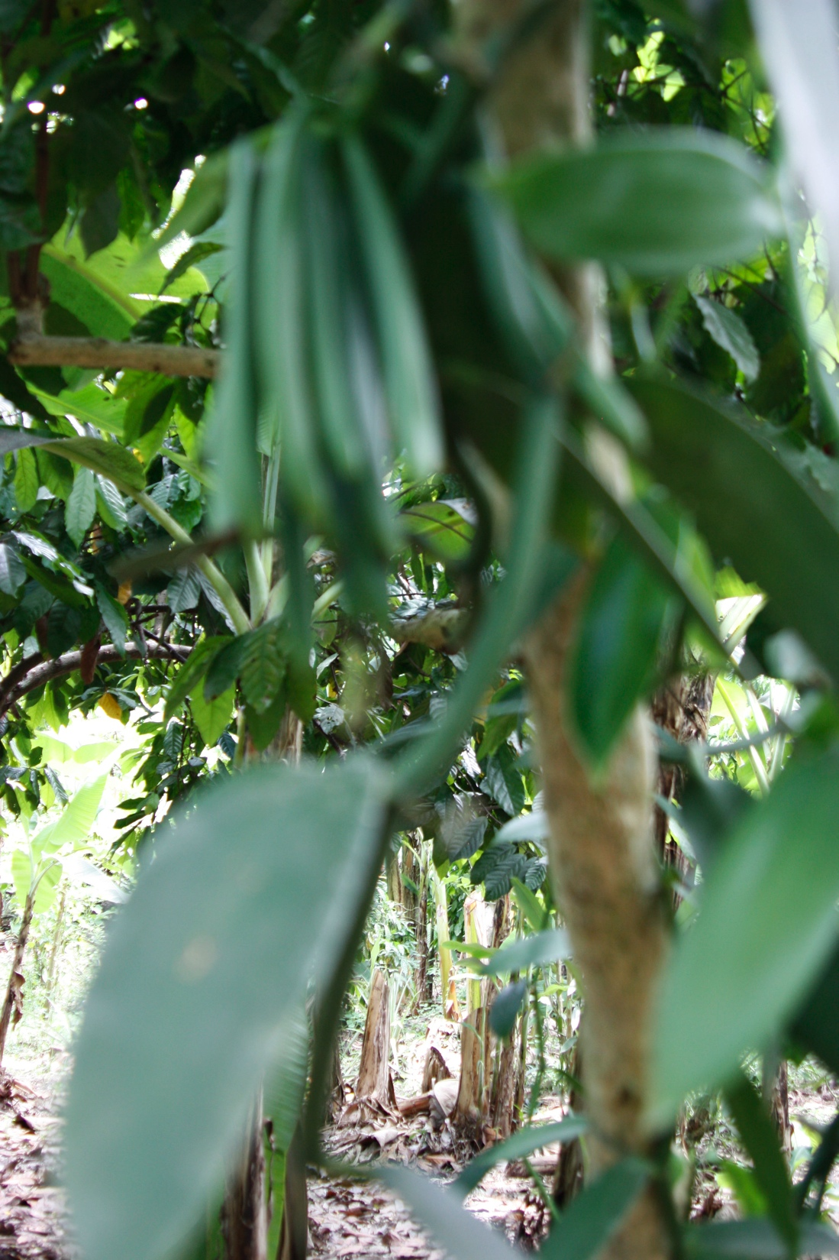
Exposure/focus problems
So let’s analyze some problems. I took this photo of vanilla beans at f/3.5, 60, ISO 400. We have problems. What? What could I have done?

Slide 106
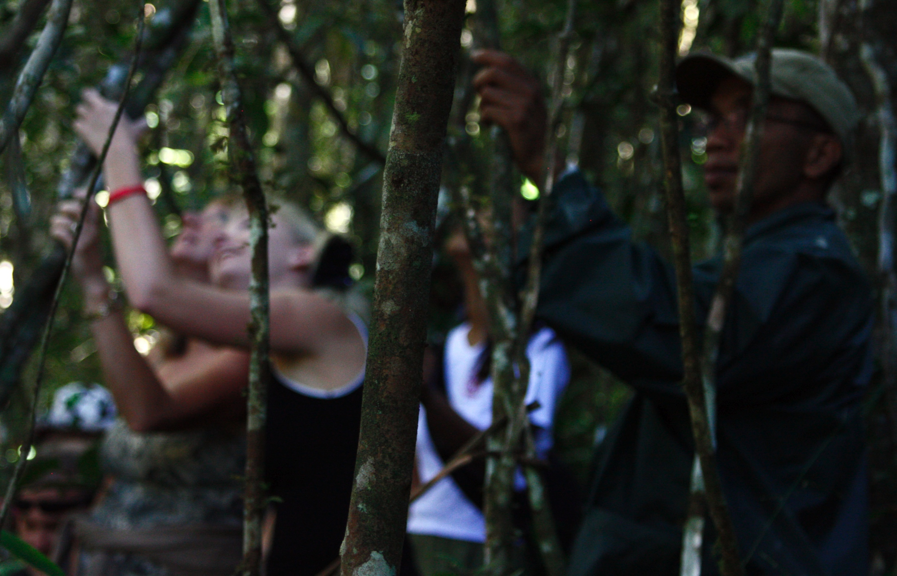
Exposure/focus problems
What happened here?

Slide 107
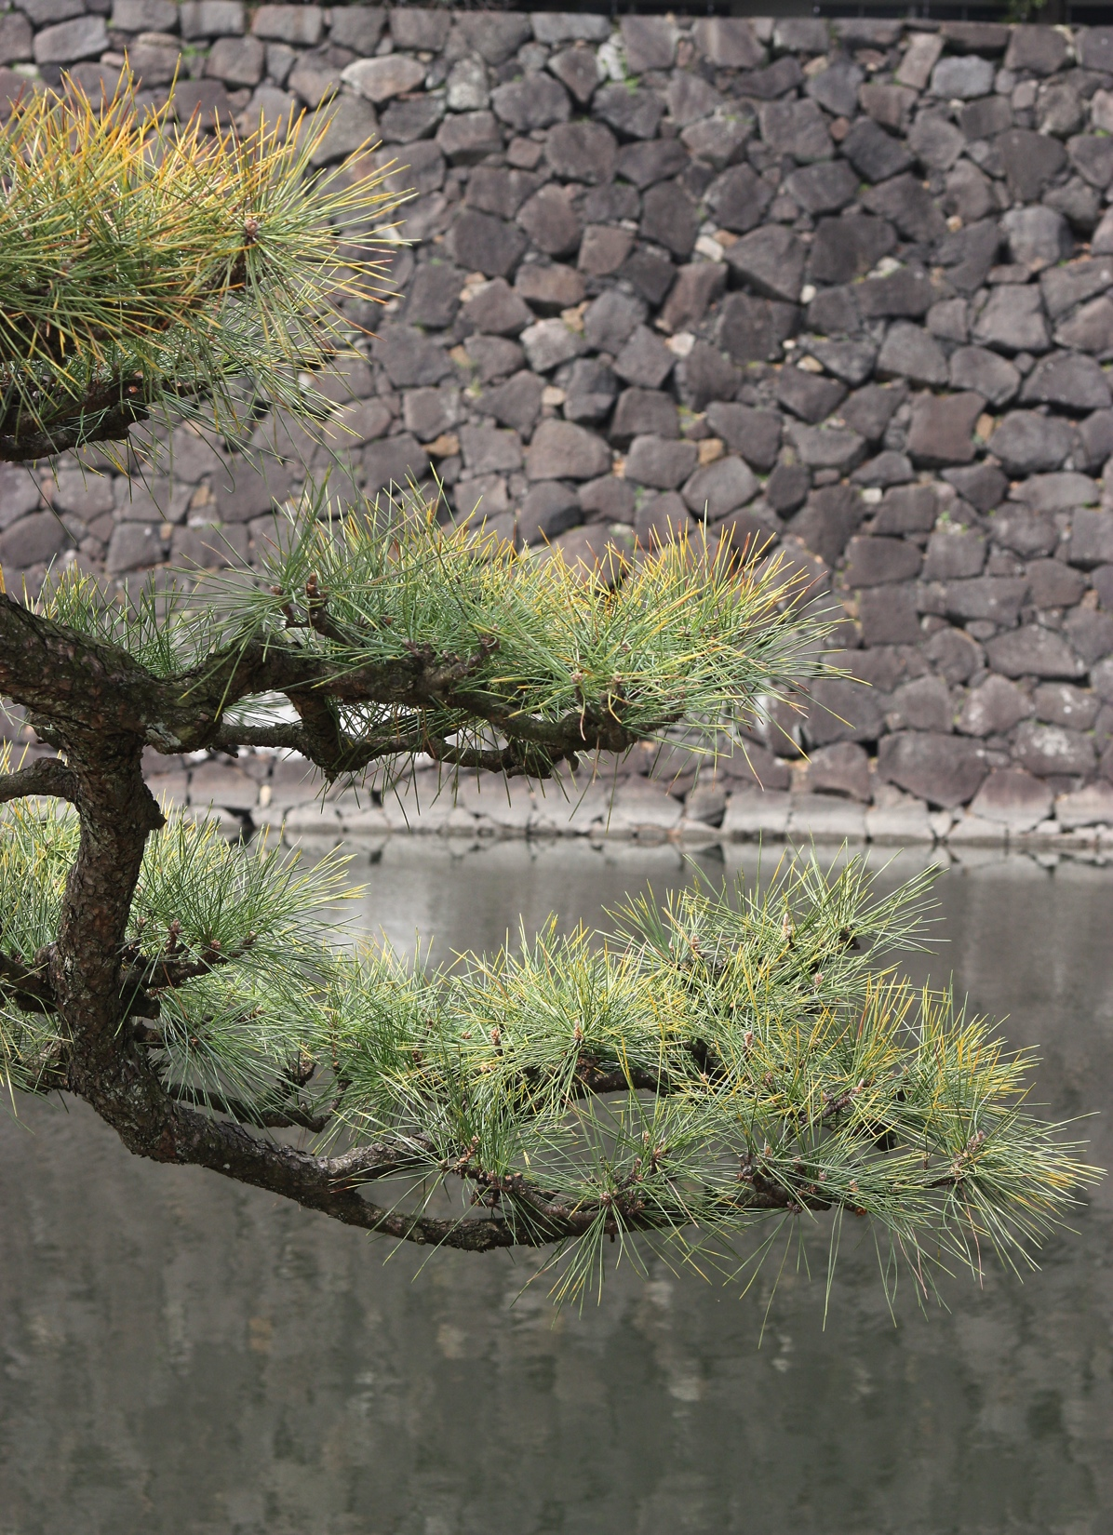
Exposure/focus problems
The background is pretty ugly. What could I have done to make it less noticeable?
Taken at f/8, 250, ISO 400.

Slide 108
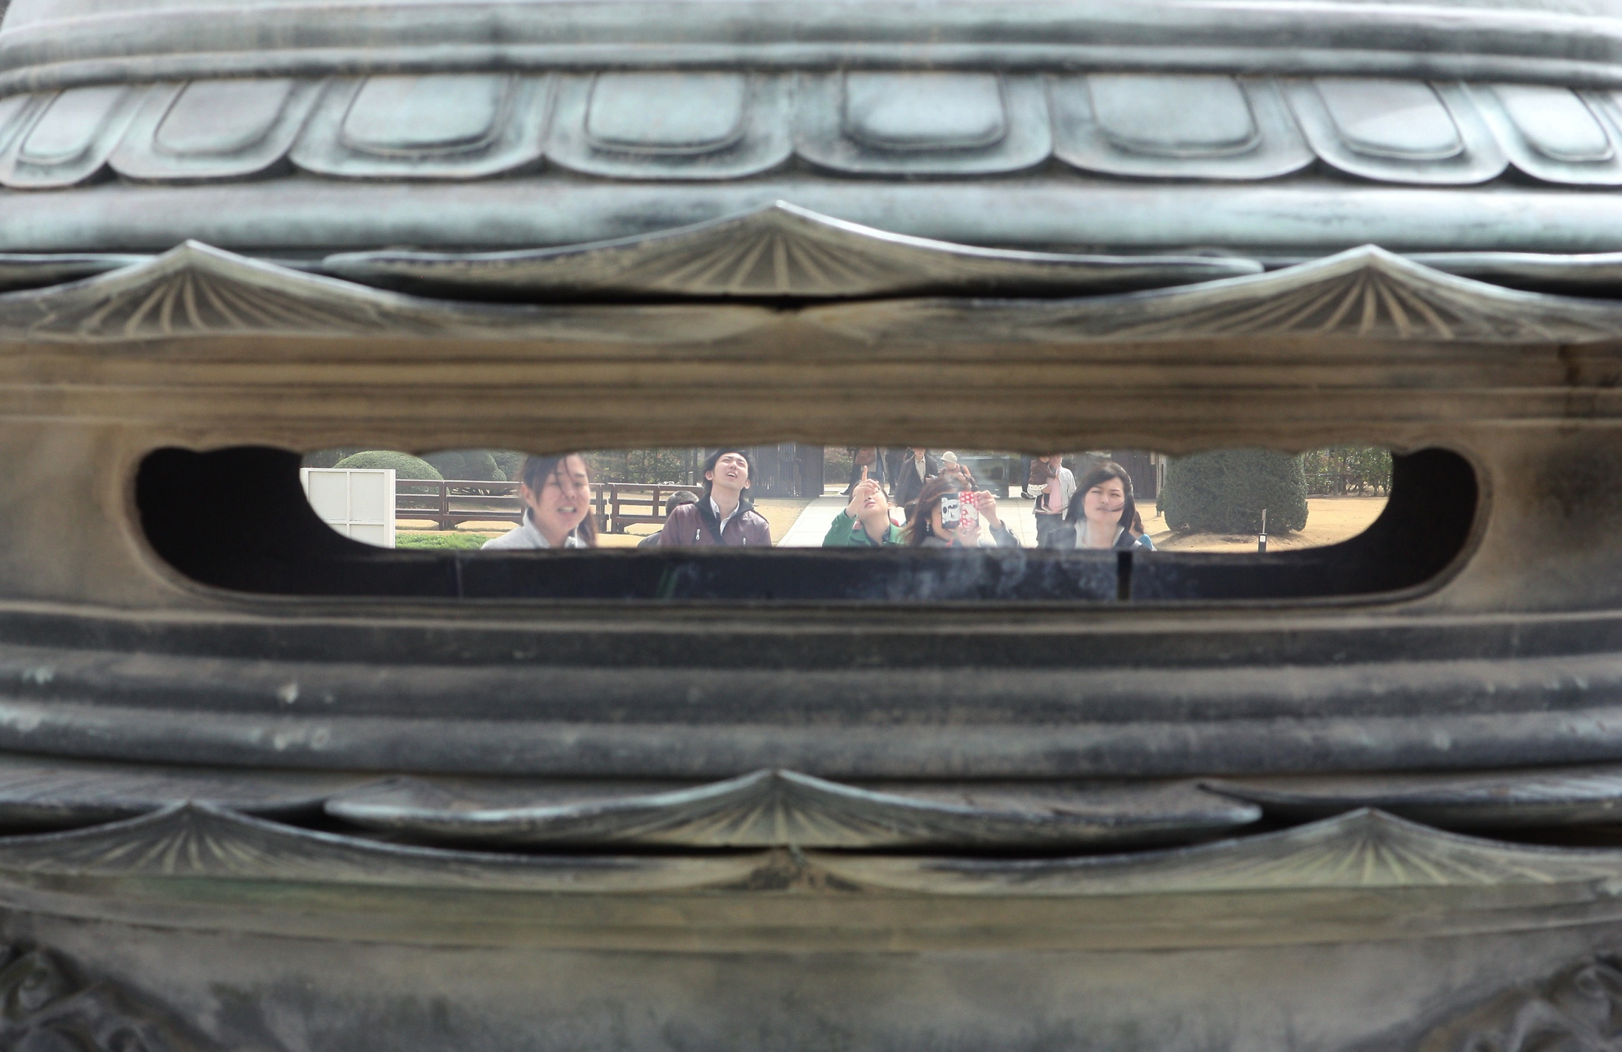
Exposure/focus problems
Kinda cool, but I’d like the lantern to be more in focus. How could I do that? Shot at f/8, 250, ISO 400.

Slide 109
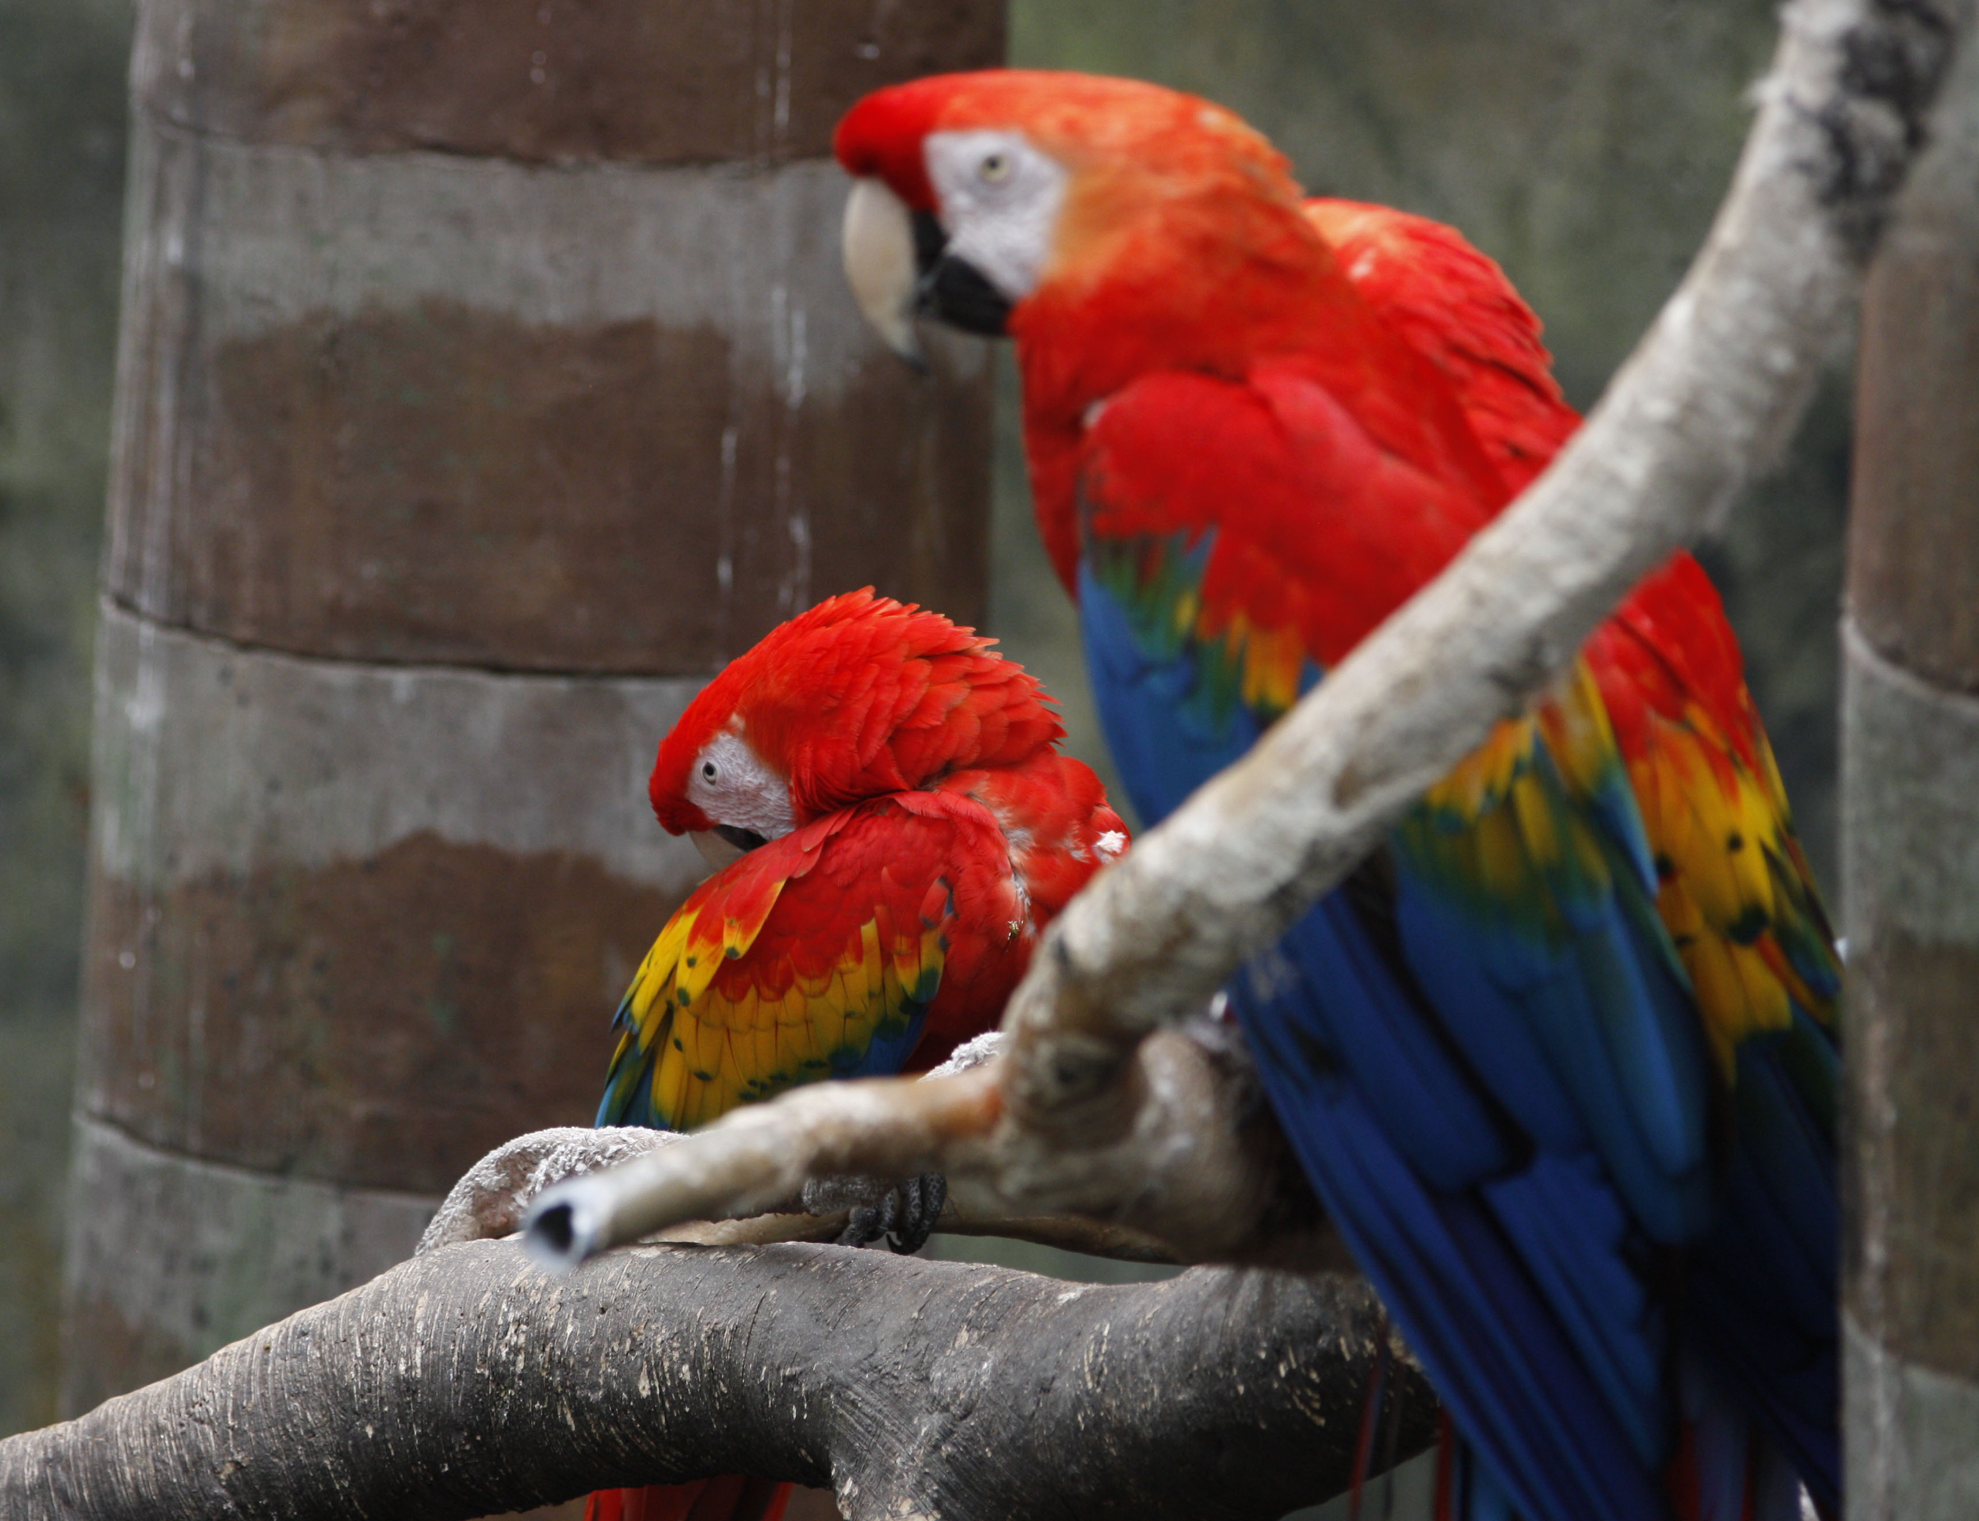
Exposure/focus problems
One bird is in focus. But I wanted both. What can I do? Birds move fast. F/3.5, 125, ISO 400.

Slide 110
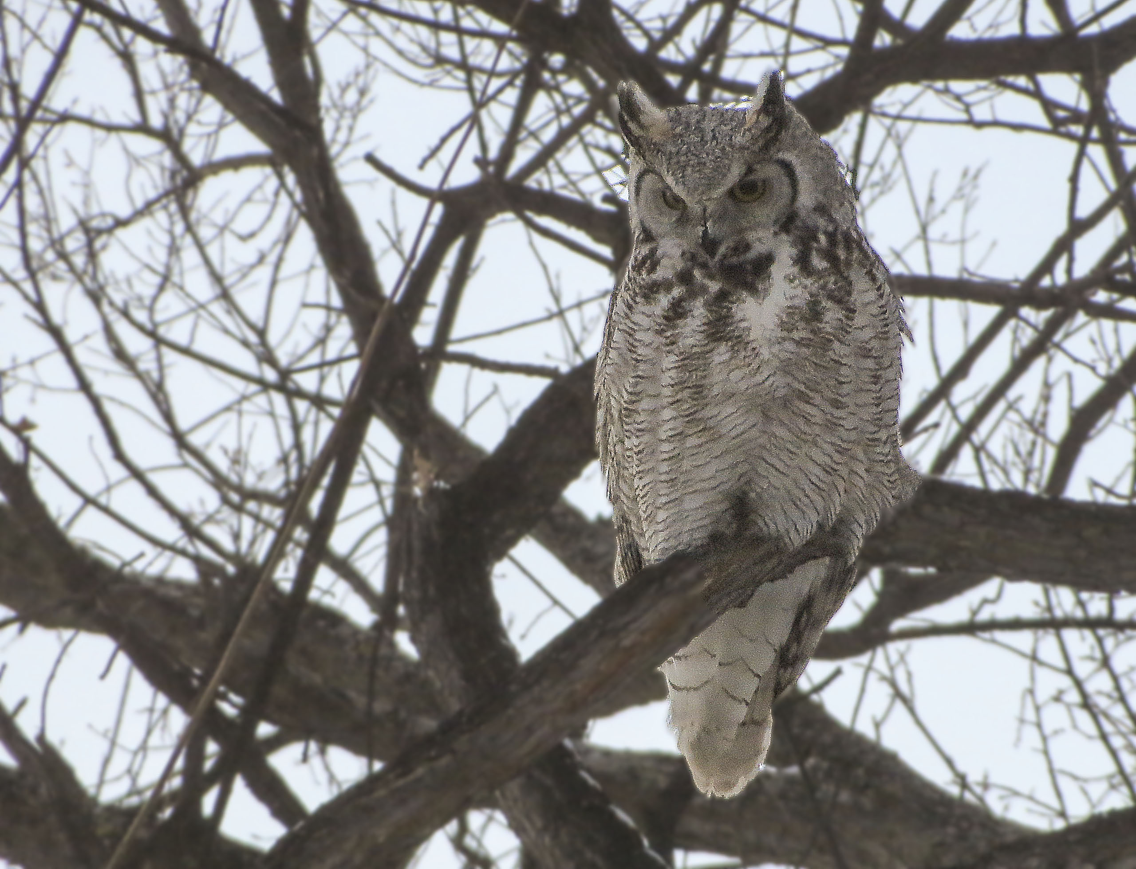
Exposure/focus problems
The background is distracting, but it’s hard to photograph birds without trees. What could we have done?

Slide 111
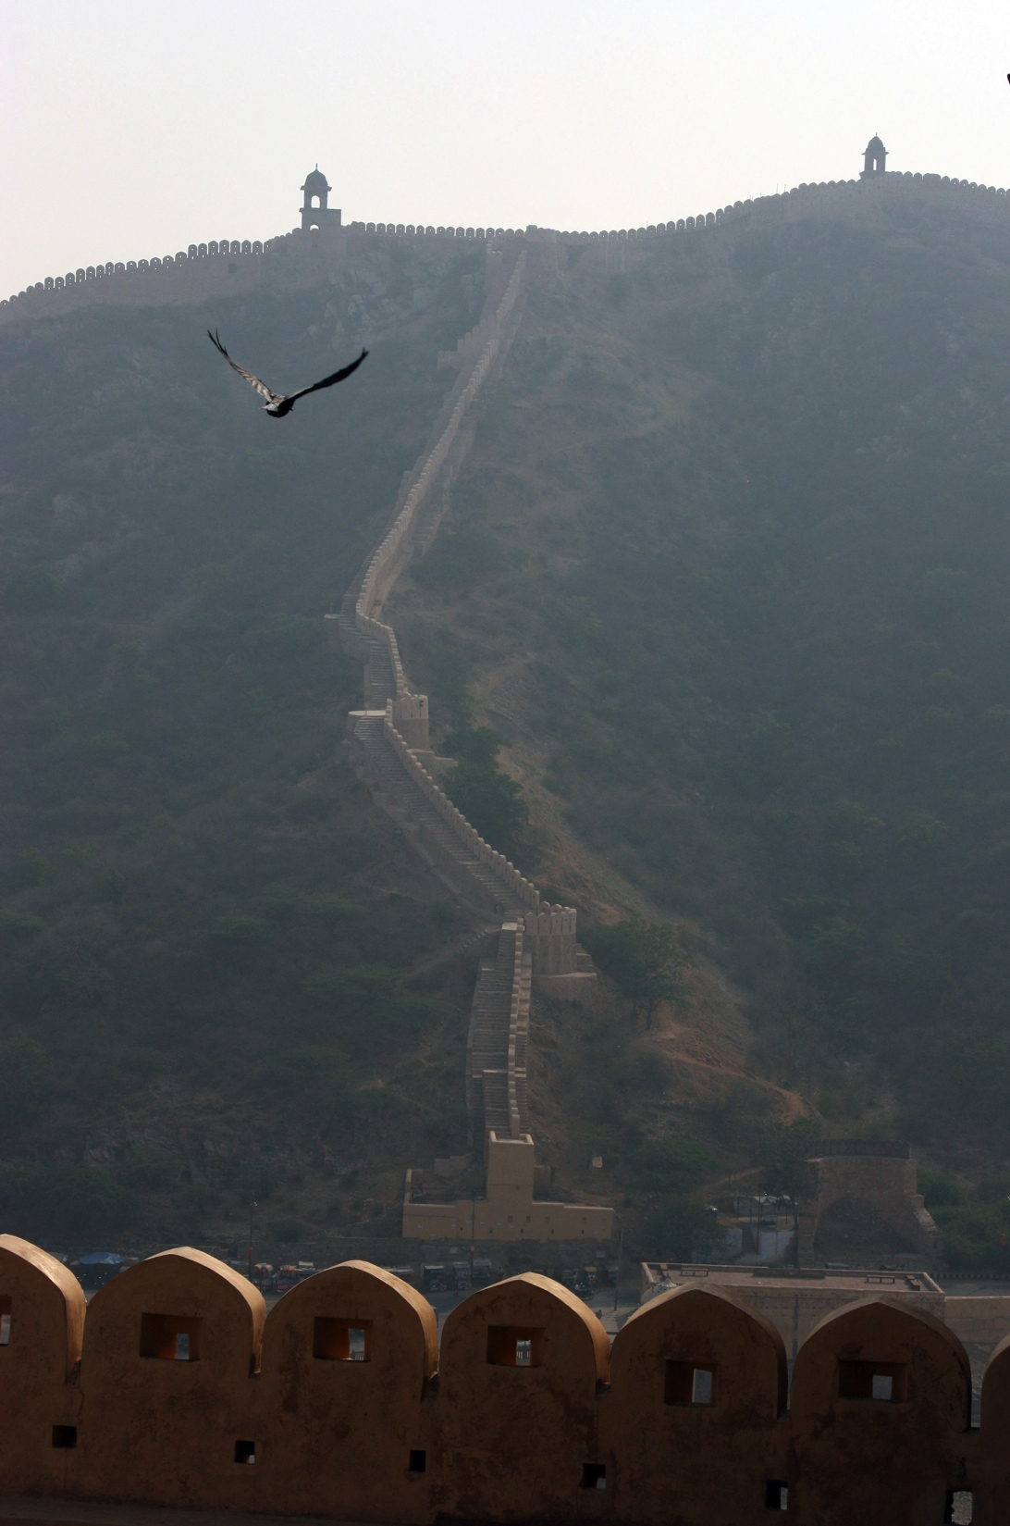
Controlling light
Control your exposure and depth of field.
Take charge of your camera!

Slide 112
Adding light
Photographers often rely an artificial light. Traditionally one way to do that is to completely control the subject matter in a studio.

Slide 113
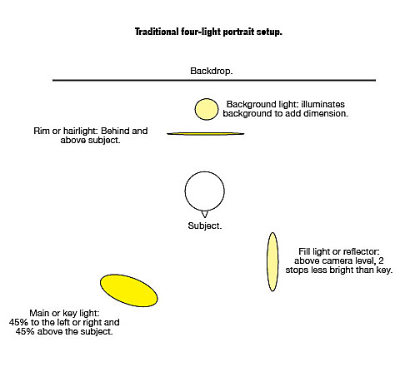
Basic formal lighting
Traditional portrait lighting uses four lights.

Slide 114
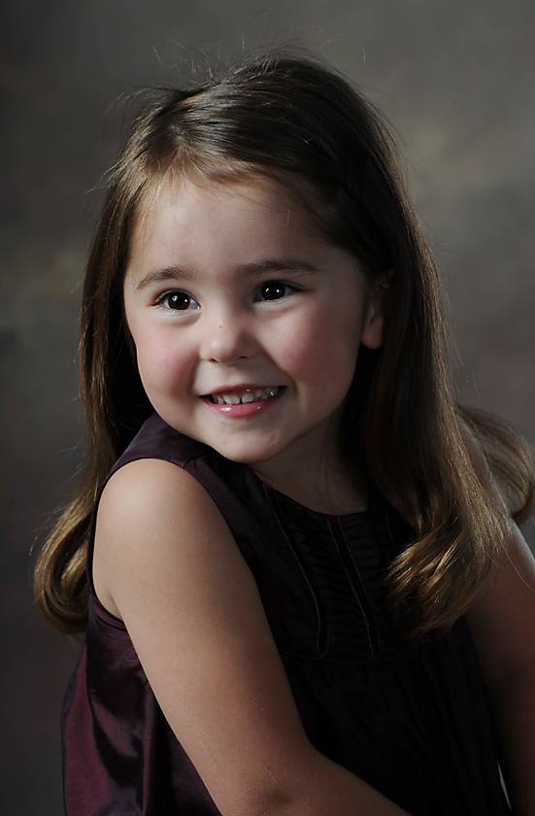
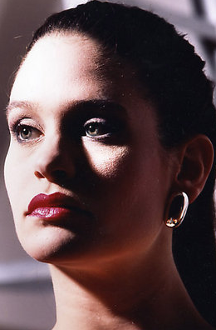
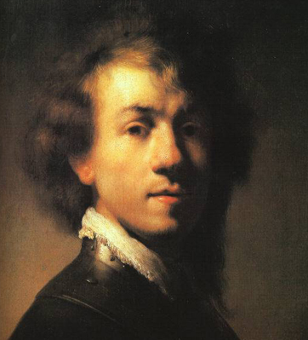
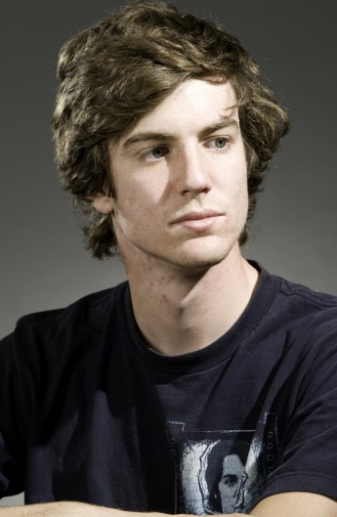
Formal lighting
This is Rembrandt lighting. It’s common in all sorts of portraits.

Slide 115
Rembrandt lighting
High-key lighting features almost no shadows. Low-key features strong contrast. Note the triangle of light on the cheek, characteristic of this lighting style.

Slide 116
Taking it outside
But most of us won’t be setting up lights like this for our photographic needs.
We can find lighting similar to the classic Rembrandt by looking at ambient light around us.

Slide 117
Ambient Rembrandt
Most lighting in the real world comes from more than one source—just as Rembrandt lighting. The source may be a reflection, such as florescent light off white tables to fill shadows.
Most ambient lighting includes the strongest light from above. The “key” light is in effect that light.

Slide 118
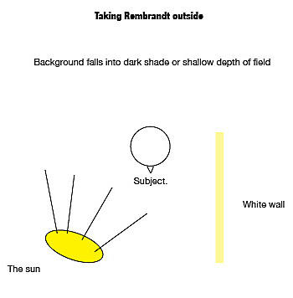
Ambient Rembrandt
Some basic camera guides tell you to shoot on a sunny day with the sun over your shoulder.
This is in effect Rembrandt lighting.

Slide 119
Ambient Rembrandt
Problems with this approach:
The sun is intense, leaving deep shadows.
Fill light is generally inadequate, or impossible to arrange.
Usually no rim light is available to delineate the subject from the background to emphasize dimension.

Slide 120
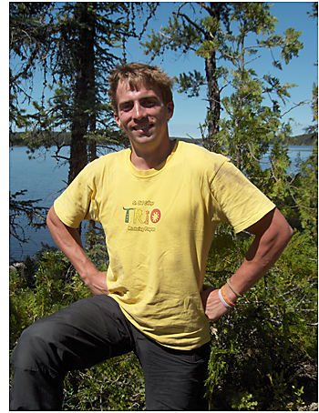
Ambient Rembrandt
This is typical of sunlight Rembrandt: deeply shaded eye sockets. Unattractive.

Slide 121
Ambient Rembrandt
The effect is generally the same under florescent lighting, although desks can provide some fill.
Many photojournalists add light to an office scene using a flash bounced off a ceiling, or off a piece of white cardboard.
Some photographers take foldable white reflectors to add fill light inside or outside.

Slide 122
Fill flash outside
An easier option is to rely on your flash to fill the harsh shadows.
Set it to one or two stops less light than your meter indicates. This will avoid having your flash overpower natural light and give an artificial look to your scene.

Slide 123
Avoid midday sun
Most photographers, however, avoid the harsh midday sun in the summer. Even with fill light, it’s hard to overcome the power of sunlight.
Some try to photograph only in the morning or evening, when the light angle is lower, and the light is softer.

Slide 124

Direct sun
In northern winters, though, the low angle of sunlight can sometimes add interesting effects—but not usually for portraits.

Slide 125


Ambient light choices
At dawn or dusk it’s hard to take a bad picture.
Its soft quality does not show texture well.

Slide 126
Fill light in shadows
If you can’t get out early or late, you can avoid harsh sun by seeking shady areas.
Often, however, you may have to add fill light, because faces will be too dark.

Slide 127

Filling the shadows
In this series of department mugshots, I moved to the shade to avoid harsh sun, and tried a shallow f/stop to blur the background.
But I still added a little fill light from my camera flash.
I underexposed the flash by one stop.

Slide 128

Fill light inside
Often we need fill light inside as well.
Window light can be soft, but also can be harsh. Add a reflector or fill flash.
The fill flash in this photo is a little too harsh for me—the shadows in the foreground face are deep and sharp. But it’s pretty good.

Slide 129

Overcast light
Because sunlight in the middle of the day is so difficult, we often wait for an overcast day to shoot outside.
The light is more foregiving, and we can more easily get detail into shadow areas.

Slide 130
Overcast
But the soft light of overcast days also does not emphasize interesting textures or shadows.
Colors are desaturated.
Some work in Photoshop will help, but you can’t make a software picture you haven’t taken with a camera.
Sports on overcast days becomes difficult, because you need a fast shutter speed.

Slide 131

Improving overcast days
Here’s some improvement.

Slide 132

Hazy sun
Best bet for daytime photos outside is wait for the lightly overcast, but still bright, day.

Slide 133
Flash
So from this discussion we can presume that photojournalists seldom use flash the way the rest of us do: based on the pop-up mode attached to many cameras.
Instead, we can use it as a fill light (always set a stop or two underexposed).
Or we can use a separate unit and bounce it off a ceiling or wall.

Slide 134

Combining ambient and flash
Sometimes we can combine ambient light and flash to interesting effect.
Below the shutter speed is slow enough to collect light while the flash freezes the action.

Slide 135
Desperation: flash on camera
If you must use flash on camera, keep in mind it looks best if the room is fairly bright.
Turn on all the lights you can to add detail to the gloom left by a flash.

Slide 136

Flash on camera
I did rely on my flash for this self-timed group shot, but the extra light in the room helped somewhat. The flash reflections should be fixed in Photoshop.

Slide 137

Other light sources
Don’t overlook less common light sources.
I’ve left the lamp in this photo so you can see the light source, incandescent light.

Slide 138
Other light sources
Note the light actually reflects of the opposite wall to help fill shadows.

Slide 139

Fire
Here we have a combination of fire light and ambient light at dusk.

Slide 140

Fire
Or even a candle.
Often this weak intensity needs a little fill.

Slide 141

Look at light
Turn off your flash and try to capture light as you see it!

Slide 142

Pictures of the Year
Photographers and photojournalism: 66th annual Pictures of the Year winners (National Press Photographers Association)http://www.youtube.com/watch?v=2i9H7FEw338 10 min.

