Slide 1
Composition
for Mass Media photography

Slide 2
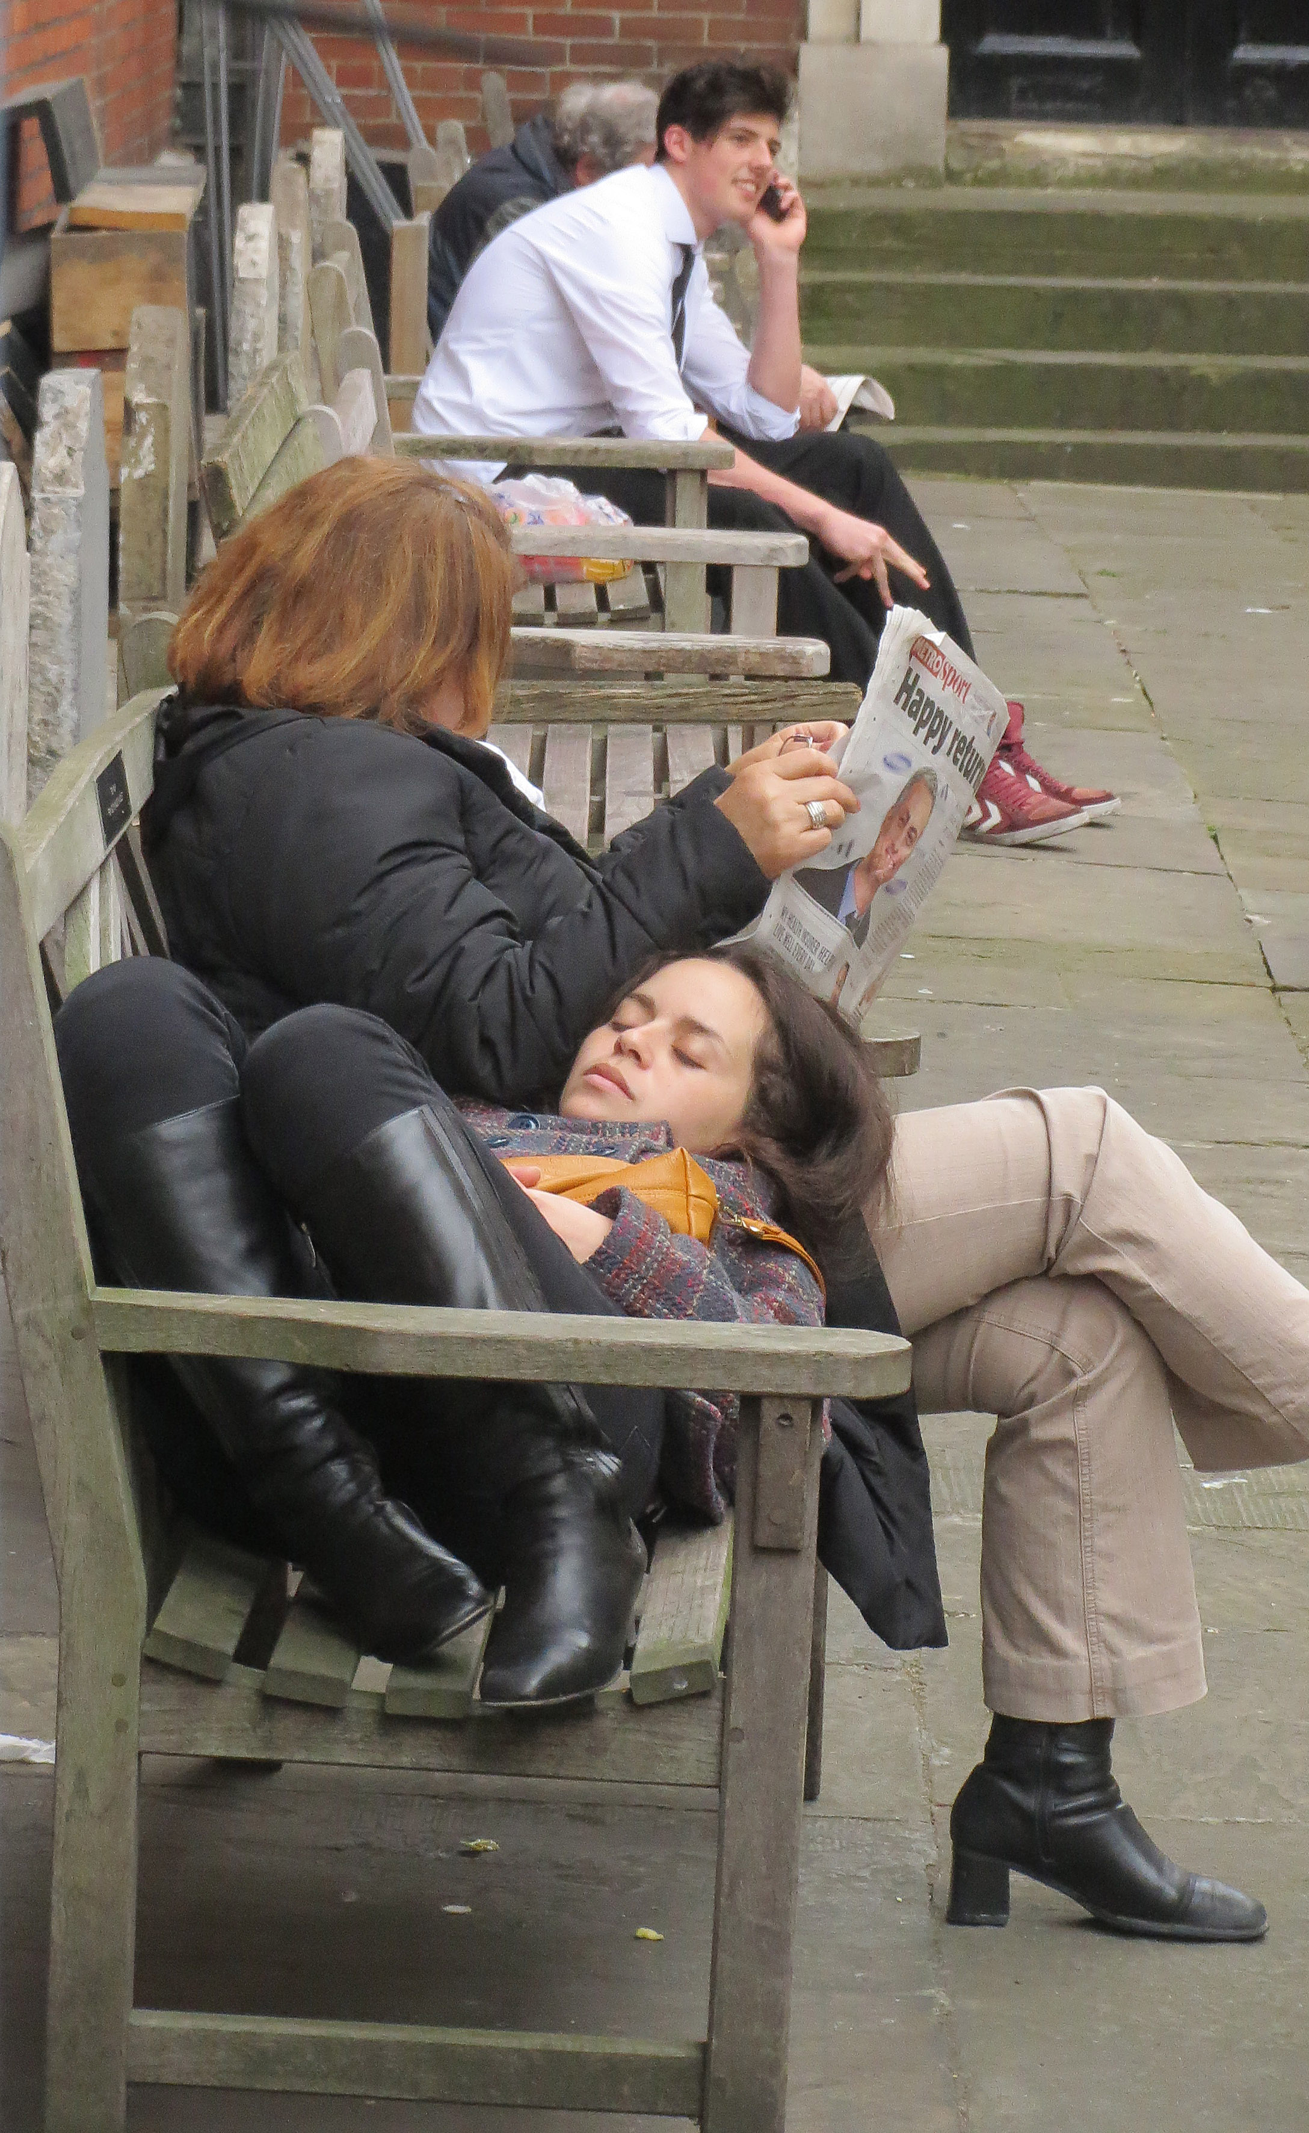
Composition
Composition is the way the elements in a scene are arranged.
A journalist chooses the lead for a story, which parts to include, which to leave out, and how to arrange them.
A photographer also does this, through center of interest, depth of field, exposure, cropping.

Slide 3
Ethics of composition
Mass media photographers tell stories based on facts.
That means our choice of composition must ethically and fairly convey the facts of an event.
We try to reflect the truth as best we can.
If you are taking photos for advertising or public relations, you have more flexibility, but following photojournalism rules produces better, and more spontaneous photos.

Slide 4
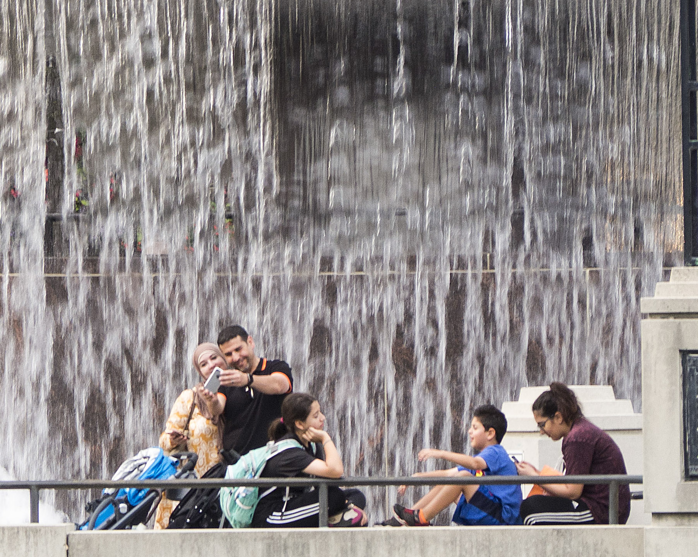
Ethics of composition
Generally, scenes should not be consciously posed, unless they are formal portraits (“mugshots”).
This means, for example, if you go out on a street to cover a labor strike, you don’t ask a striker wearing red to walk in front of picketers because it would make a more colorful picture.
The line between honest photojournalism style and unethical manipulation is sometimes hard to draw, however.

Slide 5

Ethics of composition
It is unethical in journalism to stage a composition unless it’s perfectly clear you’ve posed the subjects.
In Photoshop you can crop, lighten or darken areas.
Generally you can’t move or remove items from a scene, or put someone where they weren’t.

Slide 6
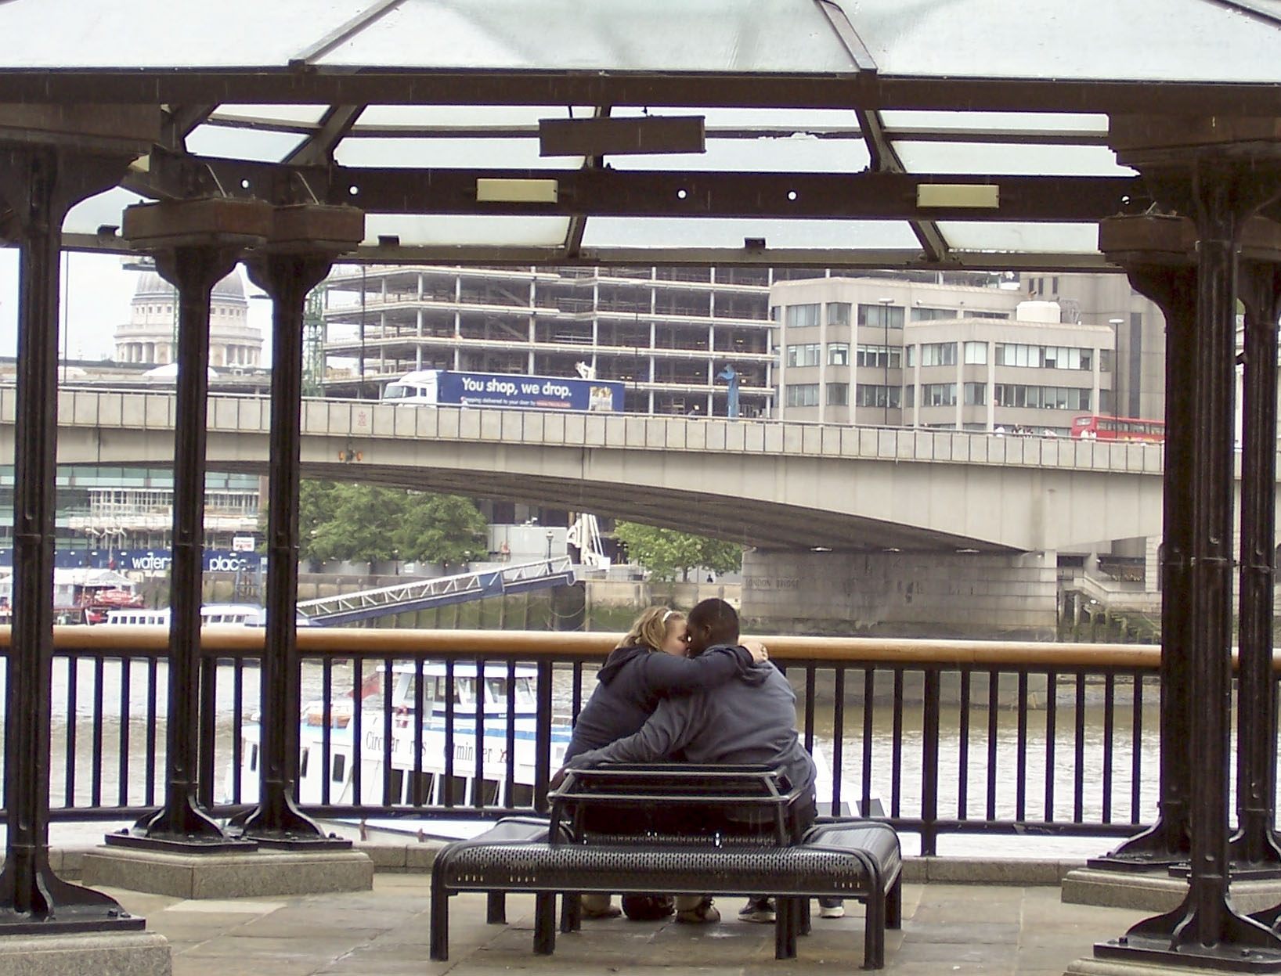
Ethics of composition
Because in photojournalism you can’t ethically set up stories, you have to be a good photo hunter.
That is, you find a good location, wait for something to happen, and shoot at just the right moment.
Luck is certainly part of photography. But the best photographers try to manage their luck.

Slide 7
what we and the camera see
We have to consider what the camera sees.
The human eye can see almost 180 degrees.
Even a very wide-angle camera lens can see up to perhaps only 84 degrees.
But our 180-degree vision isn’t sharp across the whole field of view.
In fact, our peripheral vision is blurry. Only one point is sharp.

Slide 8
We and our cameras
You can test this field of vision.
Hold two fingers nearly together in front of you.
Focus your gaze on one finger.
Move the other off to the side a little bit.
It will soon become blurry.

Slide 9
Field of vision
To compensate for this, our eyes scan a scene from many points. Our brain interprets this information to give us a perception of what we are seeing.
A camera does not do this. It will record everything in its plane of view to be in focus.
In the example above, the camera, unlike our eyes, will record both fingers in focus.

Slide 10
Camera and eye
Our brain also helps us interpret subjects as standing out from backgrounds, in a three-dimensional way.
Try this: put a finger about 18 inches in front of you.
Gaze with both eyes open. The background objects will be double images.
Now close one eye. The background objects now are single images, and so more in focus, but we lose some feeling of dimension.

Slide 11
One eye and lens
Your vision with one eye closed is more like a camera lens. It records on a two-dimensional plane.
Because our stereoscopic vision (two lenses) helps us to delineate subjects from the background, we easily fail to notice distracting background when we take a picture.
But when the photo is shown in two dimensions, the distractions become obvious.

Slide 12
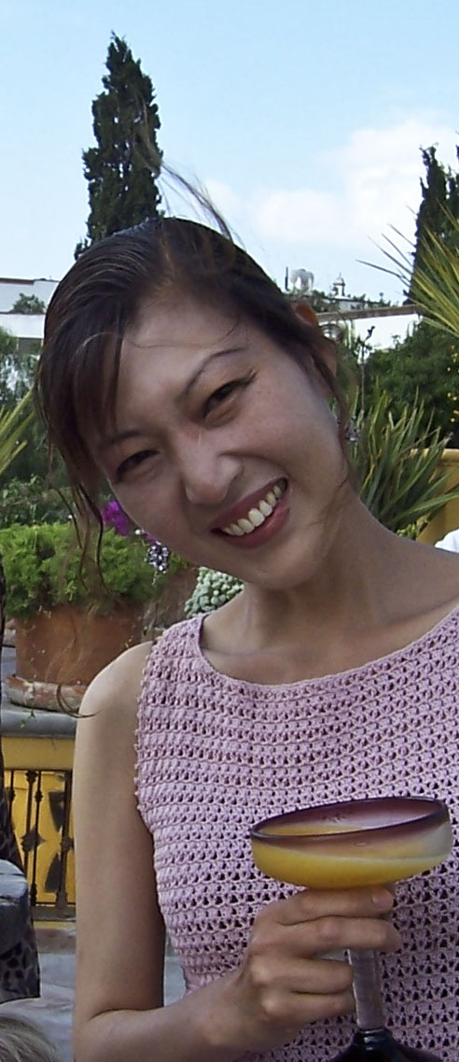
Background distractions
Oops. Didn’t see that tree growing out of the back of subject’s head!

Slide 13
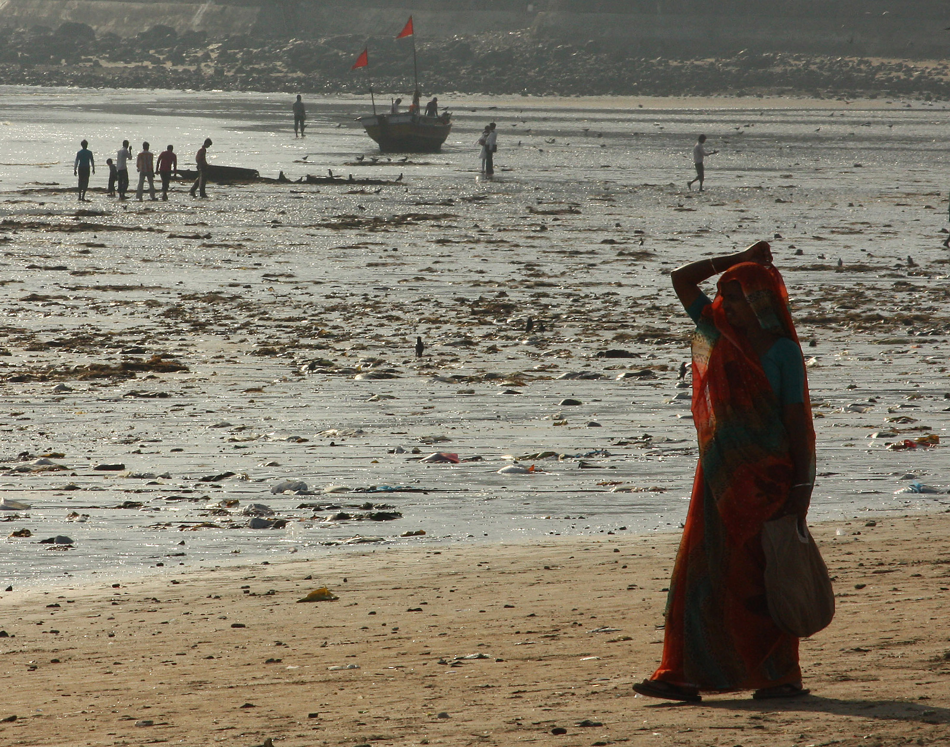
Negative space
When we take a picture, we tend to focus on the positive space—the subject.
We tend to neglect the negative space—that area not occupied by the subject.
Our goal is to notice and control that negative space.

Slide 14
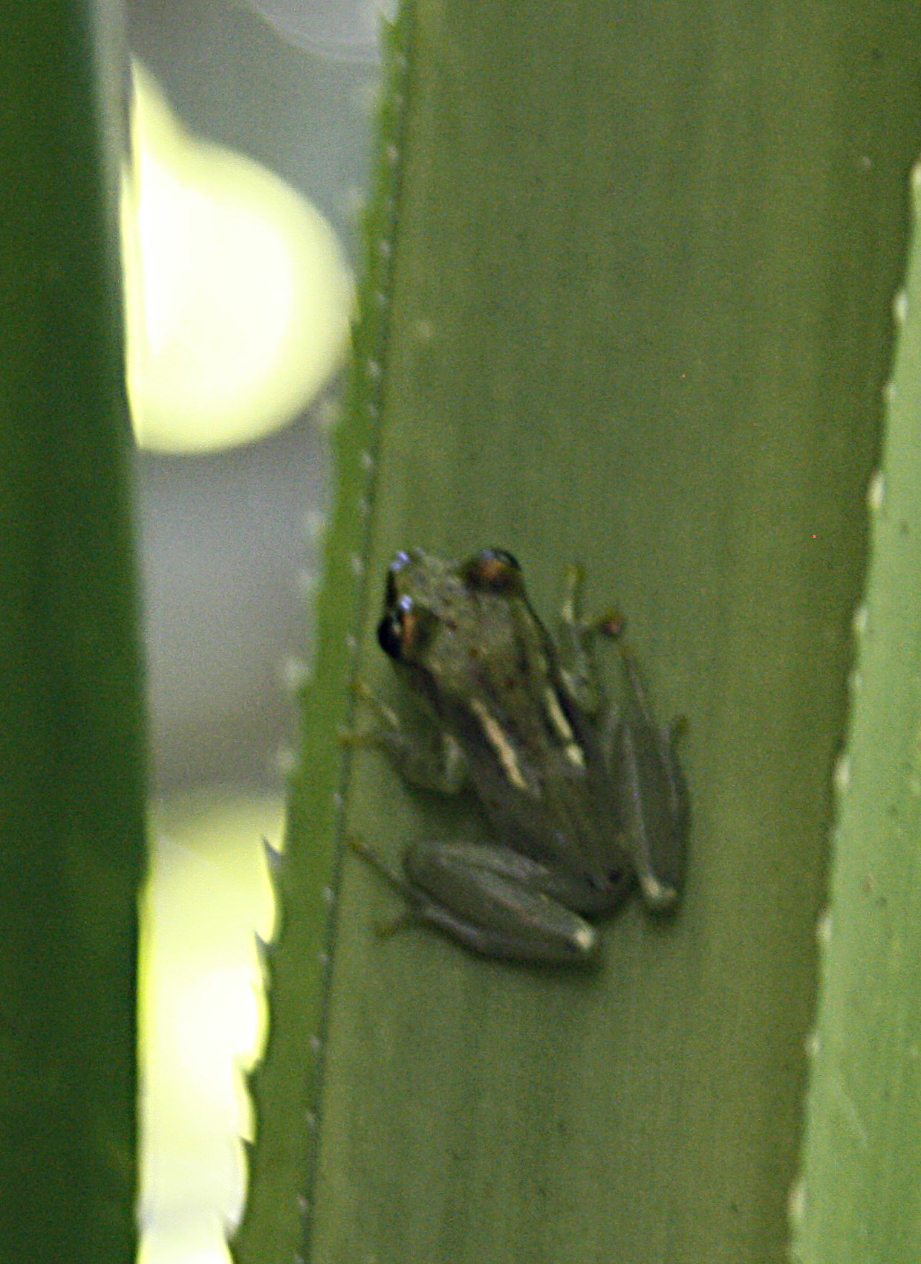
Isolating subjects
We use depth of field to help control delineation of subject from background, but it doesn’t make up for the three dimensions of our eyes.
Background also have visual weight. A particularly bright area, even if out of focus, will draw attention from the subject.

Slide 15
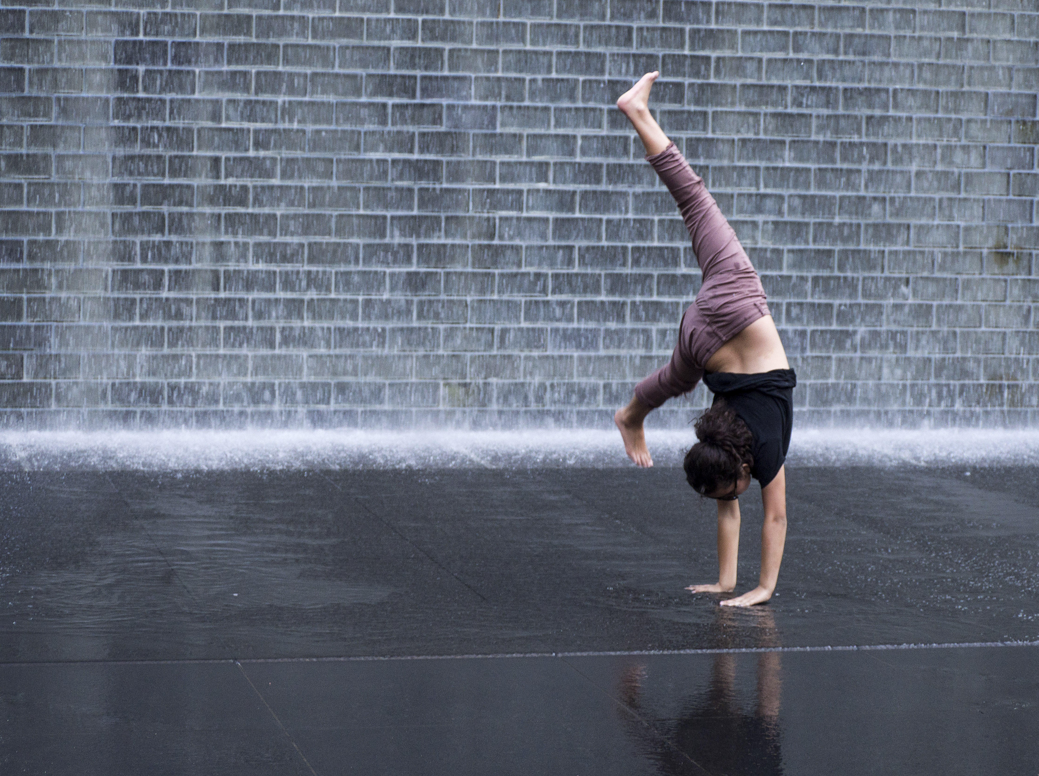
Context and mood
A camera can’t record the context and mood that made the scene exciting: the feel, the smell, the action.
It also doesn’t record the depth and range of color the eye can interpret.
We need to recreate the what we felt the scene to be through composition.

Slide 16
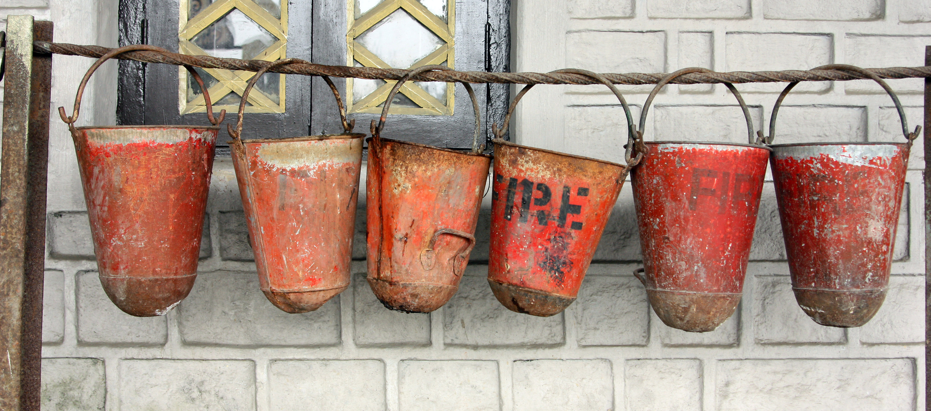
Visual tools
To do that, we use visual tools to manage our visual space.

Slide 17
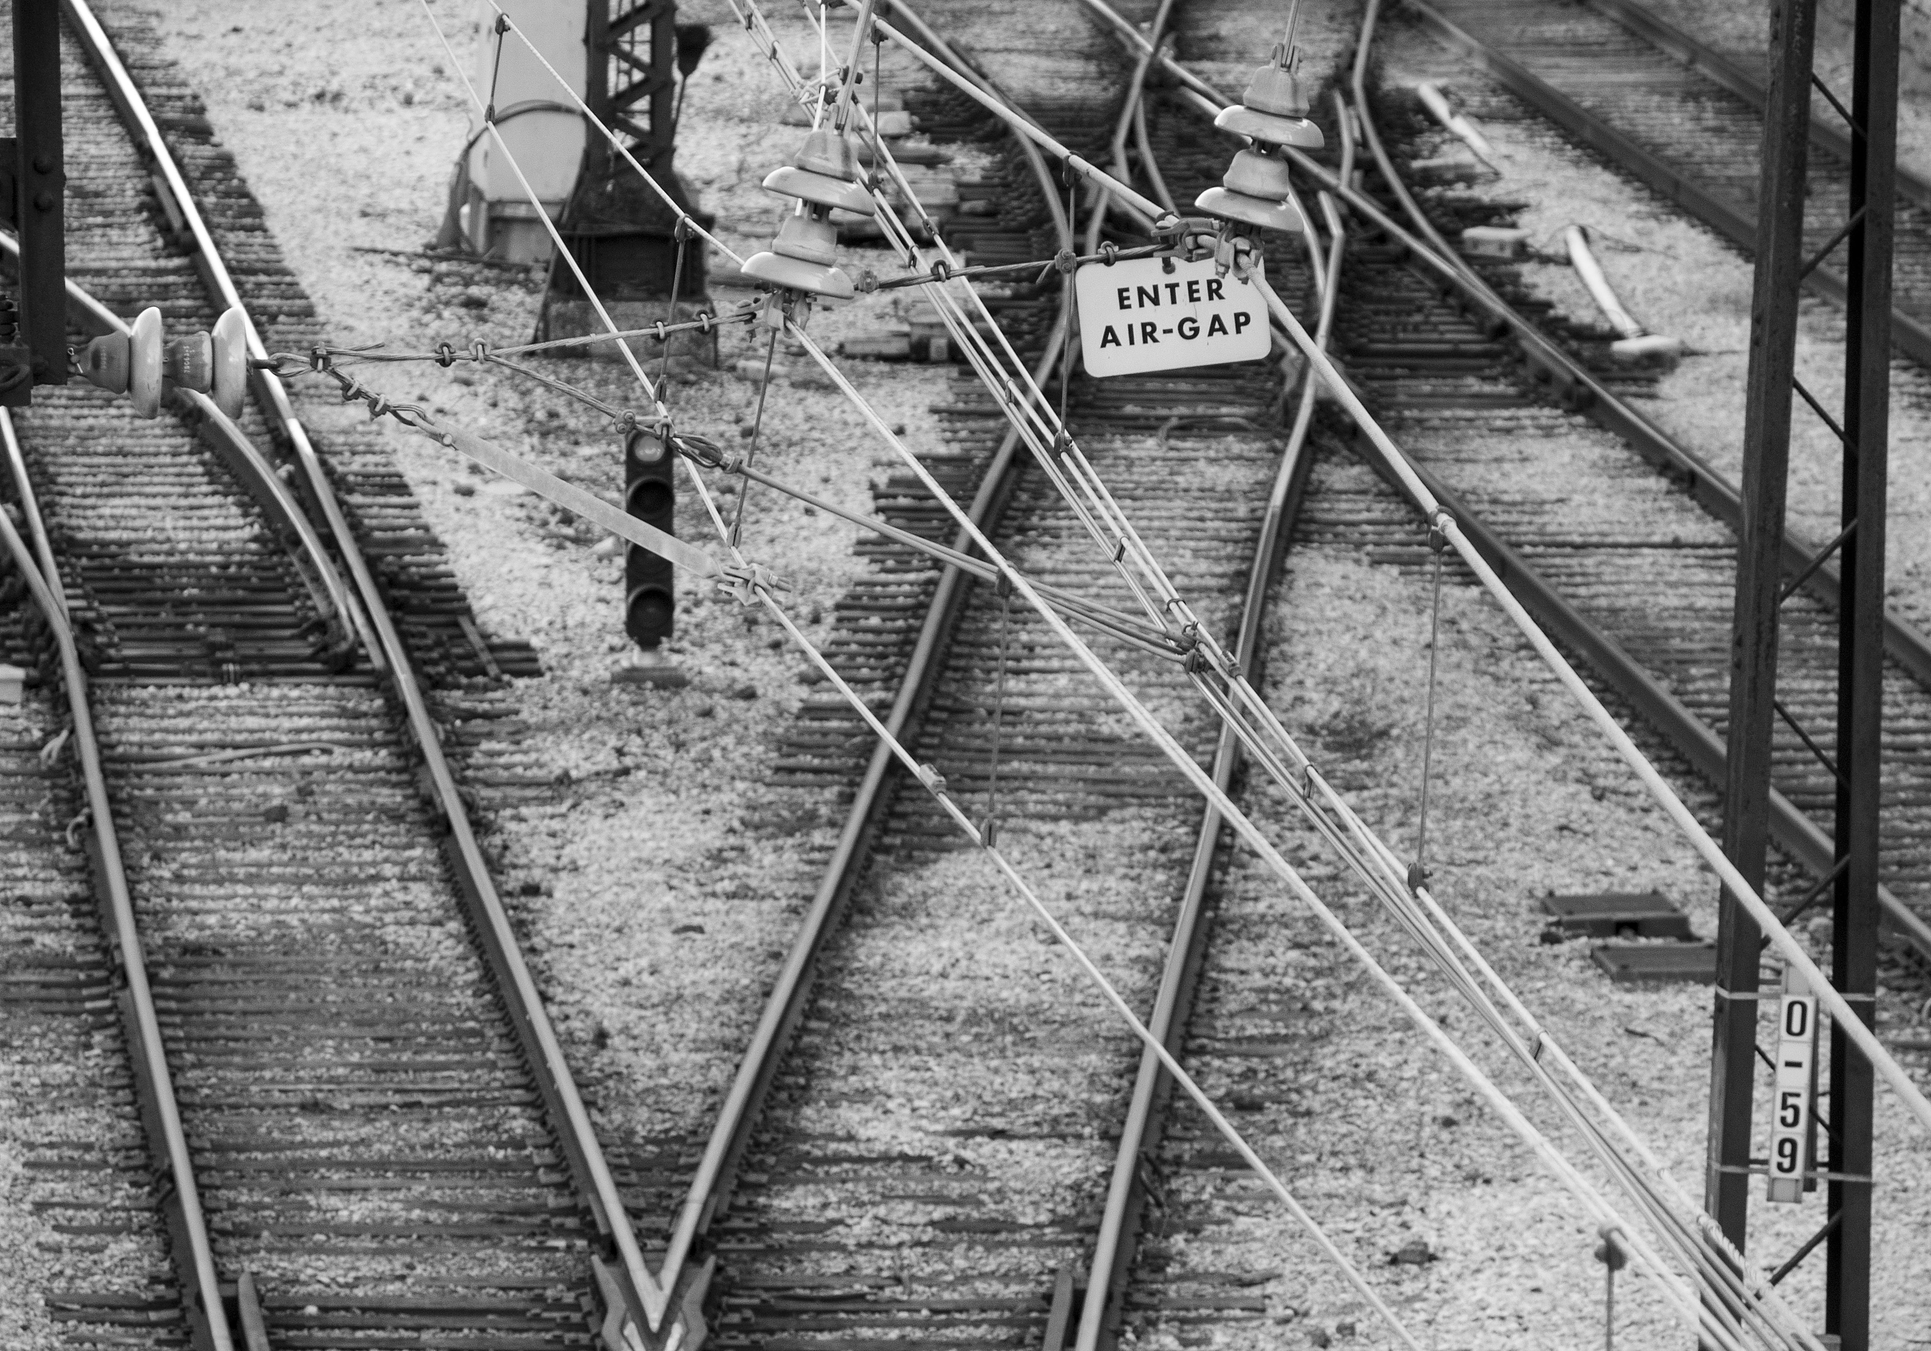
Visual tools
Line. Line marks shapes, suggests movement, or creates relationships.
Traditionally, vertical lines suggest power or majesty;
Horizontal lines suggest peace and calm;
Diagonal lines suggest dynamic tension;
Curved lines suggest grace, beauty, nature.

Slide 18
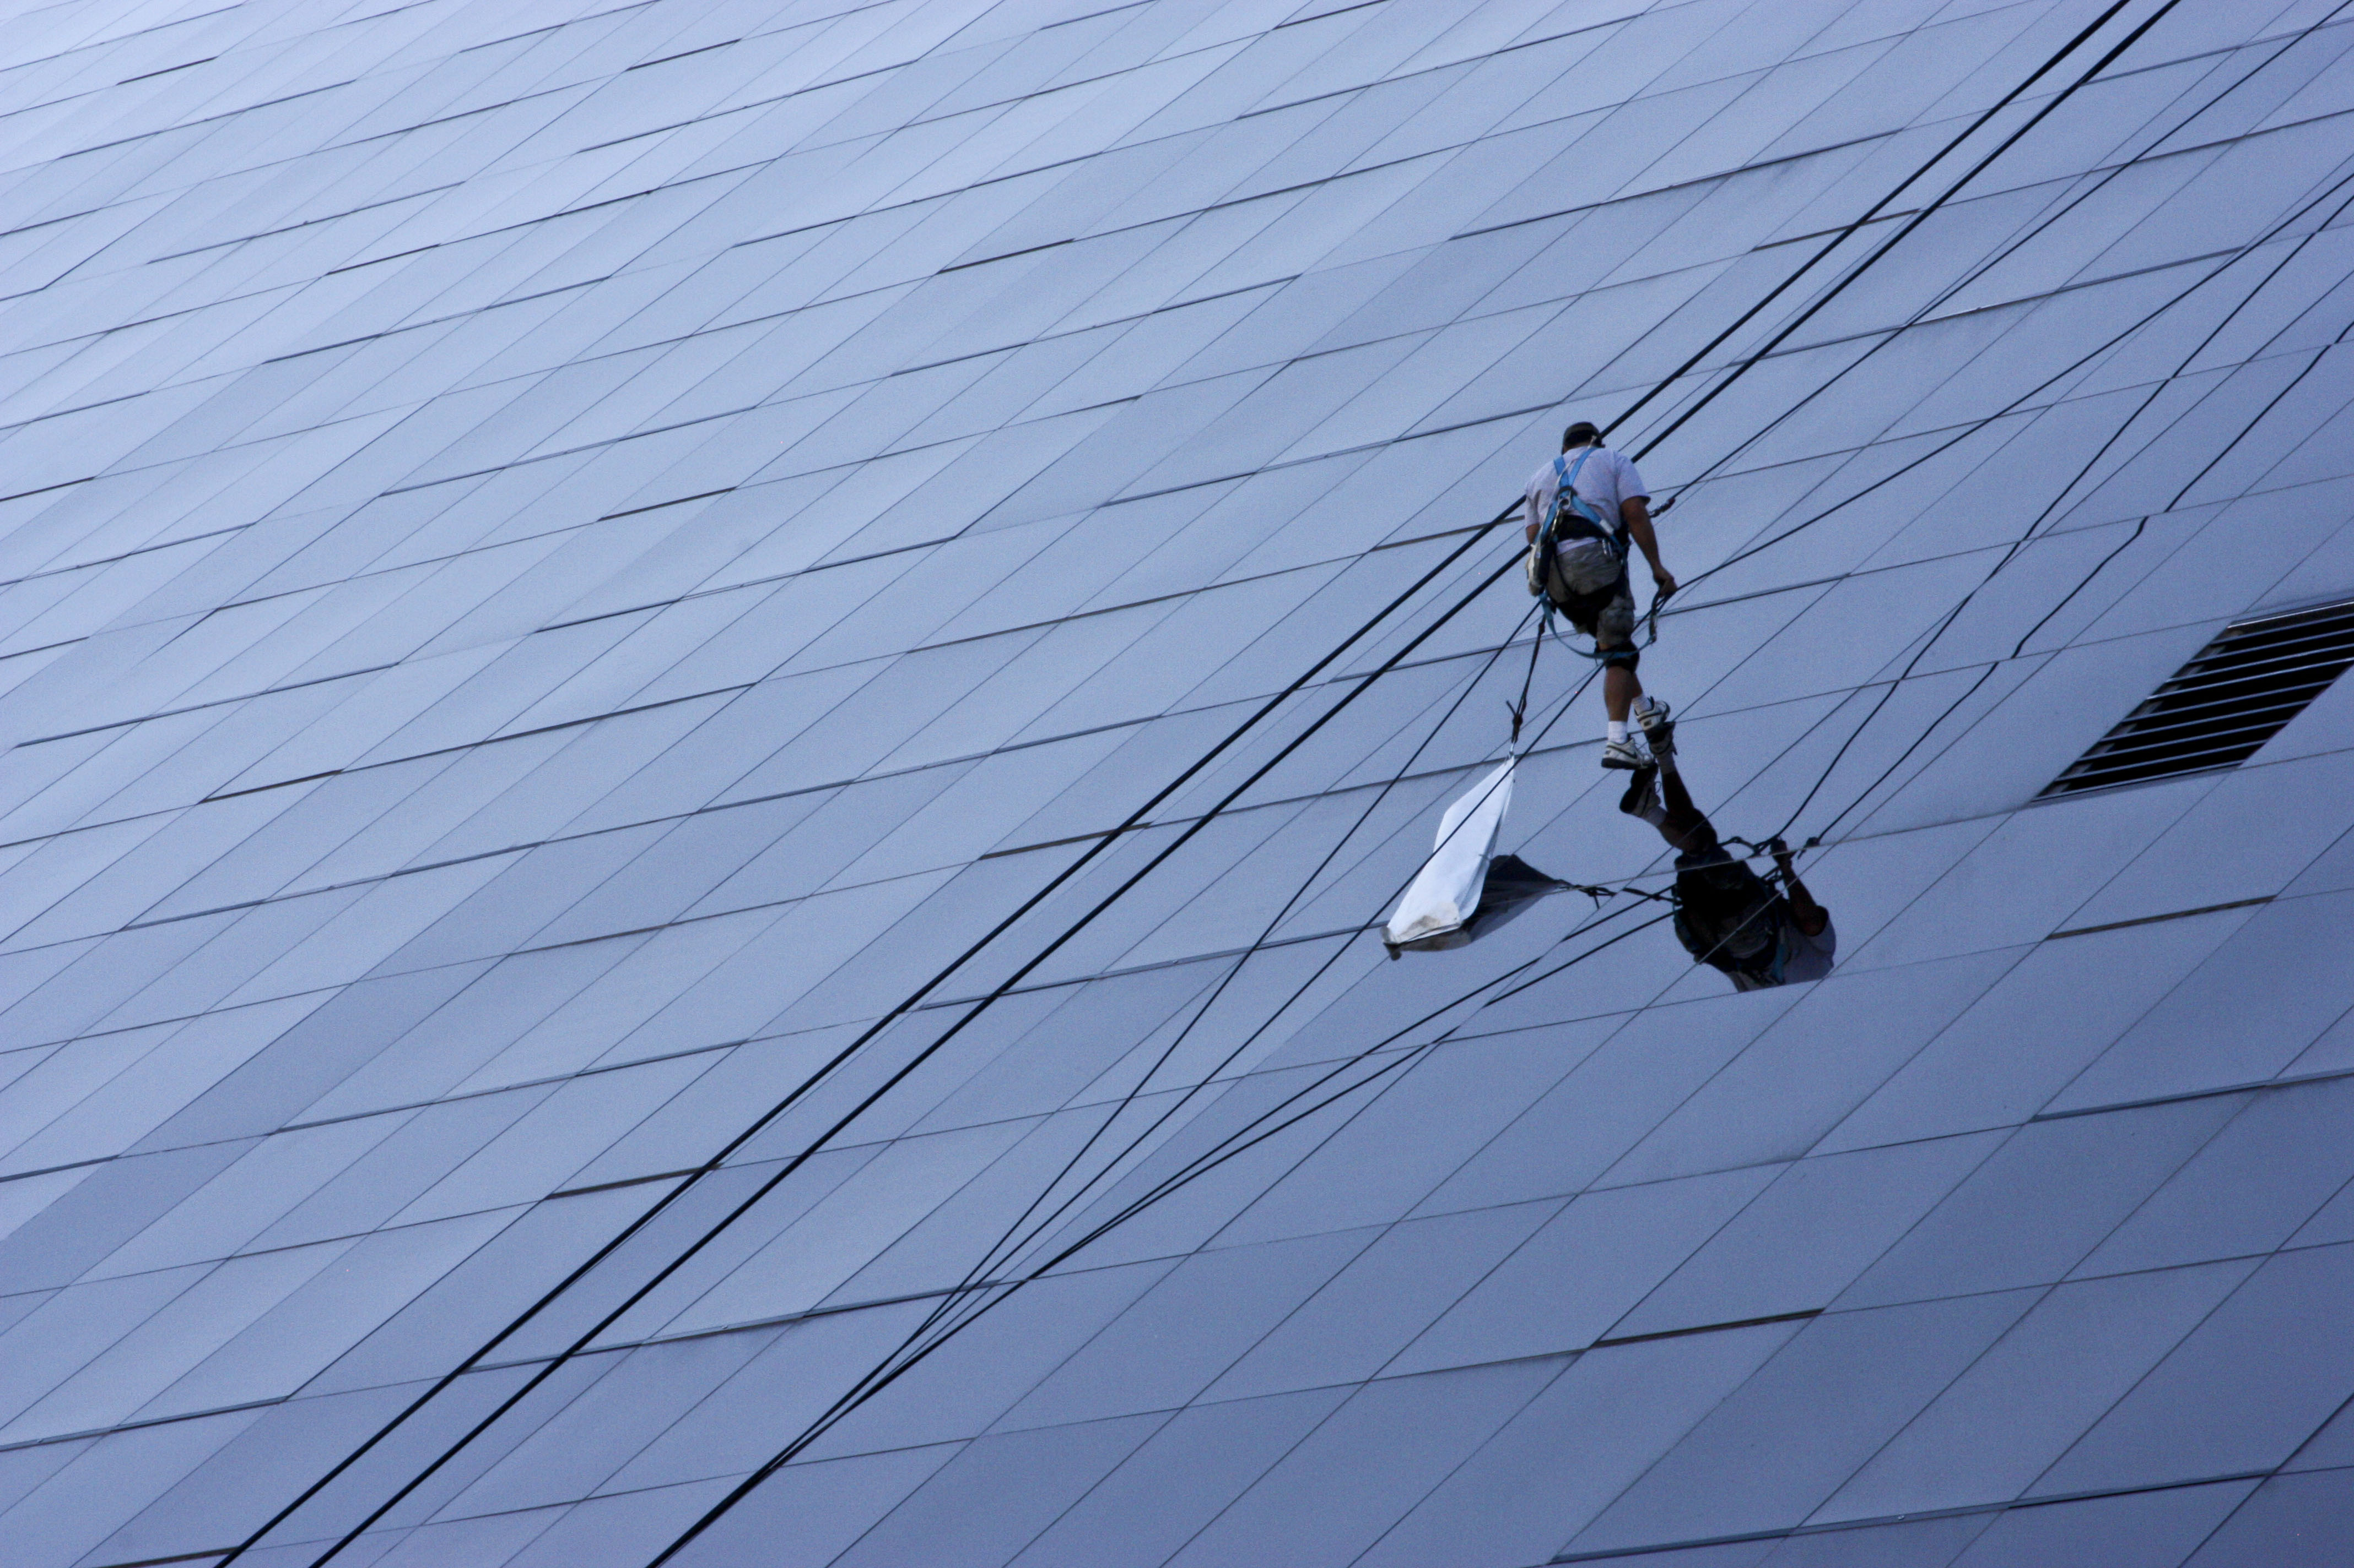
Line
Line can be stark and obvious, like telephone wires or a road, or windows on a building.

Slide 19
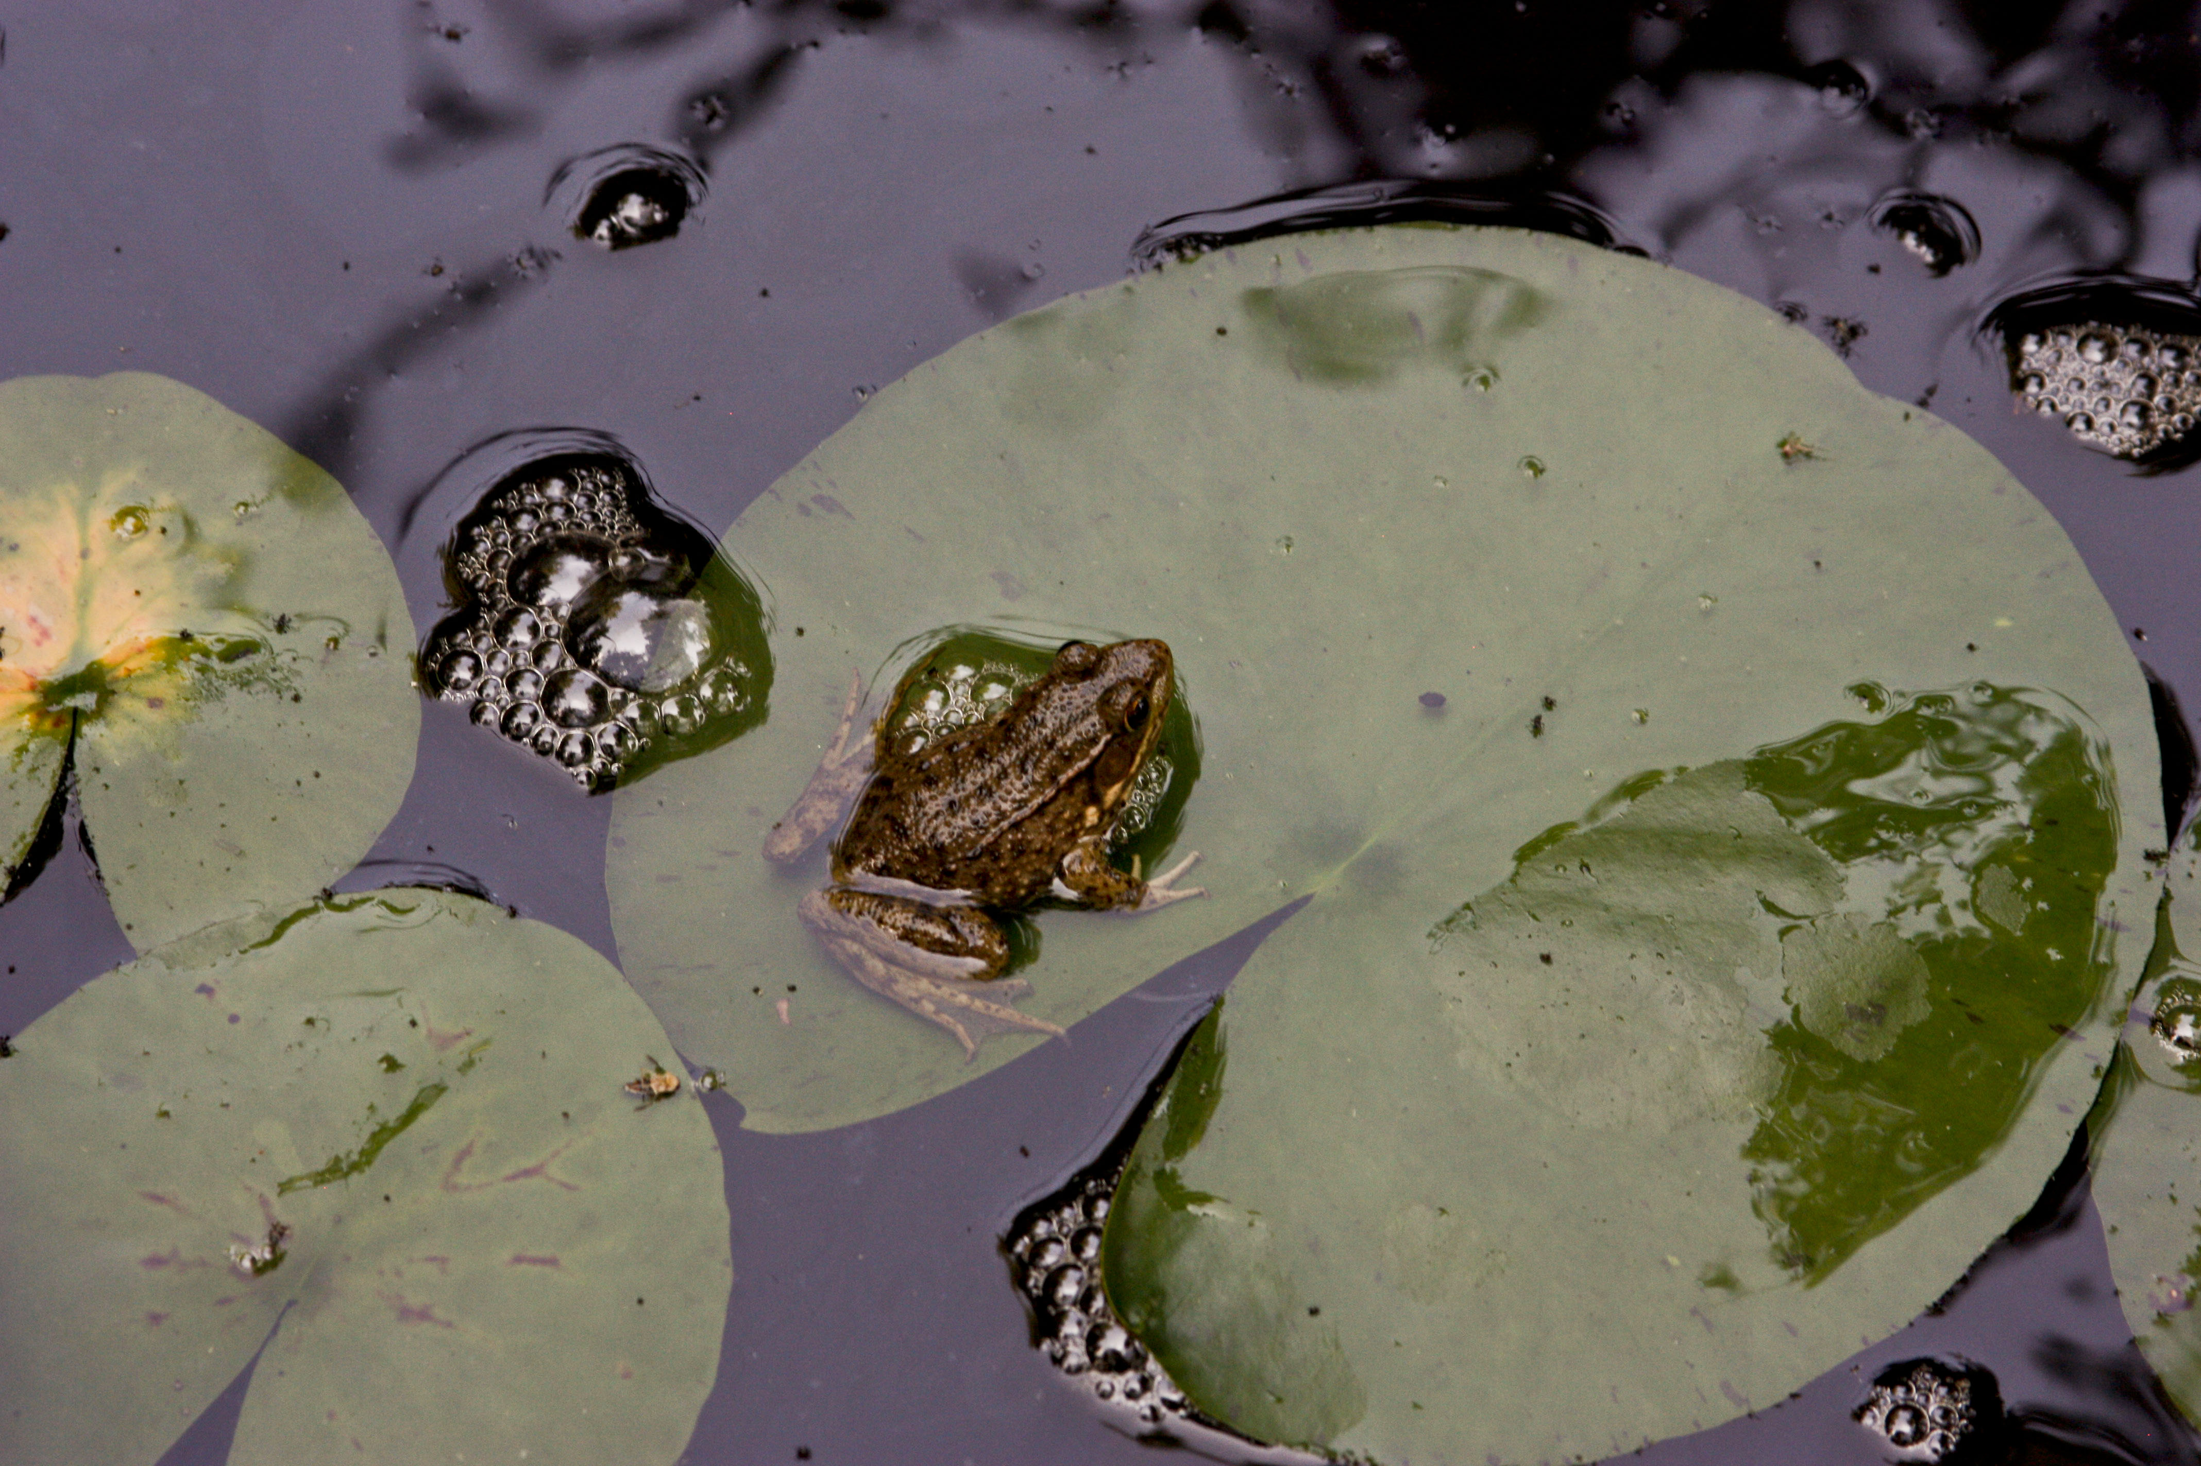
Line
Or lines can be suggested, such as a curve formed by faces in a scene or object shapes.

Slide 20
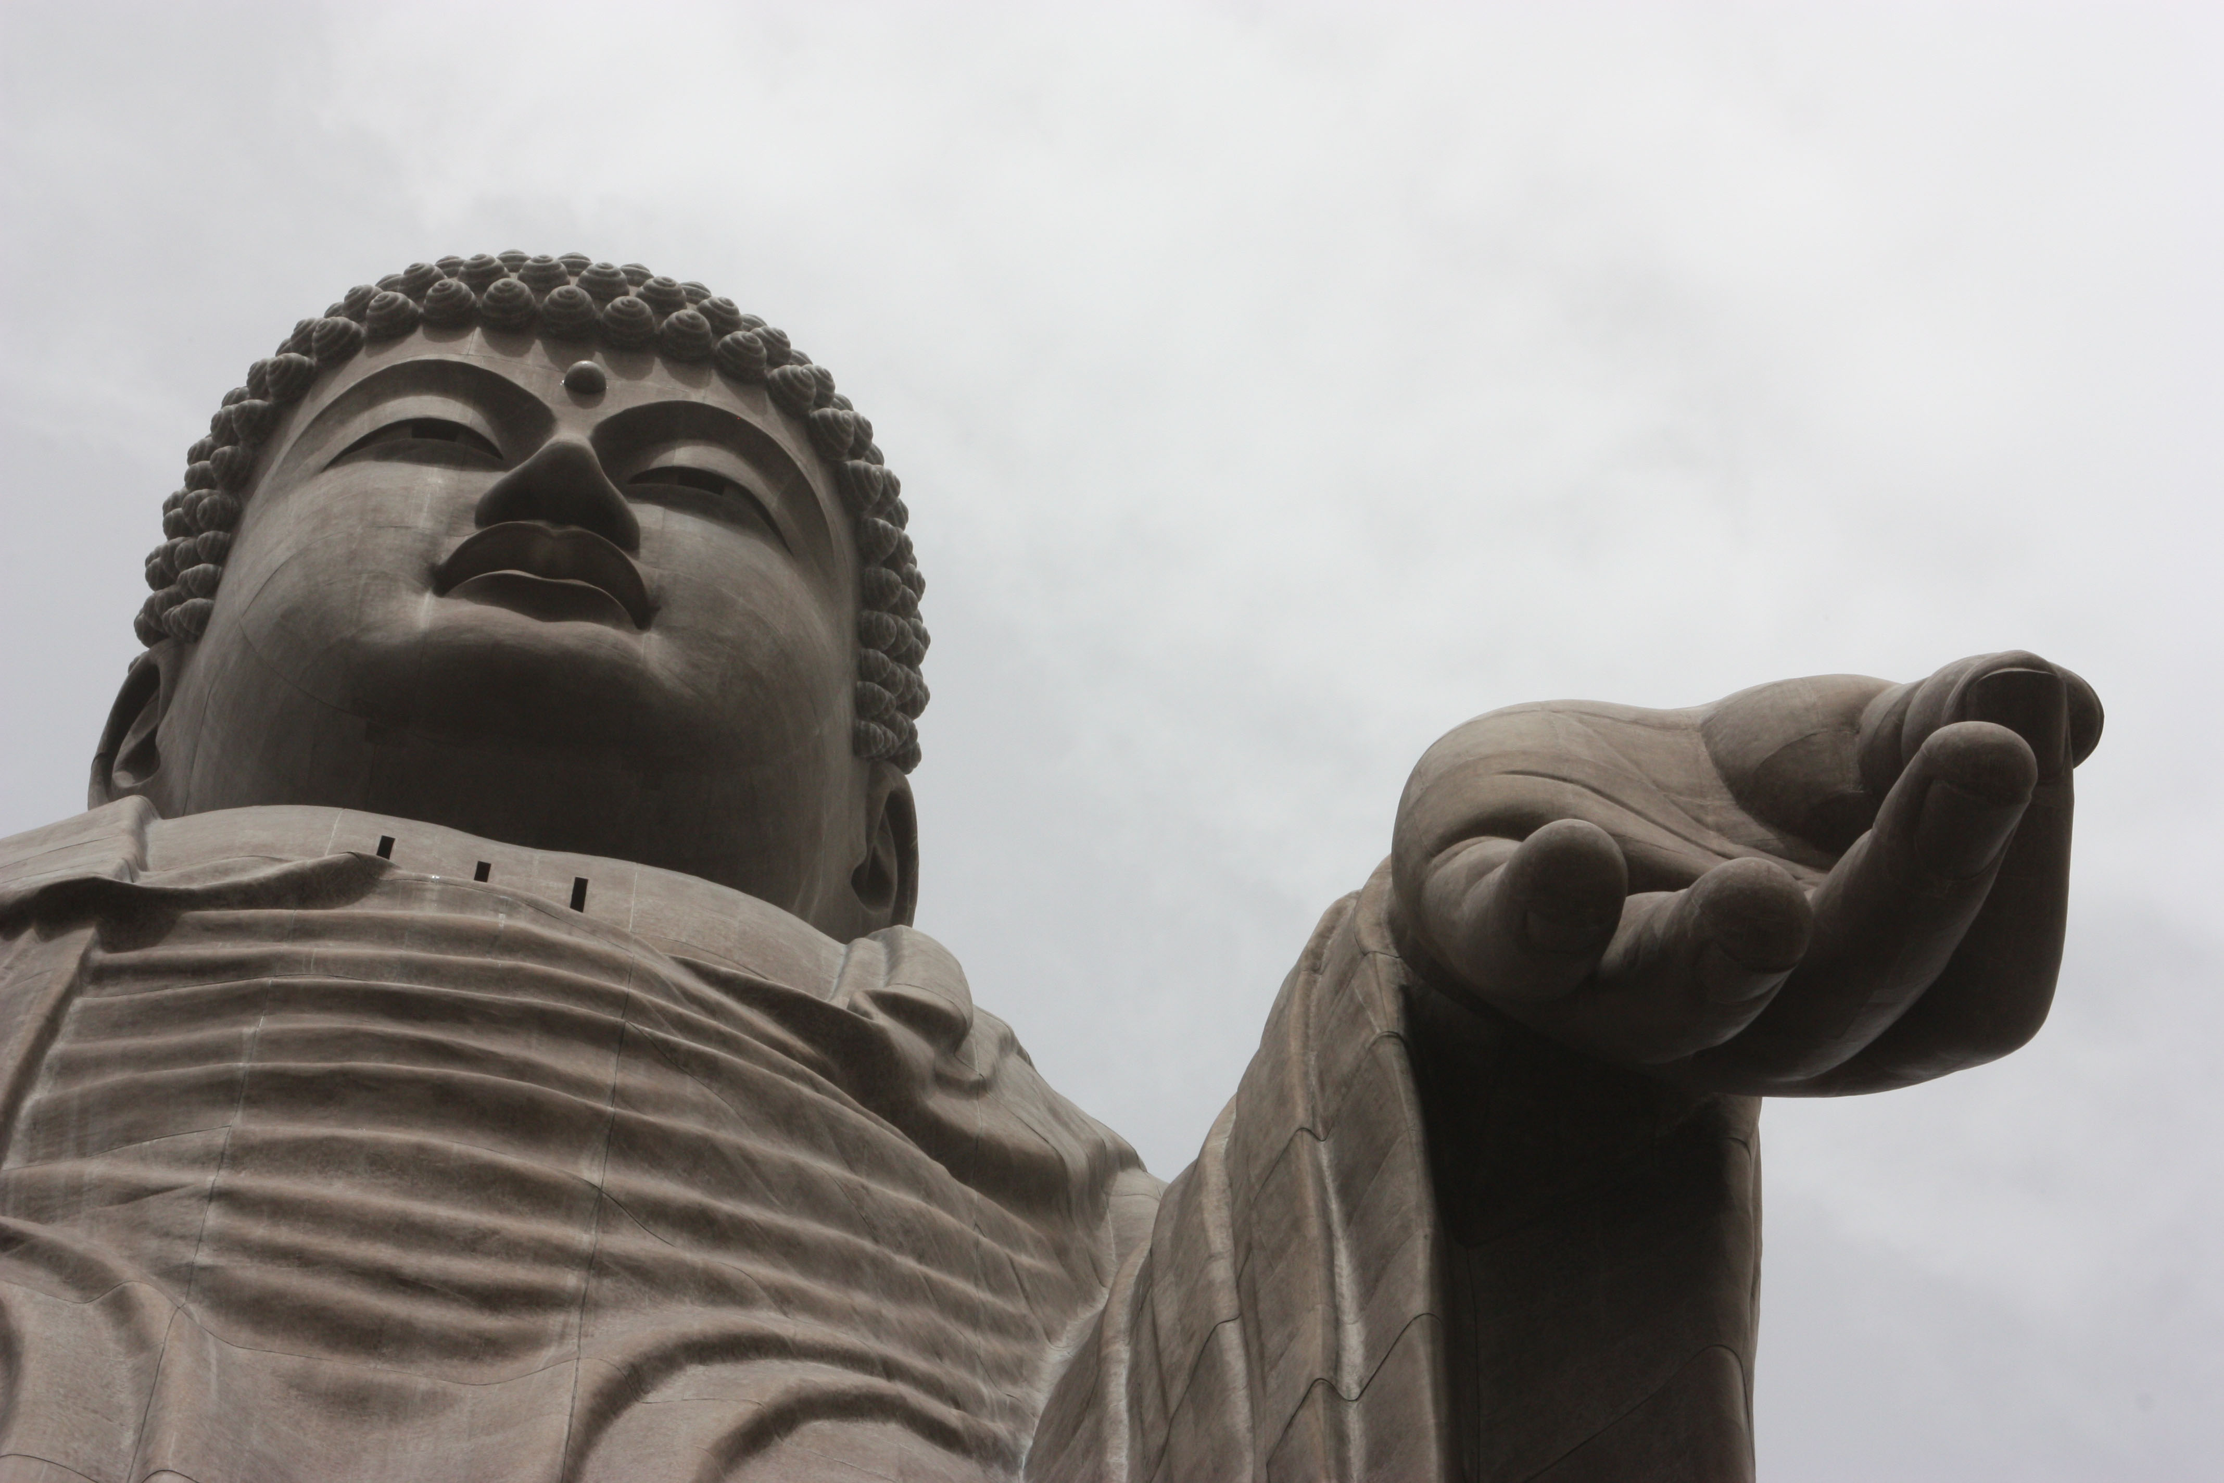
Shapes
Line obviously delineates shapes in a two-dimensional field.
Shape suggests dimension.

Slide 21
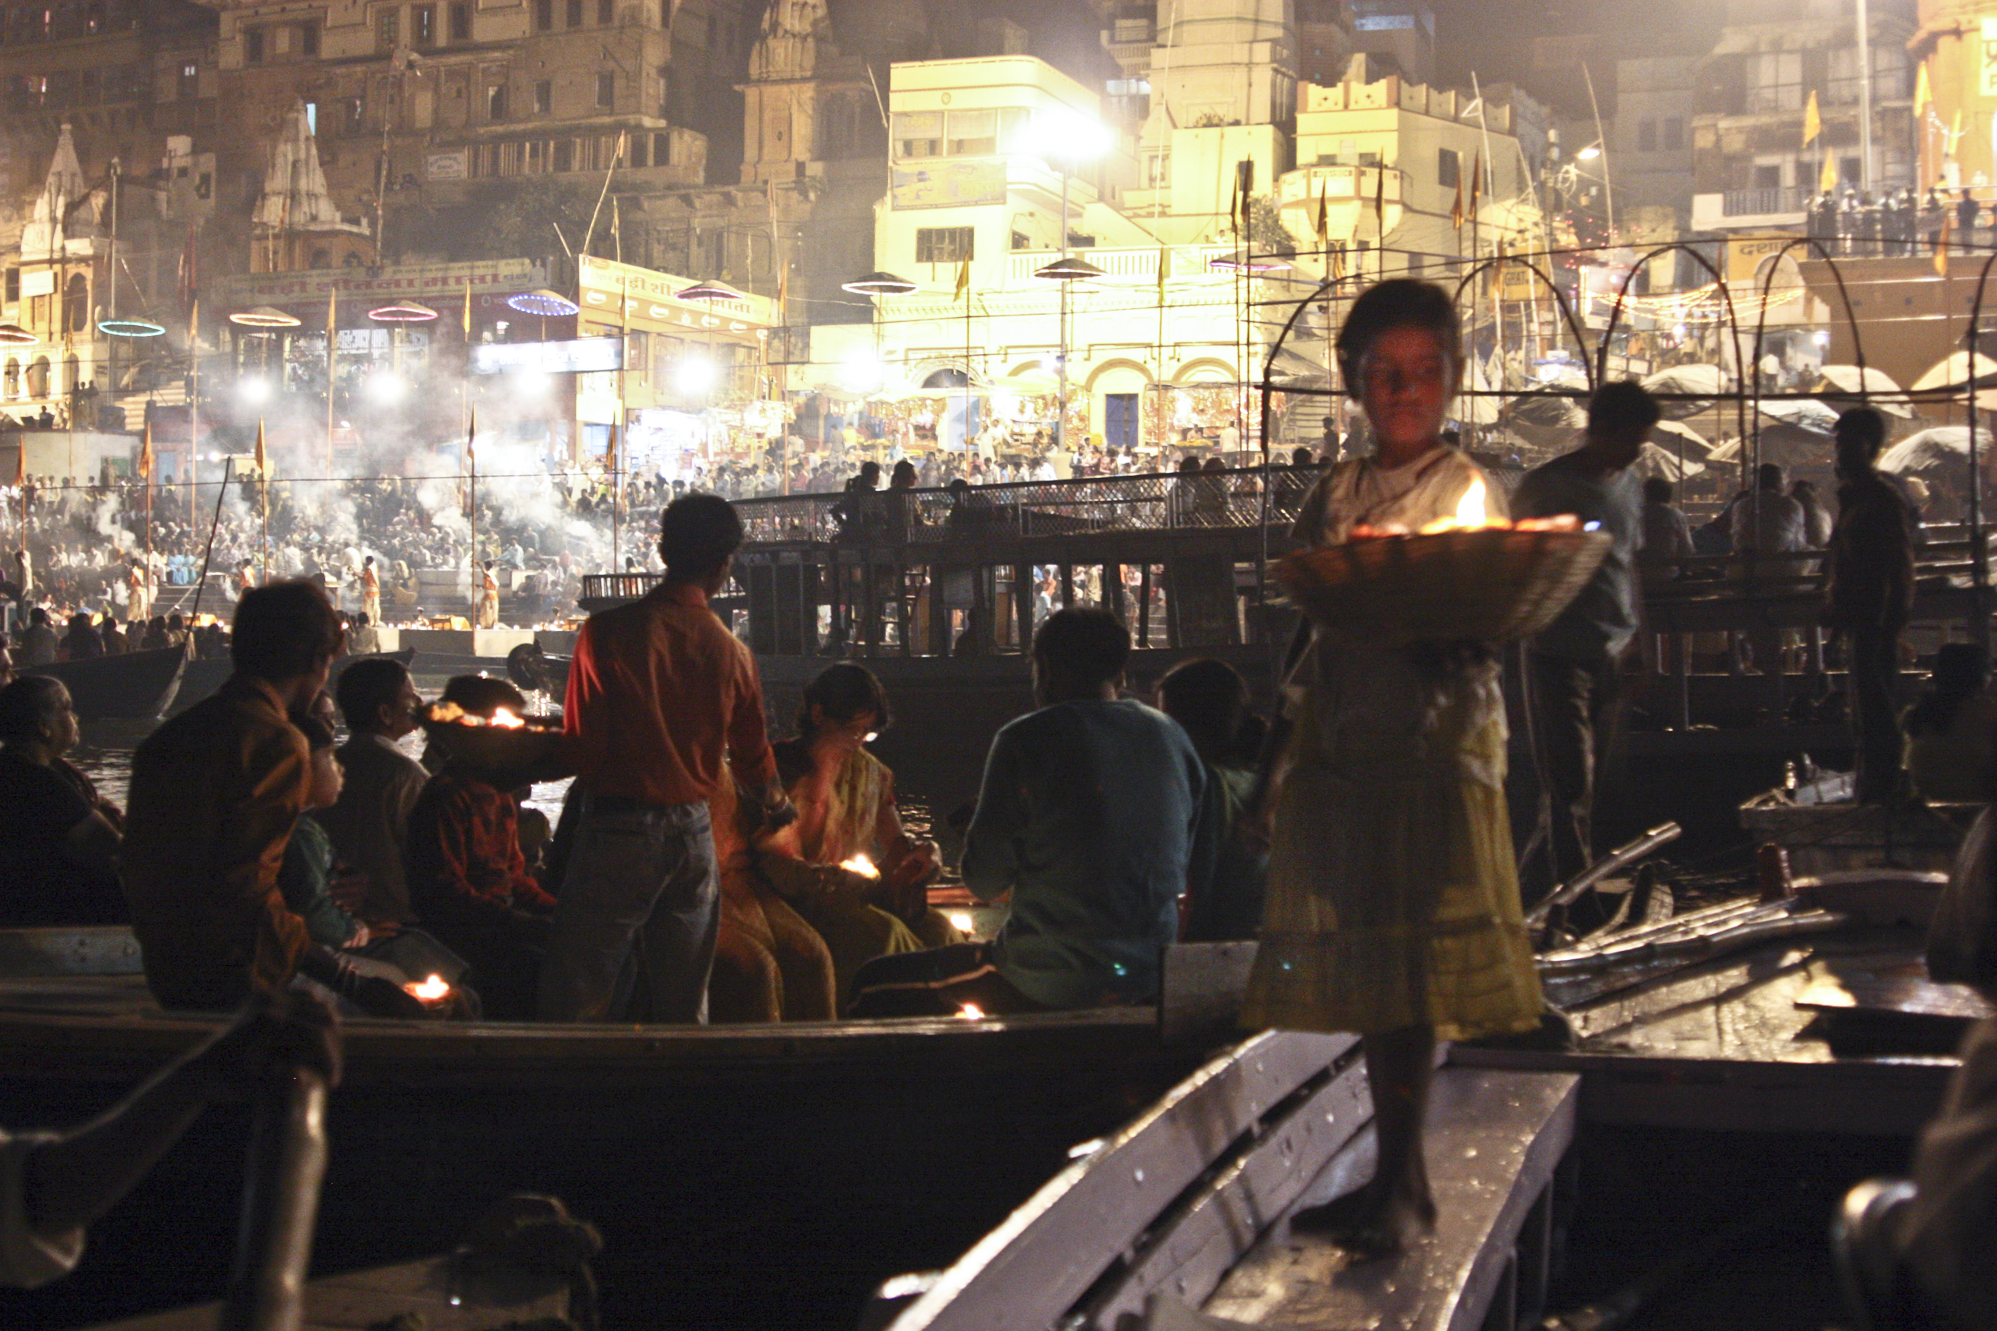
Tone
Shape reveals tone. Tone is the light and dark areas of an object.
Tone can make objects seem to advance or recede in a scene, emphasize or de-emphasize a shape.

Slide 22
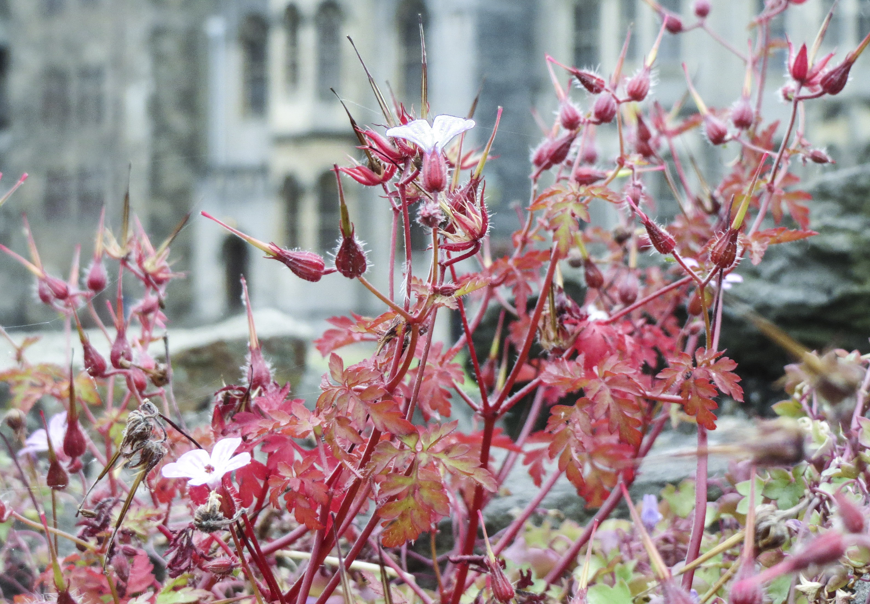
Texture
Texture gives an object a tactile quality, a feeling you would know the object by what you’d think it feels like. Light can emphasize or de-emphasize it.

Slide 23
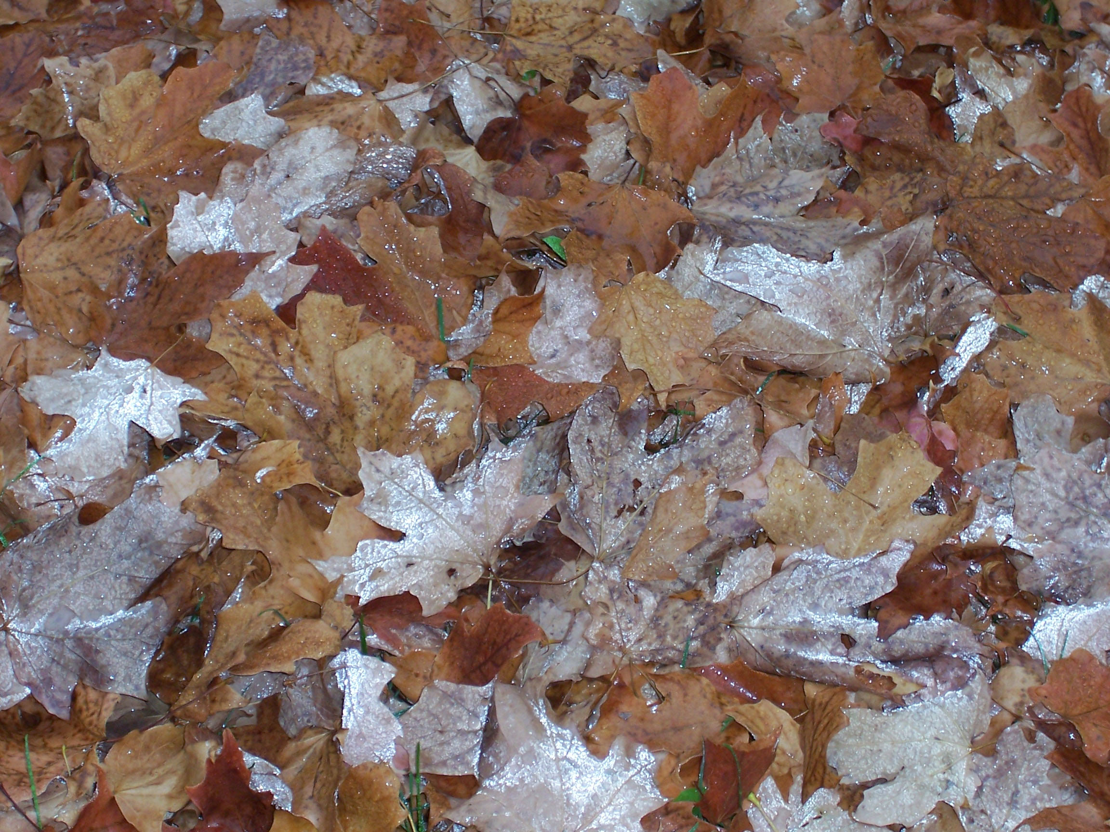
Color
And color, of course, adds a strong feeling of mood to a photograph.
It may be saturated and intense, or soft and un-saturated.
Colors may be many or limited to a few.

Slide 24
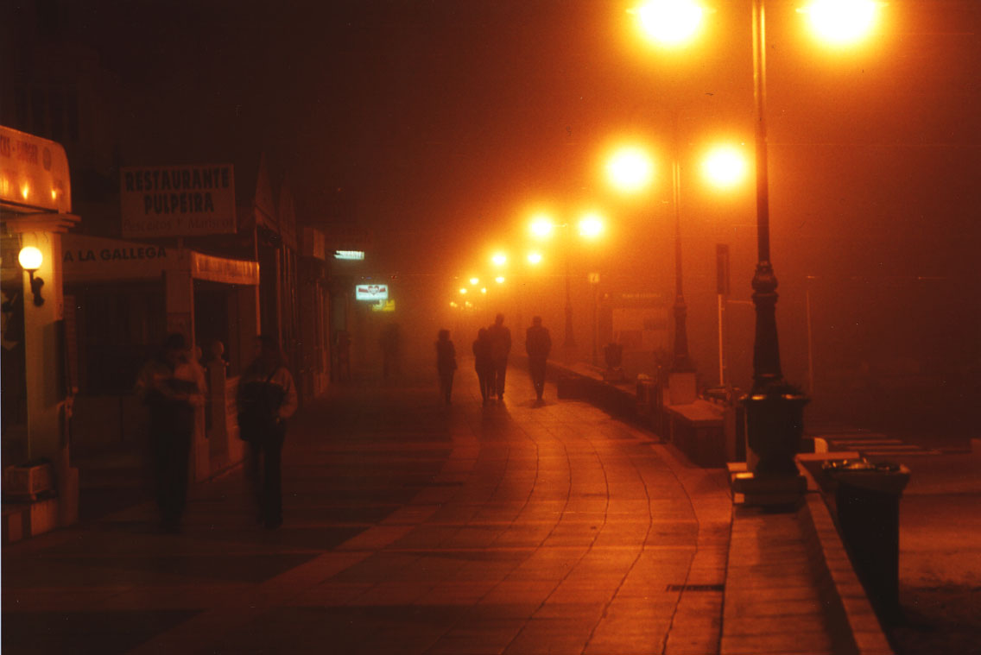
tools for composition
How we use these tools, or elements, describes composition.

Slide 25
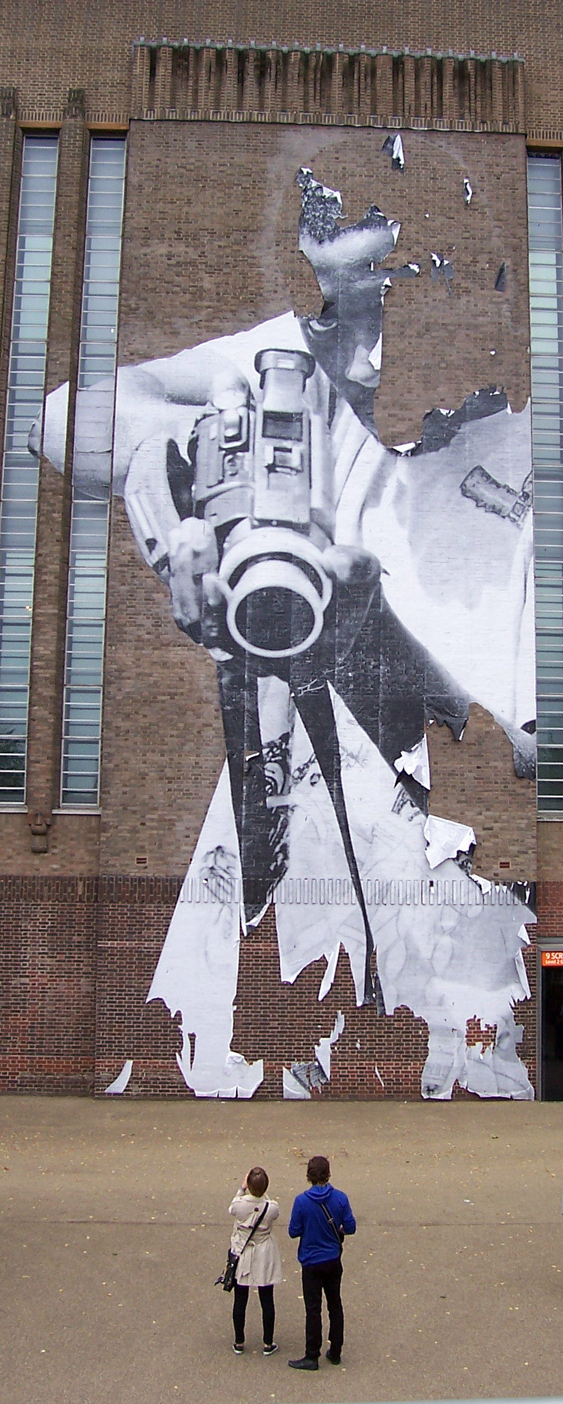
Composition: contrast
Contrast brings variety to a photograph.
Contrast may be made using shapes, colors, moods, and expressions to generate viewer interest and perhaps amusement.
Typical examples: A small hand in a large, or expressions on people’s faces.

Slide 26
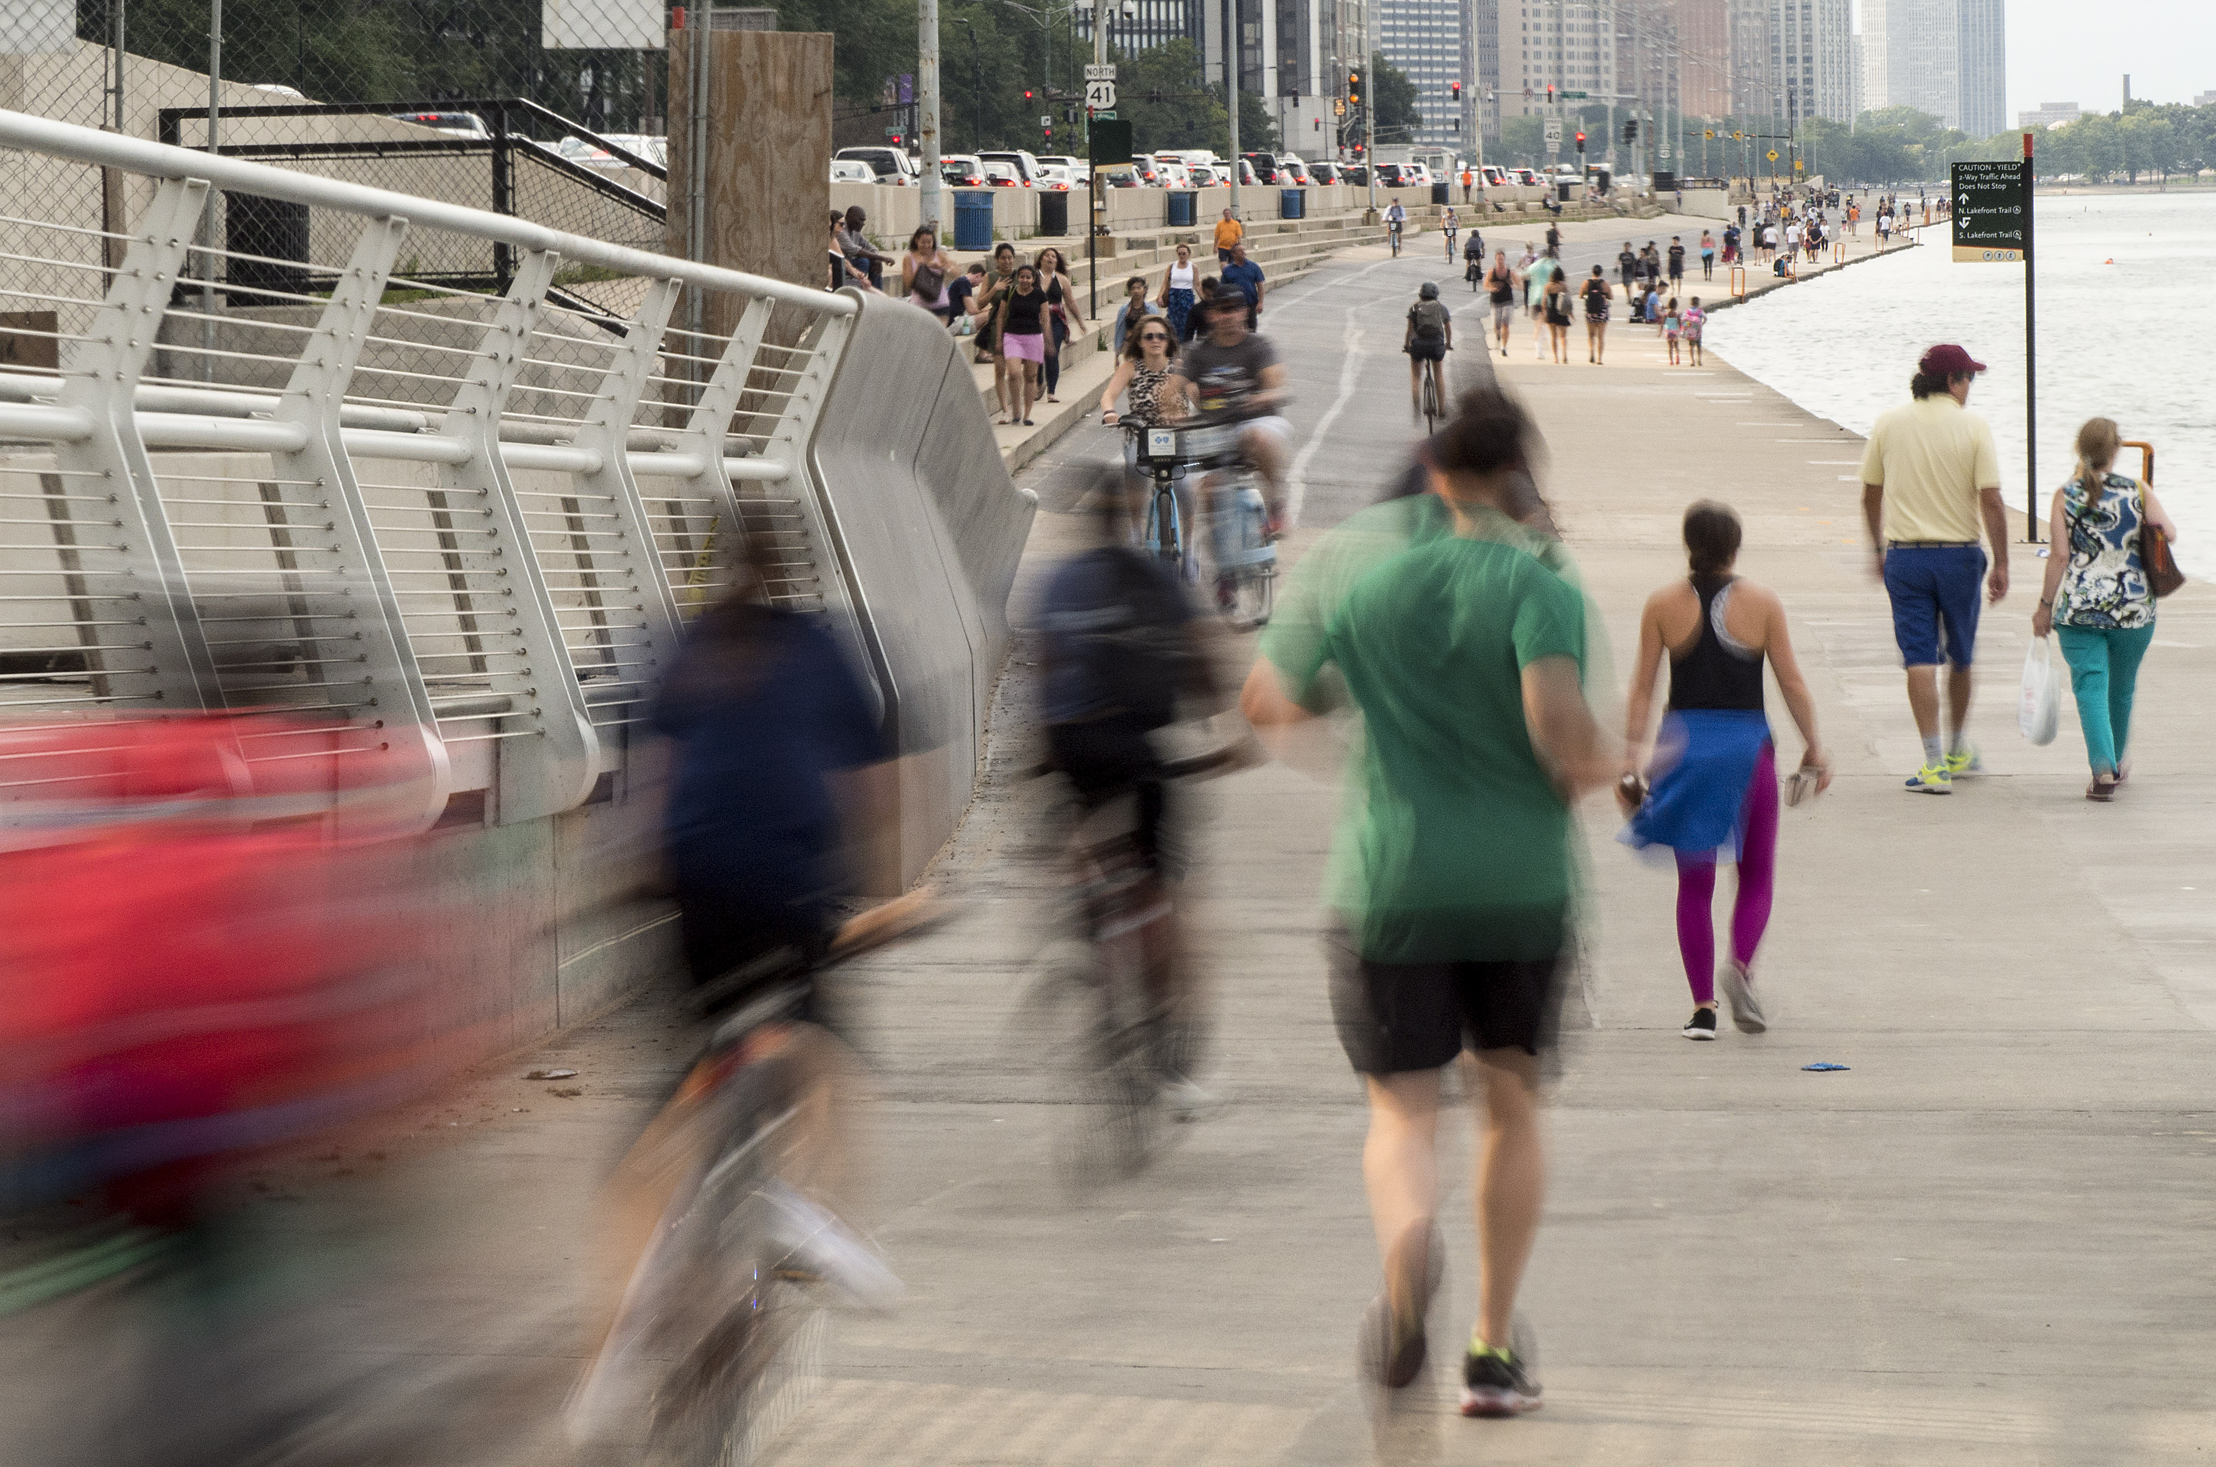
Composition: Repetition
Rhythm and repetition emphasizes repeating patterns to generate interest.
Typical examples include trees, fence posts or people retreating into the distance.
Rhythm is part of nature, and feels satisfying in photography.

Slide 27
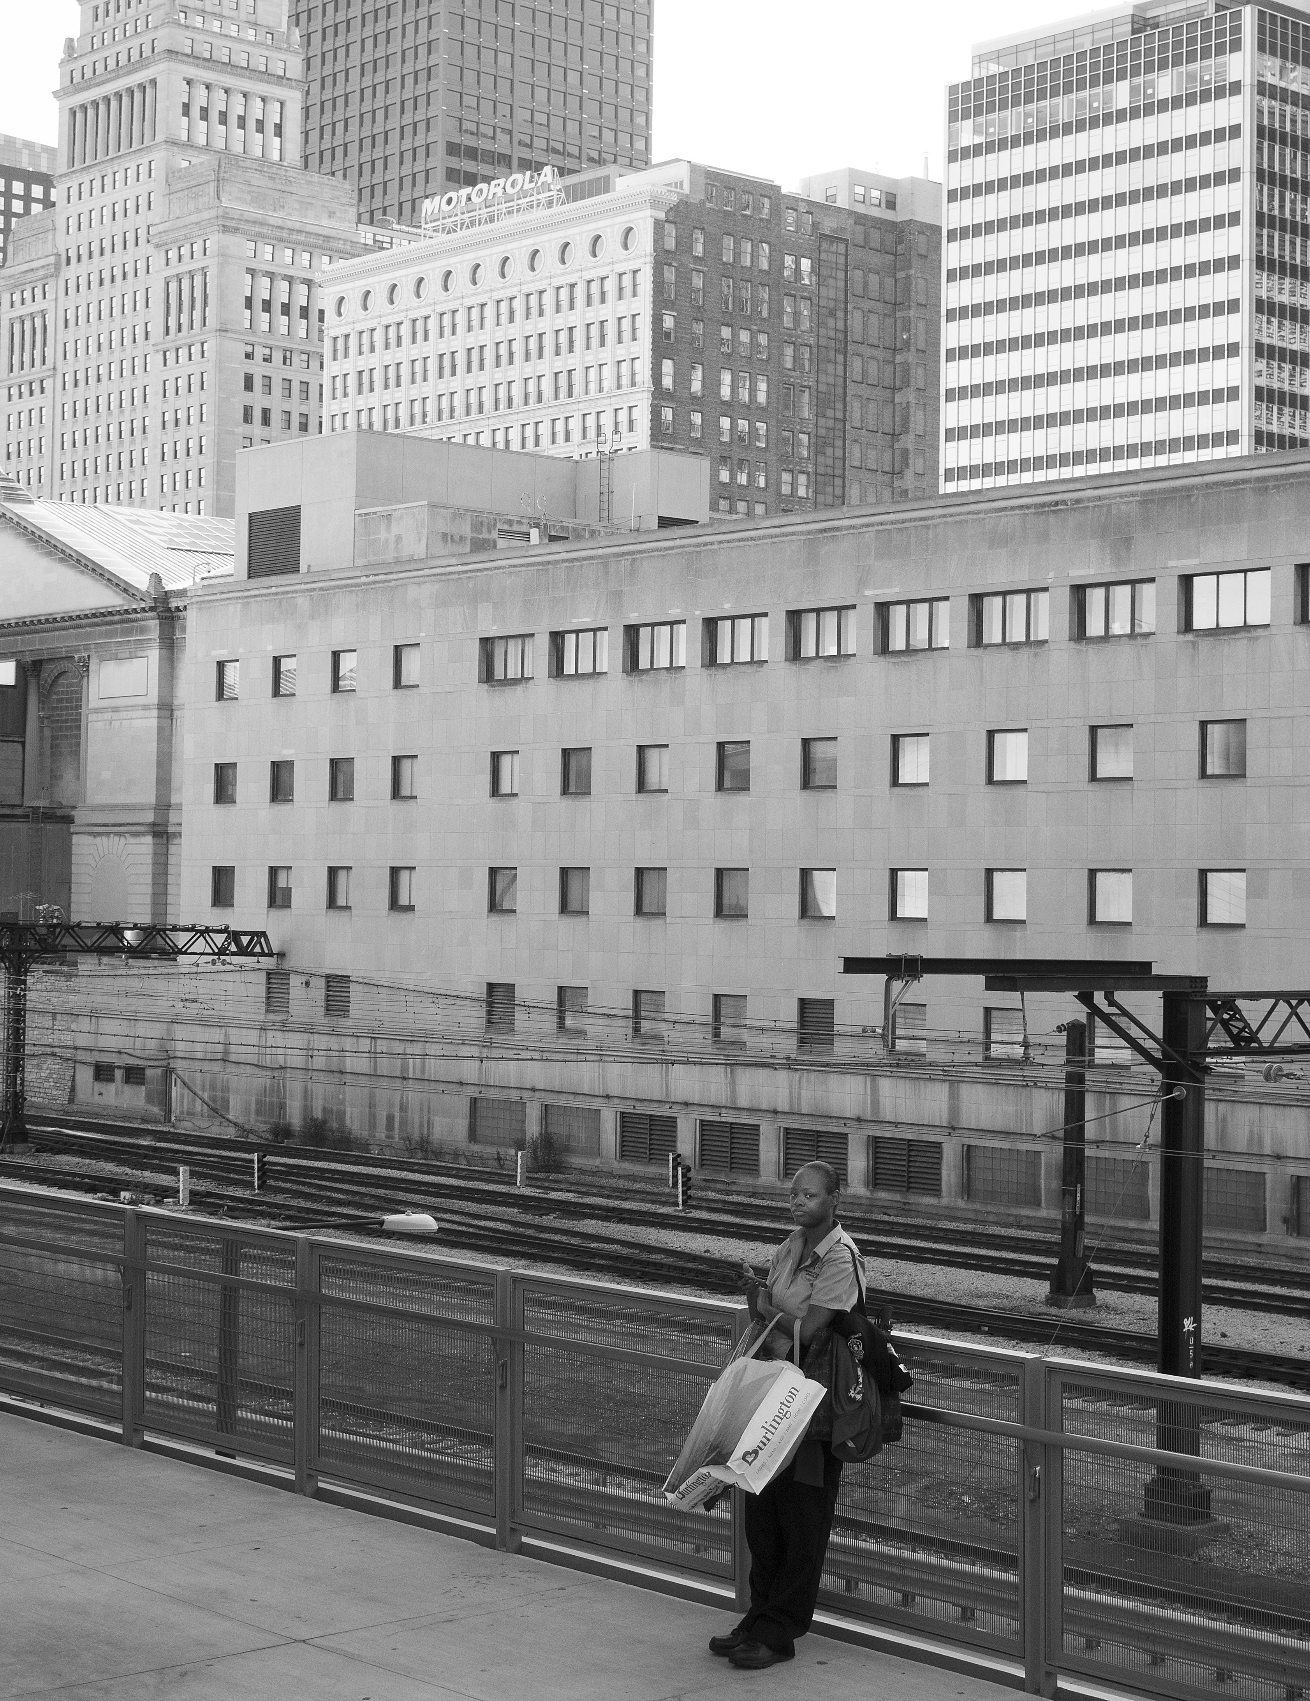
Composition: Dominance
A photographer chooses a center of interest for prominence, or dominance in a scene.
It may not be the largest area of a scene, but has most visual impact.
It may enhance a feeling of dynamic tension or action evident in even a still photo.

Slide 28
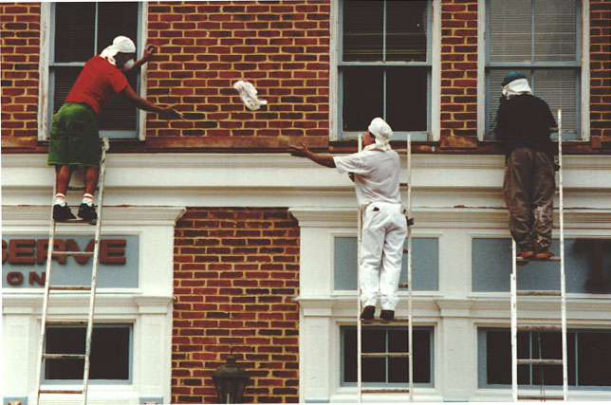
Composition: Balance
Balance may be symmetrical or asymmetrical.
Most photographs are not symmetrically balanced.
But visual weight on both sides should feel balanced.

Slide 29
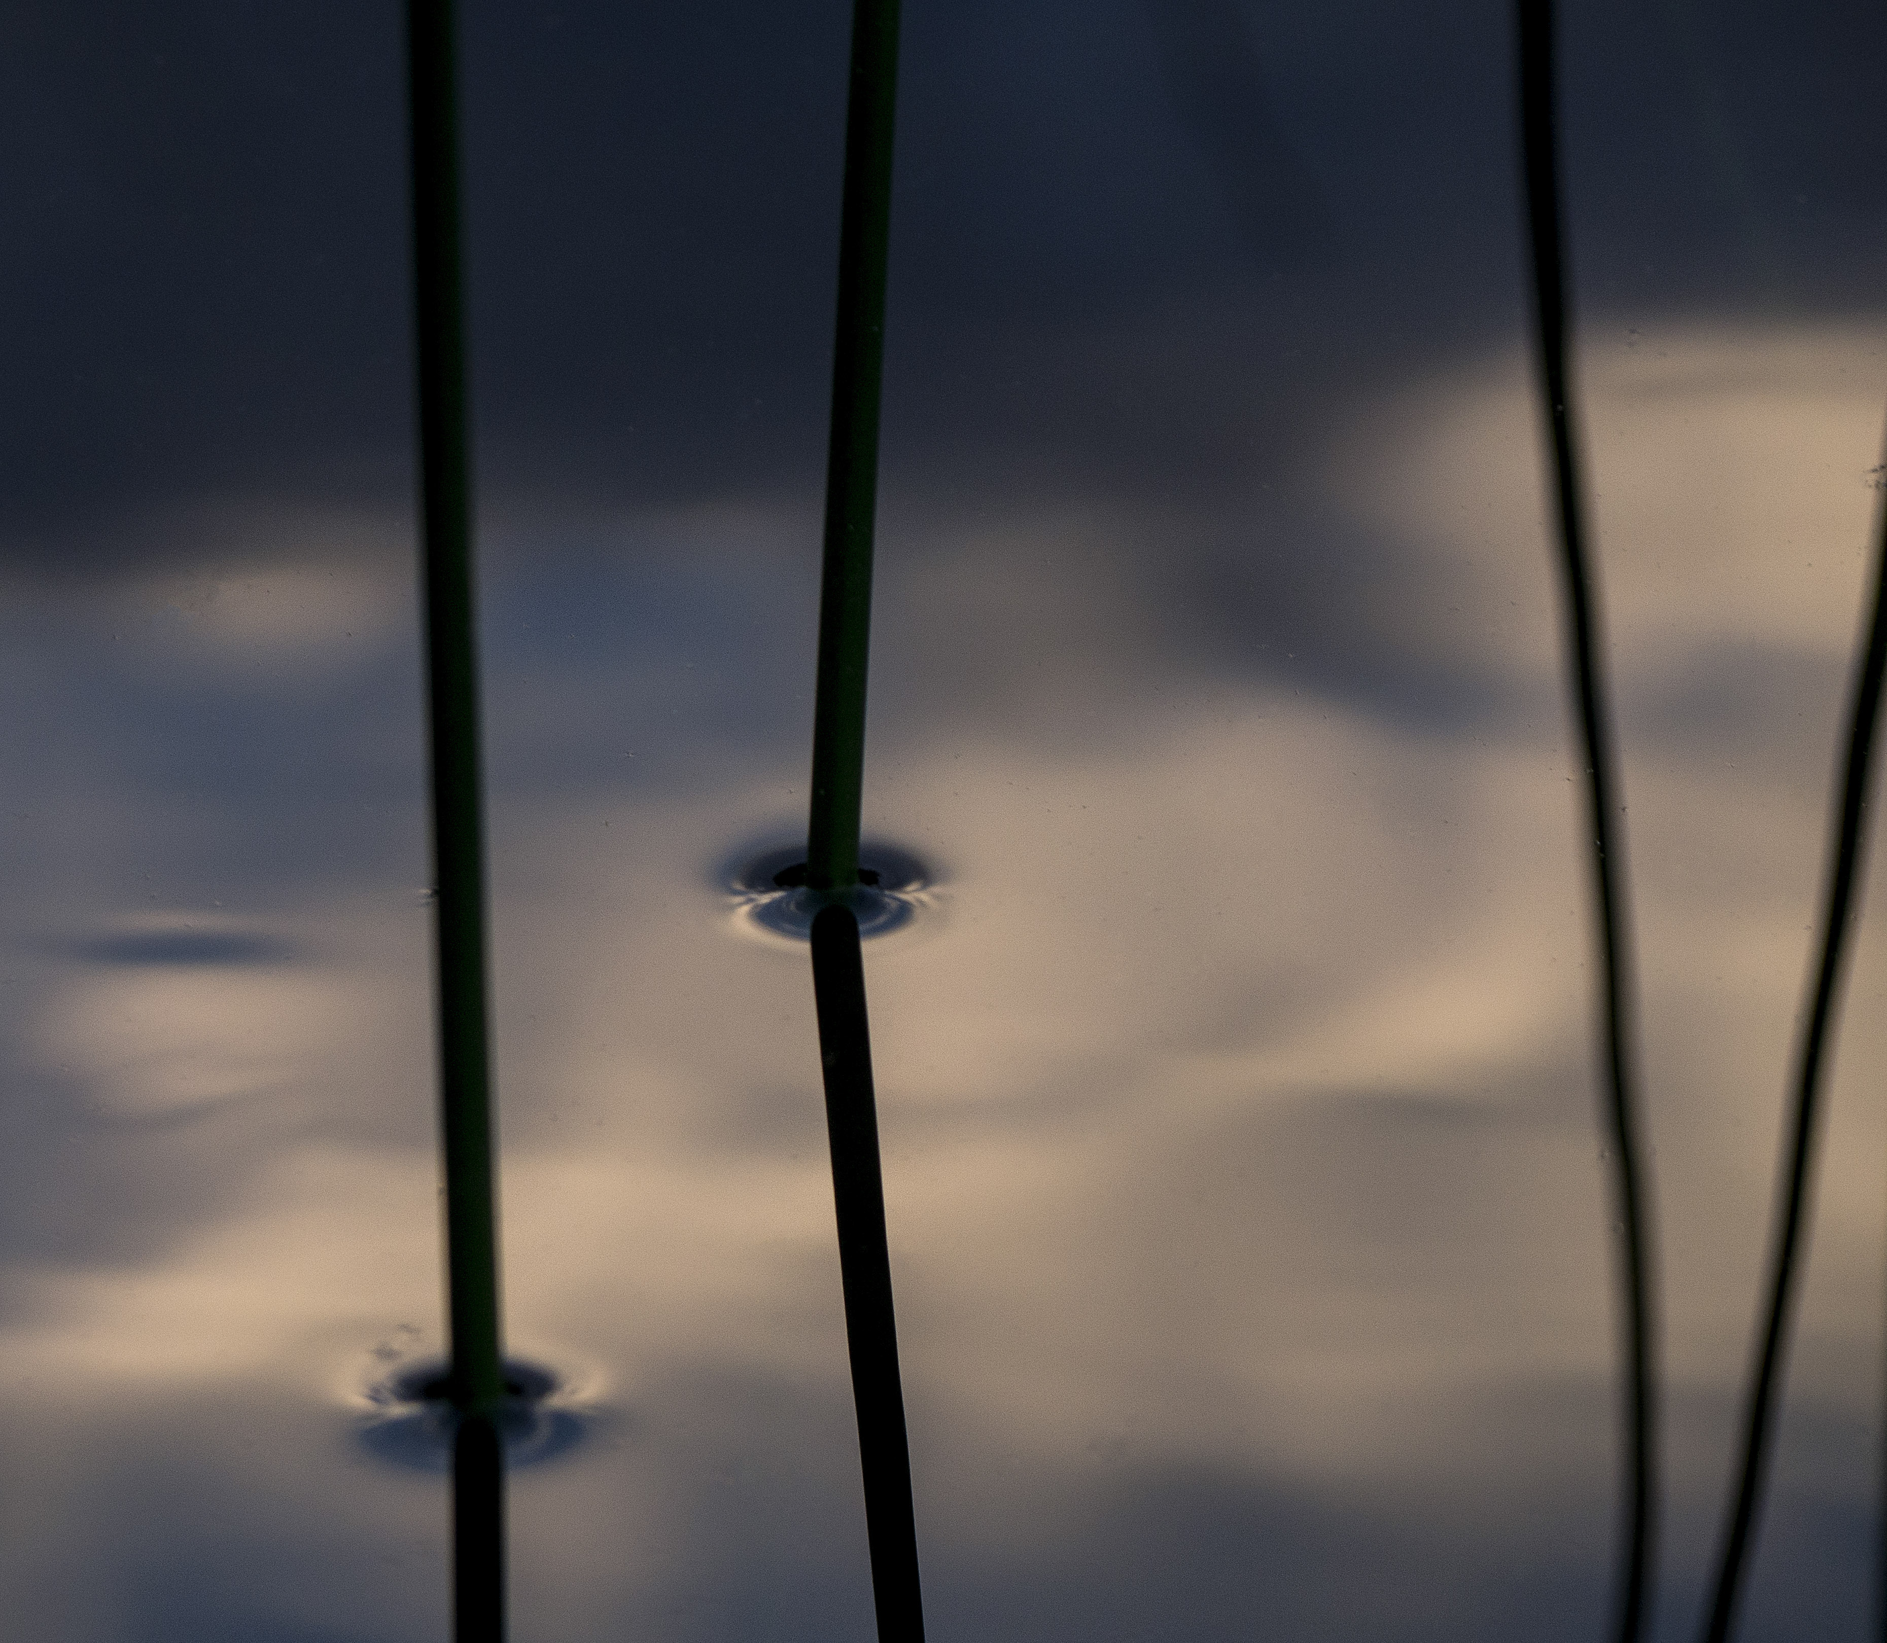
Composition: Unity
Unity reflects the entire scene, how the parts work together for the whole. I think it’s an elusive concept.

Slide 30

Basic principles
Can we offer general rules regarding composition in photography? Yes, a few.
1. Rule of thirds.
This principle emphasizes that the center of interest or subject of a photo generally should not be in the exact center of the picture. Looks static and dull.

Slide 31
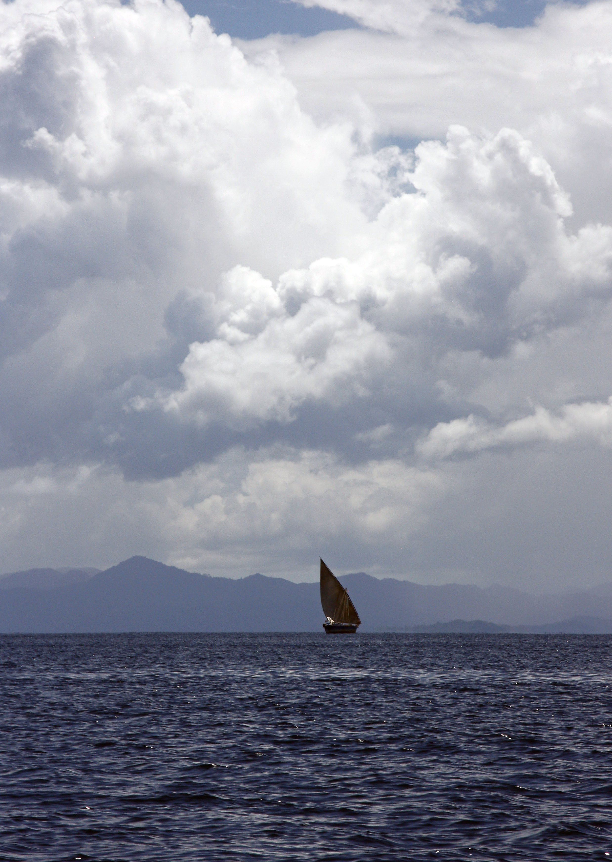
Basic Principles
Try to put your center of interest on an intersection of imaginary thirds.
Yes, this can be overdone, but it often is a good starting point to avoid the static center.

Slide 32
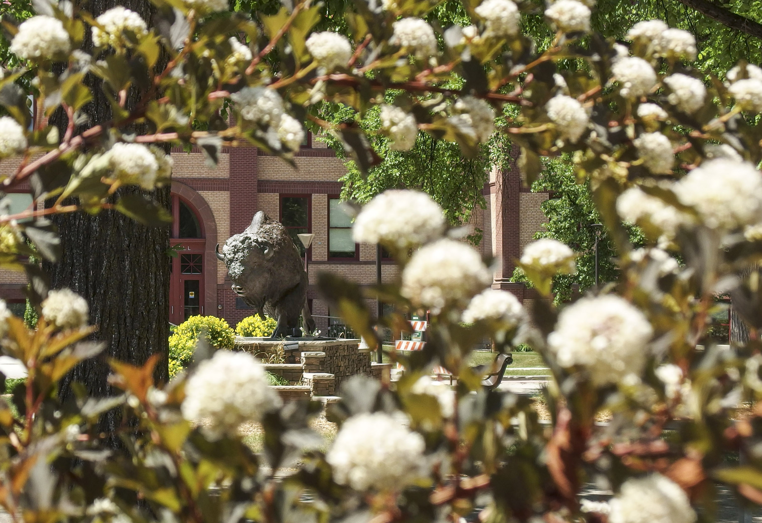
Basic Principles
We find relationships between objects on different planes of a scene. These add dimension to a photo. An old photo instructor of mine called it the “near-far” effect.
2. Frame your photo with foreground objects.

Slide 33
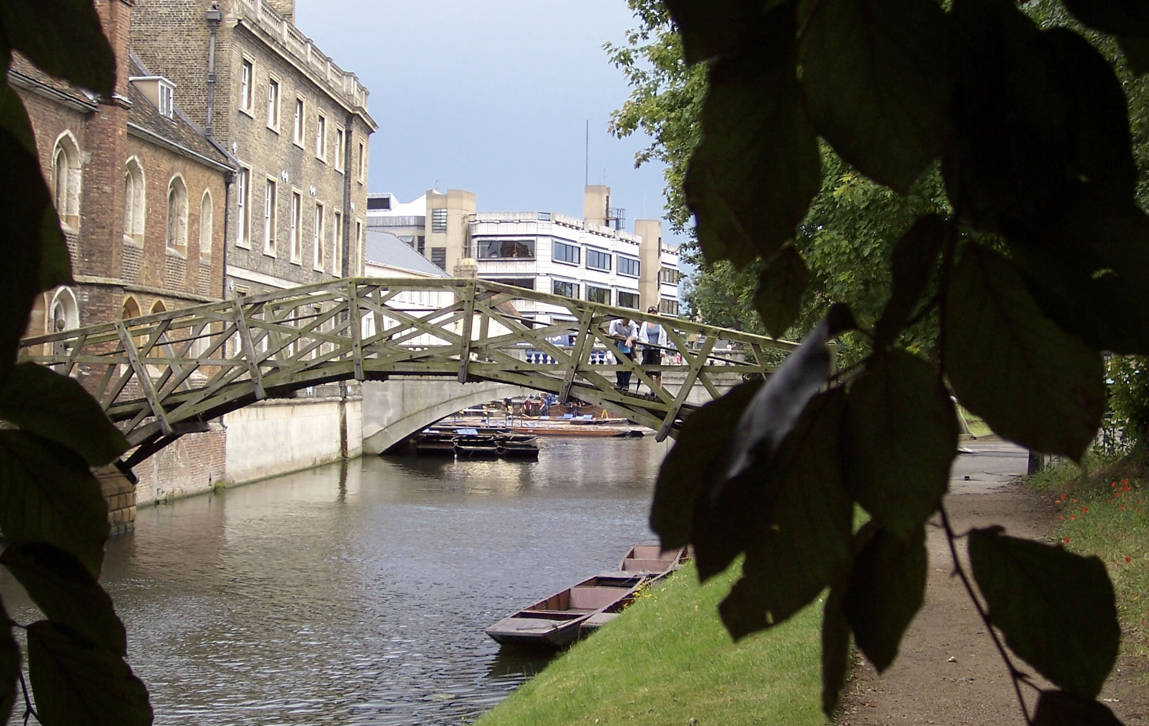
Basic principles
Like the rule of thirds, foreground framing can look cliché. Still, you’ll usually have a more powerful photo by including objects in several planes: foreground, middle, and background.

Slide 34

Basic principles
Related to the near-far effect, we try to give viewers a sense of relationships between objects in a scene.
3. We emphasize a sense of scale.

Slide 35
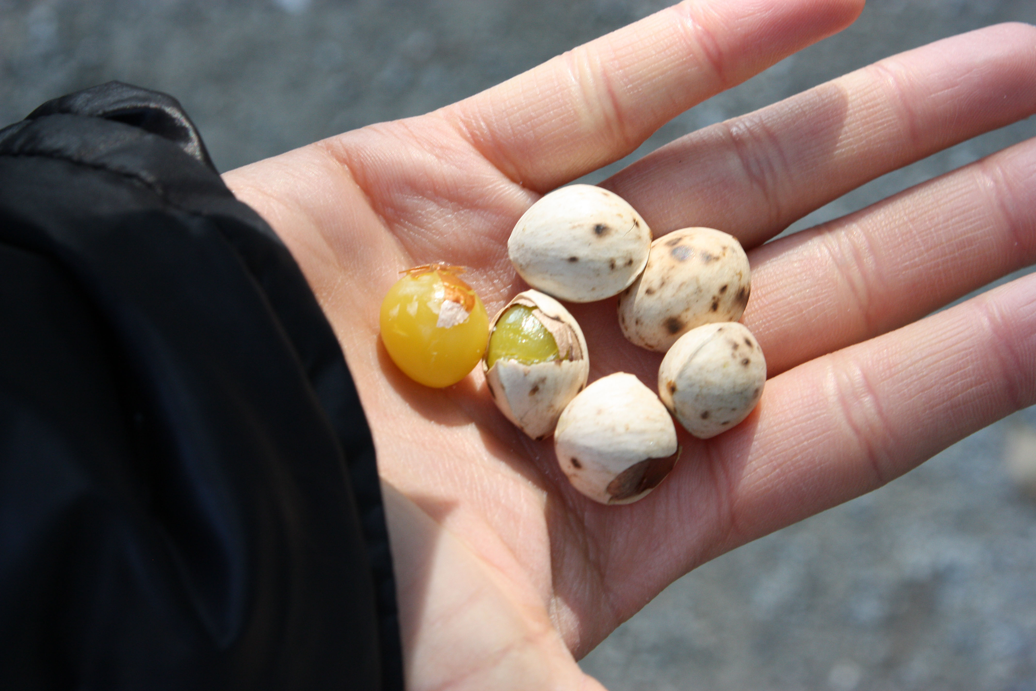
Basic principles
Often photographers emphasize scale using by adding people to a scene, or hands, or other familiar objects as a way to compare relationships.

Slide 36
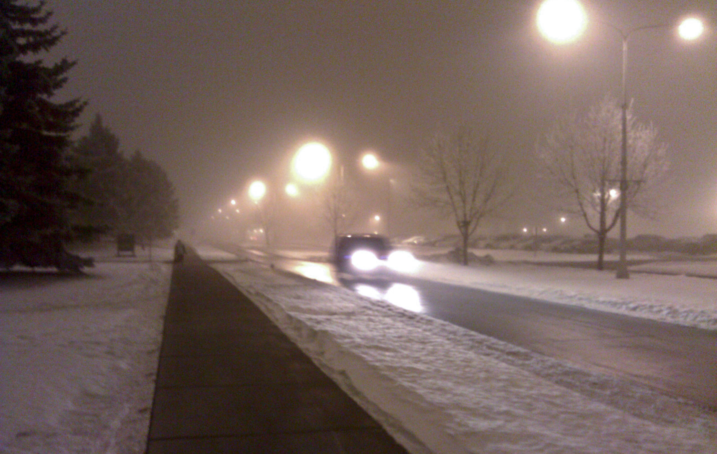
Basic Principles
We try to guide viewers through a photo. A strong way to do this is by
4. Using leading lines.
Perhaps roads and fences have sometimes become cliché, but they still work to emphasize line.

Slide 37
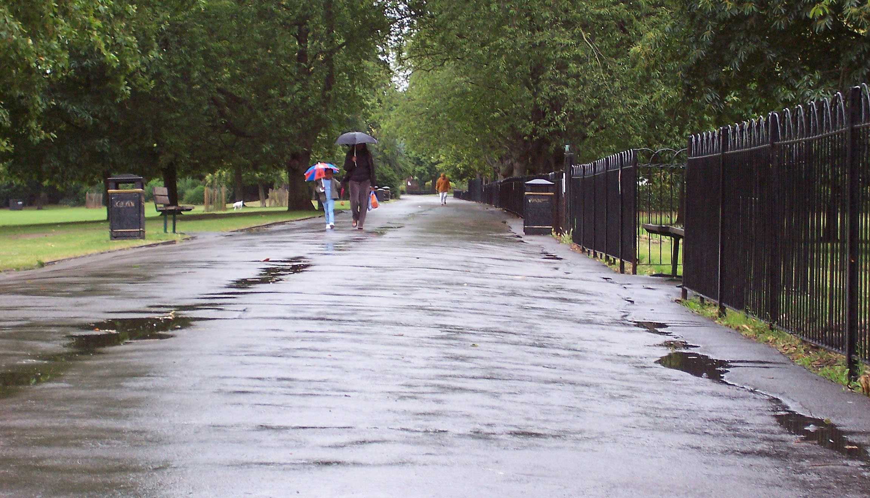
Basic principles
Note if you use leading lines, you need to have a subject or figure at the end of the line to keep your viewer in your photo.

Slide 38
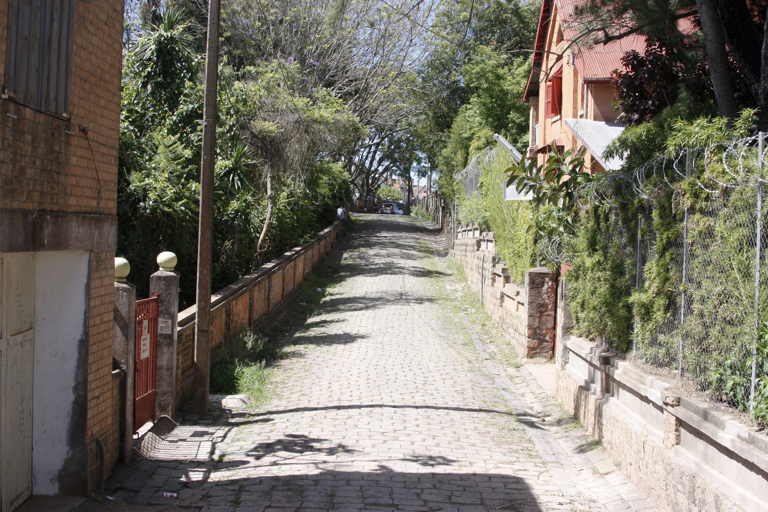
Basic principles
Oops! Leading lines, but nothing to keep the viewer from following them right out of the picture.

Slide 39
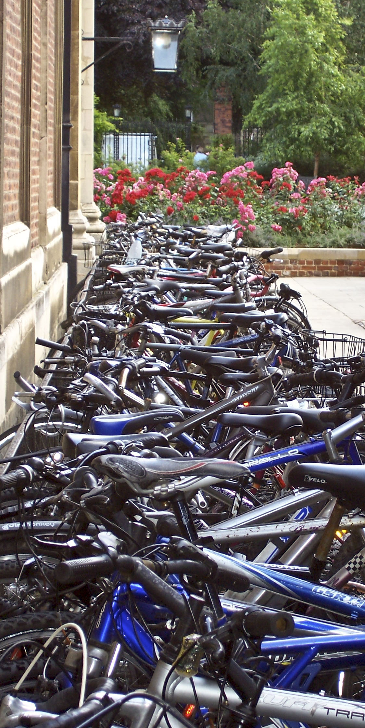
Basic principles
As line is a visual tool, so is repetition. To lead the eye and add interest to a scene we try to
5. find repeated patterns.

Slide 40
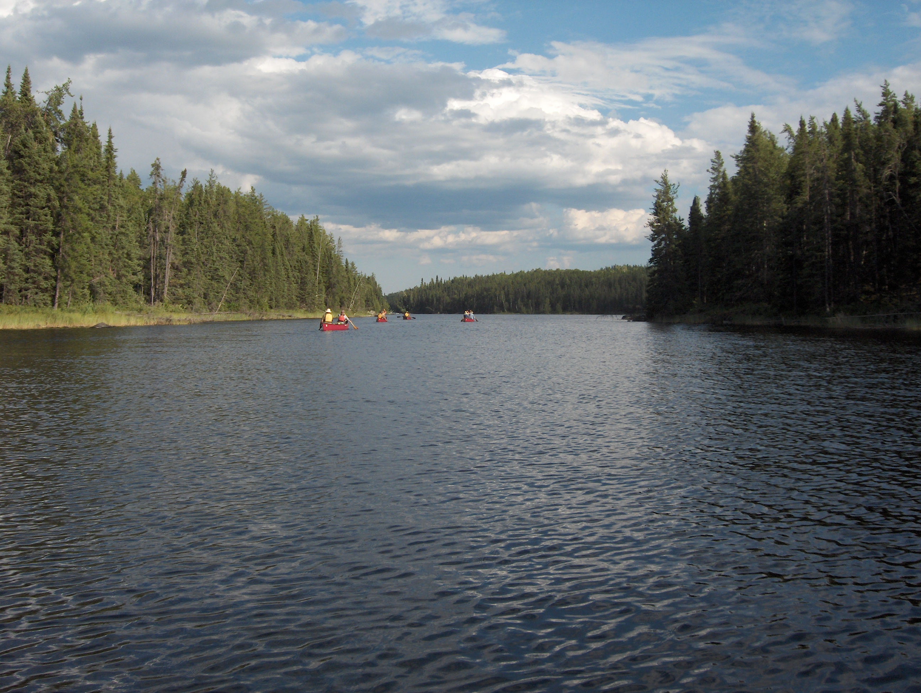
Basic principles
Repetition helps gives a feeling of meaning to a photo, and reflects the patterns of nature.

Slide 41
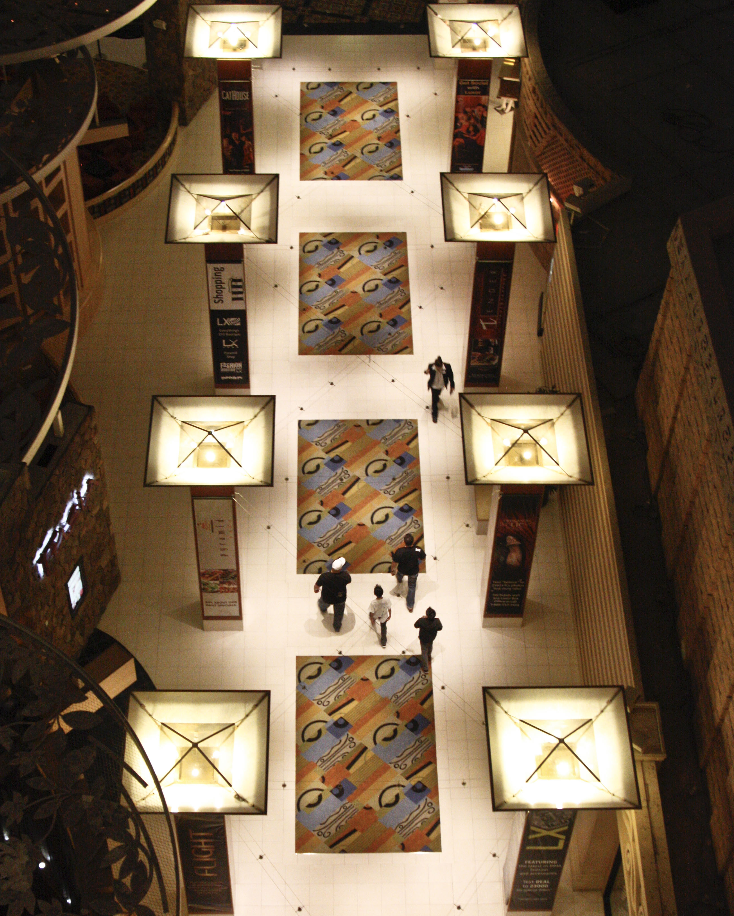
Basic principles
To add interest to a dull scene, as we’ve noted, try
6. unusual camera angles.

Slide 42
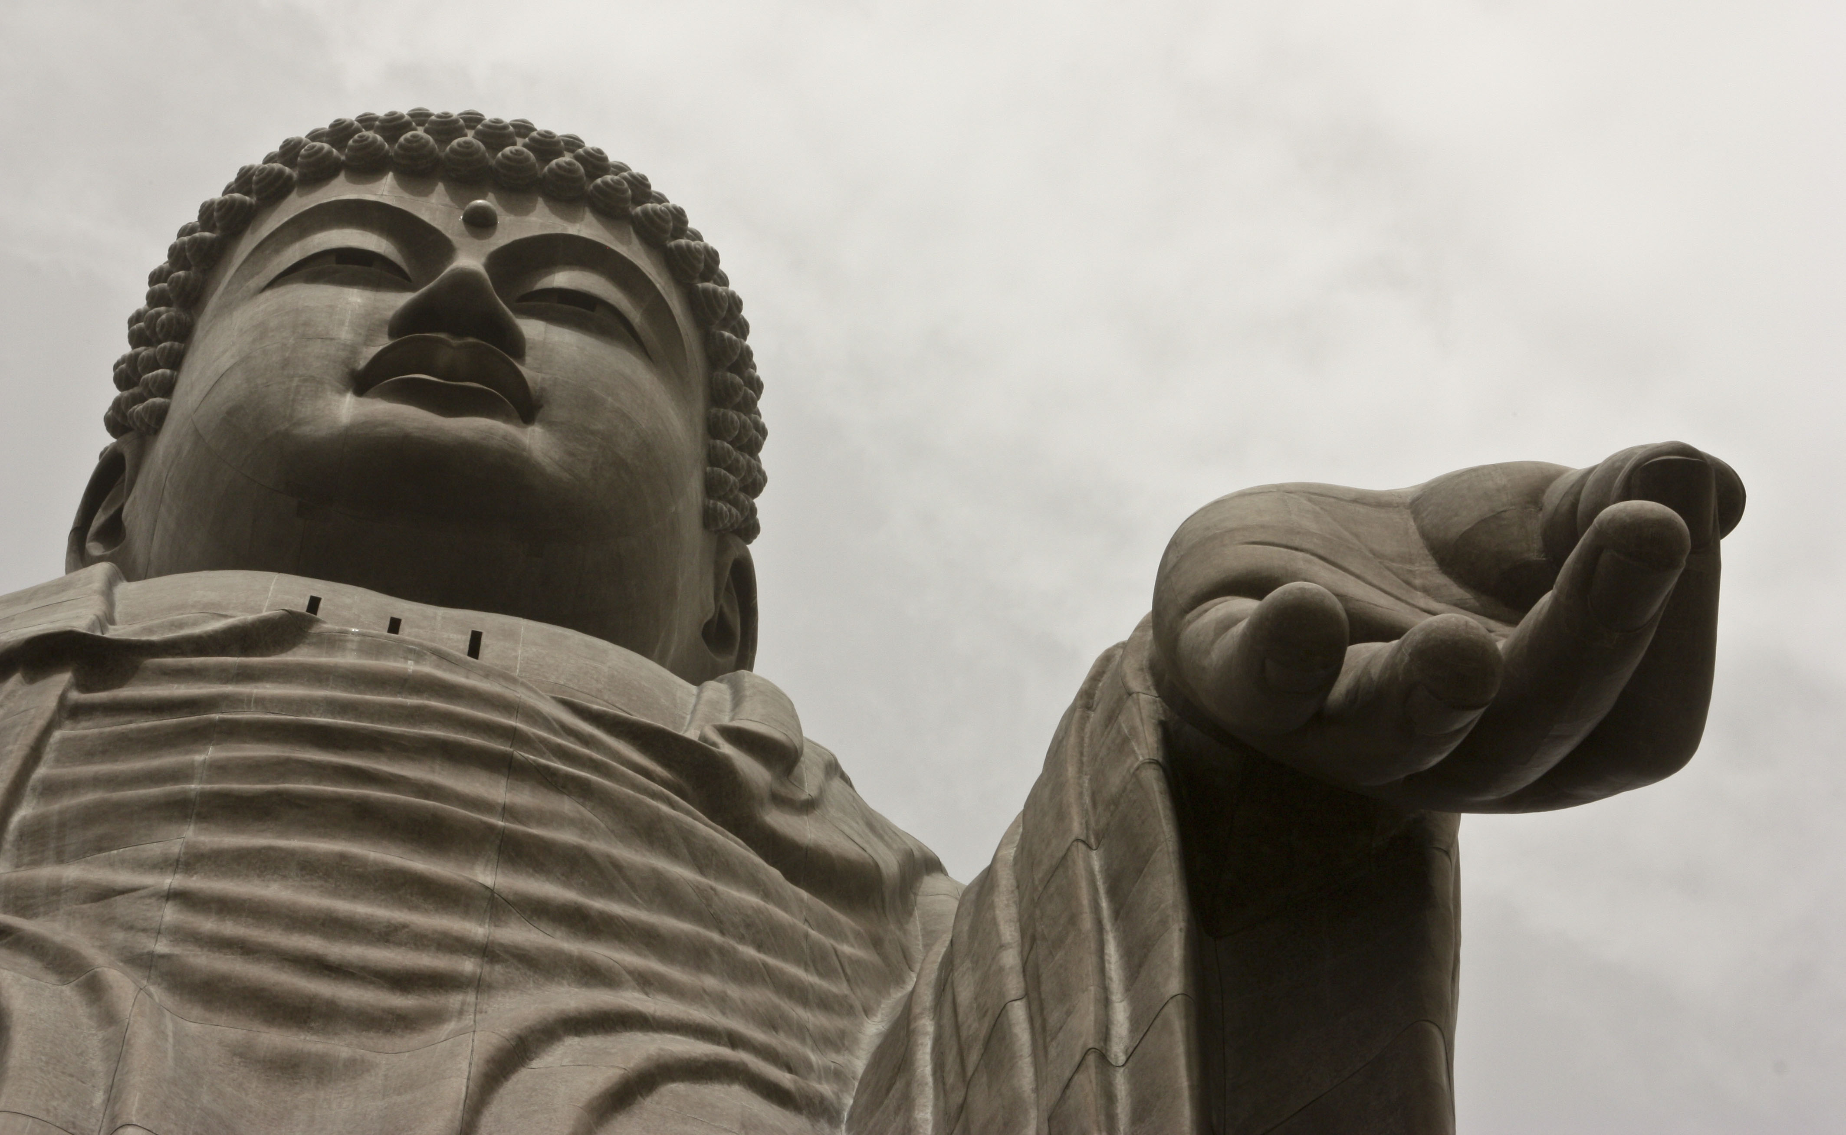
Basic principles
You also can use an unusual camera angle to isolate a subject from a distracting background.

Slide 43
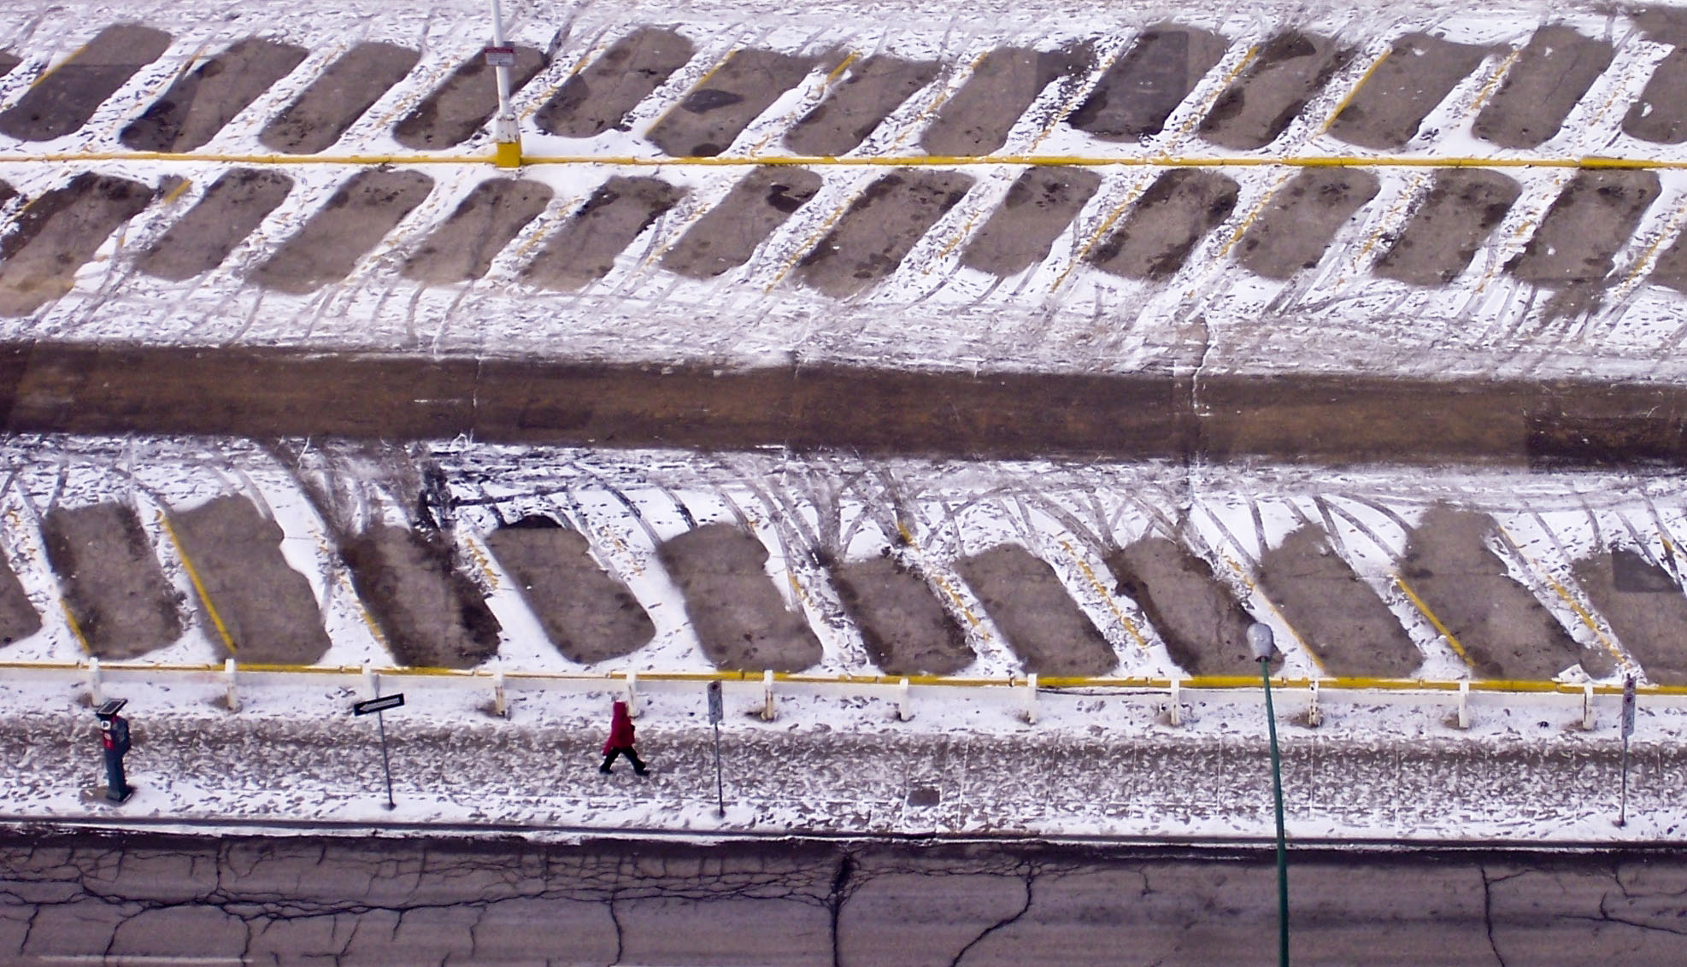
Basic principles
The photo below relies on an unusual camera angle. We also see rule of thirds, patterns and scale.

Slide 44
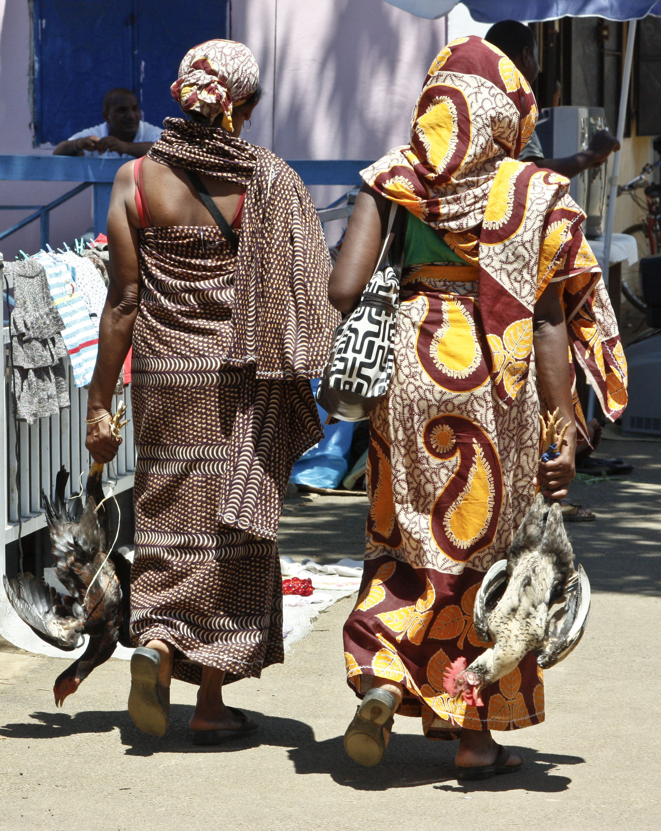
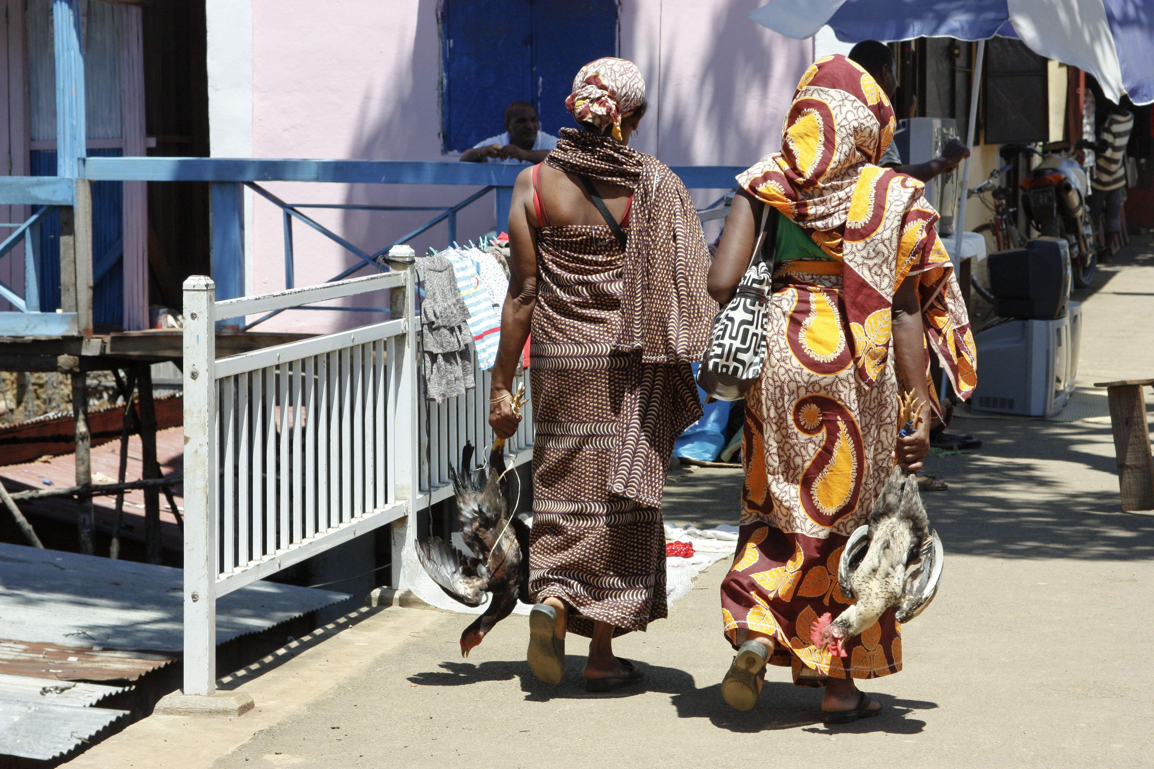
Basic principles
We’ve already considered the importance of cropping.
7. Many images need some cropping.

Slide 45
Guidelines for cropping
Crop empty space that adds nothing to the image, or wasted space. Avoid, however, cropping space that creates balance.
Crop for bolder content. Make the message unmistakeable. Don’t crop out necessary subtleties, however.
Avoid cropping hands or feet. Looks disconcerting.
Crop so that action is moving into, and not out of, the frame.
Avoid cropping into unusual shapes, such as stars or diamonds.

Slide 46

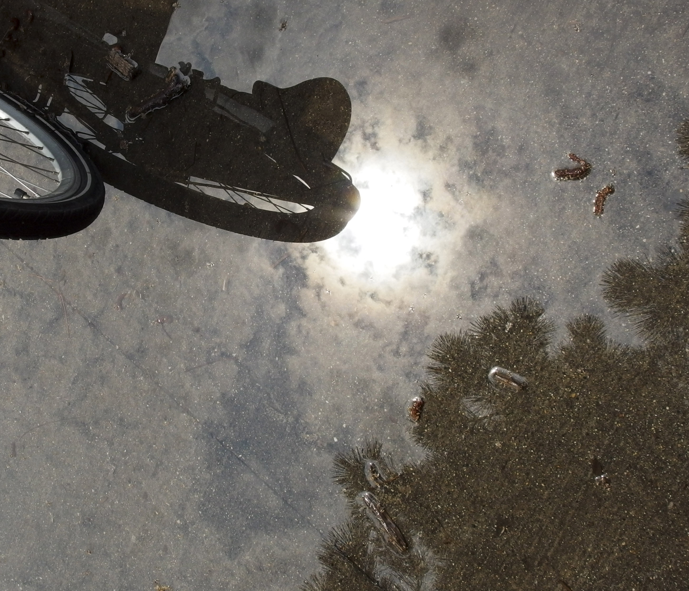
Basic principles
8. Look for interesting details.
Sometimes mundane scenes can become interesting if pulled from a distracting background and shot from an unusual angle. (Both photos taken at NDSU.)

Slide 47
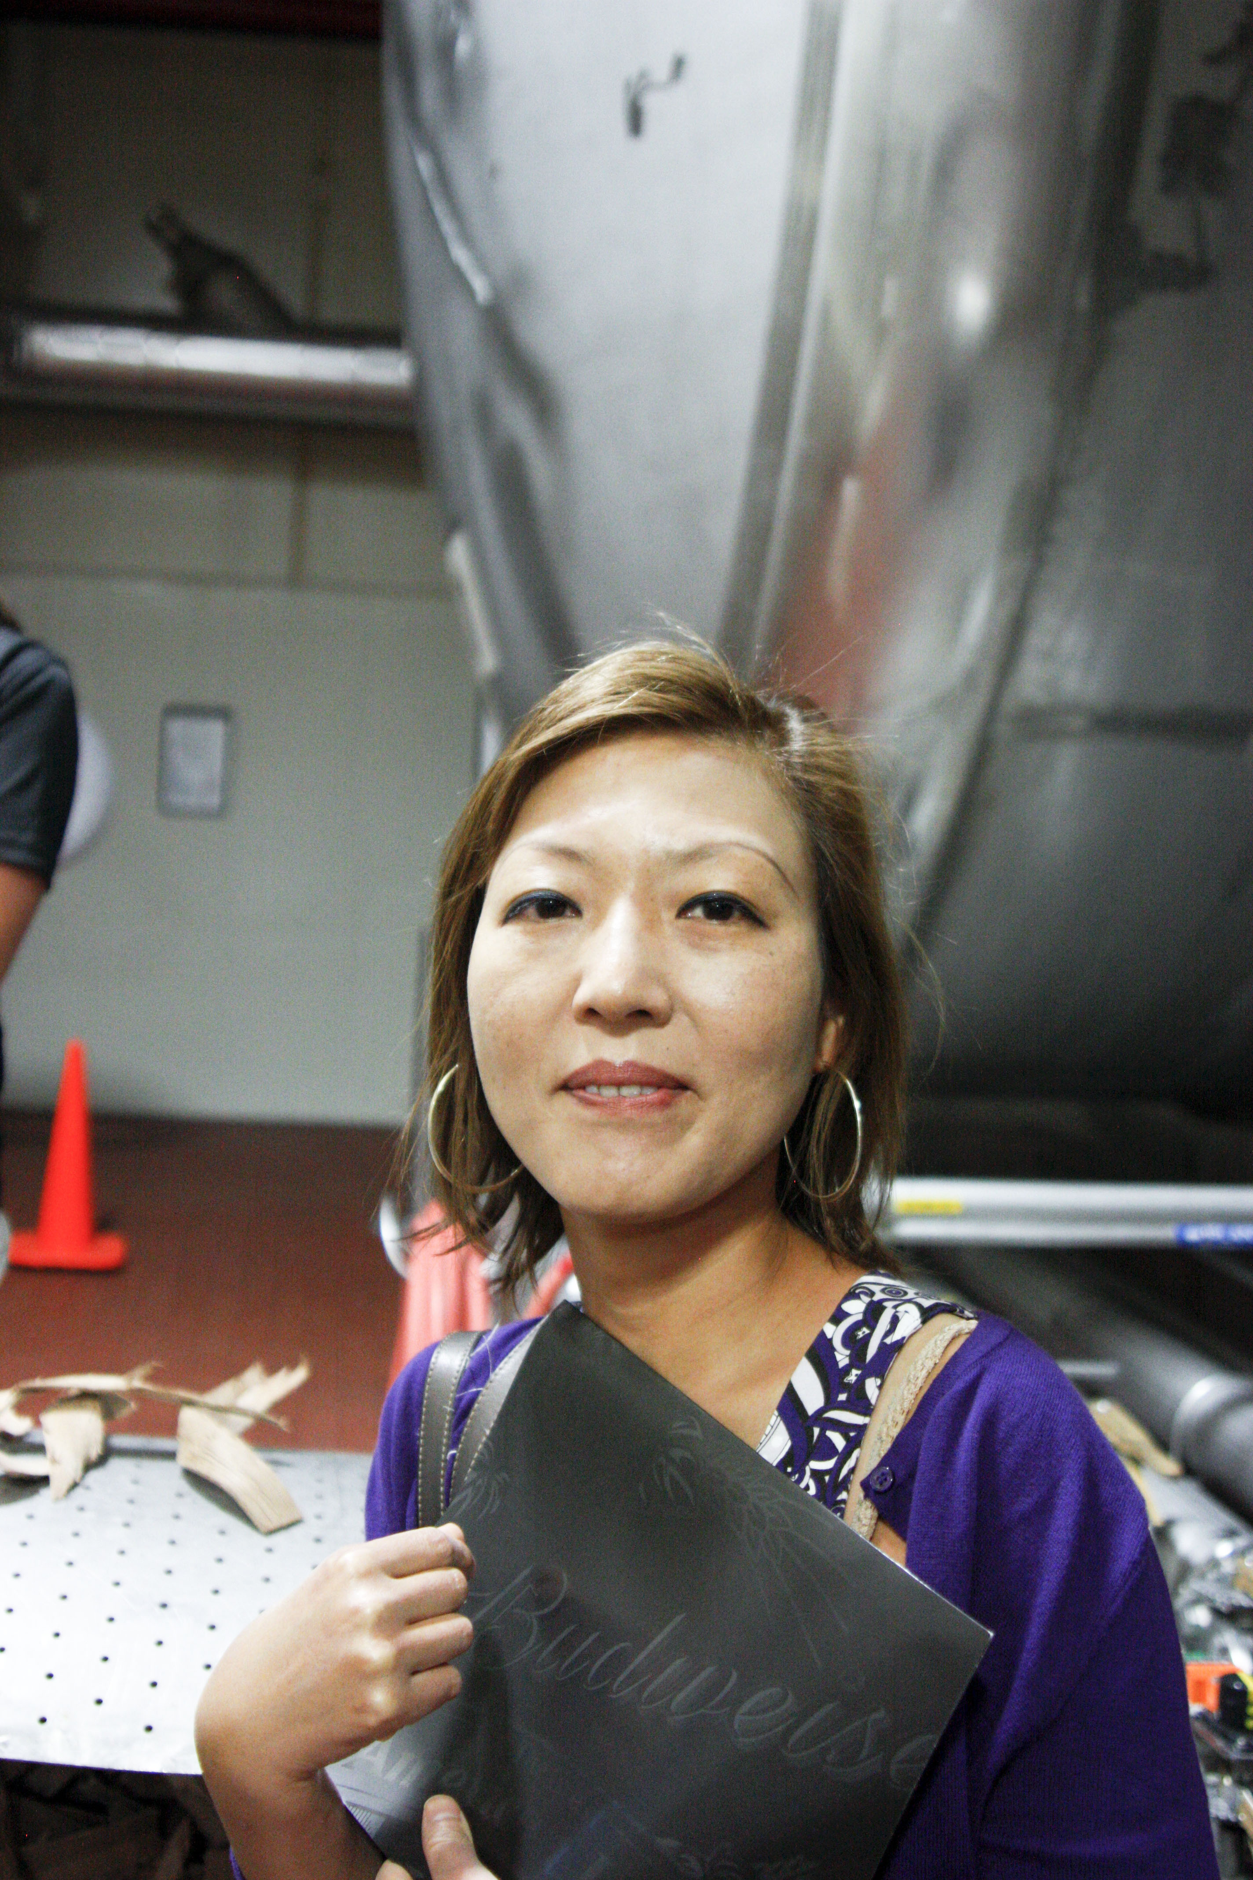
Common mistakes
Distracting background.
Don’t forget that our eye will usually not see the distraction, unless we are aware of it when we make the photograph.

Slide 48
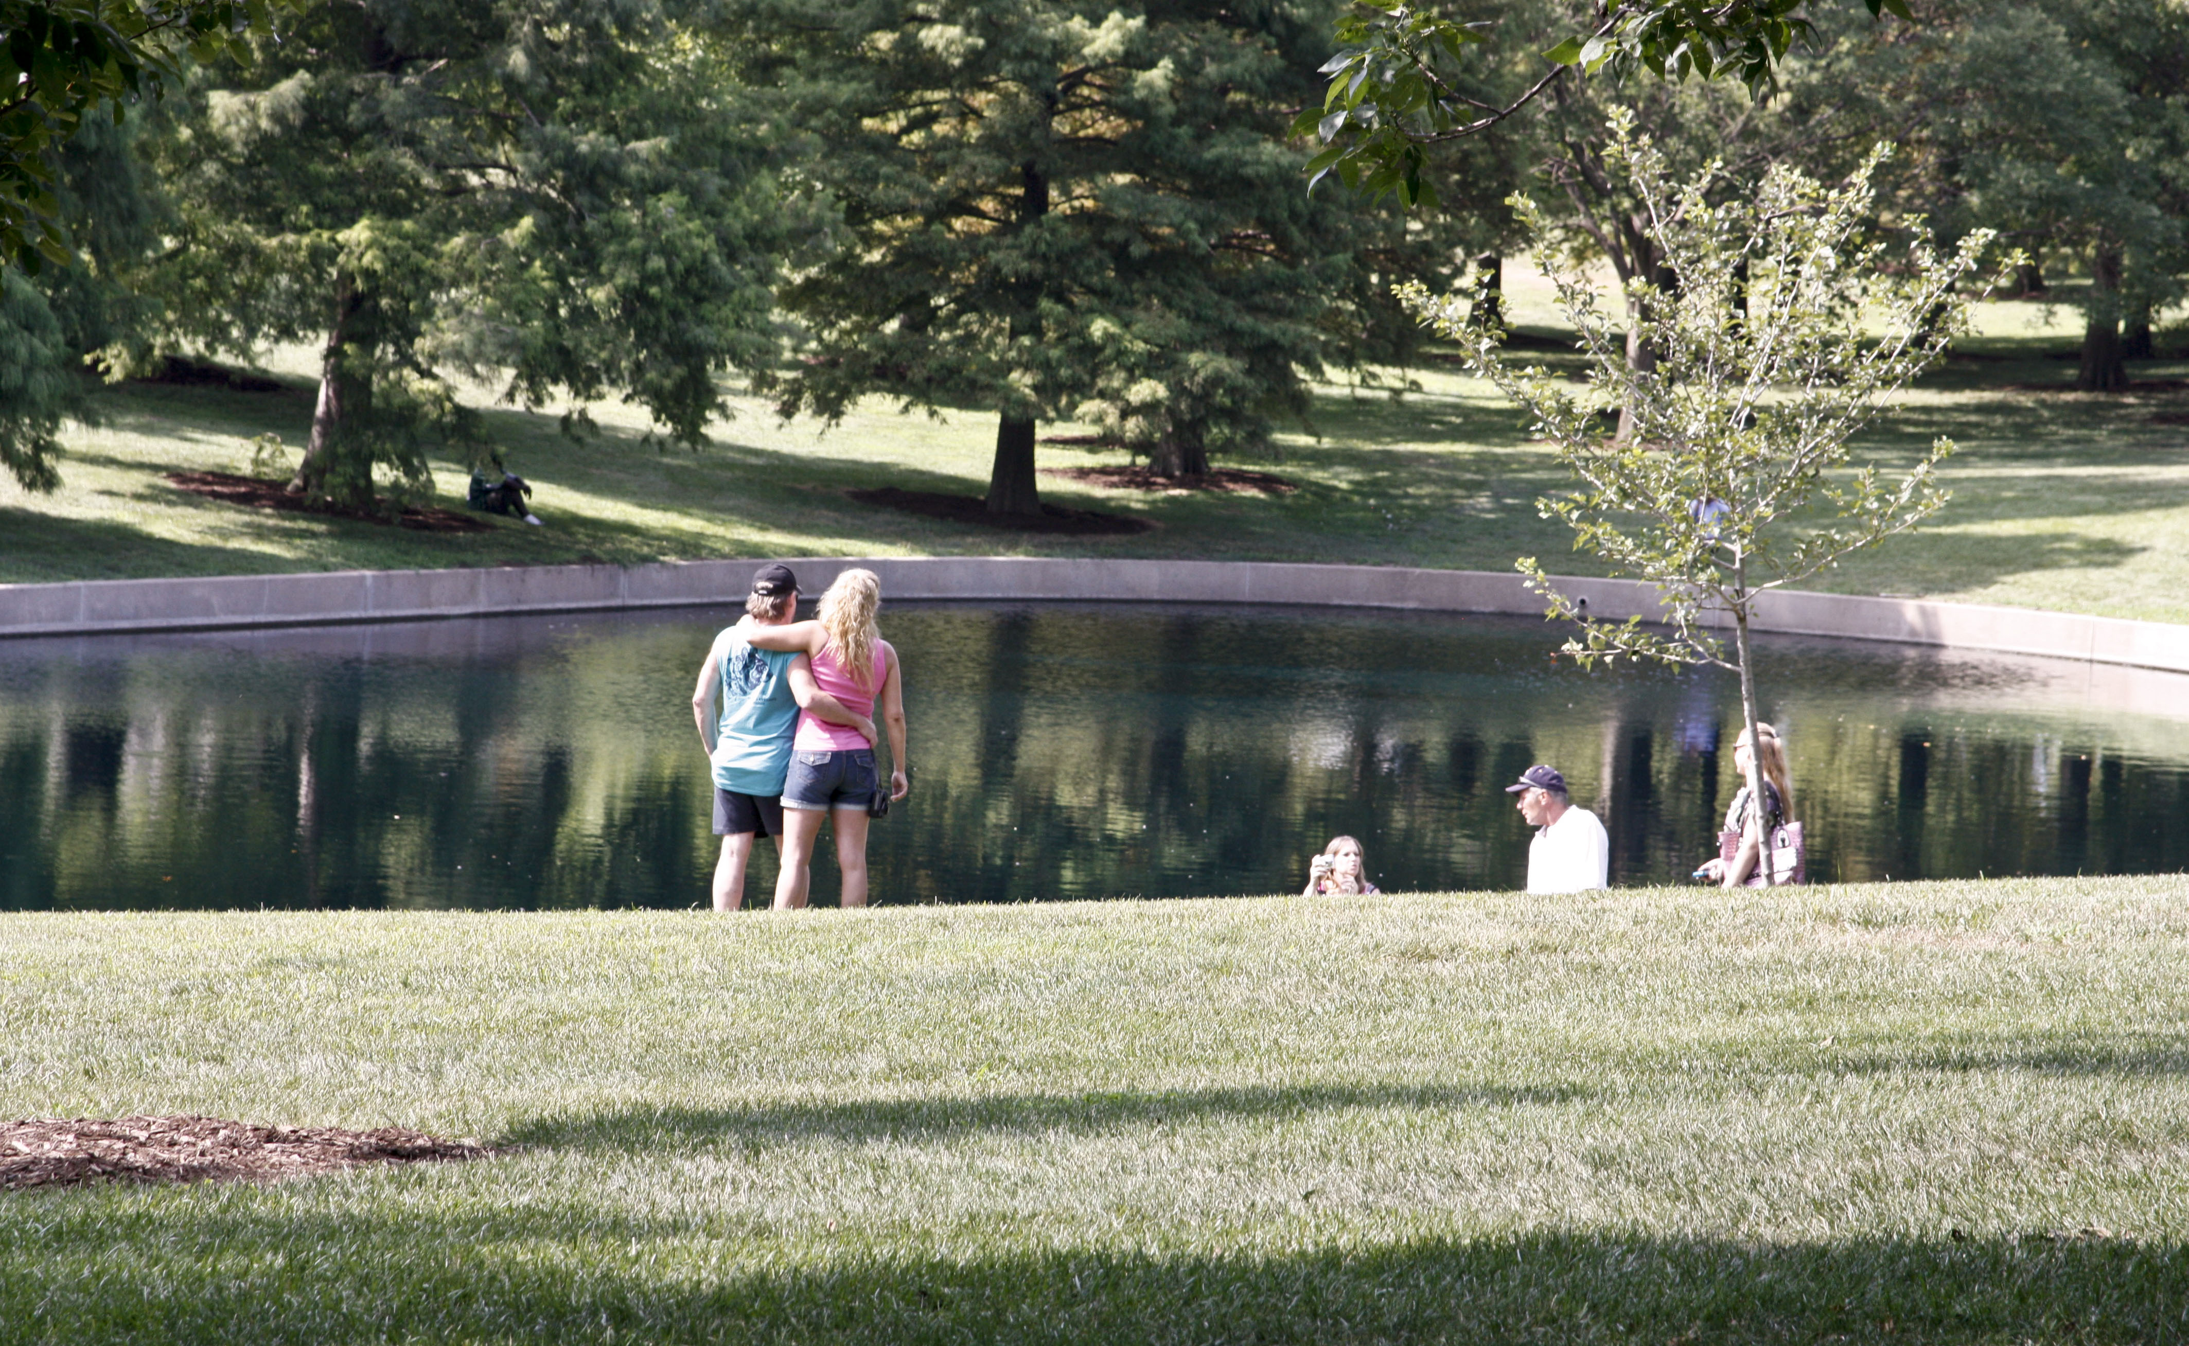
Common mistakes
Empty foreground. Try to emphasize depth by finding elements for several planes.

Slide 49
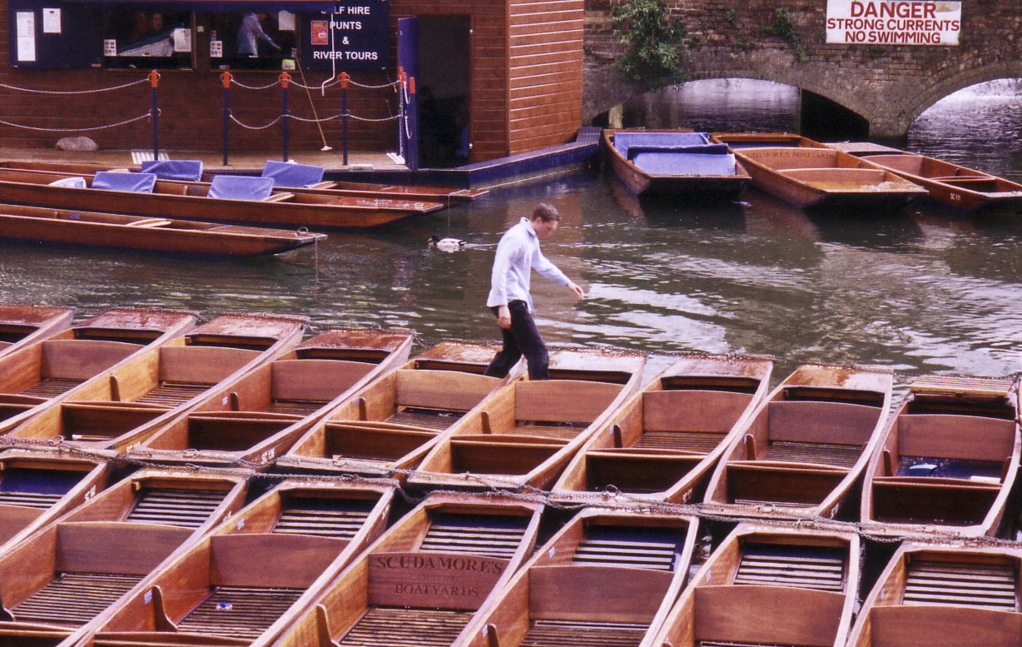
Common mistakes
Centered subject. A bull’s-eye subject is seldom attractive.

Slide 50
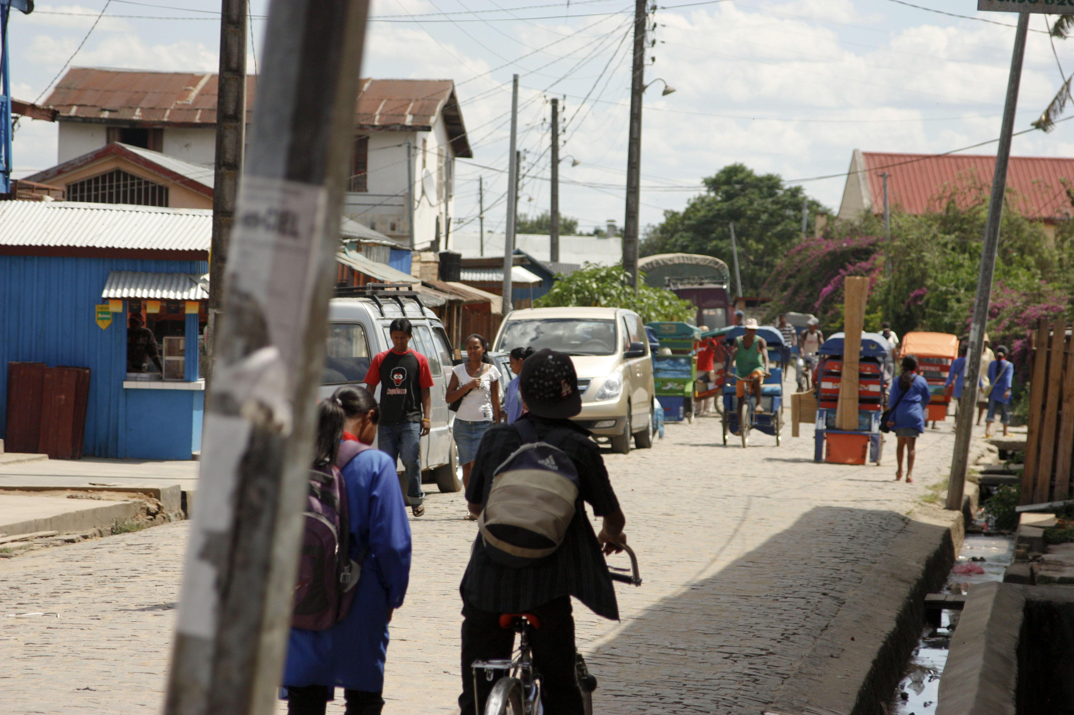
Common mistakes
No focal point. What am I taking a picture of?

Slide 51
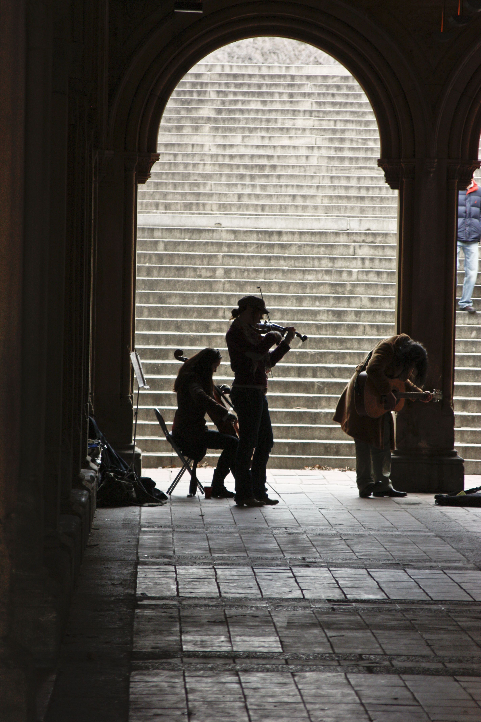
What does your photo say?
Photographers may look at a photo and ask:
What story does this photo tell?
Does the composition add to or detract from the message?
How can it be improved?

Slide 52
Photo editing
As photographer, you also likely will be a photo editor. Here are some tips.
In mass media photography look for pictures that tell a story. If it doesn’t enhance a story, or tell its own story, it’s not photojournalism—and I’m not sure if it’s of much interest to anyone.
Does the viewer get a feeling of what it might have been like at that event?
Does it fairly reflect the content of an event?

Slide 53
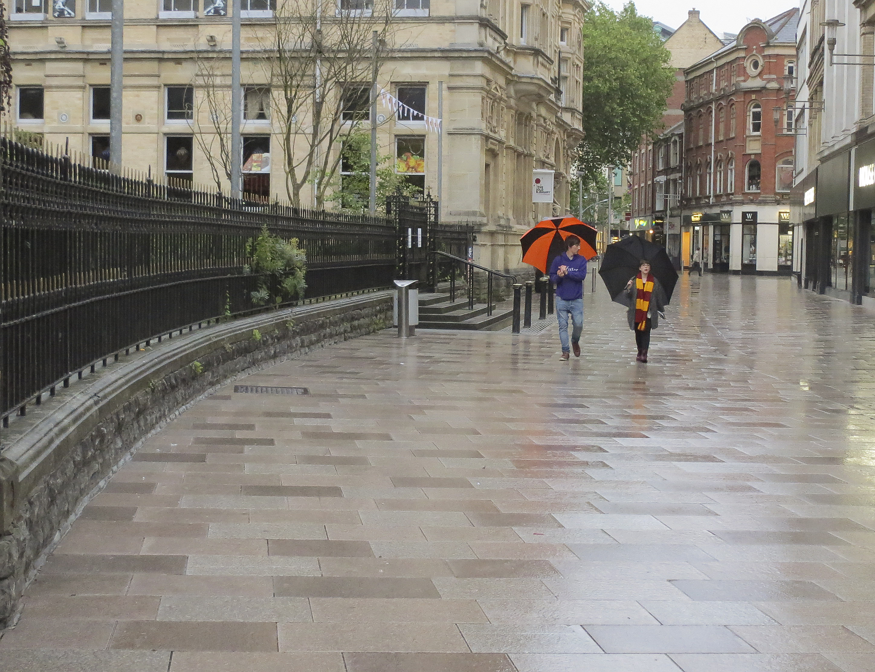
Photo editing
Mass media photography usually includes people, and they usually are facing generally toward the camera, if close enough to be identifiable.
Avoid awkward posing. People should generally not be standing and staring at the camera, except for mugshots.

Slide 54
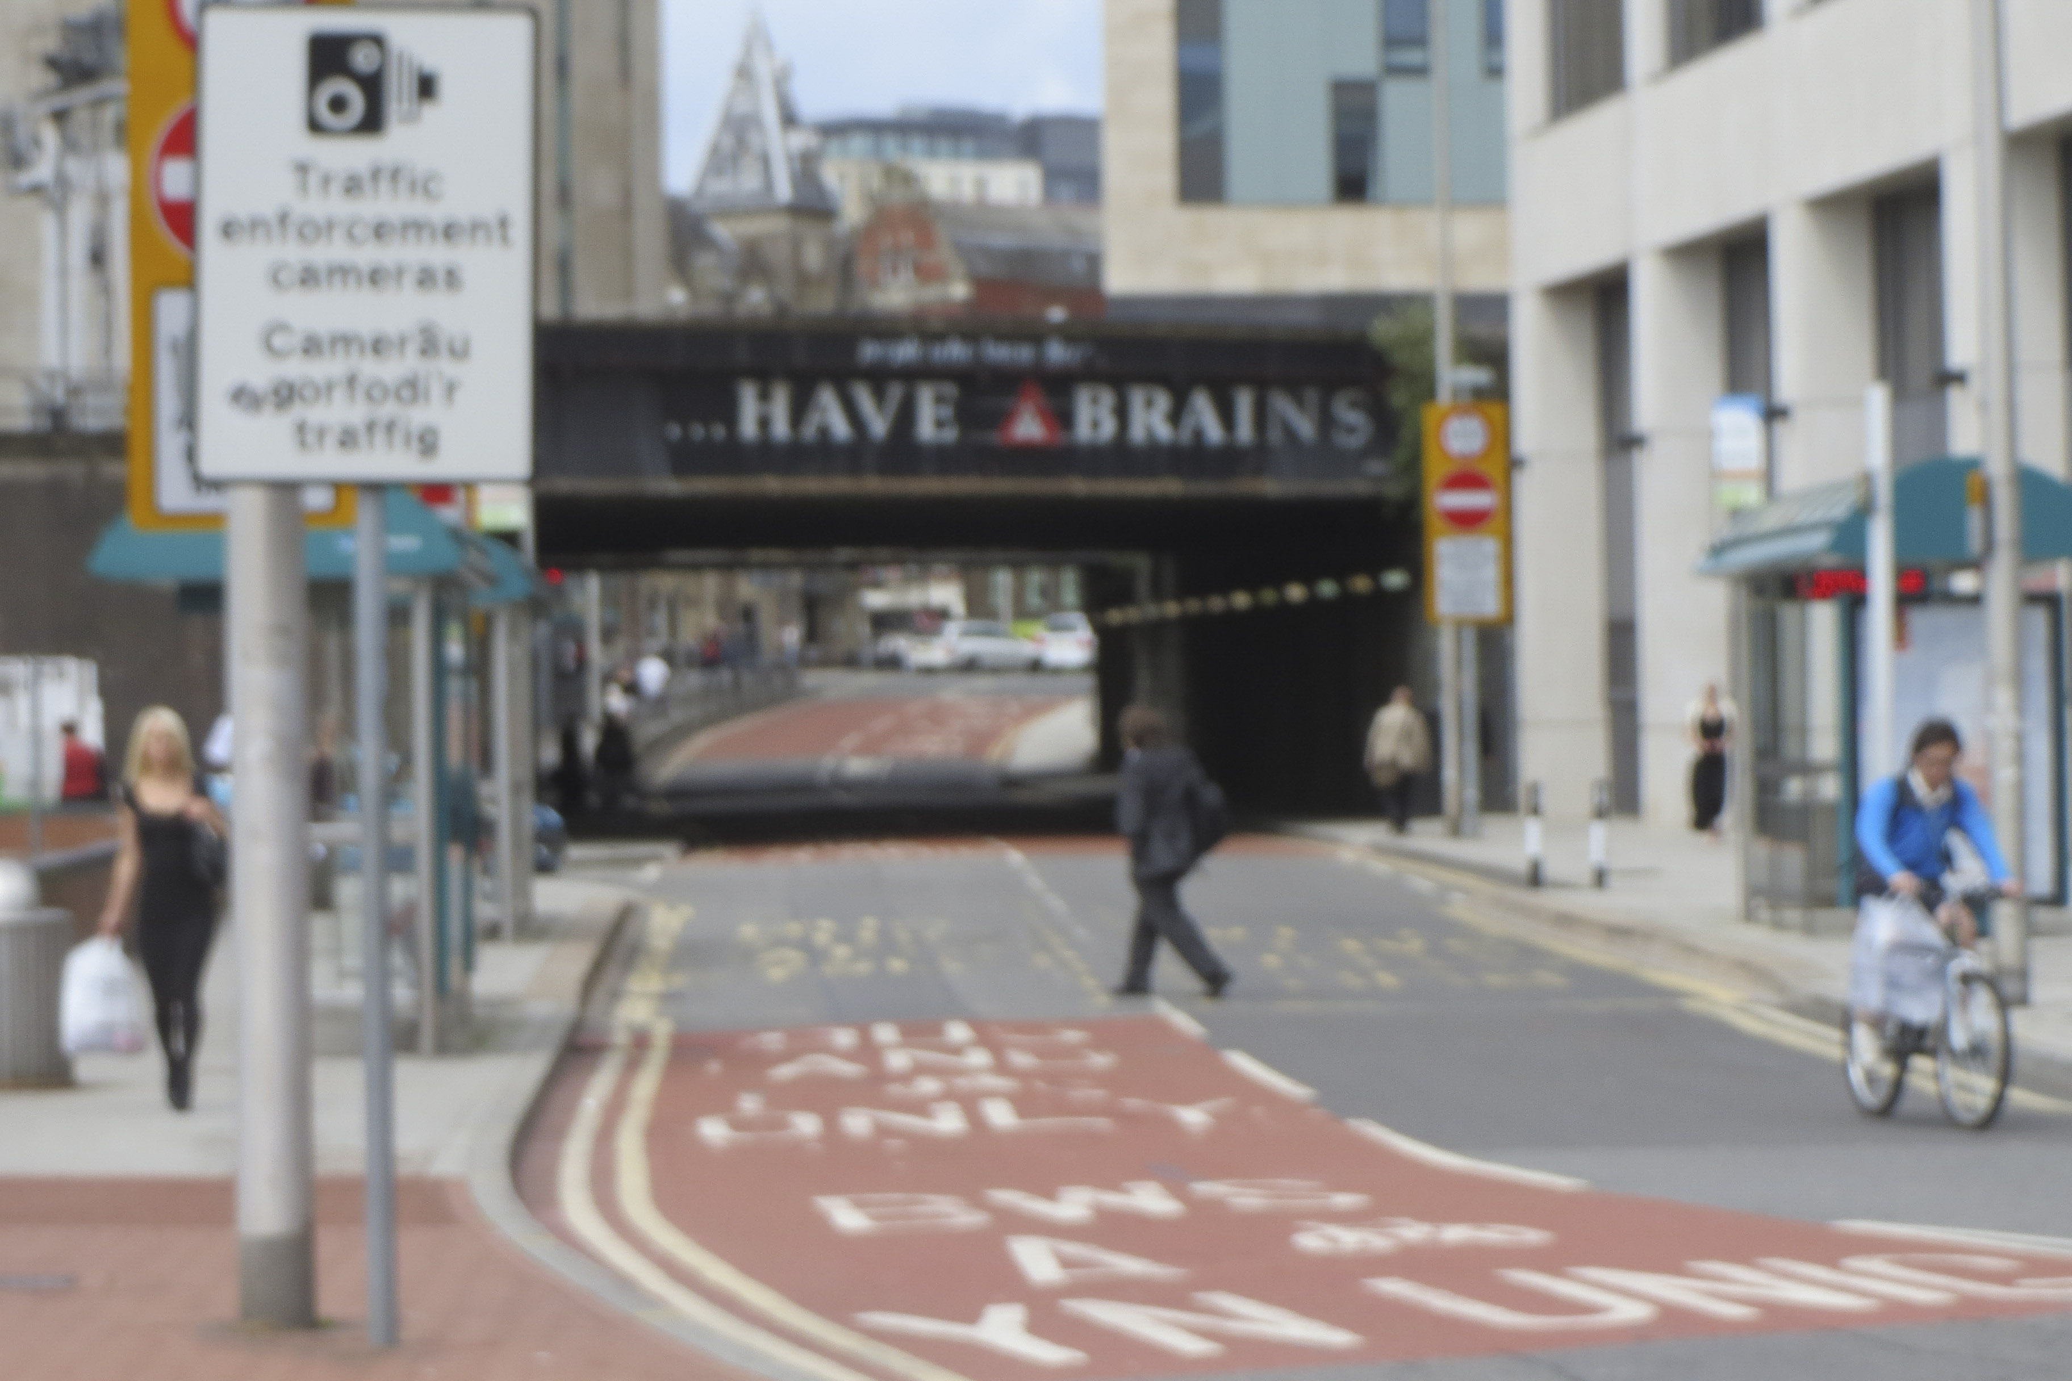
Photo editing
Avoid the common “7-10 split”: two people in a photo with an expanse of dead space in between.
Composition: If it’s poorly composed, too dark, too light, or out of focus, and can’t be fixed, throw it out. Show use the best you have.
You are judged as a photographer by your weakest photo. Keep only your strongest.

Slide 55
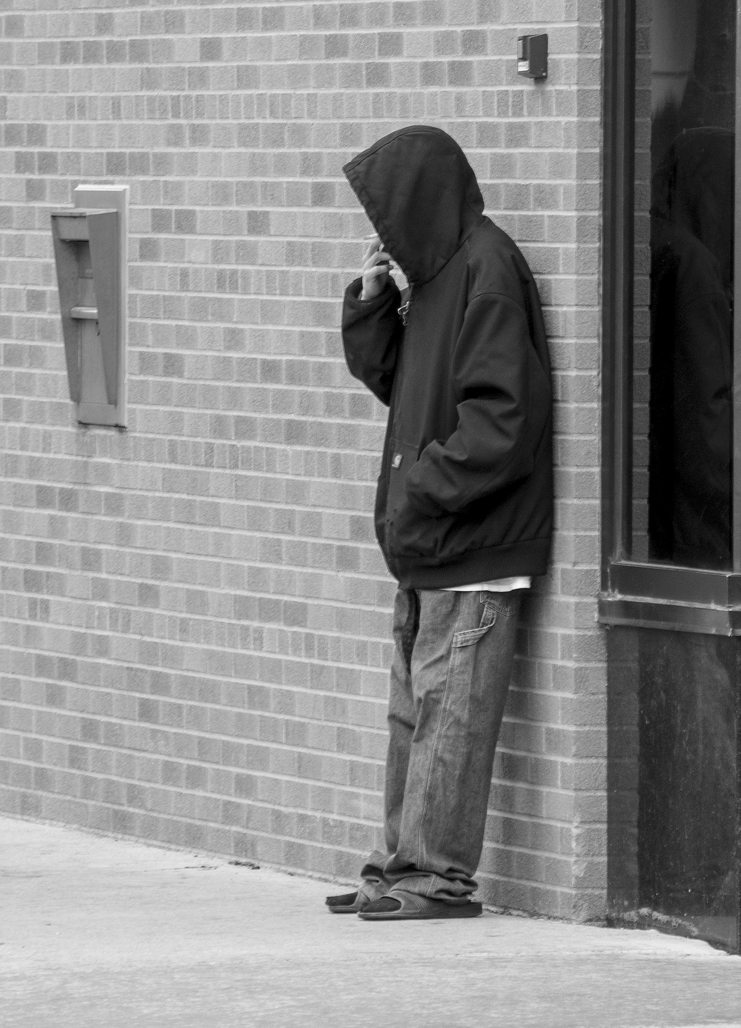
Photo editing
Ethics and mass media photography.
Is it okay to show this person in an embarrassing or private moment?
Is it okay to show nudity?
Does the photo truly reflect the expressions and the context of the story? Or does it mislead?
What is acceptable depends on the publication as well as ethical principles.

